Slide 1

73 Install Spark: Part 2
Peter H. Chen

Slide 2
73 Install Spark: Part 2
https://github.com/peterhchen/900_Python_ML_DS_DL
Install Spark: Part 2
1. Install JDK
2. Install Python (we already have this)
3. Install a pre-install version for Hadoop
4. Create a conf/log4j.properties file to change the warning level
5. Add a SPARH_HOME environment variable
6. Add %SPARK_HOME%\bin to your PATH
7. Set HADOOP_HOME to c:\Tools\winutils
8. Install winutils.exe to c:\Tools\windutils\bin

Slide 3
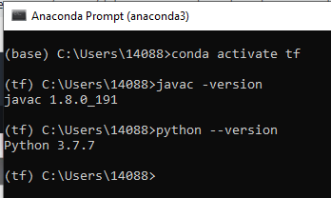
73 Install Spark: Part 2
https://github.com/peterhchen/900_Python_ML_DS_DL
Install Spark: Part 2
We installed Spark on your desktop in standalone mode.
We installed java: 1.8
We installed Python: 3.7
Next we need to install Spark.

Slide 4
73.1 Download Spark

Slide 5
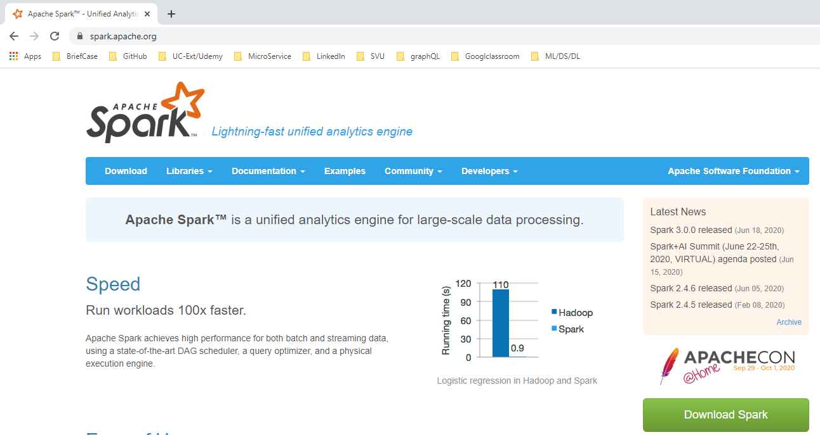
73.1 Download Spark
https://github.com/peterhchen/900_Python_ML_DS_DL
Download Spark
Go to spark.apache.org.

Slide 6
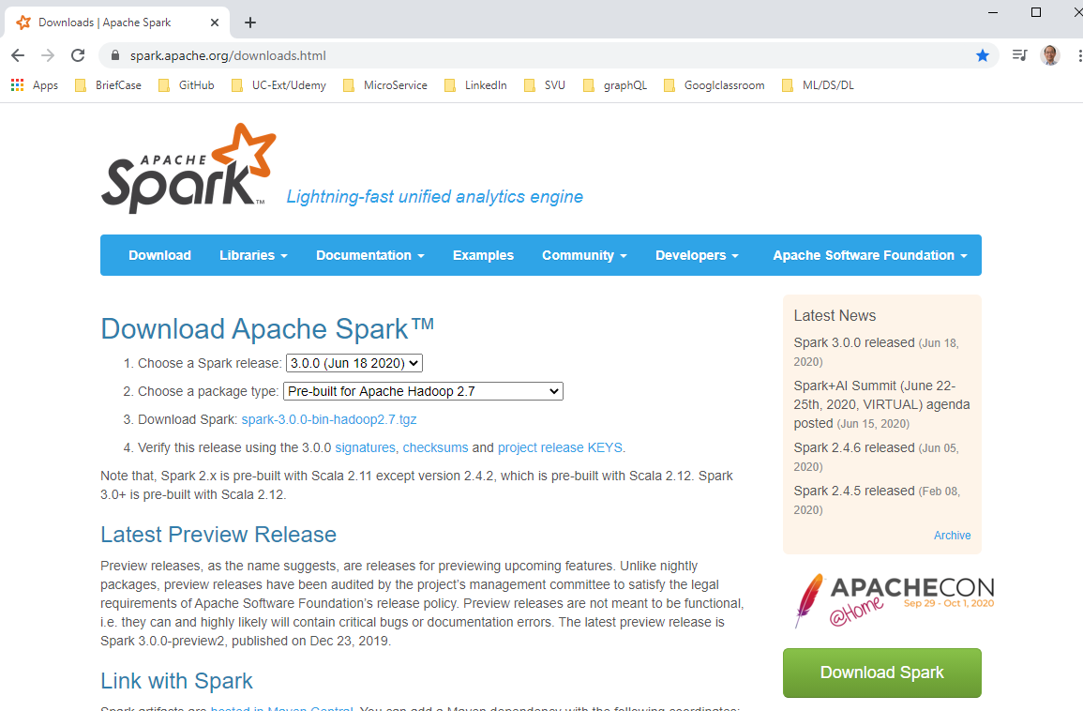
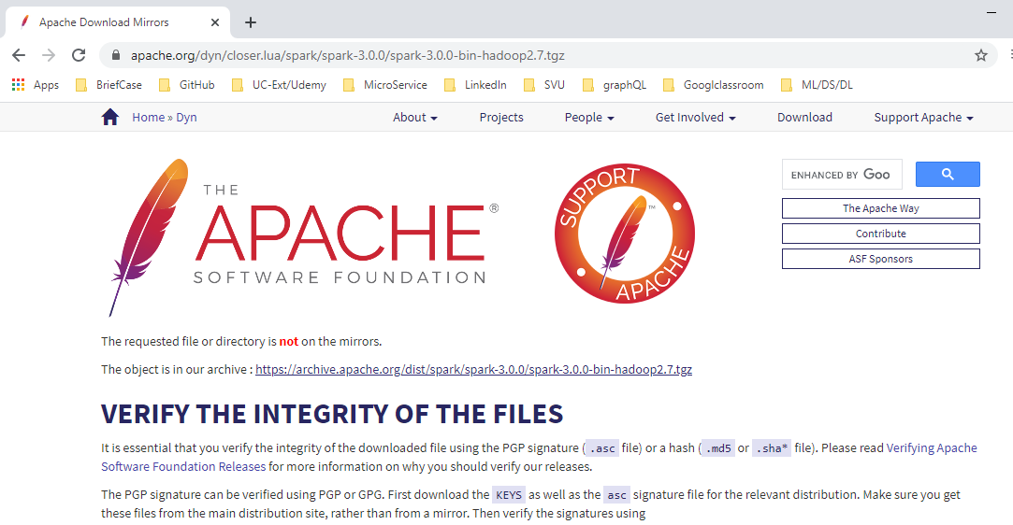
73.1 Download Spark
https://github.com/peterhchen/900_Python_ML_DS_DL
Download Spark
Click tgz (tar gnu zip) file.
Tgz file need 7-zip or WinRAR to unzip and untar.

Slide 7
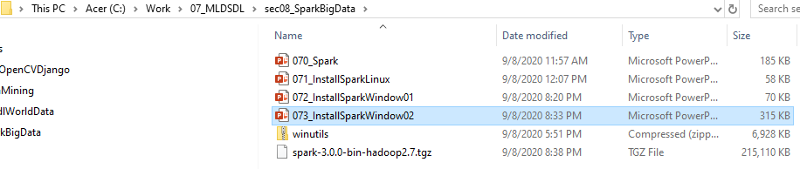
73 Install Spark: Part 2
https://github.com/peterhchen/900_Python_ML_DS_DL
Download Spark
Save the tgz file.

Slide 8
73.2 Unzip and Untar Spark

Slide 9
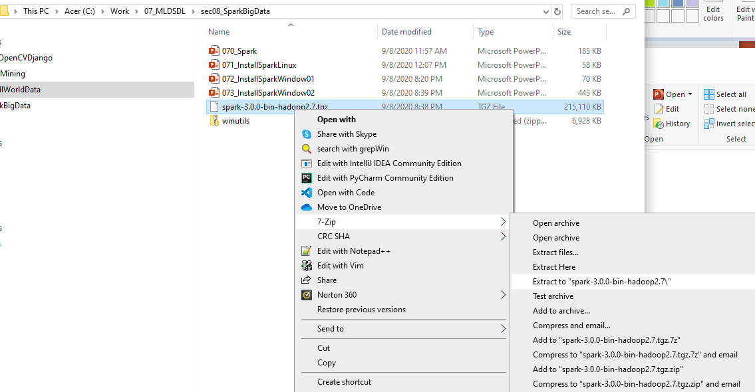
73.2 Unzip and Untar Spark
https://github.com/peterhchen/900_Python_ML_DS_DL
Unzip Spark Folder
Unzip the tgz file.

Slide 10
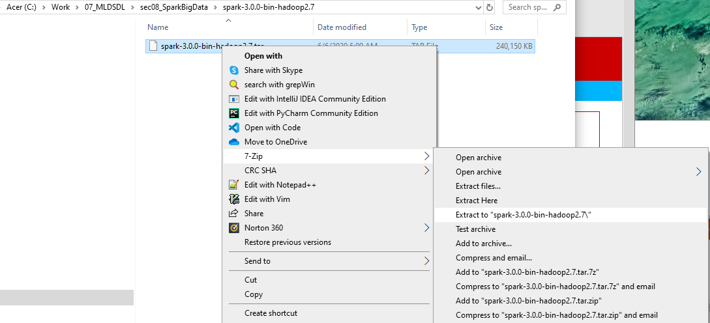
73.2 Unzip and Untar Spark
https://github.com/peterhchen/900_Python_ML_DS_DL
Untar Spark folder
Inside the unzip file folder, untar the Linux tar file.

Slide 11
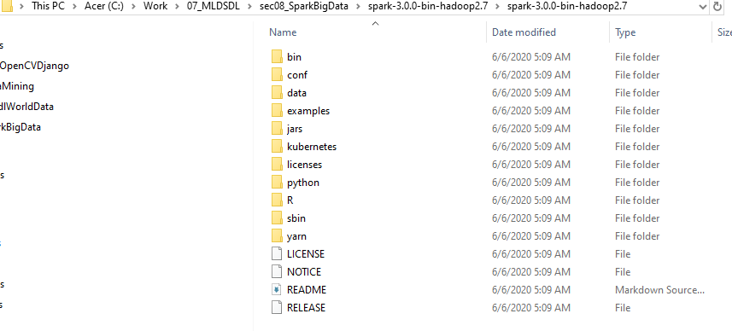
73.2 Unzip and Untar Spark
https://github.com/peterhchen/900_Python_ML_DS_DL
Check Unzip and Untar folder
Check the content of spark folder.

Slide 12
73.3 C:\spark folder

Slide 13
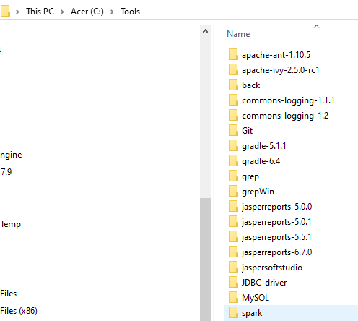
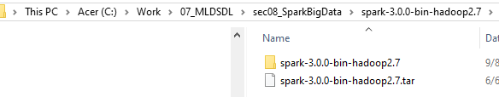
73.3 C:\spark folder
https://github.com/peterhchen/900_Python_ML_DS_DL
Create C:\spark folder
We create “C:\Tools\spark” folder.

Slide 14
73.4 Spark Configuration

Slide 15
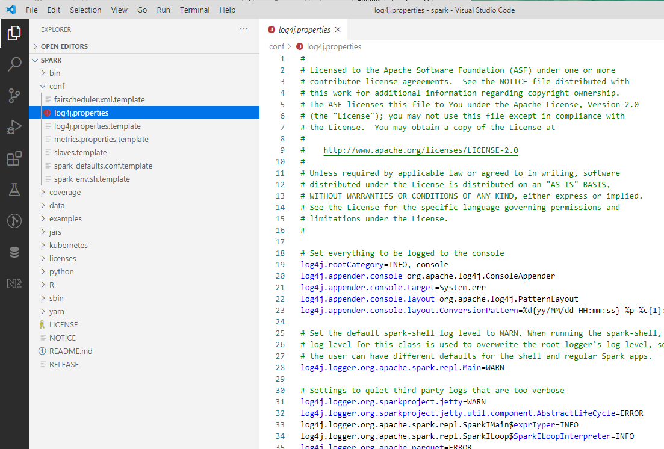
73.4 Spark Configuration
https://github.com/peterhchen/900_Python_ML_DS_DL
In “C:\Tools\Spark\conf” folder.
Copy “log4j.properties.template” to “log4j.properties”

Slide 16
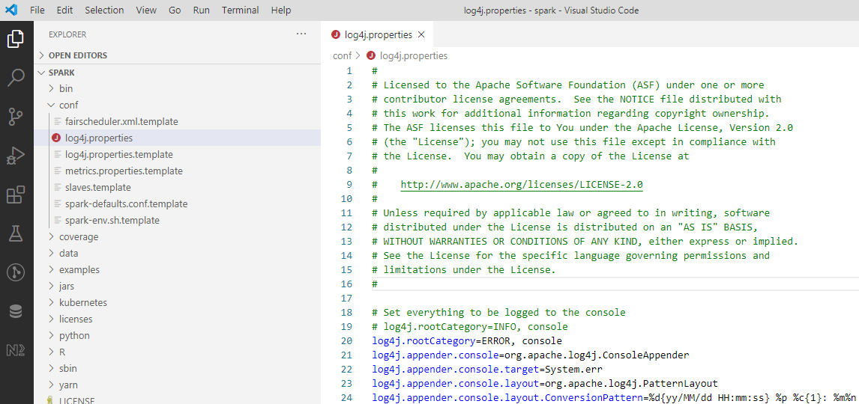
73.4 Spark Configuration
https://github.com/peterhchen/900_Python_ML_DS_DL
In “C:\Tools\Spark\conf” folder.
Change “INFO” to “ERROR”. All the error message will go to the ERROR folder.

Slide 17
73.5 Install Hadoop

Slide 18
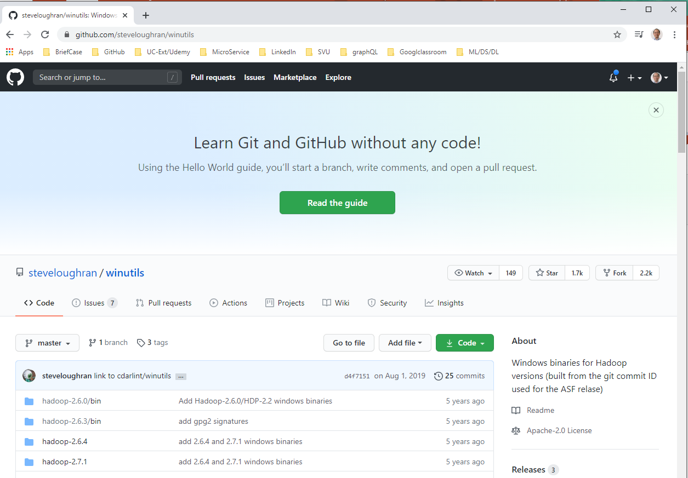
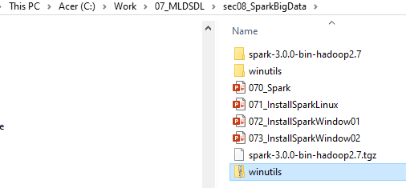
73.5 Install Hadoop
https://github.com/peterhchen/900_Python_ML_DS_DL
Now, we have done the Spark installation
Next, we need to installed the Hadoop for Windows.
For Linux and MacOS, you do not need to install Hadoop. You can skip this step.
For Windows, we need to download winutils.exe from github.
Unzip winutils.zip

Slide 19
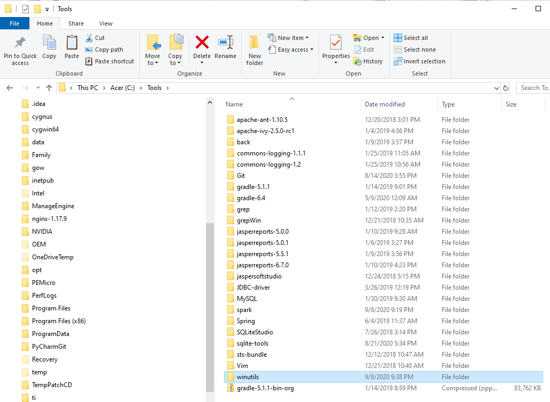
73.5 Install Hadoop
https://github.com/peterhchen/900_Python_ML_DS_DL
Now, we have done the Spark installation
Copy “winutils\Hadoop-3.0.0\bin” folder to “C:\Tools\winutils\bin”
The “bin” folder contains the executable files we need for Hadoop and Hive.

Slide 20
73.6 Create “\tmp\hive”

Slide 21
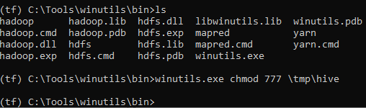
73.6 Create “\tmp\hive”
https://github.com/peterhchen/900_Python_ML_DS_DL
Create “\tmp\hiv”
Go to “C:\Tools\winutils\bin”
> (tf) c:\Tools\winutils\bin> winutils.exe chmod 777 \tmp\hive
We successful create the tmp\hive folder for Spark.

Slide 22
73.6 Setup Environment Variable

Slide 23
73.6 Setup Environment Variable
https://github.com/peterhchen/900_Python_ML_DS_DL
In System Variable:
5. Add SPARH_HOME environment variable
6. Add %SPARK_HOME%\bin to your PATH
7. Set HADOOP_HOME to c:\Tools\winutils

Slide 24
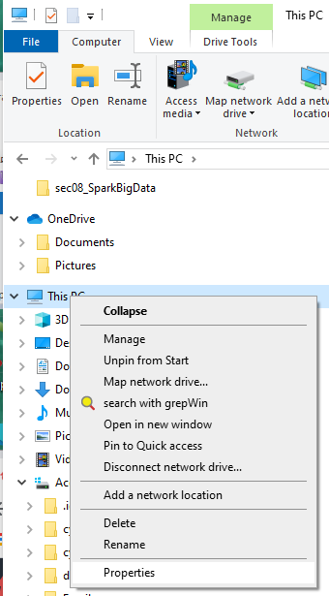
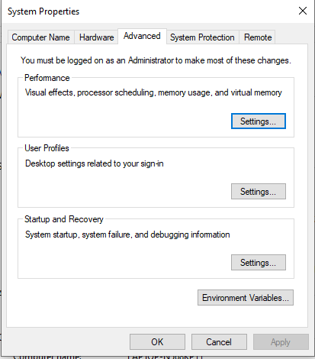
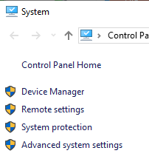
73.6 Setup Environment Variable
https://github.com/peterhchen/900_Python_ML_DS_DL
In System Variable:
> This PC > Right Mouse Button
> Properties > Advanced system settings > Environment Variables

Slide 25
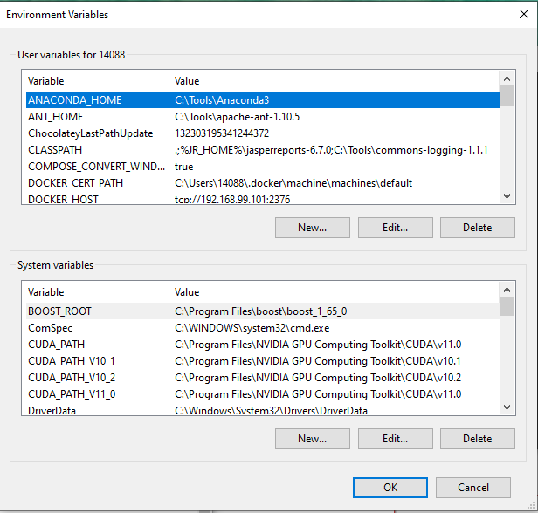
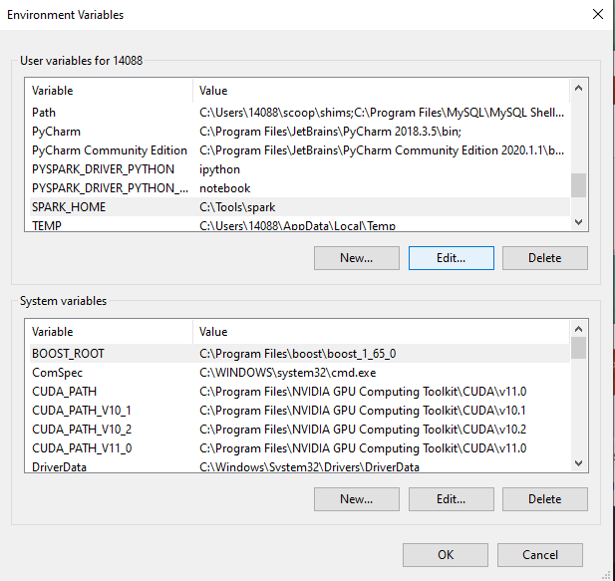
73.6 Setup Environment Variable
https://github.com/peterhchen/900_Python_ML_DS_DL
In System Variable:
“User variables for 14088” > New
“SPARK_HOME” to “C:\Tools\spark”

Slide 26
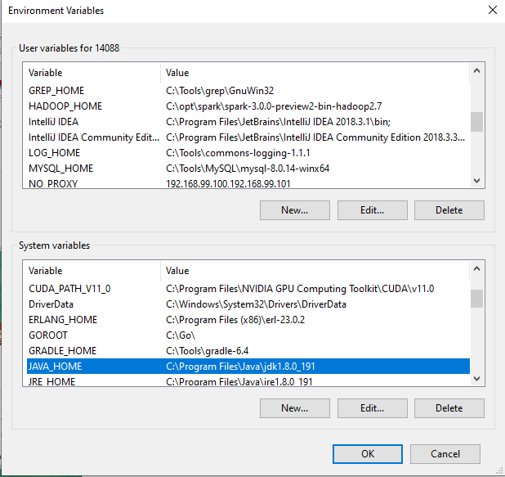
73.6 Setup Environment Variable
https://github.com/peterhchen/900_Python_ML_DS_DL
In System Variable:
“User variables for 14088” or “System Variables” > New
“JAVA_HOME” to “C:\Program Files\Java\jdk1.8.0_191”

Slide 27
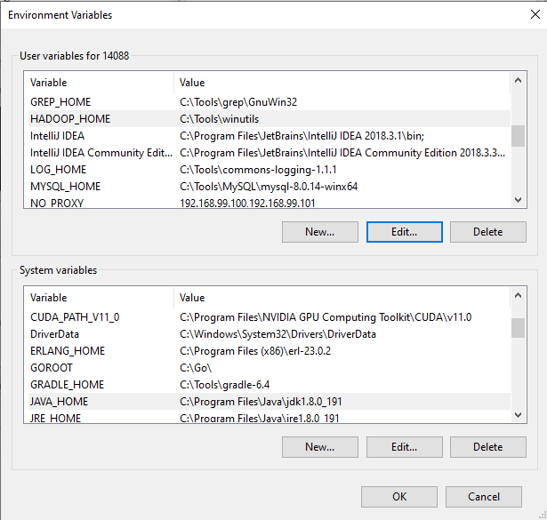
73.6 Setup Environment Variable
https://github.com/peterhchen/900_Python_ML_DS_DL
In System Variable:
“User variables for 14088” > New
“HADOOP_HOME” to “C:\Tools\winutils”

Slide 28
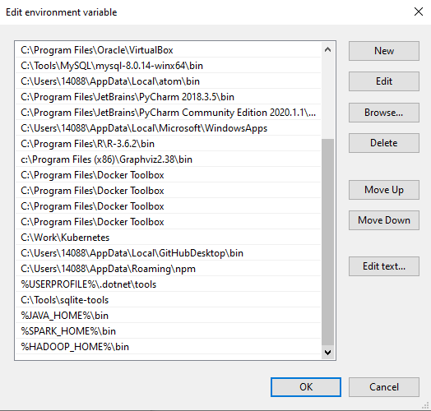
73.6 Setup Environment Variable
https://github.com/peterhchen/900_Python_ML_DS_DL
In User Variable:
PATH = %SPARK_HOME%\bin”; “%JAVA_HOME%\bin”; “%HADOOP_HOME%\bin”

Slide 29
73.6 Setup Environment Variable
https://github.com/peterhchen/900_Python_ML_DS_DL
Click OK to save all the setup

Slide 30
73.7 Verify Setup

Slide 31
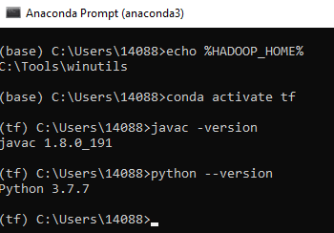
73.7 Verify Setup
https://github.com/peterhchen/900_Python_ML_DS_DL
Verify Setup
Start the anaconda environment
(base) > conda activate tf
(tf) > java -versiom
(tf) > python --version

Slide 32
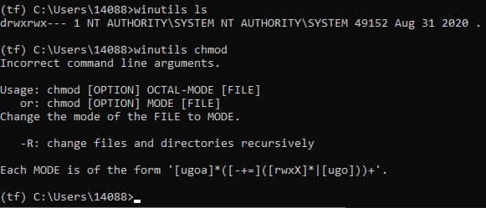
73.7 Verify Setup
https://github.com/peterhchen/900_Python_ML_DS_DL
Verify Window utils for Linux
(tf) > winutils ls
(tf) > winutils chmod

Slide 33
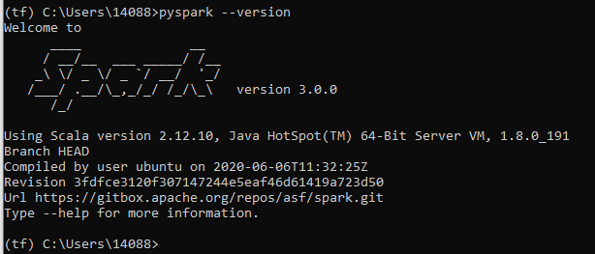
73.7 Verify Setup
https://github.com/peterhchen/900_Python_ML_DS_DL
Verify Window pySpark
(tf) > pyspark --version

Slide 34
End of Chapter

