Slide 1

56 Reinforcement Learning with Gym
Peter H. Chen

Slide 2
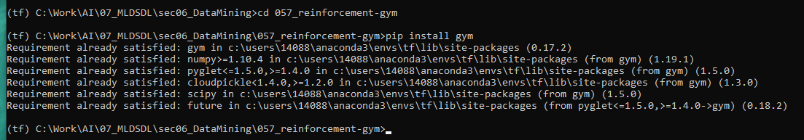
56 Reinforcement Learning with Gym
https://www.udemy.com/course/data-science-and-machine-learning-with-python-hands-on/learn/lecture/15090210#overview
Reinforcement Learning with Gym
Install gym > conda activate tf
> pip install gym

Slide 3
56.1 Make Taxi Environment
Peter H. Chen

Slide 4
56.1 Make Taxi Environment
https://www.udemy.com/course/data-science-and-machine-learning-with-python-hands-on/learn/lecture/15090210#overview
Make Taxi Environment
Reinforcement Learning
Let's describe the "taxi problem".
We want to build a self-driving taxi:
1. Pick up passengers at one of a set of fixed locations
2. Drop them off at another location, and
3. Get there in the quickest amount of time while avoiding obstacles.
The AI Gym lets us create this environment quickly:

Slide 5
56.1 Make Taxi Environment
https://www.udemy.com/course/data-science-and-machine-learning-with-python-hands-on/learn/lecture/15090210#overview
Q-Learning Explanation
Basically, we train the taxi on how to get passengers from one point to another point, and at the quickest way as possible using reinforcement learning.
We import the environment that we need.
We import the gym package we just installed and random give ourselves a consistent random seed so that we can get the same results each time
We make the environment called “taxi-v3” (or “taxi-v2”) that just contain the rules of this game.
We call the resulting model “streets” and print the streets out.
We use jupyter notebook since “taxi-3” does not support Windows command color mode.

Slide 6

56.1 Make Taxi Environment
https://www.udemy.com/course/data-science-and-machine-learning-with-python-hands-on/learn/lecture/15090210#overview
Make Environment
Let's break down what we're seeing here:
R, G, B, and Y are pickup or dropoff locations.
The BLUE letter (Here is Y) indicates where we need to pick someone up from.
The MAGENTA (Here is G) letter indicates where that passenger wants to go to.
The solid lines represent walls that the taxi cannot cross.
The filled rectangle (Here is Yellow) represents the taxi itself - it's yellow when empty, and green when carrying a passenger
In this case, someone want to go from Y to G.
MAGENTA: Passenger want to go
Yellow (empty) filled Box: Taxi
BLUE: Pick up some one from

Slide 7
56.1 Make Taxi Environment
https://www.udemy.com/course/data-science-and-machine-learning-with-python-hands-on/learn/lecture/15090210#overview
How Many States?
Our little world here, which we've called "streets", is a 5x5 grid.
The state of this world at any time can be defined by:
Where the taxi is (one of 5 x 5 = 25 locations)
What the current destination is (4 possibilities): R, G, B, Y
Where the passenger is (5 possibilities: at one of the destinations, or inside the taxi) (R, G, B, Y + 1 in Taxi)
So there are a total of 25 x 4 x 5 = 500 possible states that describe our world.

Slide 8
56.1 Make Taxi Environment
https://www.udemy.com/course/data-science-and-machine-learning-with-python-hands-on/learn/lecture/15090210#overview
How Many Action?
For each 500 possible states, there are six possible actions:
Move South, East, North, or West
Pickup a passenger
Drop off a passenger

Slide 9
56.1 Make Taxi Environment
https://www.udemy.com/course/data-science-and-machine-learning-with-python-hands-on/learn/lecture/15090210#overview
Rules:
Q-Learning will take place using the following rewards and penalties at each state:
A successful drop-off yields +20 points
Every time step taken while driving a passenger yields a -1 point penalty
Picking up or dropping off at an illegal location yields a -10 point penalty
Moving across a wall just isn't allowed at all.

Slide 10
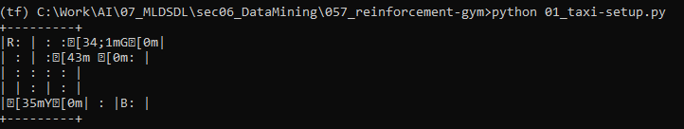
56.1 Make Taxi Environment
https://www.udemy.com/course/data-science-and-machine-learning-with-python-hands-on/learn/lecture/15090210#overview
On Anaconda environment:
There are color garbage display. The Command does not show the color.

Slide 11
56.1 Define Initial State

Slide 12


56.1 Make Environment
https://www.udemy.com/course/data-science-and-machine-learning-with-python-hands-on/learn/lecture/15090210#overview
Define Initial State
Let's define an initial state, with the taxi at location (2, 3), the passenger at pickup location 2, and the destination at location 0:
Initial State:
Destination
Taxi (2, 3)
Pickup

Slide 13
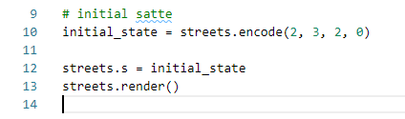
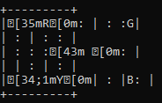
56.1 Make Environment
https://www.udemy.com/course/data-science-and-machine-learning-with-python-hands-on/learn/lecture/15090210#overview
Define Initial State
Anaconda display the color garbage.
Initial State:
Destination
Taxi (2, 3)
Pickup

Slide 14
56.2 Define Reward Table

Slide 15
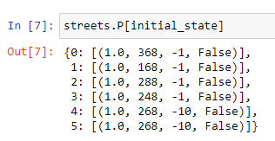
56.2 Define Reward Table
https://www.udemy.com/course/data-science-and-machine-learning-with-python-hands-on/learn/lecture/15090210#overview
Define Reward Table
Let's examine the reward table for this initial state:
There are 6 possible action (0, 2, 1, 3, and 5)
Here's how to interpret this:
each row corresponds to a potential action at this state: move South, North, East, or West, pickup, or dropoff. The four values in each row are the probability assigned to that action, the next state that results from that action, the reward for that action, and whether that action indicates a successful dropoff took place.
Move South
Destination
Move North
Move East
Move West
Pickup
Pickup
Dropoff

Slide 16
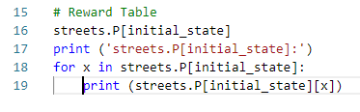
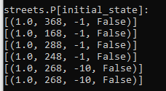
56.2 Define Reward Table
https://www.udemy.com/course/data-science-and-machine-learning-with-python-hands-on/learn/lecture/15090210#overview
Define Reward Table
Print the reward table.
Move South
Destination
Move North
Move East
Move West
Pickup
Pickup
Dropoff

Slide 17
56.3 Perform Q-Learning

Slide 18
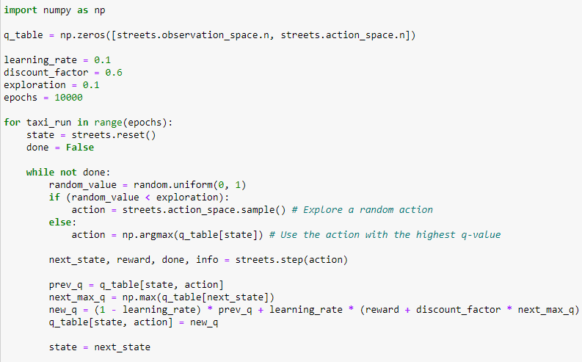
56.3 Perform Q-Learning
https://www.udemy.com/course/data-science-and-machine-learning-with-python-hands-on/learn/lecture/15090210#overview
Perform Q-Learning
First we need to train our model.
At a high level, we'll train over 10,000 simulated taxi runs.
For each run, we'll step through time, with a 10% chance at each step of making a random, exploratory step instead of using the learned Q values to guide our actions.

Slide 19
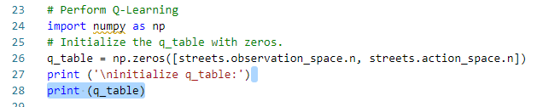
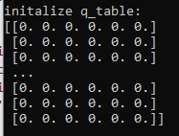
56.3 Perform Q-Learning
https://www.udemy.com/course/data-science-and-machine-learning-with-python-hands-on/learn/lecture/15090210#overview
Perform Q-Learning Explanation
First, initialize all the q-table with zero.

Slide 20
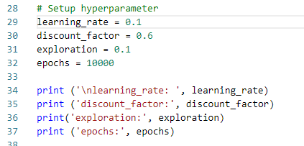

56.3 Perform Q-Learning
https://www.udemy.com/course/data-science-and-machine-learning-with-python-hands-on/learn/lecture/15090210#overview
Perform Q-Learning Explanation
First, we set the hyperparameter.
We set 10% for random exploration and 10,000 for maximum epochs.

Slide 21
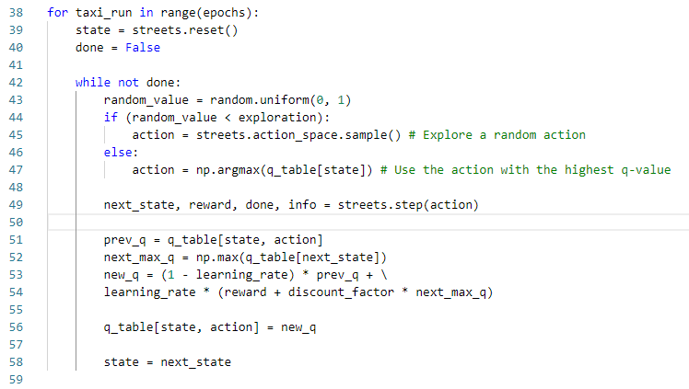
56.3 Perform Q-Learning
https://www.udemy.com/course/data-science-and-machine-learning-with-python-hands-on/learn/lecture/15090210#overview
Perform Q-Learning Explanation
For each run, if random value is less than 10%, we do the exploration.
If greater than 10%, then we take the maximum value of q_table.

Slide 22
56.4 Q-Table

Slide 23
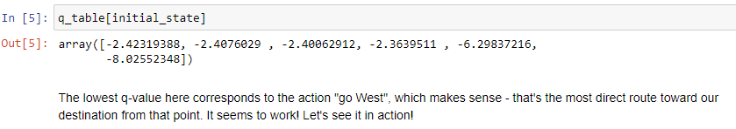
56.4 Q-Table
https://www.udemy.com/course/data-science-and-machine-learning-with-python-hands-on/learn/lecture/15090210#overview
Q-Table
The lowest q-value here corresponds to the action "go West", which makes sense - that's the most direct route toward our destination from that point. It seems to work!

Slide 24

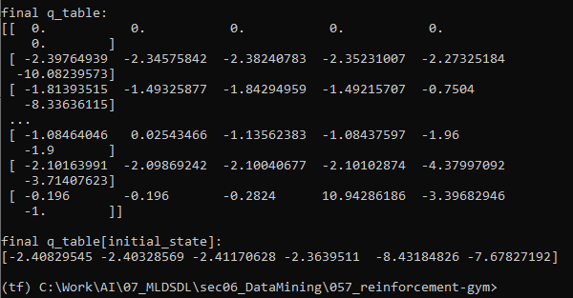
56.4 Q-Table
https://www.udemy.com/course/data-science-and-machine-learning-with-python-hands-on/learn/lecture/15090210#overview
Q-Table
Print final q_table and q_table [initial_state].

Slide 25
56.5 Q-Learning Simulation

Slide 26
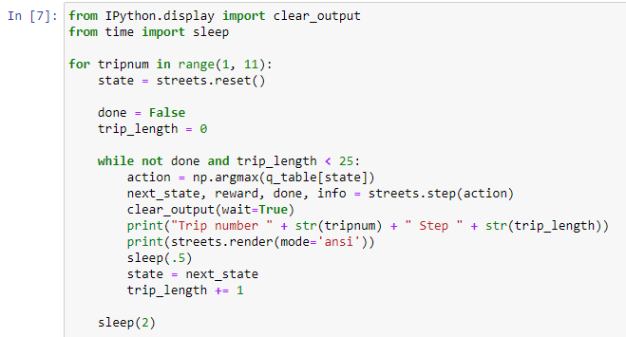
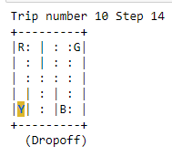
56.5 Q-Learning Simulation
https://www.udemy.com/course/data-science-and-machine-learning-with-python-hands-on/learn/lecture/15090210#overview
Q-Learning Simulation
Taxi drive for 11 trips.

Slide 27
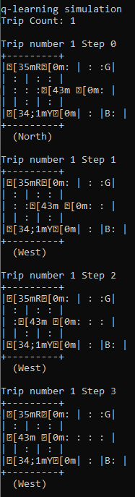
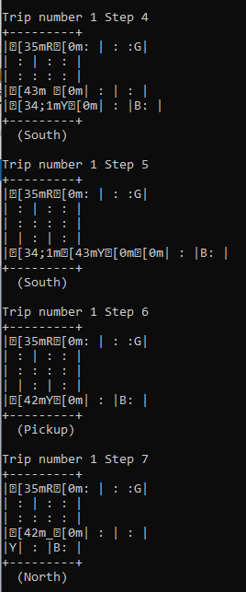
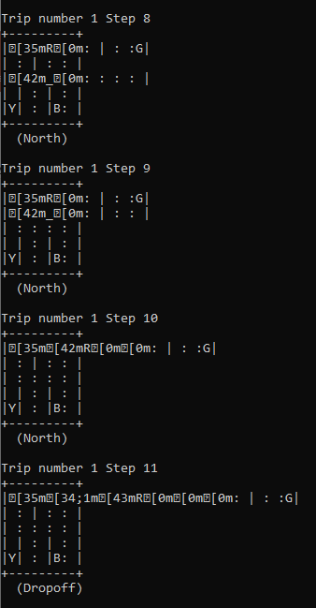
56.5 Action
https://www.udemy.com/course/data-science-and-machine-learning-with-python-hands-on/learn/lecture/15090210#overview
Q-Learning Simulation
Taxi drive for 1 trip 0-11 step.

Slide 28
56.6 Exercise

Slide 29
56.6 Exercise
https://www.udemy.com/course/data-science-and-machine-learning-with-python-hands-on/learn/lecture/15090210#overview
Exercise
1. Modify the block above to keep track of the total time steps, and use that as a metric as to how good our Q-learning system is.
2. Increase the number of simulated trips, and remove the sleep() calls to allow you to run over more samples.
3. Try experimenting with the hyperparameters: How low can the number of epochs go before our model starts to suffer?
4. Come up with better learning rates, discount factors, or exploration factors to make the training more efficient?
5. The exploration vs. exploitation rate in particular is interesting to experiment with.

Slide 30
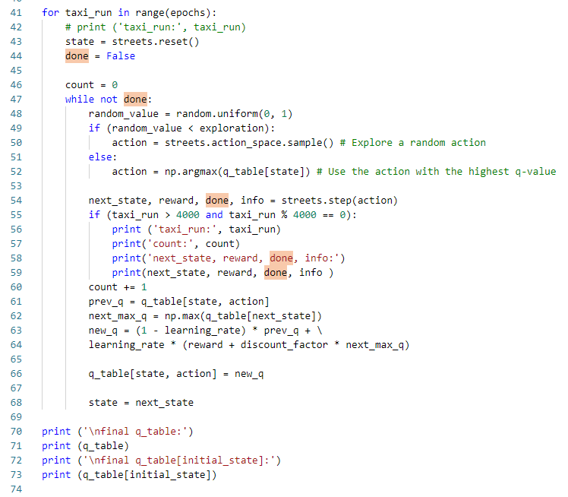
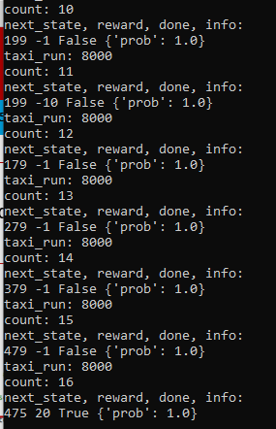
56.6 Exercise
https://www.udemy.com/course/data-science-and-machine-learning-with-python-hands-on/learn/lecture/15090210#overview
Exercise Answer:
1. Modify the Q-Learning block and trace on how many loop inside each Q-learning of the taxi_run.

Slide 31
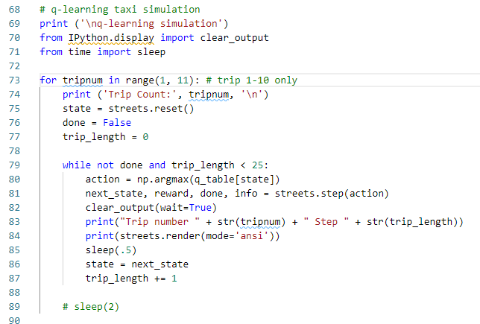
56.6 Exercise
https://www.udemy.com/course/data-science-and-machine-learning-with-python-hands-on/learn/lecture/15090210#overview
Exercise Answer
2. Increase the number of simulated trips, and remove the sleep() calls to allow you to run over more samples.

Slide 32
End of Chapter

