Slide 1

45 User-Based Collaborative Filtering
Peter H. Chen

Slide 2
45 User-Based Collaborative Filtering
https://www.udemy.com/course/data-science-and-machine-learning-with-python-hands-on/learn/lecture/4020666#overview
User-Based Collaborative Filtering
Recommender system is a system can recommend stuff to people based on other people did.
There are two techniques: User-Based and Item-Based collaborative filtering.

Slide 3
45.1 Recommender Systems

Slide 4
45.1 Recommender Systems
https://www.udemy.com/course/data-science-and-machine-learning-with-python-hands-on/learn/lecture/4020604#overview
Recommender Systems
Amazon and IMDB developed a recommender systems. Things like people who bought also bought, or recommended for you and movie recommendation for people.

Slide 5
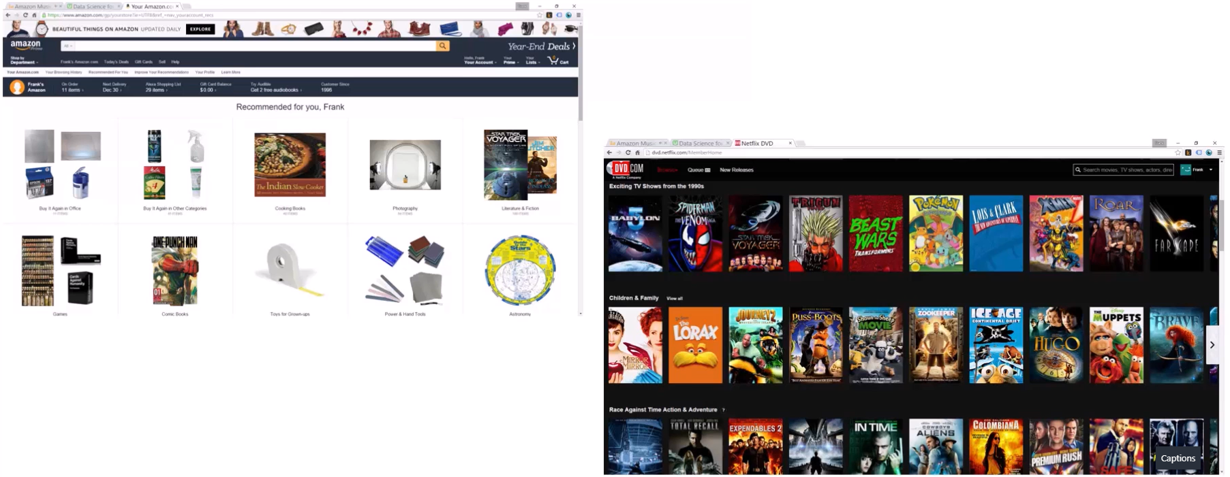
45.1 Recommender Systems
https://www.udemy.com/course/data-science-and-machine-learning-with-python-hands-on/learn/lecture/4020604#overview
What are recommender systems?
People might be interested to purchased based on your past behavior on the site and might include things that you rated or things that you bought and among other information that I might be use as well.
Amazon recommend people who bough this also bought that is a form of recommender system.

Slide 6
45.1 Recommender Systems
https://www.udemy.com/course/data-science-and-machine-learning-with-python-hands-on/learn/lecture/4020604#overview
What are recommender systems?
The recommends are based on all of your past behavior. People who bought this also bought that. People who viewed this also viewed that. These are your are looking at right now or things your are thinking to buying right now.
This may be the most of your interest right now.

Slide 7
45.1 Recommender Systems
https://www.udemy.com/course/data-science-and-machine-learning-with-python-hands-on/learn/lecture/4020604#overview
What are recommender systems?
Another example is netlist. You have various features that try to recommend new movie or other movies you have not seen yet based on the movies that you liked or watched in the past as well. They break that down by genre. They try to identify by the genre or types of movies that they think you are enjoying the most and they show you more results from those genres.

Slide 8
45.1 Recommender Systems
https://www.udemy.com/course/data-science-and-machine-learning-with-python-hands-on/learn/lecture/4020604#overview
What are recommender systems?
So, Netlist is another example of a recommender system in action.
The whole point of recommender system is to help you that never discover before.
The recommender system gives you movies, books, music, whatever a chance to be discovered might not heard about it before.

Slide 9
45.1 Recommender Systems
https://www.udemy.com/course/data-science-and-machine-learning-with-python-hands-on/learn/lecture/4020604#overview
What are recommender systems?
Recommender system is a cool technology and help new items get discovered.
It is a important role in today’s society.

Slide 10
45.2 User-Based Collaborative Filtering

Slide 11
45.2 User-Based Collaborative Filtering
https://www.udemy.com/course/data-science-and-machine-learning-with-python-hands-on/learn/lecture/4020604#overview
User-Based Collaborative (Joint) Filtering
Build a matrix for each user bought/viewed/rated.
Compute similarity score between users
Find user similar to you
Recommend stuff they bought/viewed/rated what you have not yet.

Slide 12
45.2 User-Based Collaborative Filtering
https://www.udemy.com/course/data-science-and-machine-learning-with-python-hands-on/learn/lecture/4020604#overview
User-Based Collaborative (Joint) Filtering Explanation
Everything for every user bought viewed, rated, or whatever signal of interest that you want is stored this system.
In the system, the row contains all the things they did might indicate some sort of interest in a given product.
So, given a table, I have the users for the rows. Each column is an item. The item may be a movie, a product, or whatever (a webpage), you use this for many different things.
Then, I use that matrix to compute the similarity between different users.
So, basically, we treat each row of this as a vector and we compute the similarity between each vector of users based on the behavior.
So, two users who like mostly the same things would be similar to each other.
We can then sort this by those similarity scores.
So, if we can find all the users similar to you based on their past behaviors. We can find the users most similar to you. And then recommend stuff that you did not look at yet.

Slide 13
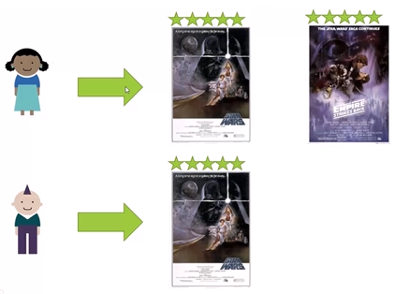
45.2 User-Based Collaborative Filtering
https://www.udemy.com/course/data-science-and-machine-learning-with-python-hands-on/learn/lecture/4020604#overview
User-Based Collaborative (Joint) Filtering
Example:
A lady watched “Star War” and the “Empire Strike Back” and she loves them both.
We have a user vector here of this lady. Vector gives five star rating for “Star Wars” and “Empire Stirks Back”
If a gentleman (with edgy Mohawk style hair) comes along and he only see the Start Wars. He does not about “Empire Strikes Back”.
You can say this gentleman is pretty similar to the lady because they both enjoy the “Star Wars” a lot.
Their similarity scores is fairly high.

Slide 14
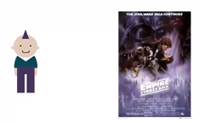
45.2 User-Based Collaborative Filtering
https://www.udemy.com/course/data-science-and-machine-learning-with-python-hands-on/learn/lecture/4020604#overview
User-Based Collaborative (Joint) Filtering
Example:
We can recommend the information from the lady the gentleman. This might be the good recommendation for this Mr. Edgy Mohawk.
We can recommend Mr. Edgy Mohawk “Empire Strikes Back”.
We will not continue with geek chorus with you here.

Slide 15
45.3 Problem with User-Based Collaborative Filtering

Slide 16
45.3 Problem with User-Based Collaborative Filtering
https://www.udemy.com/course/data-science-and-machine-learning-with-python-hands-on/learn/lecture/4020604#overview
Problem with User-Based Collaborative Filtering
People are fickle (changeable) and tastes changes
There are usually many more people than things
People do bad things

Slide 17
45.3 Problem with User-Based Collaborative Filtering
https://www.udemy.com/course/data-science-and-machine-learning-with-python-hands-on/learn/lecture/4020604#overview
Problem with User-Based Collaborative Filtering Explanation
The other problem is that there is usually a lot more people than there are things in your system.
There are 7.6 billion people in the world and much less movies in the world.
The computational problem of finding all the similarities between all of the users in your system is more complicated than finding similarities between the items in your system.
The other problem is that people to do bad things. There is a very real economic incentive. You can make your product or movie get recommended to people.
There are people who try to make their movie or product to gain more attention.
When you recommend something based on user relationship, it is very easy to fabricate fake personas (person characters) in the system by creating a new user and having them do a sequence of events, such as, make a lot of popular items to likes your items. This is called a Shilling Attack of Recommender System.
The User-Based Recommender is not good way to implement.
Note: Shilling is British monetary unit. 1 Shilling = 1/20 pound. Shilling attack is malicious fake user to manipulate the recommender system.

Slide 18
45.3 Problem with User-Based Collaborative Filtering
https://www.udemy.com/course/data-science-and-machine-learning-with-python-hands-on/learn/lecture/4020604#overview
Problem with User-Based Collaborative Filtering Explanation
Unfortunately, User-Based Collaborative Filtering have some limitation.
When you think of relationship between people. We want to find people that are similar to you and recommend stuff they liked. This is kinds of intuitive thing to do but not the best thing to do.
One problem is that, people is fickle (changeable).
Their tastes are always changing.
So may be the lady in the previous slides had a sort of brief science fiction action film phase that she went through. She started over in the drama or romance films or Rom Coms (Romantic Comedies).
So what happen in Mr. Edgy Mohawk just based on the similarity earlier in Sci-Fi period and we ended up recommend the Romantic Comedies to him as a result? That will be bad, right?
There is some protection against that in terms of how we compute the similarity scores. But people tastes change over the time and is still pollute the data.
So compare people to peoples is not a straightforward thing to do because people is fickle.

Slide 19
End of Chapter

