Slide 1

30 Train/Test
Peter H. Chen

Slide 2
30 Train/Set
https://www.udemy.com/course/data-science-and-machine-learning-with-python-hands-on/learn/lecture/4020552#overview
Train/Set to Prevent Overfit a Polynomial Regression
We some data set that we want to build a model for (in this case a polynomial regression):

Slide 3
30.1 Data Preparation

Slide 4
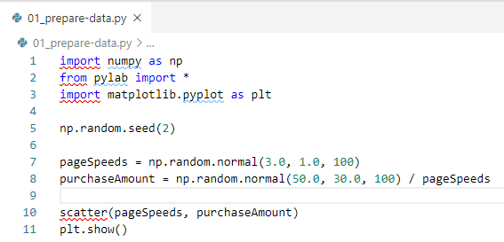
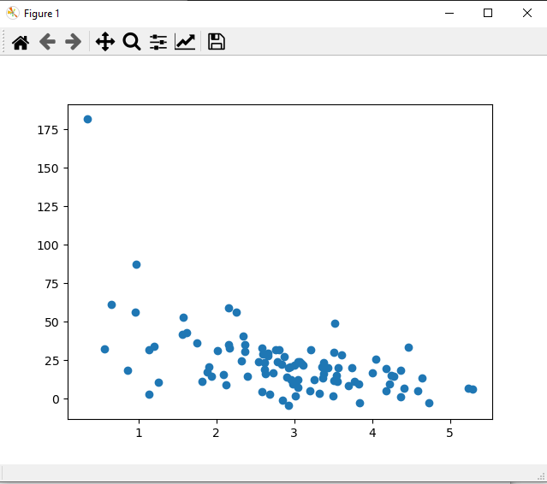
30.1 Data Preparation
https://www.udemy.com/course/data-science-and-machine-learning-with-python-hands-on/learn/lecture/4020552#overview
Data Preparation

Slide 5
30.2 Split Data

Slide 6
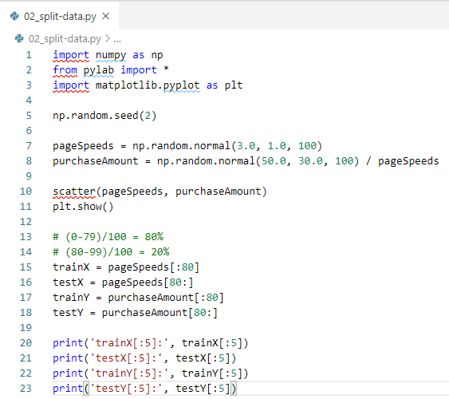
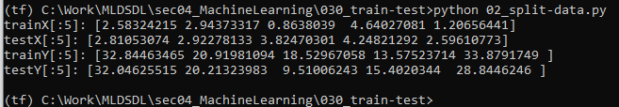
30.2 Split Data
https://www.udemy.com/course/data-science-and-machine-learning-with-python-hands-on/learn/lecture/4020552#overview
Split Data
Now we'll split the data in two - 80% of it will be used for "training" our model, and the other 20% for testing it. This way we can avoid overfitting.

Slide 7
30.3 Plot Train/Test Data Set

Slide 8
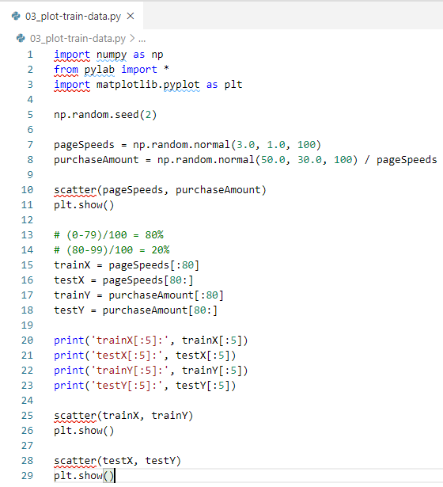
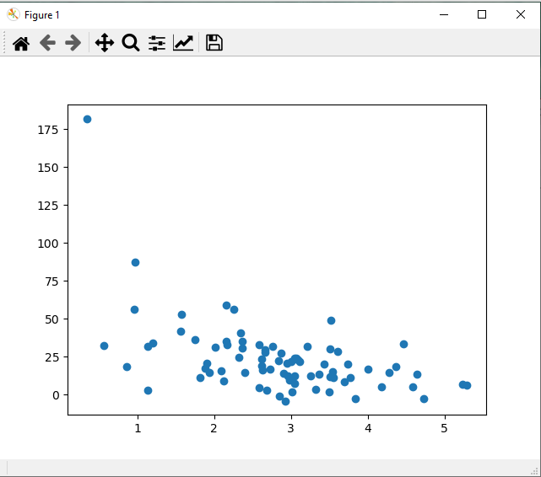
30.3 Plot Train/Test Data Set
https://www.udemy.com/course/data-science-and-machine-learning-with-python-hands-on/learn/lecture/4020552#overview
Plot Train Data Set

Slide 9
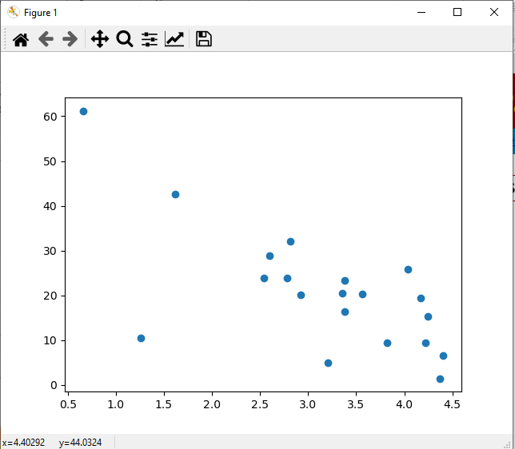
30.4 Plot Train/Test Data Set
https://www.udemy.com/course/data-science-and-machine-learning-with-python-hands-on/learn/lecture/4020552#overview
Plot Test Data Set

Slide 10
30.4 Fit Polynomial

Slide 11
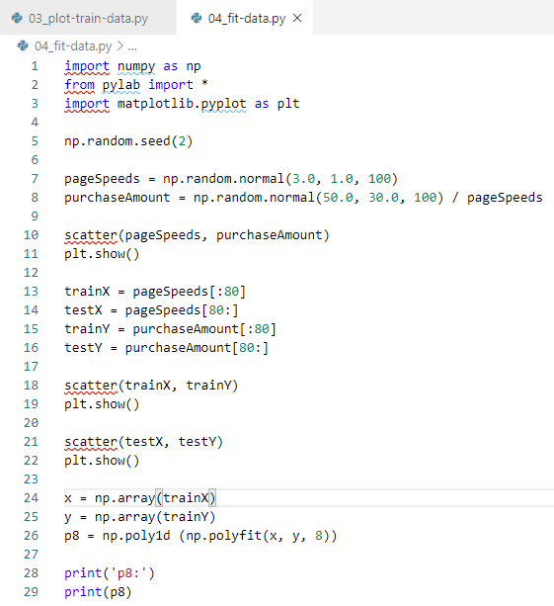
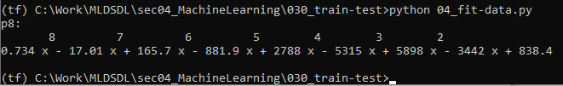
30.4 Fit Polynomial
https://www.udemy.com/course/data-science-and-machine-learning-with-python-hands-on/learn/lecture/4020552#overview
Fit Polynomial
Now we'll try to fit an 8th-degree polynomial to this data (which is almost certainly overfitting, given what we know about how it was generated!)

Slide 12
30.5 Plot Polynomial Fit Train Data

Slide 13
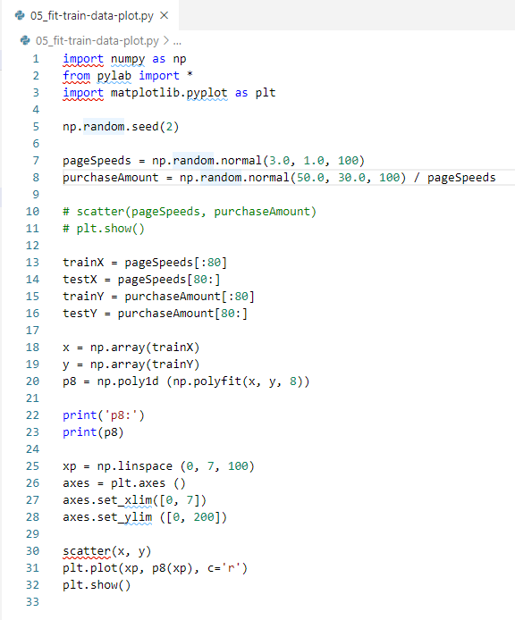
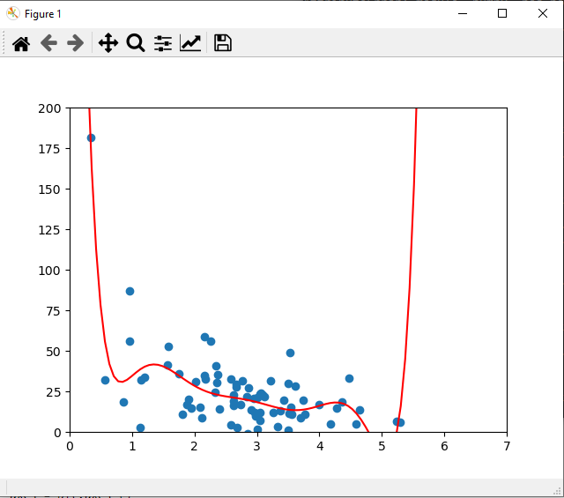
30.5 Plot Polynomial Fit
https://www.udemy.com/course/data-science-and-machine-learning-with-python-hands-on/learn/lecture/4020552#overview
Plot Polynomial Fit
Let's plot our polynomial against the training data:

Slide 14
30.6 Plot Polynomial Fit Test Data

Slide 15
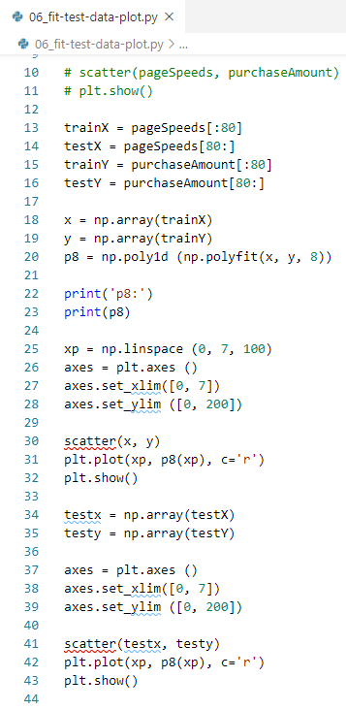
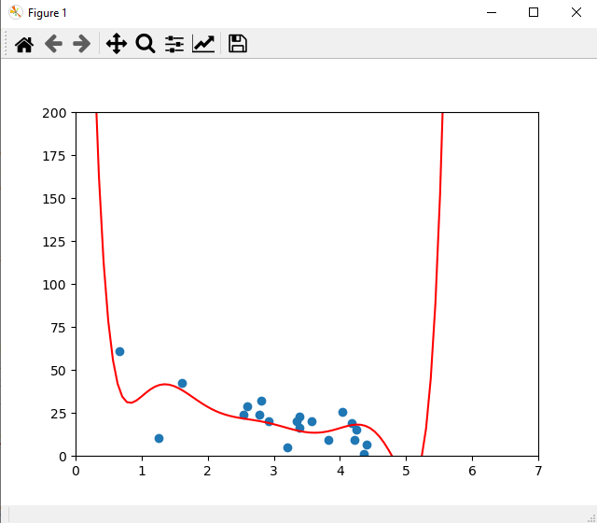
30.6 Plot Polynomial Fit Test Data
https://www.udemy.com/course/data-science-and-machine-learning-with-python-hands-on/learn/lecture/4020552#overview
Plot Polynomial Fit Test Data
And against our test data:

Slide 16
30.7 r-square

Slide 17
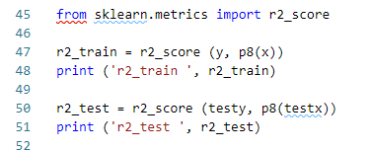
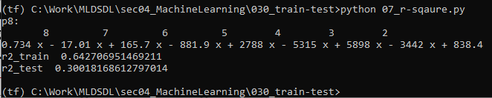
30.7 r-square
https://www.udemy.com/course/data-science-and-machine-learning-with-python-hands-on/learn/lecture/4020552#overview
R-square
Doesn't look that bad when you just eyeball it, but the r-squared score on the test data is kind of horrible!
This tells us that our model isn't all that great...
...even though it fits the training data better:

Slide 18
30.7 r-square
https://www.udemy.com/course/data-science-and-machine-learning-with-python-hands-on/learn/lecture/4020552#overview
R-square
If you're working with a Pandas DataFrame (using tabular, labeled data,) scikit-learn has built-in train_test_split functions to make this easy to do.
Later we'll talk about even more robust forms of train/test, like K-fold cross-validation - where we try out multiple different splits of the data, to make sure we didn't just get lucky with where we split it.

Slide 19
30.8 Exercise

Slide 20
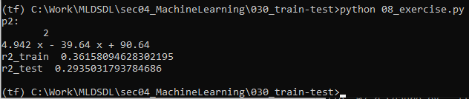
30.8 Exercise
https://www.udemy.com/course/data-science-and-machine-learning-with-python-hands-on/learn/lecture/4020552#overview
Exercise
Try measuring the error on the test data using different degree polynomial fits.
What degree works best?
Try: degree 3 and degree 2. Degree 2 is the best.

Slide 21
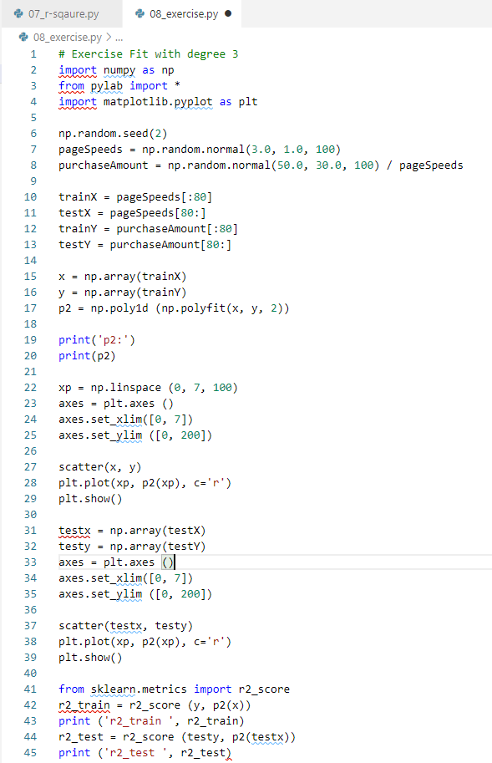
30.8 Exercise
https://www.udemy.com/course/data-science-and-machine-learning-with-python-hands-on/learn/lecture/4020552#overview
Exercise

Slide 22
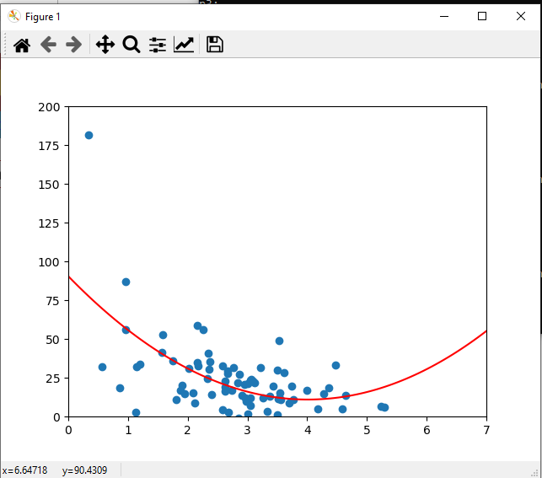
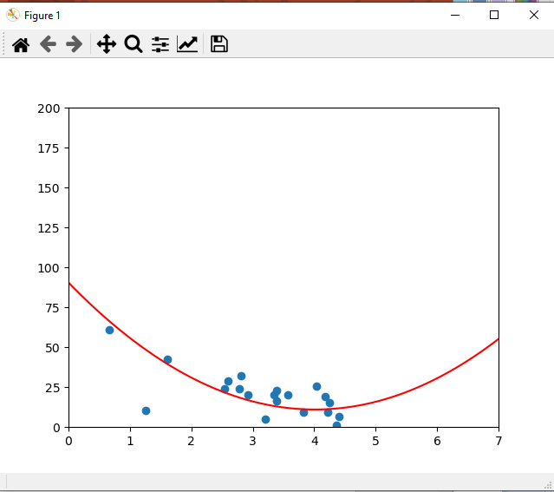
30.8 Exercise
https://www.udemy.com/course/data-science-and-machine-learning-with-python-hands-on/learn/lecture/4020552#overview
Exercise

Slide 23
End of Chapter

