Slide 1

107 Final Project Review
Peter H. Chen

Slide 2
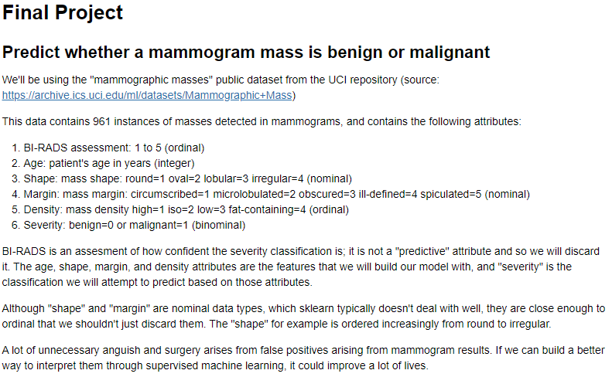
107 Final Project Review
https://github.com/peterhchen/930_Python_ML_DS_DL
Final Project Review
We Review the Final Project.
This is the medical project that can make the life better.

Slide 3
107.1 Data Preparation

Slide 4
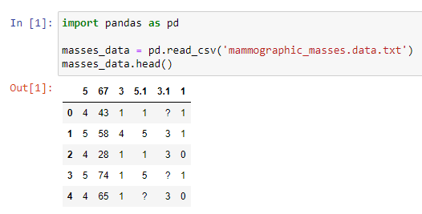
107.1 Data Preparation
https://github.com/peterhchen/930_Python_ML_DS_DL
Final Project Review
The Dataset is from UC Irvine.
We display the display and find there are missing data (?).

Slide 5
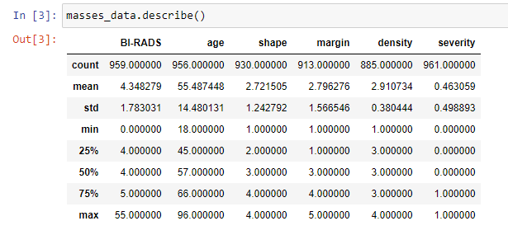
107.1 Data Preparation
https://github.com/peterhchen/930_Python_ML_DS_DL
Final Project Review
We use describe() function to count how many missing data of each column.

Slide 6
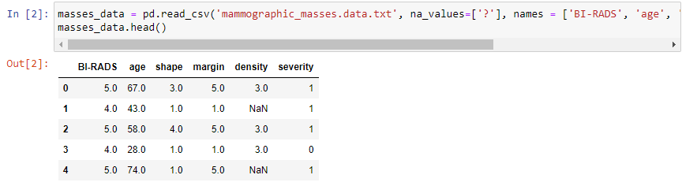
107.1 Data Preparation
https://github.com/peterhchen/930_Python_ML_DS_DL
Final Project Review
We replace the missing data (?) with NaN.

Slide 7
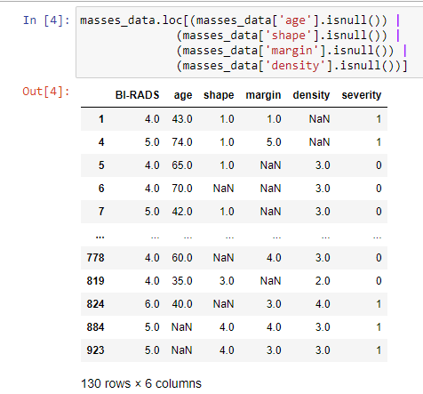
107.1 Data Preparation
https://github.com/peterhchen/930_Python_ML_DS_DL
Final Project Review
Display all rows with missing data. It has 130 rows contains the missing data.

Slide 8
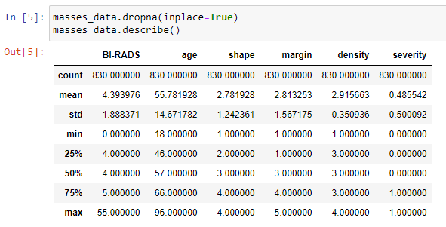
107.1 Data Preparation
https://github.com/peterhchen/930_Python_ML_DS_DL
Final Project Review
We remove the rows with missing data by dropna().
Only 830/961 rows are remained. 130 columns are removed from our array.

Slide 9
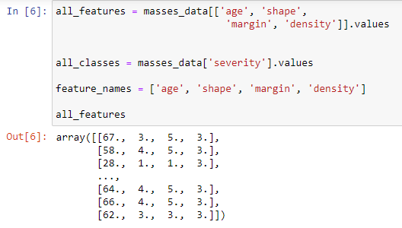
107.1 Data Preparation
https://github.com/peterhchen/930_Python_ML_DS_DL
Final Project Review
We select four features: age, shape, margin, and density for input features.
The output class is severity.
We prepare the data for scikit_learn. Only integer values are allowed.

Slide 10
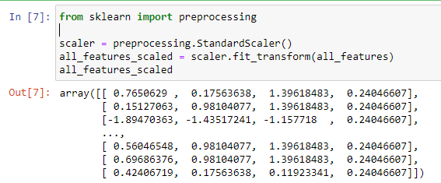
107.1 Data Preparation
https://github.com/peterhchen/930_Python_ML_DS_DL
Final Project Review
We normalized the array data.

Slide 11
107.2 Decision Tree

Slide 12
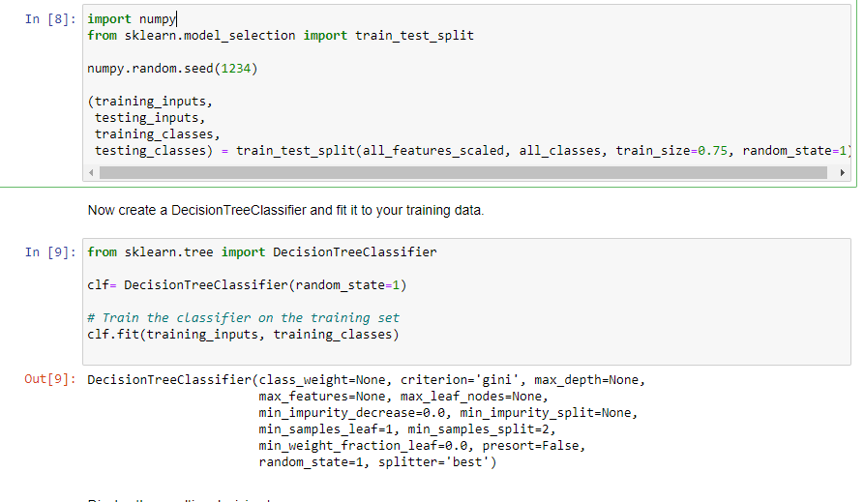
107.2 Decision Tree
https://github.com/peterhchen/930_Python_ML_DS_DL
Decision Tree
We classify by the Decision Tree.

Slide 13
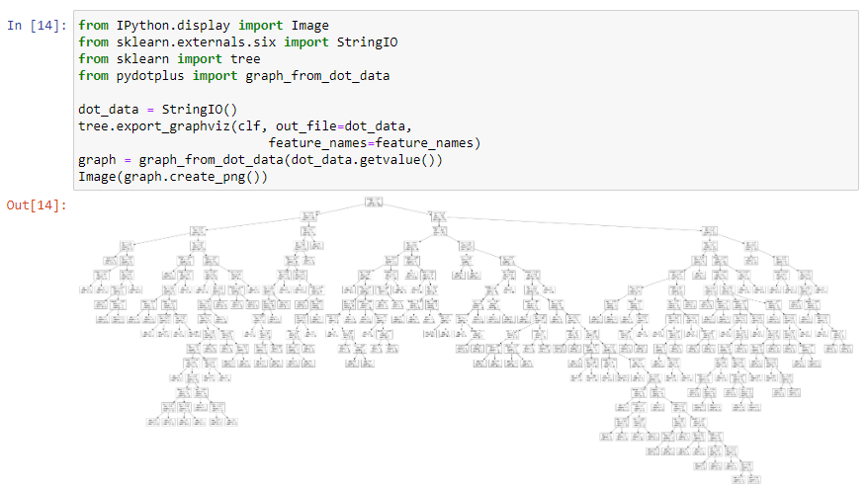
107.2 Decision Tree
https://github.com/peterhchen/930_Python_ML_DS_DL
Decision Tree
Create Decision Tree Graph. Decision Tree is very complicated and my not the best solution.

Slide 14
107.3 Random Forest

Slide 15
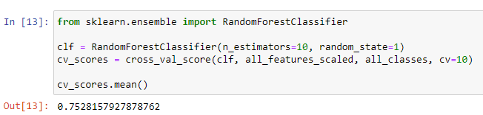
107.3 Random Forest
https://github.com/peterhchen/930_Python_ML_DS_DL
Radom Forest of Decision Tree
Only about 75%, not good enough.

Slide 16
107.4 SVM

Slide 17
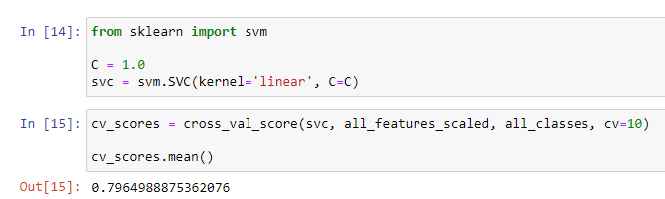
107.4 SVM
https://github.com/peterhchen/930_Python_ML_DS_DL
SVM: About 80%

Slide 18
107.5 KNN

Slide 19
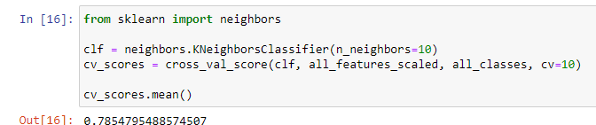
107.5 KNN
https://github.com/peterhchen/930_Python_ML_DS_DL
KNN: About 78%
We also try different K

Slide 20
107.6 Naïve Bayes

Slide 21
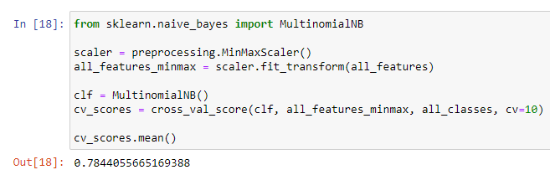
107.6 Naïve Bayes
https://github.com/peterhchen/930_Python_ML_DS_DL
Naïve Bayes: About 78%

Slide 22
107.7 Different Kernel of SVM

Slide 23
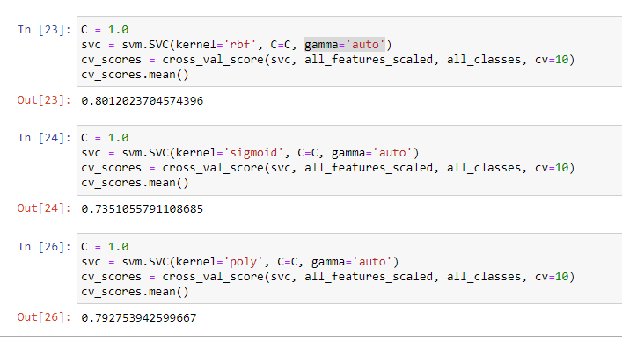
107.7 Different Kernel of SVM
https://github.com/peterhchen/930_Python_ML_DS_DL
Different Kernel of SVM
So far, the winner is SVM with rbf (radial basis funciton) kernel.

Slide 24
107.8 Logistic Regression

Slide 25
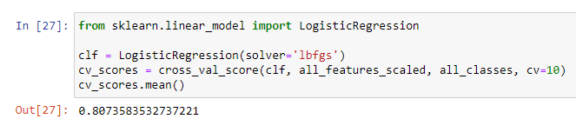
107.8 Logistic Regression
https://github.com/peterhchen/930_Python_ML_DS_DL
Logistic Regression
It is a regression for classification problem. It is simple and 80%.

Slide 26
107.9 Neural Network

Slide 27
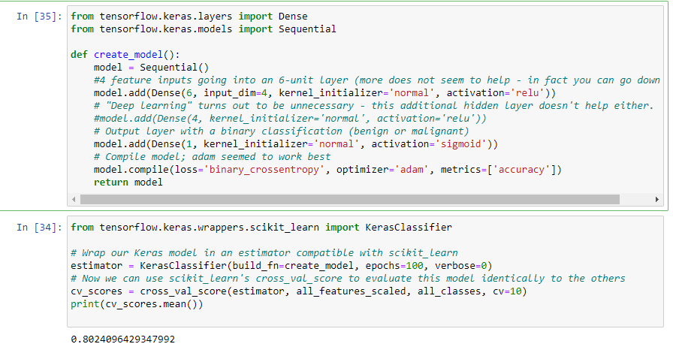
107.9 Neural Network
https://github.com/peterhchen/930_Python_ML_DS_DL
Neural Network
Simple layer of neuron give me 80%. You can have Keras for more accurate.
We have binary cross entropy for loss function and optimizer is adam.

Slide 28
107.10 Who is Winner?

Slide 29
107.10 Who is Winner?
https://github.com/peterhchen/930_Python_ML_DS_DL
Who is the Winner?
For this simple problem, we can choose the simple regression with 80%.
For more accuracy, we can choose neural network for more layers.

Slide 30
End of Chapter

