Slide 1

59 Measure Classifier
Peter H. Chen

Slide 2
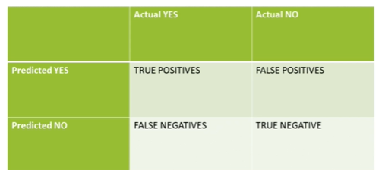
59 Measure Classifier
https://www.udemy.com/course/data-science-and-machine-learning-with-python-hands-on/learn/lecture/16656252#overview
Measure Your Model
We discuss some metrics that derived from Confusion Matrix.
We have the confusion matrix as below.
We have true positive, false positive, true negative, and false negative.
Make sure you understand the true positive and true negative, and etc.

Slide 3
59.1 Recall

Slide 4
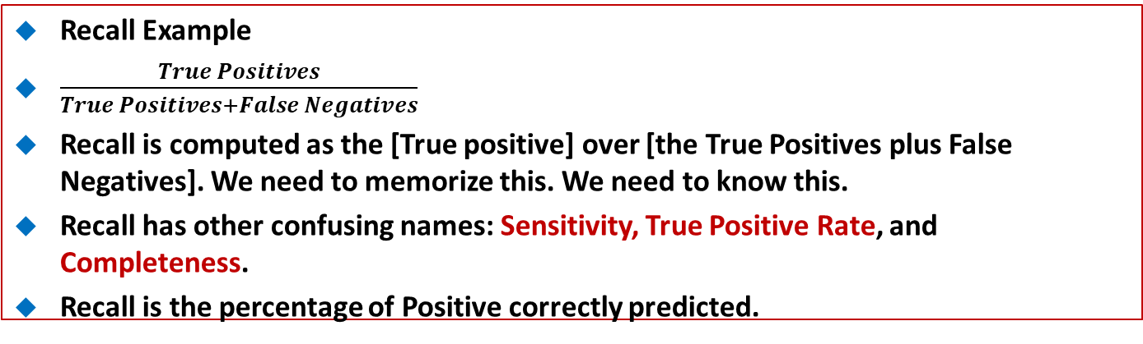
59.1 Recall
https://www.udemy.com/course/data-science-and-machine-learning-with-python-hands-on/learn/lecture/16656252#overview
Recall Example
$\frac{True Positives}{True Positives+False Negatives}$
Recall is computed as the [True positive] over [the True Positives plus False Negatives]. We need to memorize this. We need to know this.
Recall has other confusing names: Sensitivity, True Positive Rate, and Completeness.
Recall is the percentage of Positive correctly predicted.
Recall is a good choice of metric when you care about the false negative.
Fraud Detection is an example of that. True Positive over the True Positive plus False negatives.

Slide 5
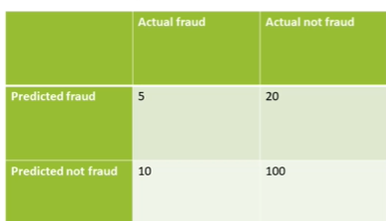
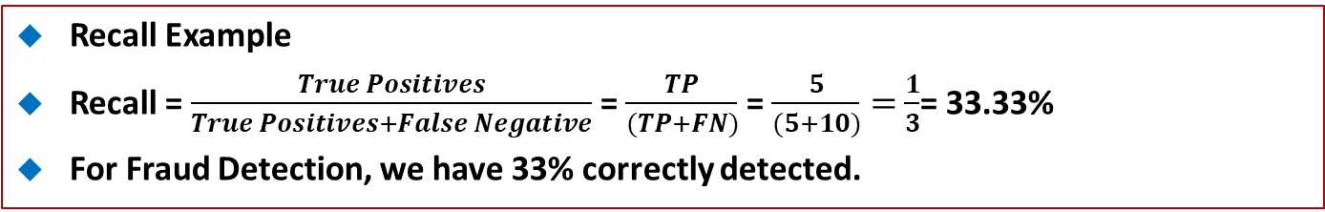
59.1 Recall
https://www.udemy.com/course/data-science-and-machine-learning-with-python-hands-on/learn/lecture/16656252#overview
Recall Example
Recall = $\frac{True Positives}{True Positives+False Negative}$ = $\frac{TP}{(TP+FN)}$ = $\frac{5}{(5+10)}=$ $\frac{1}{3}$= 33.33%
For Fraud Detection, we have 33% correctly detected.

Slide 6
59.2 Precision

Slide 7
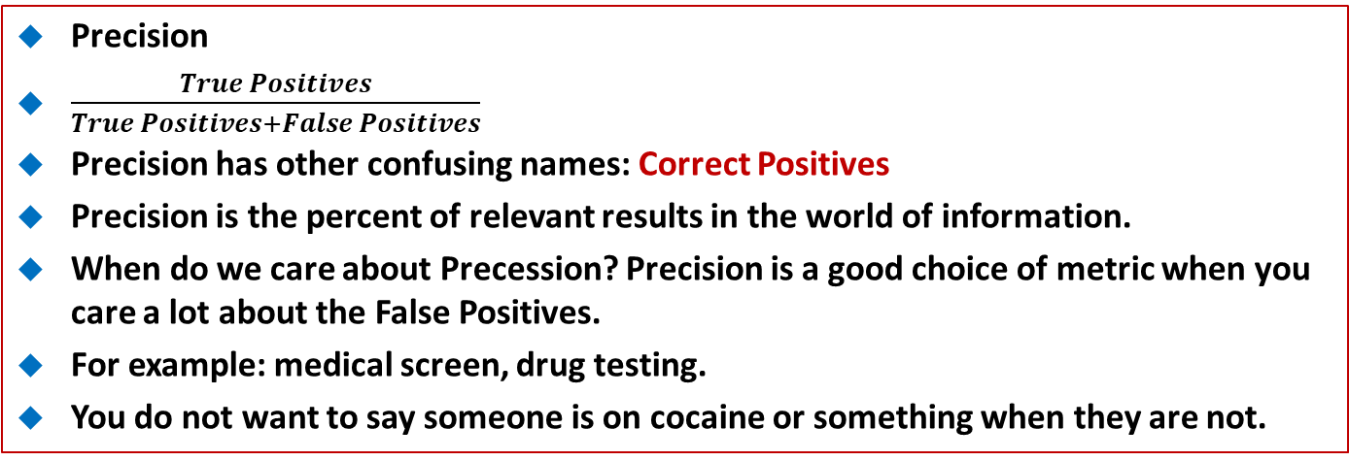
59.2 Precision
https://www.udemy.com/course/data-science-and-machine-learning-with-python-hands-on/learn/lecture/16656252#overview
Precision
$\frac{True Positives}{True Positives+False Positives}$
Precision has other confusing names: Correct Positives
Precision is the percent of relevant results in the world of information.
When do we care about Precession? Precision is a good choice of metric when you care a lot about the False Positives.
For example: medical screen, drug testing.
You do not want to say someone is on cocaine or something when they are not.
That will have really bad effect on their life and career.
Precision care about the False Positive more than False negative. Drug testing is a classic example.

Slide 8
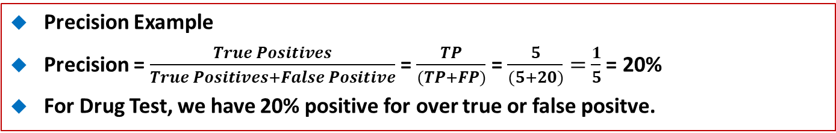
59.2 Precision
https://www.udemy.com/course/data-science-and-machine-learning-with-python-hands-on/learn/lecture/16656252#overview
Precision Example
Precision = $\frac{True Positives}{True Positives+False Positive}$ = $\frac{TP}{(TP+FP)}$ = $\frac{5}{(5+20)}=$ $\frac{1}{5}$ = 20%
For Drug Test, we have 20% positive for over true or false positve.

Slide 9
59.3 Other Metrics: Specificity

Slide 10
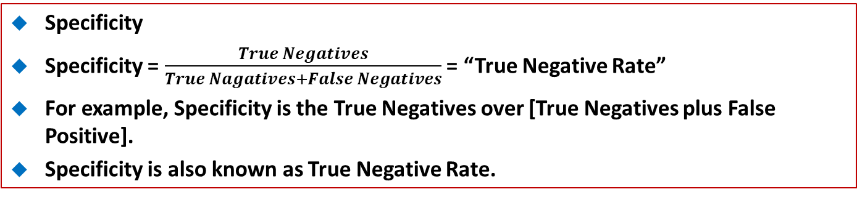
59.3 Other Metrics: Specificity
https://www.udemy.com/course/data-science-and-machine-learning-with-python-hands-on/learn/lecture/16656252#overview
Specificity
Specificity = $\frac{True Negatives}{True Nagatives+False Negatives}$ = “True Negative Rate”
For example, Specificity is the True Negatives over [True Negatives plus False Positive].
Specificity is also known as True Negative Rate.

Slide 11
59.4 Other Metrics: F1 Score

Slide 12
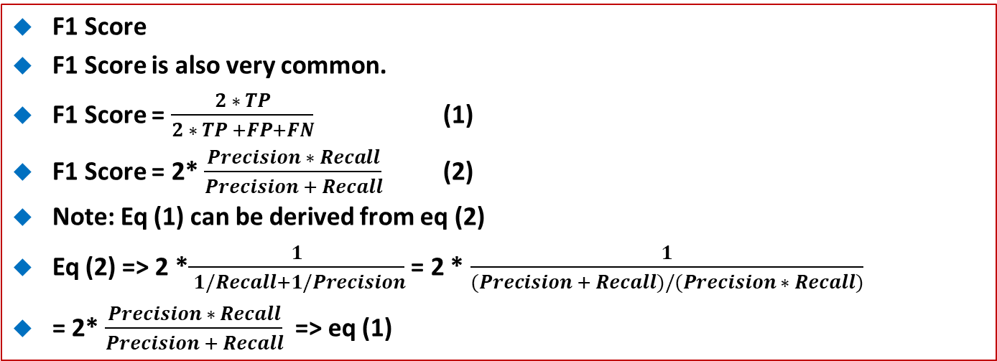
59.4 Other Metrics: F1 Score
https://www.udemy.com/course/data-science-and-machine-learning-with-python-hands-on/learn/lecture/16656252#overview
F1 Score
F1 Score is also very common.
F1 Score = $\frac{2 ∗ TP}{2 ∗ TP +FP+FN}$ (1)
F1 Score = 2* $\frac{Precision ∗ Recall}{Precision + Recall}$ (2)
Note: Eq (1) can be derived from eq (2)
Eq (2) => 2 *$\frac{1}{ 1/Recall+1/Precision}$ = 2 * $\frac{1}{(Precision + Recall)/(Precision ∗ Recall)}$
= 2* $\frac{Precision ∗ Recall}{Precision + Recall}$ => eq (1)

Slide 13
59.4 Other Metrics: F1 Score
https://www.udemy.com/course/data-science-and-machine-learning-with-python-hands-on/learn/lecture/16656252#overview
F1 Score
F1 Score is also very common.
Mathematically, F1 Score is a Harmonic mean of Recall (or Sensitivity) and Precision.
When you care about both Recall and Precision, F1 Score is a metric that balances the two if you know that your model want to capture both recall and precision.
F1 Score can be a way of doing that but the real world, we only care about recall more or precision more, respectively. We do not pay attention on both together.
So, F1 Score is not used in real world.

Slide 14
59.5 Other Metrics: RMSE

Slide 15
59.5 Other Metrics: RMSE
https://www.udemy.com/course/data-science-and-machine-learning-with-python-hands-on/learn/lecture/16656252#overview
RMSE
Accuracy measurement: RMSE (Root Mean Squared Error) measures the accuracy.
It is exactly measure the root mean squared error. It adds all of these squared errors of each prediction from its actual value and take the square root of it.
RMSE does not get into the Confusion Matrix (or Recall, Sensitivity, and etc.)

Slide 16
59.6 Other Metrics: AUC

Slide 17
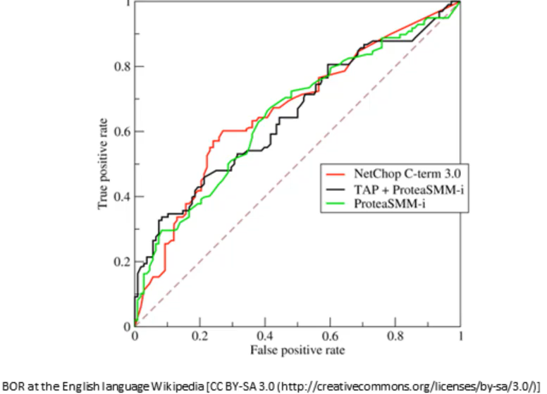
59.6 Other Metrics: ROC
https://www.udemy.com/course/data-science-and-machine-learning-with-python-hands-on/learn/lecture/16656252#overview
ROC Curve
Another way of evaluating our mode is the ROC curve.
ROC (Receiver Operating Characteristics Curve) plot the True Positive Rate (Recall) to False Positive Rate at various threshold settings.
Basically, you evaluate the ROC curve above the diagonal curve. Points above the diagonal represent good classification (better than random)
Ideal curve would just be a point in the upper-left corner.
The more it is bent toward the upper-left, the better.

Slide 18
59.7 Other Metrics: ROC

Slide 19
59.7 Other Metrics: AUC
https://www.udemy.com/course/data-science-and-machine-learning-with-python-hands-on/learn/lecture/16656252#overview
AUC Curve
https://developers.google.com/machine-learning/crash-course/classification/roc-and-auc
AUC (Area Under the ROC Curve) is the area under the ROC Curve.
AUC is the area under ROC which represents the probability of a classifier
AUC randomly chosen positive instance higher than a randomly chosen negative one. AUC rank from 0 to 1.
AUC of 0.5 is an useless classifier.
AUC 1.0 is perfect classifier. The entire area is for entire ROC curve.
AUC Commonly used metric for comparing classifiers. The higher value of AUC is the better.

Slide 20
End of Chapter

