Slide 1

22 Conditional Probability
Peter H. Chen

Slide 2
22 Conditional Probability
https://www.udemy.com/course/data-science-and-machine-learning-with-python-hands-on/learn/lecture/4020120#overview
Conditional Probability
In Amazon, we always see if customer buy this, you may interested to buy this.
This is a conditional probability.

Slide 3
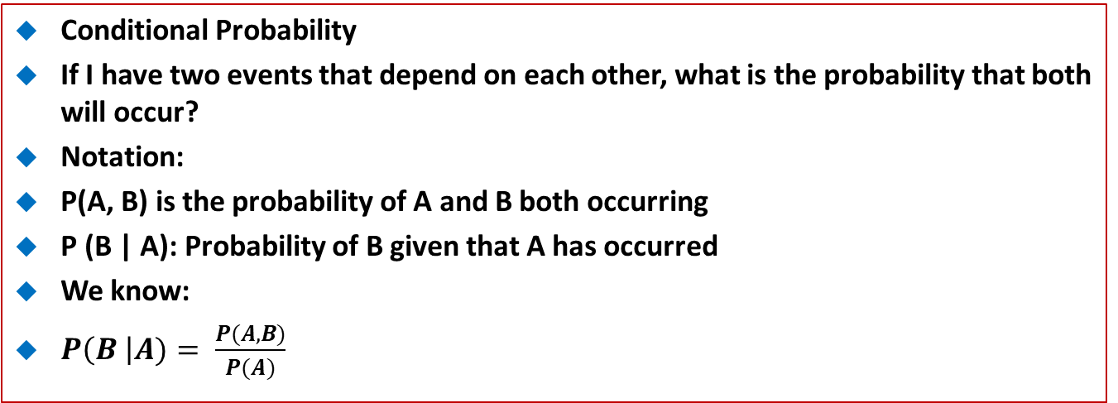
22 Conditional Probability
https://www.udemy.com/course/data-science-and-machine-learning-with-python-hands-on/learn/lecture/4020120#overview
Conditional Probability
If I have two events that depend on each other, what is the probability that both will occur?
Notation:
P(A, B) is the probability of A and B both occurring
P (B | A): Probability of B given that A has occurred
We know:
$P\left(B \right|A)= \frac{P(A, B)}{P(A)}$

Slide 4
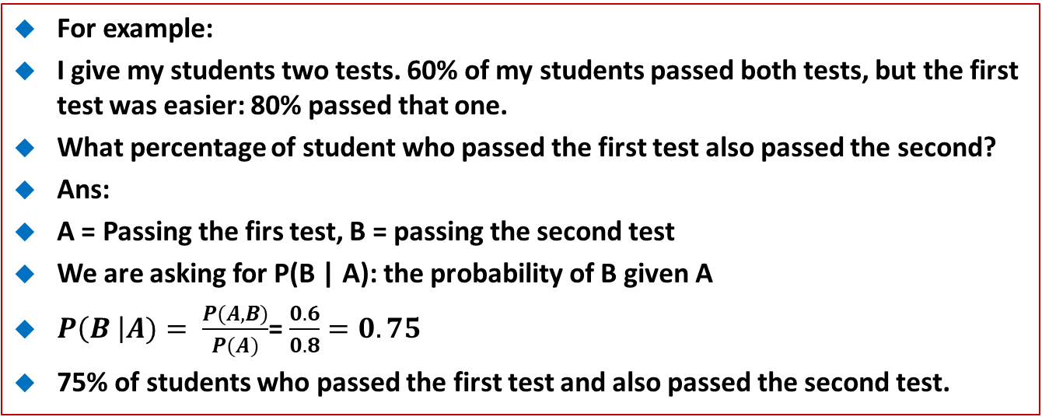
22 Conditional Probability
https://www.udemy.com/course/data-science-and-machine-learning-with-python-hands-on/learn/lecture/4020120#overview
For example:
I give my students two tests. 60% of my students passed both tests, but the first test was easier: 80% passed that one.
What percentage of student who passed the first test also passed the second?
Ans:
A = Passing the firs test, B = passing the second test
We are asking for P(B | A): the probability of B given A
$P\left(B \right|A)= \frac{P(A, B)}{P(A)}$= $\frac{0.6}{0.8}=0.75$
75% of students who passed the first test and also passed the second test.

Slide 5
22.1 Generate totals and purchases

Slide 6
22.1 Generate totals and purchases
https://www.udemy.com/course/data-science-and-machine-learning-with-python-hands-on/learn/lecture/4020120#overview
Code
Below is some code to create some fake data on how much stuff people purchase given their age range.
It generates 100,000 random "people" and randomly assigns them as being in their 20's, 30's, 40's, 50's, 60's, or 70's.
It then assigns a lower probability for young people to buy stuff.
In the end, we have two Python dictionaries:
"totals" contains the total number of people in each age group.
"purchases" contains the total number of things purchased by people in each age group.
The grand total of purchases is in totalPurchases, and we know the total number of people is 100,000.
Let's run it and have a look:

Slide 7
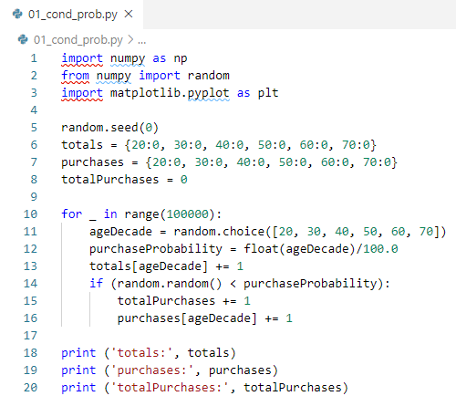
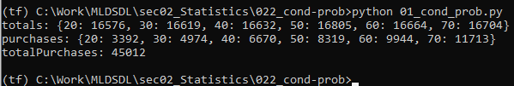
22.1 Generate totals and purchases
https://www.udemy.com/course/data-science-and-machine-learning-with-python-hands-on/learn/lecture/4020120#overview
Code

Slide 8
22.2 Calculate Conditional Probability

Slide 9
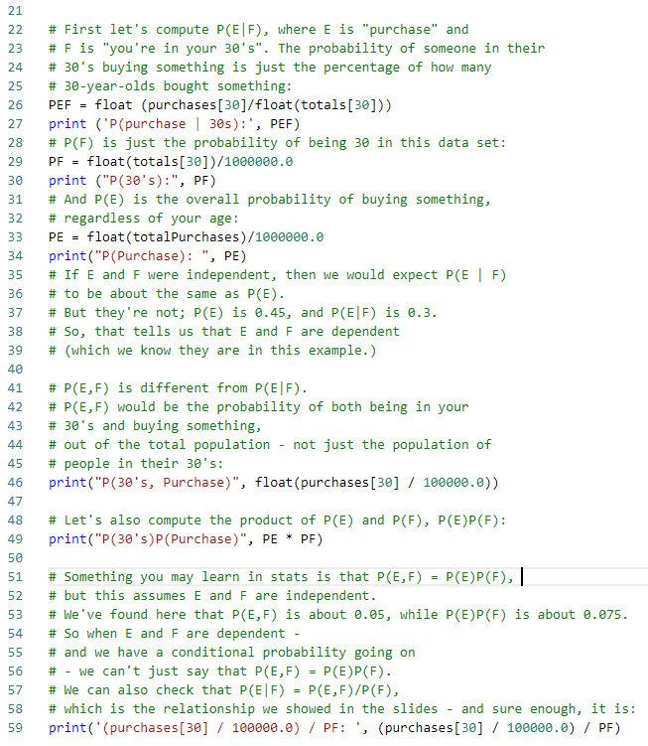
22.2 Calculate Conditional Probability
https://www.udemy.com/course/data-science-and-machine-learning-with-python-hands-on/learn/lecture/4020120#overview
Code

Slide 10
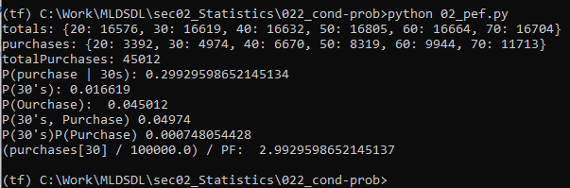
22.2 Calculate Conditional Probability
https://www.udemy.com/course/data-science-and-machine-learning-with-python-hands-on/learn/lecture/4020120#overview
Code

Slide 11
22.3 Assignment

Slide 12
22.3 Assignment
https://www.udemy.com/course/data-science-and-machine-learning-with-python-hands-on/learn/lecture/4020120#overview
Assignment
Modify the code above such that the purchase probability does NOT vary with age, making E and F actually independent.
Then, confirm that P(E|F) is about the same as P(E), showing that the conditional probability of purchase for a given age is not any different than the a-priori probability of purchase regardless of age.

Slide 13
End of Chapter

