Slide 1

23 Conditional Probability Assignment
Peter H. Chen

Slide 2
23 Conditional Probability Assignment
https://www.udemy.com/course/data-science-and-machine-learning-with-python-hands-on/learn/lecture/4020122#overview
Assignment
Modify the code above such that the purchase probability does NOT vary with age, making E and F actually independent.
Then, confirm that P(E|F) is about the same as P(E), showing that the conditional probability of purchase for a given age is not any different than the a-priori probability of purchase regardless of age.

Slide 3
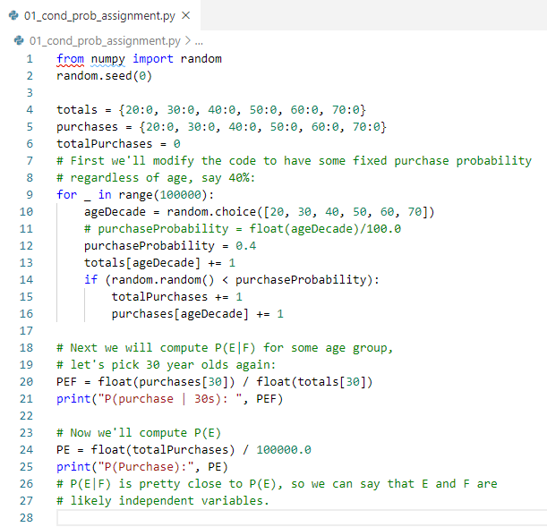

23 Conditional Probability Assignment
https://www.udemy.com/course/data-science-and-machine-learning-with-python-hands-on/learn/lecture/4020122#overview
Assignment

Slide 4
End of Chapter

