Slide 1

65 Outliers
Peter H. Chen

Slide 2
65 Outliers
https://www.udemy.com/course/data-science-and-machine-learning-with-python-hands-on/learn/lecture/4020730#overview
Deal with Outliers
Sometimes your real world data will contain outliers and they might be legitimate (legal) outliers they might be caused by real people and not by some sort of malicious traffic or fake data and you'll have to decide how you're going to deal with them.

Slide 3

65 Outliers
https://www.udemy.com/course/data-science-and-machine-learning-with-python-hands-on/learn/lecture/4020730#overview
Deal with Outliers
Sometimes it's appropriate to remove them. Sometimes it isn’t.
Make sure you make that decision responsibly.
For example: If you are doing collaborative filtering for movie recommendations, you might have a few power users that have watched every movie ever made and rated every movie ever made and they could end up having an inordinate (unusual) influence on the recommendations for everybody else. And you don't really want a handful of people to have that much power in your system. It would be a legitimate to filter out them as an outlier.
Another example: In Web log data, outliers could be robots or other agents that should be discarded.
Another Example: If somebody really wanted join the mean average income in the United States and not the median. Some billionaires of dollars are going to push that mean amount up.

Slide 4
65 Outliers
https://www.udemy.com/course/data-science-and-machine-learning-with-python-hands-on/learn/lecture/4020730#overview
How do we identify the Outliers?
We can use standard deviation. We computes the standard deviation of a dataset that have a more or less normal distribution. If you see a data point that's outside of one or two standard deviations there you have an outlier.
Remember we talked too about the box and whisker diagrams too.
And those also have a built in way of detecting and visualizing outliers and those defined outliers as lying outside one point five the interquartile range so what multiple do you choose.
Well you kind of have to use common sense. There's no hard and fast rule as to what is an outlier. You have to look at your data and kind of eyeball it.
Look at the distribution. Look at the histogram see if there's actual things that stick out to you as obvious outliers and understand what they are before you just throw them away.

Slide 5
65.1 Outlier Example

Slide 6
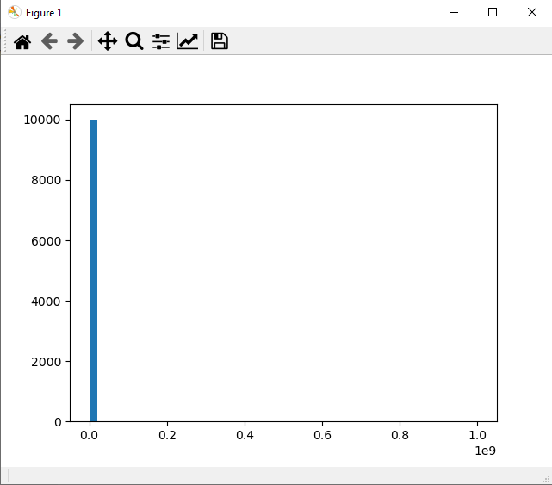
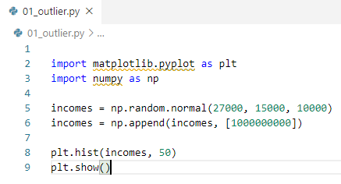
65.1 Outlier Example
https://www.udemy.com/course/data-science-and-machine-learning-with-python-hands-on/learn/lecture/4020730#overview
Outlier Example
Sometimes outliers can mess up an analysis; you usually don't want a handful of data points to skew the overall results.
Let's revisit our example of income data, with one billionaire in the normal distribution. Plot incomes vs. people count.
We have normal distribution with 27,000 dollars with deviation 15,000 and with 10,000 people. Then we add a billionaire after this array.
If we plot histogram of the data, we see all the normal people around 20,000 and 1 people way at billion (10^9).

Slide 7


65.1 Outlier Example
https://www.udemy.com/course/data-science-and-machine-learning-with-python-hands-on/learn/lecture/4020730#overview
Outlier Example
We can see the mean.
That's not very helpful to look at.
One billionaire ended up squeezing everybody else into a single line in my histogram.
Plus it skewed my mean income significantly:

Slide 8
65.2 Reject Outlier

Slide 9
65.2 Reject Outlier
https://www.udemy.com/course/data-science-and-machine-learning-with-python-hands-on/learn/lecture/4020730#overview
Reject Outlier
It is important to dig into what is causing your outliers, and understand where they are coming from.
You also need to think about whether removing them is a valid thing to do, given the spirit of what it is you're trying to analyze.
If I know I want to understand more about the incomes of "typical Americans", filtering out billionaires seems like a legitimate thing to do.
Here's something a little more robust than filtering out billionaires - it filters out anything beyond two standard deviations of the median value in the data set:

Slide 10
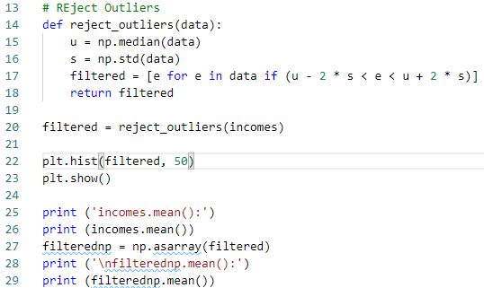
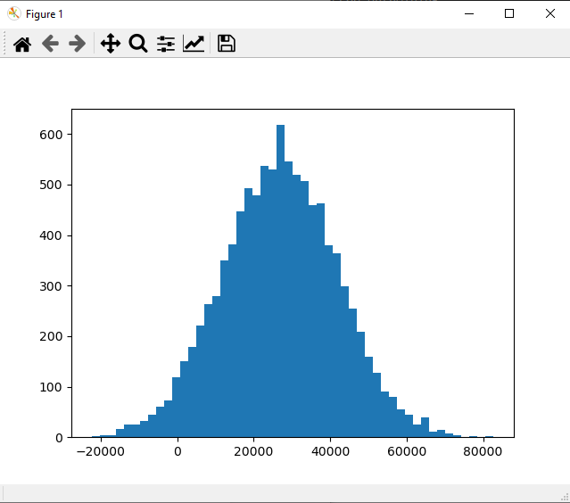

65.2 Reject Outlier
https://www.udemy.com/course/data-science-and-machine-learning-with-python-hands-on/learn/lecture/4020730#overview
Reject Outlier
Here we choose data inside 2 standard deviation around the median of data.
The billionaire will be thrown away from the incomes dataset.

Slide 11
65.3 Exercise

Slide 12
65.3 Exercise
https://www.udemy.com/course/data-science-and-machine-learning-with-python-hands-on/learn/lecture/4020730#overview
Exercise
1. Instead of a single outlier, add several randomly-generated outliers to the data.
2. Experiment with different values of the multiple of the standard deviation to identify outliers, and see what effect it has on the final results.

Slide 13
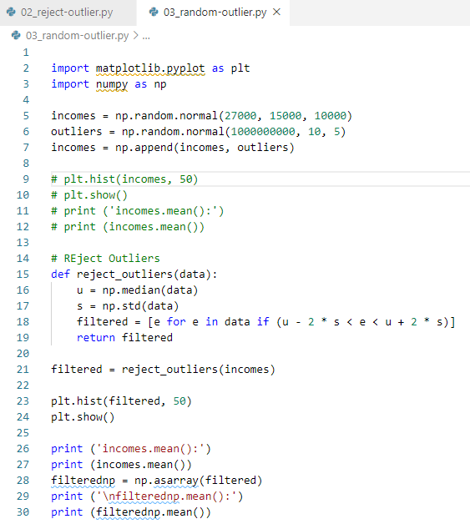
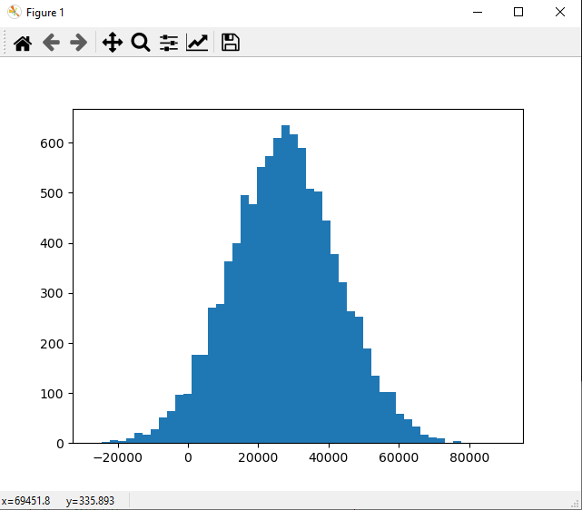

65.3 Exercise
https://www.udemy.com/course/data-science-and-machine-learning-with-python-hands-on/learn/lecture/4020730#overview
Exercise
1. Instead of a single outlier, add several randomly-generated outliers to the data.
Ans: Generate 5 billionaire people and filtered out with 2 standard deviation.

Slide 14
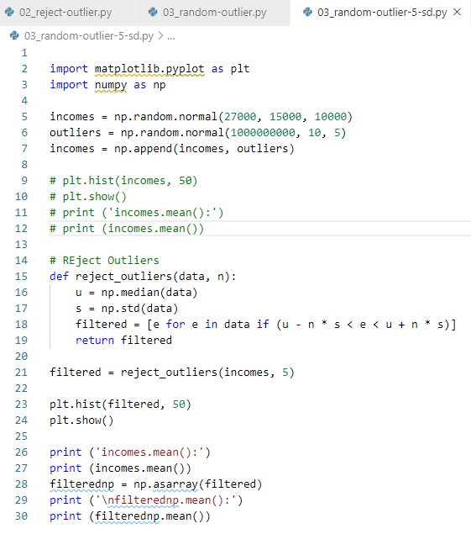
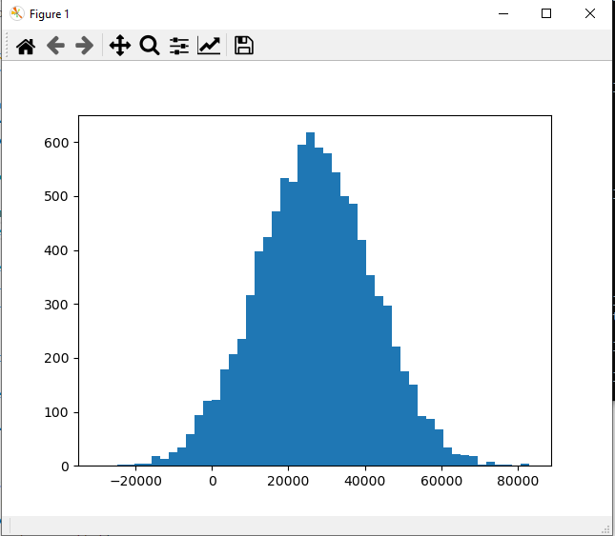

65.3 Exercise
https://www.udemy.com/course/data-science-and-machine-learning-with-python-hands-on/learn/lecture/4020730#overview
Exercise
2. Experiment with different values of the multiple of the standard deviation to identify outliers, and see what effect it has on the final results.
Ans: Generate 5 billionaire people and filtered out with 5 standard deviation.

Slide 15
End of Chapter

