Slide 1
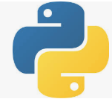
8 List, Tuple, and Dictionary
Peter H. Chen

Slide 2
8 List, Tuple, and Dictionary
https://github.com/peterhchen/900_Python_ML_DS_DL
List, Tuple, and Dictionary
We discuss Python List, Tuple, and Dictionary.

Slide 3
8.6 List

Slide 4
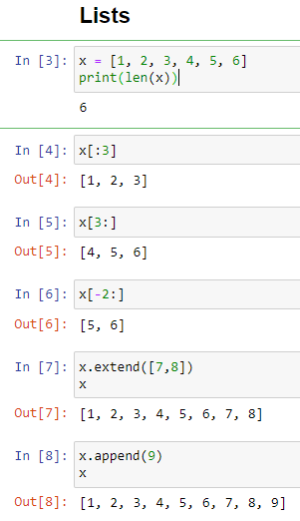
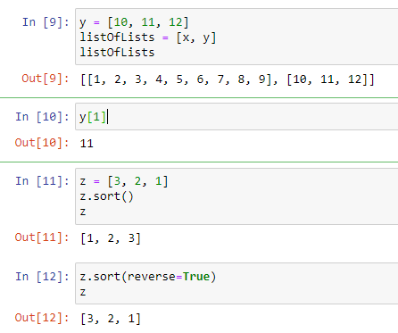
8.6 List
https://github.com/peterhchen/900_Python_ML_DS_DL
Lists: a List is an array with elements can be modified. List use square bracket [].
Lists: Jupyter Notebook
2020/9/24

Slide 5
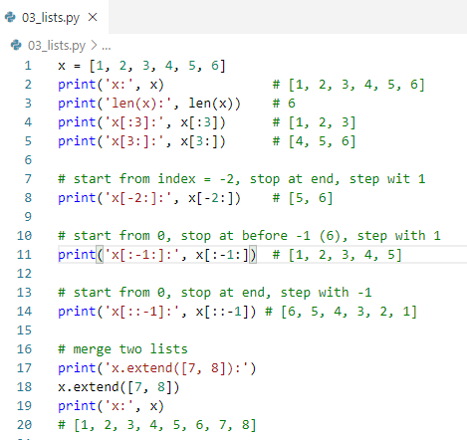
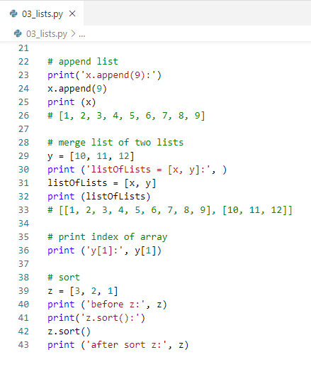
8.6 List
https://github.com/peterhchen/900_Python_ML_DS_DL
Lists: Python Anaconda Prompt
2020/9/24

Slide 6
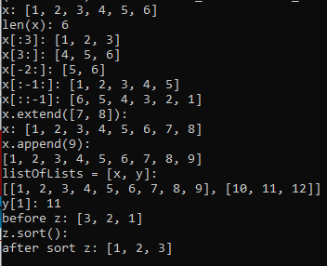
8.6 List
https://github.com/peterhchen/900_Python_ML_DS_DL
Lists: Python Anaconda Prompt
2020/9/24

Slide 7
8.7 Tuple

Slide 8
8.7 Tuple
https://github.com/peterhchen/900_Python_ML_DS_DL
Let's talk about tuples next.
Tuples are a lot like lists.
But the main difference is that they are immutable (constant).
Once you create a tuple you can't change them.
Tuples are handy for people doing functional programming or for interfacing with systems like Apache Spark. Tuple elements are fixed and never changed.
2020/9/24

Slide 9
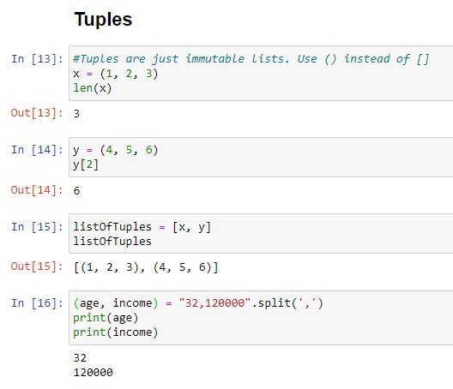
8.7 Tuple
https://github.com/peterhchen/900_Python_ML_DS_DL
Tuple: A tuple is a constant array cannot be modified. Tuple use round bracket ().
Jupyter notebook:
2020/9/24

Slide 10
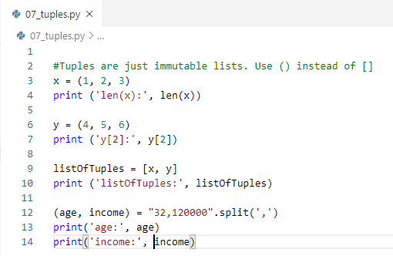

8.7 Tuple
https://github.com/peterhchen/900_Python_ML_DS_DL
Lists: Python Anaconda Prompt
2020/9/24

Slide 11
8.8 Dictionary

Slide 12
8.8 Dictionary
https://github.com/peterhchen/900_Python_ML_DS_DL
Dictionary in other languages are known as a map or a hash table.
It is basically a lookup table where you store values associated with some unique set of key values.
Dictionary is expressed as curly bracket {}.
2020/9/24

Slide 13
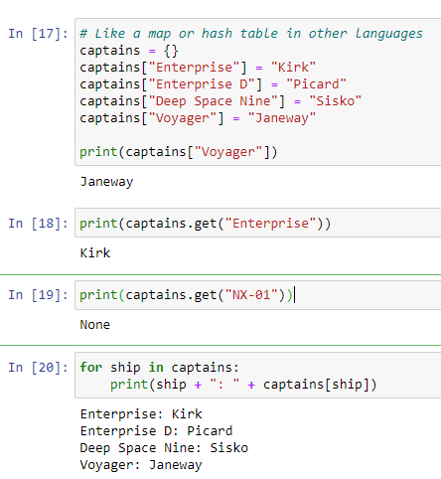
8.8 Dictionary
https://github.com/peterhchen/900_Python_ML_DS_DL
Dictionary:
Jupyter notebook:
The get() is used to retrieve the element, if the element is not existed, to avoid the exception and crash, we use get instead of index.
The get() will return “None” instead of exception.
To iterate a dictionary, we can use key in the dictionary objects. They use key to index the value of the dictionary.
2020/9/24

Slide 14
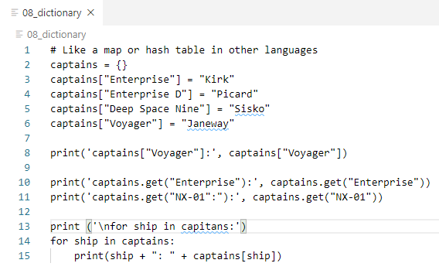
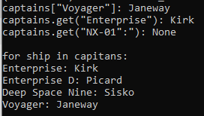
8.8 Dictionary
https://github.com/peterhchen/900_Python_ML_DS_DL
Lists: Python Anaconda Prompt
2020/9/24

Slide 15
8.9 Function

Slide 16
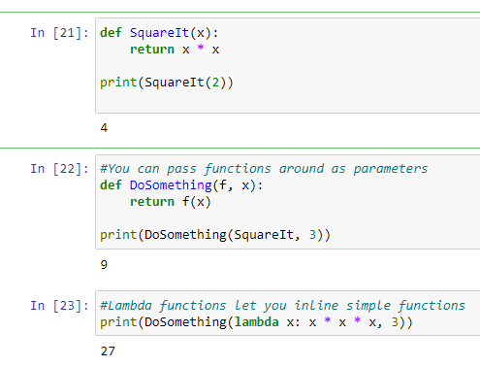
8.9 Function
https://github.com/peterhchen/900_Python_ML_DS_DL
Function: Jupyter Notebook
2020/9/24

Slide 17
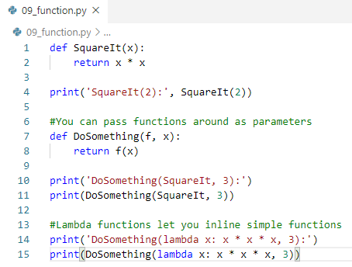

8.9 Function
https://github.com/peterhchen/900_Python_ML_DS_DL
Lists: Python Anaconda Prompt
2020/9/24

Slide 18
End of Chapter

