Slide 1

105 Deep Learning Ethics
Peter H. Chen

Slide 2
105 Deep Learning Ethics
https://github.com/peterhchen/930_Python_ML_DS_DL
Deep Learning Ethics
We discuss the ethics of Deep Learning.
Are we actually creating something that’s good for humanity or ultimately bad for humanity?

Slide 3
105.1 Types of Error

Slide 4

105.1 Types of Error
https://github.com/peterhchen/930_Python_ML_DS_DL
Type of Error
Accuracy does not tell you the whole story
Type 1: False Positive (nothing happened but predict Positive)
Unnecessary surgery
Slam on the brakes for no reason
Type 2: False Negative (Something happened but predict Negative)
Untreated conditions
You crash into the car in front of you
Think about the ramifications (branching) of different types of errors from your model, tune it accordingly.

Slide 5
105.1 Types of Error
https://github.com/peterhchen/930_Python_ML_DS_DL
Type of Error (Explanation)
The Deep Learning can be misused. The robot may take over the future world. If someone is devil may misuse the technology.

Slide 6
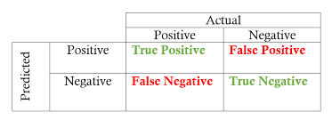
105.1 Types of Error
https://github.com/peterhchen/930_Python_ML_DS_DL
Type of Error (Explanation)
Anther kind of problem related to accuracy. There are different kinds of errors.
First, call a "type 1" error, which is a False Positive, that is Actually is Negative but Predict is Positive.
For example
False Positive (Actually nothing but predict something): You mis-interpreted a tumor that was measured by some breast biopsy. For a non-malignant cancer, the false positive (Actual is false, predict is positive) of a malignant cancerous result could result in real unnecessary surgery to somebody.

Slide 7
105.1 Types of Error
https://github.com/peterhchen/930_Python_ML_DS_DL
Type of Error (Explanation)
False Positive (Actually nothing but predict something) : A self-driving car see a shadow and predict a object. Your car press on the brakes for emergency stop. This is unnecessary stop.

Slide 8
105.1 Types of Error
https://github.com/peterhchen/930_Python_ML_DS_DL
Type of Error (Explanation)
The second type is a False Negative (Actually Positive but Predict is False Negative):
for example, you might have breast cancer (actually Positive), but fail to detect it, you may have misclassified it is being benign (False Negative). It may causes somebody dies if you get that wrong.
For self-driving car, you predict False Negative. You predict nothing, but actually something there, you did detect the car (cause not press the brake) and cause car accident.

Slide 9
105.1 Types of Error
https://github.com/peterhchen/930_Python_ML_DS_DL
Type of Error (Explanation)
So people are very eager to apply Deep Learning to different situations in the real world, but often the real world consequences of getting something wrong is a life and death matter quite literally.
You need to really think about how your system is being used and make sure that your superiors and the people who were actually rolling this out to the world understand the consequences of what happens when things go wrong and the real odds of things going wrong.
You can't oversell your systems.

Slide 10
105.2 Hidden Biases

Slide 11
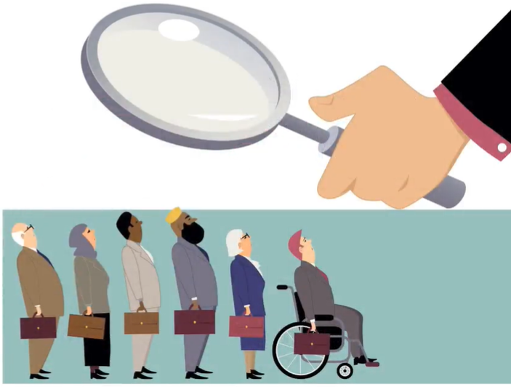
105.2 Hidden Biases
https://github.com/peterhchen/930_Python_ML_DS_DL
Hidden Biases
Just because your model is not human, it does mean it is inherently fair
For example, train a model on job applicants get hired, use it to screen resume
Past biases toward gender, age, race, will be reflected in your model, because it was reflected in the data you trained the model with.

Slide 12
105.2 Hidden Biases
https://github.com/peterhchen/930_Python_ML_DS_DL
Hidden Biases (Explanation)
There can also be hidden biases in your system.
So just because the artificial neural network you've built is not human, does not mean that it's inherently fair and unbiased.
Remember, your model is only as good as the data that you train it with.
For example, if you're going to build a neural network that can try to predict whether somebody gets hired or not just based on attributes of that person.
For example, if your data are biased in age, race, gender, you might end up with a system that is full of racist, ageist, or sexist, simply because the training data you provided was made by people who have these biases.
For example, if you're feeding in years of experience to the system that predicts whether or not somebody should get a job interview, you're going to have an implicit bias in there, right?
The years of experience will vary, definitely be correlated with the age of the applicant.

Slide 13
105.2 Hidden Biases
https://github.com/peterhchen/930_Python_ML_DS_DL
Hidden Biases (Explanation)
If your past training data had a bias toward, white men in their 20s who are fresh out of college, your system is going to penalize more experienced candidates who might in fact be better candidates who got passed over simply because they were viewed as being too old by human people.
So think deeply about whether the system you're developing has hidden biases and what you can do to at least be transparent about what those biases are.

Slide 14
105.3 Better than Human?

Slide 15

105.3 Better than Human?
https://github.com/peterhchen/930_Python_ML_DS_DL
Better than Human?
Do not oversell the capabilities of an algorithm in your excitement
For Example, medical diagnostic that are almost, but not quite, as good as human doctor
Another example: Self-driving cars that can kill people

Slide 16
105.3 Better than Human?
https://github.com/peterhchen/930_Python_ML_DS_DL
Better than Human (Explanation)
Another thing to consider is, is the system you just built really better than a human?
If you're building a Deep Learning system that the people in your sales department, or your management, or your investors really want to sell as something that can replace jobs and save people, or save company’s money rather, you need to think about whether the system you're selling really is as good as a human and if it's not, what are the consequences of that.
For example, you can build Deep Learning systems that perform medical diagnoses and you might have a very eager sales rep who wants to sell that as being better than a human doctor, Is it really? What happens when your system goes wrong? Do people die? That will be bad!
You'll be better to be insistent with your superiors that this system is only marketed as an supplementary tool to aid doctors in making a decision and not as a replacement for human beings making a decision that can affect life or death.

Slide 17
105.3 Better than Human?
https://github.com/peterhchen/930_Python_ML_DS_DL
Better than Human (Explanation)
A self-driving car is another example where if you get it wrong, if your self-driving car isn't actually better than a human being and someone puts your car on autopilot, it can actually kill people. We see this happening already.

Slide 18
105.4 Research Issues

Slide 19
105.4 Research Issues
https://github.com/peterhchen/930_Python_ML_DS_DL
Some Research Issues
Also think about some issues of your research.
For example, we develop military flight simulator and training simulator, its idea was to simulate combat a virtual reality environment in order to train our soldiers to better preserve their own lives and come out of the battlefield safely.
After a few years, the same technology is used in a command and control system, it was being used to help commanders actually visualize how to actually roll out real troops and actually kill real people.
Another example, Facebook's targeting algorithms on Social Media may be used for political reason to control the human right.

Slide 20
105.5 Summary

Slide 21
105.5 Summary
https://github.com/peterhchen/930_Python_ML_DS_DL
Summary
Type of Errors:
1. False Positive may cause unnecessary action.
2. False negative may kill people.
Hidden Biases: Training data contain the Bias data will cause bias result
Human is better than Machine
Research Problem: May cause problem in future.

Slide 22
End of Chapter

