Slide 1

29 Supervised vs. Unsupervised
Peter H. Chen

Slide 2
29 Supervised vs. Unsupervised
https://www.udemy.com/course/data-science-and-machine-learning-with-python-hands-on/learn/lecture/4020552#overview
Supervised vs. Unsupervised Learning and Train/Test
The fundamental concept of machine learning is called train/test.
We evaluate how good of the model is.

Slide 3
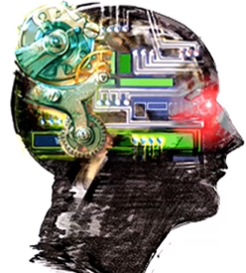
29 Supervised vs. Unsupervised
https://www.udemy.com/course/data-science-and-machine-learning-with-python-hands-on/learn/lecture/4020552#overview
Supervised vs. Unsupervised Learning and the concept of Train/Test
What is machine learning?
Algorithms that can learn from observation data, and can make predictions based on it.
That is pretty much what your own brain does too.
The concept is pretty simple and we human being already done this, right?
If we look at regression, we look a set of observation data, we fit a line to the data, and then we can use the line to make prediction.
By definition, it is machine learning. It is pretty simple.
The brain works that way too. It is time to look are there any insight in these algorithms and look into how your brain actually works.
Is there a really simple thing going on inside your brain? But the brain theory is the topic of different course.

Slide 4
29.1 Unsupervised Learning

Slide 5
29.1 Unsupervised Learning
https://www.udemy.com/course/data-science-and-machine-learning-with-python-hands-on/learn/lecture/4020552#overview
Unsupervised Learning
The basic definition of unsupervised learning is that your are not given your model any “answers” to learn from.
You are just presenting it with a group of data and try to make sense out of it. Given no additional information.

Slide 6
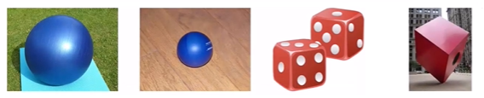
29.1 Unsupervised Learning
https://www.udemy.com/course/data-science-and-machine-learning-with-python-hands-on/learn/lecture/4020552#overview
Unsupervised Learning
For Example, we have a bunch of different objects, balls, cubes, sets of dice, and etc. We have some algorithms that will cluster these objects into categories based on some similarity metric.
We do not know ahead of time what category of certain objects belong to and we do not have a cheat-sheet to learn from.
We only have a set of existing objects and the categorization is based on them.
We have to those categories by its own.
That is an example of unsupervised learning.
We gather the answer and group them based on the data presented and similarity between the data.

Slide 7
29.1 Unsupervised Learning
https://www.udemy.com/course/data-science-and-machine-learning-with-python-hands-on/learn/lecture/4020552#overview
Unsupervised Learning
Unsupervised learning seems awful! Why use it?
You do not know what you are looking for: It is a powerful tool for discovering classification that we do not even know we were there. We called that is a latent variables. So some property of the data that we did not even know was there originally, but unsupervised learning can tear out for you.
For example, we are clustering people instead of balls, dice and etc.
We are running a dating site and we want to see what sorts of people tend to cluster together.
Are there some attributes that people tend to cluster around that they tend to like each other and data each other?
You may find that the clusters that immerge do not conform to your predisposed stereotypes. The people are not the college students, middle-aged people, or people who are divorced, and etc.

Slide 8
29.1 Unsupervised Learning
https://www.udemy.com/course/data-science-and-machine-learning-with-python-hands-on/learn/lecture/4020552#overview
Unsupervised Learning
If you look at the people that emerge from that analysis, you find out something new about your users and actually figure out that there is something more important than any of those existing features.
That is the example of unsupervised learning.
If we want to cluster a movie, like IMDB or etc. You maybe get surprise, not just the genre of the movies.
The unsupervised learning tear out the latent and surprised information.

Slide 9
29.2 Supervised Learning

Slide 10
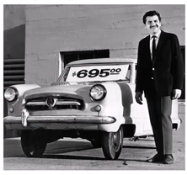
29.2 Supervised Learning
https://www.udemy.com/course/data-science-and-machine-learning-with-python-hands-on/learn/lecture/4020552#overview
Supervised Learning
In supervised learning, the data algorithm “learns” from come with the “correct” answers.
The model created is then used to predict the answer for now, unknown values.
For example, you can train a model for predicting car prices based on car attributes using historical sales data. That model can then predict the optimal price for new cars that have not been sold before.

Slide 11
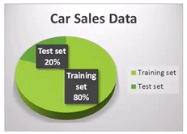
29.2 Supervised Learning
https://www.udemy.com/course/data-science-and-machine-learning-with-python-hands-on/learn/lecture/4020552#overview
How Do You Evaluate Supervised Learning?
If you have a set of training data that includes the value you are trying to predict. You do not have to guess if the resulting model is good or not.
If you have enough training data, you can split it into two parts: a training set and a test set.
You then train the model using only the training set.
And then measure (using r-squared or some other metric) the model’s accuracy by asking it to predict values for the test set, and compare that to the known, true values.

Slide 12
29.3 Train/Test in Practice

Slide 13
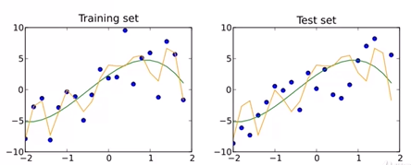
29.3 Train/Test in Practice
https://www.udemy.com/course/data-science-and-machine-learning-with-python-hands-on/learn/lecture/4020552#overview
Train/Test is not Good enough due to:
Maybe your sample size are too small
Or due to random chance, you train and test sets are too similar (the data are not good enough for model) and cause error prediction.
Overfitting can still happen

Slide 14
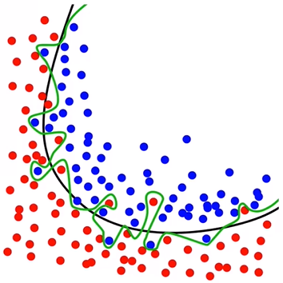
29.3 Train/Test in Practice
https://www.udemy.com/course/data-science-and-machine-learning-with-python-hands-on/learn/lecture/4020552#overview
Train/Test in Practice
Need to ensure both sets ae large enough to contain representatives of all the variations and outliers in the data you care about
The data sets must selected randomly
Train/Test us a great way to guard against overfitting.
If your model is overfitting and going out of its way to accept outliers in your training data.
All the errors prediction of outliers in the test data set will come out.

Slide 15
29.4 K-Fold Cross Validation

Slide 16
29.4 K-Fold Cross Validation
https://www.udemy.com/course/data-science-and-machine-learning-with-python-hands-on/learn/lecture/4020552#overview
K-Fold Cross Validation
One way to further protect against overfitting is K-Fold Cross Validation.
Looks complicated, but it is a simple idea:
Split your data into K randomly-assigned segments.
Reserve one segment as your test data
Train on each of the remaining K-1 segments and measure their performance against the test set
Take the average of K-1 r-squared scores
Then pick up the best model from K-1 segments.

Slide 17
29.5 Summary

Slide 18
29.5 Summary
https://www.udemy.com/course/data-science-and-machine-learning-with-python-hands-on/learn/lecture/4020552#overview
Summary
We discussed
What is Unsupervised Learning
What is Supervised Learning
What is Train/Set
What is K-Fold Cross Validation

Slide 19
End of Chapter

