Slide 1
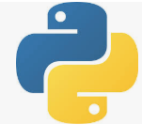
75 Spark RDD
Peter H. Chen

Slide 2
75 Spark RDD
https://github.com/peterhchen/900_Python_ML_DS_DL
Spark RDD (Resilient Distributed Dataset)
We discussed the RDDs (Resilient Distributed Data Store).
RDDs is the core that you use in Spark Programming.

Slide 3
75.1 Resilient Distributed Dataset

Slide 4
75.1 Resilient Distributed Dataset
https://github.com/peterhchen/900_Python_ML_DS_DL
Resilient Distributed Dataset
Resilient
Distributed
Dataset

Slide 5
75.1 Resilient Distributed Dataset
https://github.com/peterhchen/900_Python_ML_DS_DL
Resilient Distributed Dataset Explanation
The most fundamental piece of Spark is called the RDDs (Resilient distributed dataset). Resilient means flexible.
The RDDs is used to load, transform, and get the answers in Spark.
RDDs is very important to know. RDDs are rows of information.
The key is the R (Resilient) and the first D (Distributed).
It is Resilient (Flexible) in that Spark makes sure that if you are running RDDs on a cluster, and one of those clusters goes down, it can automatically recover from that and retry for other clusters.
If you do not have enough resources available to run the job, resilient will still fail. You will have to add more resources in order to run the job.
There is a limit to how many times resilient will retry for a given task.
Resilient makes its best effort for try for an unstable cluster or an unstable network, continue to try its best to run through to completion.
Resilient is distributed

Slide 6
75.1 Resilient Distributed Dataset
https://github.com/peterhchen/900_Python_ML_DS_DL
Resilient Distributed Dataset Explanation
The Spark is for big data problems where you distribute the processing across the entire CPU and memory power of a cluster of computers.
Spark distributed jobs horizontally. You can throw as many computers as you want to a given problem.
The larger the problem, the more computers. There is no upper bound.

Slide 7
75.2 SparkContext

Slide 8
75.2 SparkContext
https://github.com/peterhchen/900_Python_ML_DS_DL
SparkContext
SparkContext is create by your driver program
SparkContext is responsible for making RDD’s resilient and distributed.
SparkContext creates RDDs.
The Spark shell creates a “sc” object for you

Slide 9
75.2 SparkContext
https://github.com/peterhchen/900_Python_ML_DS_DL
SparkContext Explanation
You always start your Spark scripts by getting a SparkContext object, and this is the object that inside the Spark.
SparkContext give you your RDDs to process.
SparkContext running jobs for you under the hood.
If you are running in the Spark shell interactively, Spark shell has an sc object already available for you.
You can use SparkContext to create RDDs.
In a standalone script, you will have to create that SparkContext explicitly, and you'll have to pay attention to the parameters that you use, because you can tell the SparkContext how you want that to be distributed.
Should I take advantage of every core that I have available to me? Should I be running on cluster or just standalone on my local computer?
That's where you set up the fundamental settings of how Spark will operate.
Let's look at some little code snippets
of actually creating RDDs, and I think it'll make
a little bit more sense.
Here's a very simple example.
If I just want to make an RDD out of a plain old Python list,
I can call the parallelize function in Spark,
and that will convert a list of stuff,
in this case just numbers, one, two, three, four,
into an RDD object called nums.
That is the simplest case of creating an RDD
just from a hard coded list of stuff,
and that list could come from anywhere.
It doesn't have to be hard coded either,
but that kind of defeats the purpose of big data, right?
If I have to load the entire dataset into memory
before I can create an RDD from it, what's the point?
I can also load an RDD from a text file,
and that could be anywhere.
In this example, maybe I have some giant text file,
that's the entire Encyclopaedia or something,
and I'm reading that from my local disc in this example,
but that will actually convert every line of that text file
into its own row in an RDD.
You can think of the RDD as a database of rows,
and, in that example, they will load up my text file
into an RDD where every row contains one line of text,
and I can then do further processing in that RDD
to parse or break out the delimiters in that data,
but that's where I start from.
Remember when we talked about etl and and elt.
This is a good example of where you might actually be
loading raw data into a system and doing the transform
on the system itself that you use to query your data.
You can take raw text files that haven't been processed
at all and use the power of Spark
to actually transform those into more structured data.
It can also talk to things like Hive.
If you have an existing Hive database set up
at your company, you can create a HiveContext
that's based on your SparkContext, and how cool is this?
You can actually create an RDD, in this cased called rows,
that's generated by actually executing a SQL query
on your Hive database.
That's an example of also creating an RDD,
and there are more ways to create RDDs as well.
You can create them from JDBC connexions,
so basically any database that supports JDBC
can also talk to Spark and have RDDs created from it.
Cassandra, Hbase, Elastisearch.
Also files in JSON format, CSV format, sequence files,
object files, and a bunch of other compressed files
like ORC or what have you.
I don't want to get into the details of all those.
You can go get a book and look those up if you need to,
but the point is it's very easy to create an RDD
from data wherever it might be,
whether it's on a local file system
or distributed data store.
Just to call attention to that again,
up here I'm loading from a local file
using the File url system, but I could also use S3n
if I wanted to host this file on a distributed
Amazon S3 bucket or HDFS if I want to refer to data
that's stored on a distributed HDFS cluster.
That stands for Hadoop distributed file system
if you're not familiar with HDFS.
When you're dealing with big data,
and you're working with a Hadoop cluster,
usually that's where your data will live.
Again, RDD, just a way of loading and maintaining
very large amounts of data and keeping track of it
all at once, but, conceptually within your script,
an RDD is just an object that contains a bunch of data,
and you don't have to think about the scale,
'cause Spark does that for you.
Now, there are two different types of classes
of things you can do on RDDs once you have them.
You can do transforms, and you can do actions.
Let's talk about transformations first.
Transformations are exactly what it sounds like.
It's a way of taking an RDD and transforming every row
in that RDD to some new value based on
some function you provide.
Map and flatmap are the ones you'll see the most often.
Both of these will take any function that you can dream up
that will take as input a row of an RDD,
and it will output a transformed row.
For example, you might take raw input from some CSV file,
and your map operation might take that input
and break it up into individual fields
based on the comma delimiter and return back a Python list,
for example, that has that data in a more structured format
that you can perform further processing on,
and you can chain map operations together.
The output of one map might end up creating a new RDD
that you then do another transformation on
and so on and so forth, and, again, the key is
Spark can distribute those transformations across a cluster.
It might take part of your RDD and transform it
on one machine and another part of your RDD
and transform it on another.
Now, like I said, map and flatmap are
the most common transformations you'll see.
The only difference is that, they differ in that,
map will only allow you to output one value
for every row whereas flatmap will let you actually output
multiple new rows for a given row.
You can actually create a larger RDD or a smaller RDD
than you started with using flatmap.
Also, filter can be used if what you want to do is just create
a Boolean function that says,
"Should this row be preserved or not? Yes or no,"
and there are some less commonly-used transformations
as well, like distinct which will only return back
distinct values within your RDD.
Sample lets you take a random sample from it,
and then you can perform intersection operations
like union, intersection, subtract,
or you can produce every cartesian combination
that exists within an RDD.
Here's a little example of how it might work.
Let's say I created an RDD just from the list
one, two, three, four.
I can call then rdd.map with a lambda function of x
that takes in each row, each value of that RDD,
calls it x, and then it applies the function
x times x to square it.
The output of this, if I were to then collect the output
of this RDD, would be one, four, nine, and six,
because it would take each individual entry
of that RDD and square it and put that into a new RDD.
Okay, make sense?
Now, if you don't remember what lambda functions are,
we did talk about it a little bit earlier in this course,
but, as a refresher, the lambda function is just
a shorthand for defining a function in lines.
Lambda x: x*x is exactly the same thing as defining
a separate function that we named called squareit
that returns x times x, then saying rdd.map ,
so it's just a shorthand for very simple functions
that you want to pass in as a transformation.
It eliminates the need to actually declare this
as a separate named function of its own,
and that's the whole idea of functional programming,
so you can say you understand functional programming now,
by the way, but, really, it's just shorthand notation
for defining a function in line as part of the parameters
to a map function, or any transformation for that matter.
You can also perform actions on RDDs.
When you want to actually get a result, you can call collect
on an RDD, and that will give you back
a plain old Python object that you can then iterate through
and print out the results or save 'em to a file,
or whatever you want to do.
You can also call count, which will force it to actually
go count how many entries are in the RDD at this point.
CountByValue will give you a breakdown of how many times
each unique value within that RDD occurs,
and you can also sample from the RDD using take,
which will take some random number of entries from the RDD
or top, which will give you the first few entries
in that RDD if you want to just get a little peek into
what's in there for debugging purposes.
The more powerful action is reduce,
and that will actually let you combine values together
for a same common key value.
You can also use RDDs in the context of key value data,
and the reduce function lets you define a way
of combining together all of the values for a given key,
so very much similar in spirit to mapreduce.
Using reduce reduces, basically, the analogous operation
to a reducer in mapreduce, and map is analogous to mapper.
It's often very straightforward to actually take
a mapreduce job and convert it to Spark
by using these functions.
Remember, too, that nothing actually happens in Spark
until you call an action.
Once you call one of those action methods,
that's when Spark goes out and does its magic
with directed acyclic graphs and actually computes
to optimal way to get the answer you want,
but, remember, nothing really occurs
until that action happens.
That can sometimes trip you up when you're writing
Spark scripts, because you might have
a little print statement in there, and you might expect
to get an answer there, but it doesn't actually appear
until the action is actually performed.
Let's talk a little bit more about MLlib next
and to get into more details
about how this works conceptually.
That is Spark 101 in a nutshell.
Those are the basics you need for Spark programming,
basically, what is an RDD, and what are the things
you can do to an RDD, and, once you get those concepts,
then you can write some Spark code.
Up next, we'll talk about MLlib and some specific features
in Spark that let you do
machine learning algorithms using Spark.

Slide 10
75.3 Create RDDs

Slide 11
75.3 Create RDD
https://github.com/peterhchen/900_Python_ML_DS_DL
Create RDD
Some example of creating RDDs. We call parallelize() function in Spark.
The list of numbers [1, 2, 3, 4] can be a Datasets in Big Data.
> nums = parallelize ([1, 2, 3, 4])
I can also load the RDD from text file:
> sc.textFile (“file:///C:/users/peter/gobs-otxt.txt”)
> Or (s3n://…, hdfs://…)
> hiveCtx = HiveContext(sc)
> rows = hiveCtx.sql (“SELECT name , age FROM users”)
Can also create form:
JDBC
Cassandra
HBase
Elasticsearch
JSON, CSV, sequence files, object files, various compressed formats

Slide 12
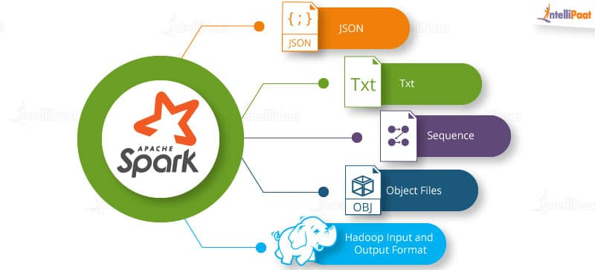
75.3 Create RDDs
https://github.com/peterhchen/900_Python_ML_DS_DL
Create RDDs Explanation
I can call the parallelize function in Spark, and that will convert a list of numbers: [1, 2, 3, 4] into an RDD object called nums.
The list [1, 2, 3, 4] could come from a Dataset of Big Data.
If I have to load the entire dataset into memory before I can create an RDD from big Dataset.
I can also load an RDD from a text file, and that could be anywhere (any Dataset).
In this example, I'm reading that from my local disc.

Slide 13
75.3 Create RDDs
https://github.com/peterhchen/900_Python_ML_DS_DL
Create RDDs Explanation
This sc.textFile () converts every line of that text file into its own row into an RDDs.
You can think of the RDD as a database of rows.
In that example, they load my text file into an RDD where every row contains one line of text.
Remember when ELT (Extract, Load, Transform) and ETL (Extract, Transform, Load).

Slide 14
75.3 Create RDDs
https://github.com/peterhchen/900_Python_ML_DS_DL
Create RDDs Explanation
This is a good example of loading raw data into a system and doing the transform on the system by query your data.
Spark sc.textFile() takes raw text files. The hiveContext(sc) and hiveCtx.sql() transform into more structured data into Hive Database if you have an existing Hive database set up at your company.
You can create a HiveContext that is based on your SparkContext.
You can actually create an RDD, in this cased called rows, that's generated by actually executing a SQL query on your Hive database.
This an example of also creating an RDD from text file format.

Slide 15
75.3 Create RDDs
https://github.com/peterhchen/900_Python_ML_DS_DL
Create RDDs Explanation
You also can create RDDs from JDBC connections, Cassandra, HBase, Elasticsearch.
You also can read files in JSON format, CSV format, sequence files, object files, and a bunch of other compressed files, and etc.
The point is very easy to create RDD from various sources, such as, local file or distributed data store, URL file systems.
If I wanted to host this file on a s3n (distributed Amazon S3 bucket) or HDFS if I want to refer to data that is stored on a distributed HDFS (Hadoop Distributed File System) cluster.

Slide 16
75.3 Create RDDs
https://github.com/peterhchen/900_Python_ML_DS_DL
Create RDDs Explanation
What is HDFS?
When you are dealing with big data and you are working with a Hadoop cluster, HDFS are usually your data will live.
RDDs is just a way of loading and maintaining very large amounts of data and keeping track in your script.
An RDD is an object that contains a bunch of data, and you do not have to think about the scale/size, because Spark does that for you.

Slide 17
75.3 Create RDDs
https://github.com/peterhchen/900_Python_ML_DS_DL
Create RDDs Explanation
Now, there are two different types of classes of things you can do on RDDs once you have them.
You can do transforms, and you can do actions.
Let's talk about transformations first.
Transformations are exactly what it sounds like.
It's a way of taking an RDD and transforming every row in that RDD to some new value based on some function you provide.
Map and flatmap are the ones you'll see the most often.
Both of these will take any function that you can dream up
that will take as input a row of an RDD,
and it will output a transformed row.
For example, you might take raw input from some CSV file,
and your map operation might take that input
and break it up into individual fields
based on the comma delimiter and return back a Python list,
for example, that has that data in a more structured format
that you can perform further processing on,
and you can chain map operations together.
The output of one map might end up creating a new RDD
that you then do another transformation on
and so on and so forth, and, again, the key is
Spark can distribute those transformations across a cluster.
It might take part of your RDD and transform it
on one machine and another part of your RDD
and transform it on another.
Now, like I said, map and flatmap are
the most common transformations you'll see.
The only difference is that, they differ in that,
map will only allow you to output one value
for every row whereas flatmap will let you actually output
multiple new rows for a given row.
You can actually create a larger RDD or a smaller RDD
than you started with using flatmap.
Also, filter can be used if what you want to do is just create
a Boolean function that says,
"Should this row be preserved or not? Yes or no,"
and there are some less commonly-used transformations
as well, like distinct which will only return back
distinct values within your RDD.
Sample lets you take a random sample from it,
and then you can perform intersection operations
like union, intersection, subtract,
or you can produce every cartesian combination
that exists within an RDD.
Here's a little example of how it might work.
Let's say I created an RDD just from the list
one, two, three, four.
I can call then rdd.map with a lambda function of x
that takes in each row, each value of that RDD,
calls it x, and then it applies the function
x times x to square it.
The output of this, if I were to then collect the output
of this RDD, would be one, four, nine, and six,
because it would take each individual entry
of that RDD and square it and put that into a new RDD.
Okay, make sense?
Now, if you don't remember what lambda functions are,
we did talk about it a little bit earlier in this course,
but, as a refresher, the lambda function is just
a shorthand for defining a function in lines.
Lambda x: x*x is exactly the same thing as defining
a separate function that we named called squareit
that returns x times x, then saying rdd.map ,
so it's just a shorthand for very simple functions
that you want to pass in as a transformation.
It eliminates the need to actually declare this
as a separate named function of its own,
and that's the whole idea of functional programming,
so you can say you understand functional programming now,
by the way, but, really, it's just shorthand notation
for defining a function in line as part of the parameters
to a map function, or any transformation for that matter.
You can also perform actions on RDDs.
When you want to actually get a result, you can call collect
on an RDD, and that will give you back
a plain old Python object that you can then iterate through
and print out the results or save 'em to a file,
or whatever you want to do.
You can also call count, which will force it to actually
go count how many entries are in the RDD at this point.
CountByValue will give you a breakdown of how many times
each unique value within that RDD occurs,
and you can also sample from the RDD using take,
which will take some random number of entries from the RDD
or top, which will give you the first few entries
in that RDD if you want to just get a little peek into
what's in there for debugging purposes.
The more powerful action is reduce,
and that will actually let you combine values together
for a same common key value.
You can also use RDDs in the context of key value data,
and the reduce function lets you define a way
of combining together all of the values for a given key,
so very much similar in spirit to mapreduce.
Using reduce reduces, basically, the analogous operation
to a reducer in mapreduce, and map is analogous to mapper.
It's often very straightforward to actually take
a mapreduce job and convert it to Spark
by using these functions.
Remember, too, that nothing actually happens in Spark
until you call an action.
Once you call one of those action methods,
that's when Spark goes out and does its magic
with directed acyclic graphs and actually computes
to optimal way to get the answer you want,
but, remember, nothing really occurs
until that action happens.
That can sometimes trip you up when you're writing
Spark scripts, because you might have
a little print statement in there, and you might expect
to get an answer there, but it doesn't actually appear
until the action is actually performed.
Let's talk a little bit more about MLlib next
and to get into more details
about how this works conceptually.
That is Spark 101 in a nutshell.
Those are the basics you need for Spark programming,
basically, what is an RDD, and what are the things
you can do to an RDD, and, once you get those concepts,
then you can write some Spark code.
Up next, we'll talk about MLlib and some specific features
in Spark that let you do
machine learning algorithms using Spark.

Slide 18
75.4 Transform into RDDs

Slide 19
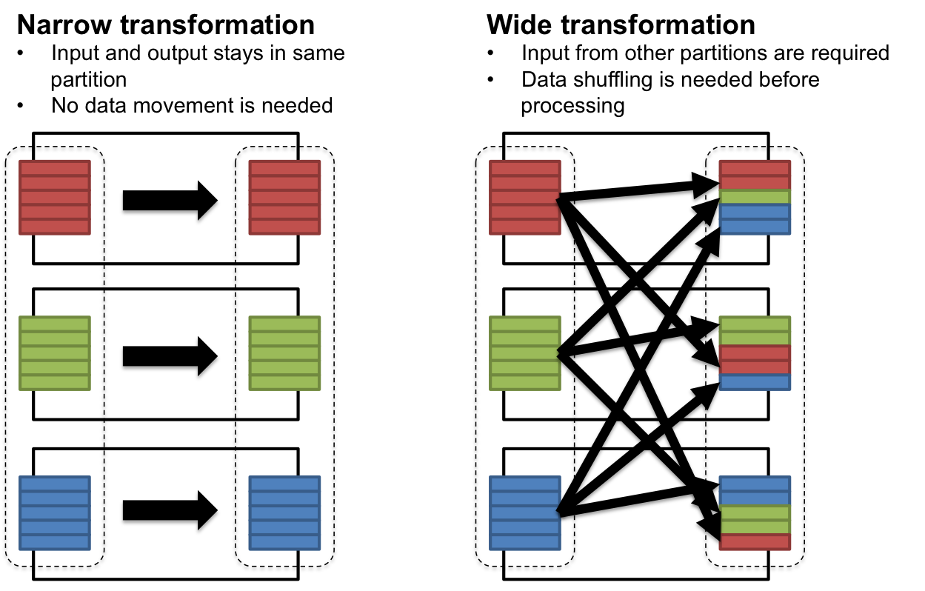
75.4 Transform into RDDs
https://github.com/peterhchen/900_Python_ML_DS_DL
Transform into RDDs
map
flatmap
milter
distinct
sample
union, intersection, subtract, cartesian

Slide 20
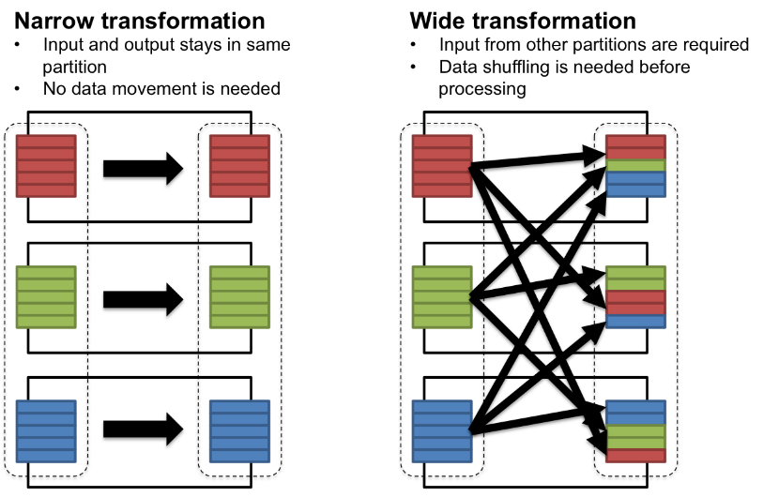
75.4 Transform into RDDs
https://github.com/peterhchen/900_Python_ML_DS_DL
Transform into RDDs Explanation
Now, there are two different types of classes you can do on RDDs once you have dataset. You can do transforms or you can do actions.
Let's talk about transformations first. Transformations are exactly what it sounds like. It's a way of taking an RDD and transforming every row in that RDD to some new value based on some function you provide.

Slide 21
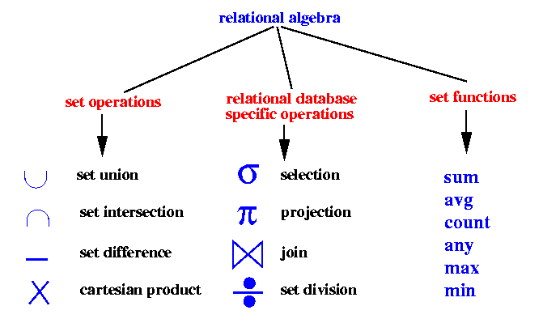
75.4 Transform into RDDs
https://github.com/peterhchen/900_Python_ML_DS_DL
Transform into RDDs Explanation
The dataset may be part of your RDD. Spark transforms dataset on one machine and another part of your RDD and transform it on another.
The map and flatmap are the most common transformations you'll see.
The only difference between map and flatmap: map will only allow you to output one value for every row; whereas, flatmap will let you actually output multiple new rows for a given row.
You can actually create a larger RDD or a smaller RDD when using flatmap.

Slide 22
75.4 Transform into RDDs
https://github.com/peterhchen/900_Python_ML_DS_DL
Transform into RDDs Explanation
The only difference between map and flatmap: map will only allow you to output one value for every row; whereas, flatmap will let you actually output multiple new rows for a given row.
You can actually create a larger RDD or a smaller RDD when using flatmap.
The filter can be used as a Boolean function for selection a row, "Should this row be preserved or not? Yes or no“.

Slide 23
75.4 Transform into RDDs
https://github.com/peterhchen/900_Python_ML_DS_DL
Transform into RDDs Explanation
There are some less commonly-used transformations, such as, distinct which will only return back distinct values within your RDD.
The sample lets you take a random sample from it.
You can perform intersection operations, such as, union, intersection, subtract, or cartesian combination in an RDD.

Slide 24
75.5 Map() Example

Slide 25
75.5 Map() Example
https://github.com/peterhchen/900_Python_ML_DS_DL
Map() Example
> rdd = sc.parallelize ([1, 2, 3, 4])
> rdd.map (lambda x: x * x)
This yields 1, 4, 9, 16

Slide 26
75.5 Map() Example
https://github.com/peterhchen/900_Python_ML_DS_DL
Map() Example Explanation
Here's a little example of how it might work.
Let's say I created an RDD just from the list one, two, three, four.
I can call then rdd.map with a lambda function of x that takes in each row, each value of that RDD, calls it x, and then it applies the function x times x to square it.
The output of this, if I were to then collect the output of this RDD, would be one, four, nine, and six, because it would take each individual entry of that RDD and square it and put that into a new RDD.

Slide 27
75.6 What is Lambda?

Slide 28
75.6 What is Lambda?
https://github.com/peterhchen/900_Python_ML_DS_DL
What is Lambda?
Many RDD methods accept a function as a parameter
> rdd.map (lambda x: x * x)
Is the same as
> def squareIt (x):
> return x * x
> rdd.map (squareIt)
The lambda function or pass in function/component into a function is HOC (Higher Order Component/Function) is functional programming paradigm.
Now, you understand functional programming.

Slide 29
75.6 What is Lambda?
https://github.com/peterhchen/900_Python_ML_DS_DL
What is Lambda? Explanation
The lambda function is just a shorthand for defining a function in lines.
Lambda x: x*x is exactly the same thing as defining a separate function that we named called squareIt that returns x times x, then saying rdd.map. It is a shorthand for very simple functions that you want to pass in as a transformation.
It eliminates the need to actually declare this as a separate named function of its own, and that's the whole idea of functional programming.
You understand functional programming now. It is just shorthand notation for defining a function in line as part of the parameters to a map function, or any transformation for that matter.

Slide 30
75.7 RDD Actions

Slide 31
75.7 RDD Actions
https://github.com/peterhchen/900_Python_ML_DS_DL
RDD Actions
collect
count
countByValue
take
top
reduce
… and more …

Slide 32
75.7 RDD Action
https://github.com/peterhchen/900_Python_ML_DS_DL
RDD Action Explanation
You can also perform actions on RDDs.
When you want to actually get a result, you can call collect on an RDD, and that will give you back a plain old Python object that you can then iterate through and print out the results or save them to a file, or whatever you want to do.
You can also call count, which will force it to actually go count how many entries are in the RDD at this point.
CountByValue will give you a breakdown of how many times each unique value within that RDD occurs
You can also sample from the RDD using take, which will take some random number of entries from the RDD or top, which will give you the first few entries in that RDD if you want to just get a little peek into what's in there for debugging purposes.
The more powerful action is reduce, reduce combines values together for a same common key value.

Slide 33
75.7 RDD Action
https://github.com/peterhchen/900_Python_ML_DS_DL
RDD Action Explanation
You can also use RDDs in the context of key value data, and the reduce function lets you define a way of combining together all of the values for a given key, so very much similar to mapReduce.
The reduce is similar to operation to a reducer in mapReduce.
The map is similar to mapper in mapReduce.
It is often very straightforward to actually take a mapReduce job and convert it to Spark by using these functions.

Slide 34
75.8 Lazy Evaluation

Slide 35
75.8 Lazy Evaluation
https://github.com/peterhchen/900_Python_ML_DS_DL
Lazy Evaluation
Remember, too, that nothing actually happens in Spark until you call an action.
Once you call one of those action methods, that's when Spark goes out and does its magic with directed acyclic graphs and actually computes to optimal way to get the answer you want, but, remember, nothing really occurs until that action happens.
That can sometimes trip you up when you're writing Spark scripts, because you might have a little print statement in there, and you might expect to get an answer there, but it doesn't actually appear until the action is actually performed.

Slide 36
75.9 MLLib

Slide 37
75.9 MLLib
https://github.com/peterhchen/900_Python_ML_DS_DL
MLLib
Let's talk a little bit more about MLlib next and to get into more details about how this works conceptually.
That is Spark in a nutshell.
Those are the basics you need for Spark programming, basically, what is an RDD, and what are the things.
You can do to an RDD, and, once you get those concepts, then you can write some Spark code.
Next, We will discuss about MLLib programming in Spark.

Slide 38
End of Chapter

