Slide 1

84 T-Test and P-Value
Peter H. Chen

Slide 2
84 T-Test and P-Value
https://github.com/peterhchen/900_Python_ML_DS_DL
T-Test and P-Value
How do I know if a change, resulting from an AB test is real?
If it is actually a real result of what I changed or it is just a random variation?
Well, there are a couple of statistical tools at called the T-Statistic and the P-Value.
Let's learn more about what those are and how they can help you determine whether an experiment is good or not.
As I said in our previous lecture, variance is your enemy when you're running an A/B test, so how do we account for that?

Slide 3
84 T-Test and P-Value
https://github.com/peterhchen/900_Python_ML_DS_DL
T-Tests and P-Values (Explanation)
There are some statistical tools at our disposal called the T-Test, the T-Statistic, more specifically, and the P-Value which allow us to quantify the effective variance on our results and make a decision that takes that variance into account.

Slide 4
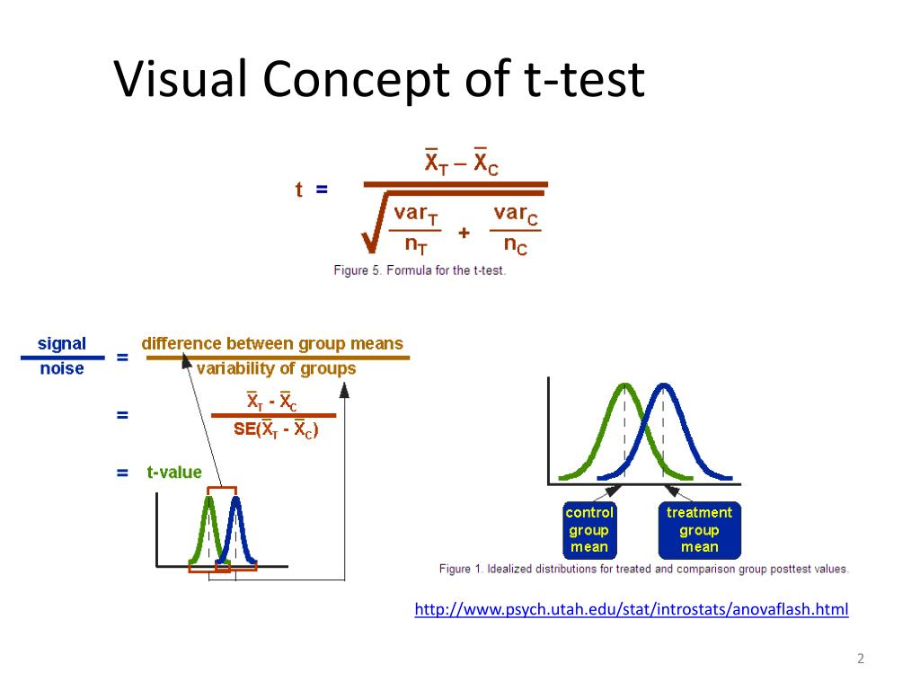
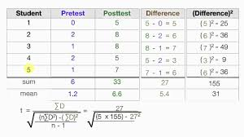
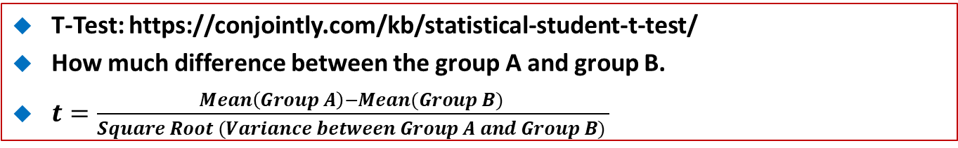
84 T-Test and P-Value
https://github.com/peterhchen/900_Python_ML_DS_DL
T-Test: https://conjointly.com/kb/statistical-student-t-test/
How much difference between the group A and group B.
$t=\frac{Mean\left(Group A\right)−Mean(Group B) }{Square Root (Variance between Group A and Group B) }$
4

Slide 5
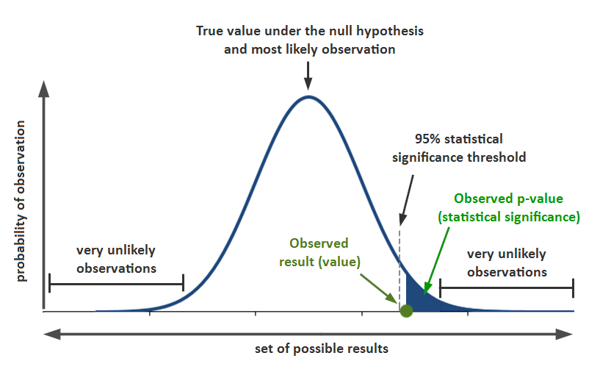
84 T-Test and P-Value
https://github.com/peterhchen/900_Python_ML_DS_DL
P-Value based on t-test:
https://en.wikipedia.org/wiki/P-value
How likely (probability/good) to pick up B over A. The higher score, the better.
H: Null Hypothesis: Assume no relationship between two distribution.
Prob (T > t | H) for one-side (right tail) test.

Slide 6
84.1 Determine Significance

Slide 7
84.1 Determine Significance
https://github.com/peterhchen/900_Python_ML_DS_DL
Determine Significance
How do we know the result is likely to be “real” as opposed to or just random variation?
T-Tests and P-Values

Slide 8
84.1 Determine Significance
https://github.com/peterhchen/900_Python_ML_DS_DL
Determine Significance (Explanation)
The point is to figure out if a result is real or not.
Was this just a result of random variance that's inherent in the data itself or are we seeing an actual statistically significant change in behavior between our control group and our test group?
T-Tests and P-Values are a way to compute that and remember to, again, statistically significant doesn't really have a specific meaning.
At the end of the day it has to be a judgement call.
You have to pick some probability value that you're going to accept of a result being real or not, but there's always going to be a chance that it's still a result of random variation and you have to make sure your stakeholders understand that.

Slide 9
84.2 T-Statistics

Slide 10
84.2 T-Statistics
https://github.com/peterhchen/900_Python_ML_DS_DL
T-Statistics
A measure of the difference between the two sets expressed in units of standard error.
The size of the difference relative to the variance in the data
A high T value means there is probably a real difference between the two sets.
Assume a normal distribution of behavior
This is a good assumption if your are measuring revenue as conversion
See also: Fisher’s exact test (for clickthrough rates), E-test (for transaction per user), and chi-squared test (for product quantities purchased).

Slide 11
84.2 T-Statistics
https://github.com/peterhchen/900_Python_ML_DS_DL
T-Statistics (Explanation)
Let's start with the T-Statistic, also known as a T-Test.
It's basically a measure of the difference in behavior between these two sets, between your control and treatment group, expressed in units of standard error.
So it is based on standard error, which accounts for the variance inherent in the data itself, so by normalizing everything by that standard error, we get some measure of the change in behavior between these two groups, that takes that variance into account.
The way to interpret a T-Statistic is that a high T-Value means there's probably a real difference between these two sets. Of course, a low T-Value means not so much.
You have to decide, you know, what's a threshold that you're willing to accept and the sign of the T-Statistic will tell you if it's a positive or a negative change.
If you're comparing your control to your treatment group and you end up with a negative T-Statistic, that implies that this is a bad change, if that absolute value of that T-Statistic is large.

Slide 12
84.2 T-Statistics
https://github.com/peterhchen/900_Python_ML_DS_DL
T-Statistics (Explanation)
How large is large?
Well, that's debatable, but we'll look at some examples shortly.
Now this does assume that you have a normal distribution of behavior and when we're talking about things like that amount people spend on a website, that's usually a decent assumption.
There does tend to me a normal distribution of how much people spend.
However, there are more refined versions of T-Statistic that you might want to look at for other specific situations.
For example, there's something called Fisher's exact test when you're talking about clickthrough rates, the E-test, when you're talking about transactions per user, like how many web pages do they see, and the chi-squared test, which is often relevant for when you're looking at order quantities.
Sometimes you'll want to look at all of these statistics for a given experiment and choose the one that actually fits what you're trying to do the best.

Slide 13
84.3 P-Value

Slide 14
84.3 P-Value
https://github.com/peterhchen/900_Python_ML_DS_DL
P-Value
Think of it as the probability of A and B satisfying the “null hypothesis”
So, a low P-value implies significance.
It is the probability of an observation lying at an extreme T-value assuming the null hypothesis.

Slide 15
84.3 P-Value
https://github.com/peterhchen/900_Python_ML_DS_DL
P-Value (Explanation)
Now, it's a lot easier to talk about P-Values than T-Statistics because you don't have to think about how many standard deviations are we talking about and what does the actual value mean.
The P-Value is a little bit more easy for people to understand, which makes it a better tool for you to communicate the results of an experiment to the stakeholders in your business.
The P-Value is the probability that this experiment satisfies the null hypothesis, that is the probability that there is no real difference between the control and treatment's behavior.
A low P-Value means there's a low probability of it having no effect, kind of a double negative going on there, so it's a little bit counter-intuitive.
At the end of the day, you just have to understand that a low P-Value means that there's a high probability that your change had a real effect.

Slide 16
84.3 P-Value
https://github.com/peterhchen/900_Python_ML_DS_DL
P-Value (Explanation)
What you wan to see are a high T-Statistic and a low P-Value and that will imply a significant result.

Slide 17
84.4 Use P-Values

Slide 18
84.4 Use P-Values
https://github.com/peterhchen/900_Python_ML_DS_DL
Use P-Values
Choose some threshold for “Significance” before your experiment
1% ? 5%?
When your experiment is over:
Measure your P-Value
If it is less then your significance threshold, then you can reject the null hypothesis
If it is a positive change, roll it out
If it is a negative change, discard it before you lose more money

Slide 19
84.4 Use P-Values
https://github.com/peterhchen/900_Python_ML_DS_DL
Use P-Values (Explanation)
Before you start your experiment, you need to decide what your threshold for success is going to be.
Decide that with the people in charge of the business. What P-Value are you willing to accept as a measure of success?
Is it 1%? Is it 5%?
This is the likelihood that there is no real effect, that it's just a result of random variance.
It's just a judgement call at the end of the day.
A lot of times people use one percent, sometimes they use five percent, if they're feeling a little bit more risky, but there's always going to be that chance that your result was just various random data that came in, but you can choose the probability that you're willing to accept as being likely enough that this is a real effect that's worth rolling out into production.

Slide 20
84.4 Use P-Values
https://github.com/peterhchen/900_Python_ML_DS_DL
Use P-Values (Explanation)
When your experiment is over and we'll talk about when you declare an experiment to be over, you want to measure your P-Value.
If it's less than the threshold you decide upon, then you can reject the null hypothesis and you can say, well, there's a high likelihood that this change produced a real positive or negative result.
If it is a positive result, then you can roll that change out to the entire site and it is no longer an experiment, it is part of your website that will hopefully make you more and more money, as time goes on.
If it's a negative result, you want to get rid of it before it costs you any more money.
Remember, there's a real cost to running an AB test when your experiment has negative results, so you don't want to run it for too long because there's a chance you could be losing money.

Slide 21
84.4 Use P-Values
https://github.com/peterhchen/900_Python_ML_DS_DL
Use P-Values (Explanation)
This is why you want to monitor the results of an experiment on a daily basis, so if there are early indications that a change is making a horrible impact to the website, maybe there's a bug in it or something that's horrible, you can pull the plug on it prematurely if necessary and limit the damage.

Slide 22
84.5 T-Test and P-Value Example

Slide 23
84.5 T-Test and P-Value Example
https://github.com/peterhchen/900_Python_ML_DS_DL
T-Test and P-Value (Explanation only)
Let's go to an actual example and see how you might measure a T-Statistics and P-Values using Python, up next.
That's the T-Test, the T-Statistic, and the P-Value.
Useful tools for determining whether a result is actually real or a result of random variation.
Next let's dive into some real examples with Python code and compute these things.

Slide 24
84.6 Summary

Slide 25
84.6 Summary
https://github.com/peterhchen/900_Python_ML_DS_DL
Summary
High T-Statistic Value: High Variance. Two test are different. This is NOT a random variable.
High P-Value: New test are very consistent with old test.
We want high T-Value (Different Test, not random variable) and High P-Value (Bigger than threshold) for consistent data.

Slide 26
End of Chapter

