Slide 1

21 Covariance and Correlation
Peter H. Chen

Slide 2
21 Covariance and Correlation
https://www.udemy.com/course/data-science-and-machine-learning-with-python-hands-on/learn/lecture/4020118#overview
Covariance and Correlation
These are two way of measuring whether two different attributes are related to each other in the set of data.

Slide 3
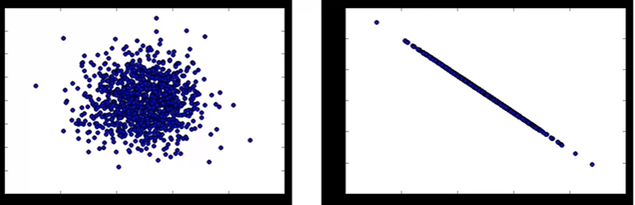
21 Covariance and Correlation
https://www.udemy.com/course/data-science-and-machine-learning-with-python-hands-on/learn/lecture/4020118#overview
Covariance
Measures how two variables vary in tandem from their means.
Left: No relation. Right: It is a very clear linear relationship.
Covariance give us of measuring how tight these things are correlated.
The right hand relation has higher correlation.

Slide 4
21 Covariance and Correlation
https://www.udemy.com/course/data-science-and-machine-learning-with-python-hands-on/learn/lecture/4020118#overview
Measuring Covariance
Think of the data sets for the two variables as high-dimensional vectors
Convert these two vectors of variances from the mean.
Take the dot product (cosine of the angle between them) of the two vectors
Divide by the sample size.

Slide 5
21 Covariance and Correlation
https://www.udemy.com/course/data-science-and-machine-learning-with-python-hands-on/learn/lecture/4020118#overview
Interpreting Covariance is hard
We know a small covariance, close to 0, means there is not much correlation between two variables,
And large covariance, i.e., far from 0 (could be negative for inverse relationships) mean there is a correlation.
Bow how large is “large”?

Slide 6
21 Covariance and Correlation
https://www.udemy.com/course/data-science-and-machine-learning-with-python-hands-on/learn/lecture/4020118#overview
Normalize Correlation
Just divide the covariance by the standard deviations of both variables, and that normalizes things.
Correlation of -1: Perfect inverse correction.
Correction of 0: No correlation
Correlation of 1: Prefect correlation

Slide 7
21.1 No Relation Example

Slide 8
21.1 No Relation Example
https://www.udemy.com/course/data-science-and-machine-learning-with-python-hands-on/learn/lecture/15090172#overview
Code
Covariance measures how two variables vary in tandem from their means.
For example, let's say we work for an e-commerce company, and they are interested in finding a correlation between page speed (how fast each web page renders for a customer) and how much a customer spends.
numpy offers covariance methods, but we'll do it the "hard way" to show what happens under the hood. Basically we treat each variable as a vector of deviations from the mean, and compute the "dot product" of both vectors. Geometrically this can be thought of as the angle between the two vectors in a high-dimensional space, but you can just think of it as a measure of similarity between the two variables.
First, let's just make page speed and purchase amount totally random and independent of each other; a very small covariance will result as there is no real correlation:

Slide 9
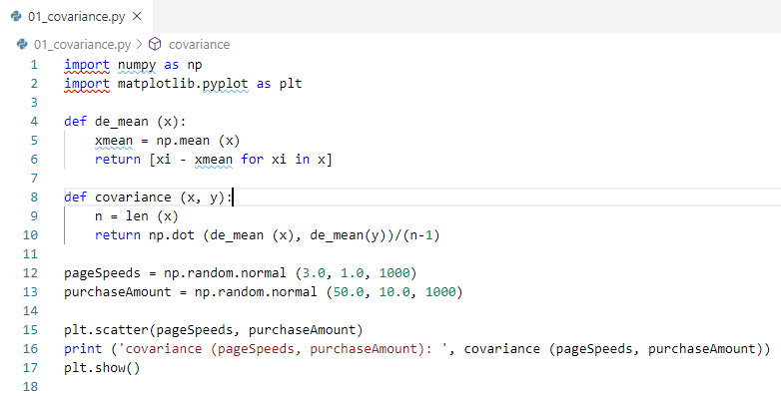
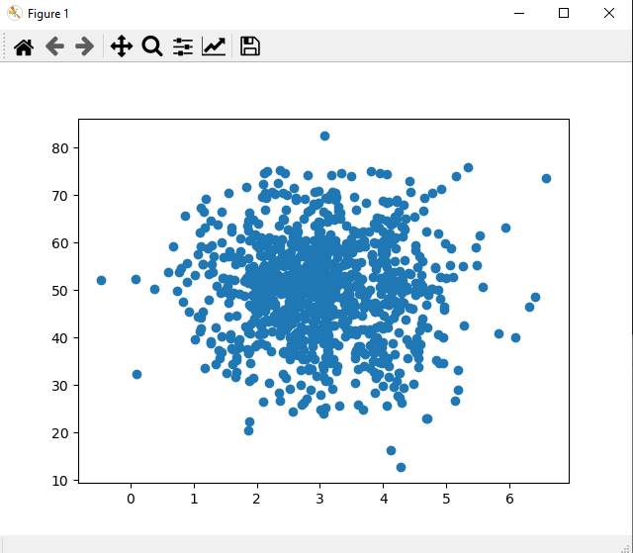
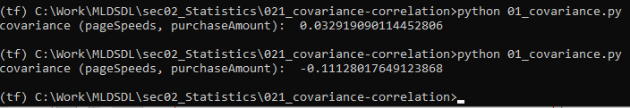
21.1 No Relation Example
https://www.udemy.com/course/data-science-and-machine-learning-with-python-hands-on/learn/lecture/15090172#overview
Code: The covariance is close to zero. No relationship.

Slide 10
21.2 High Relation Example

Slide 11
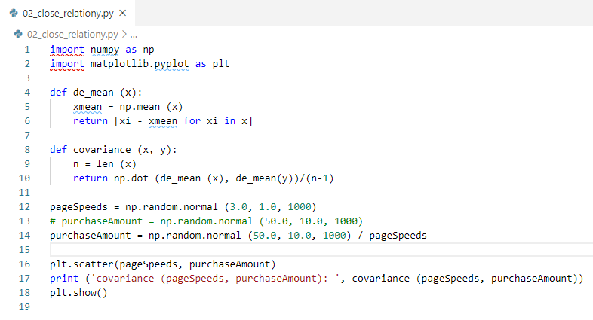
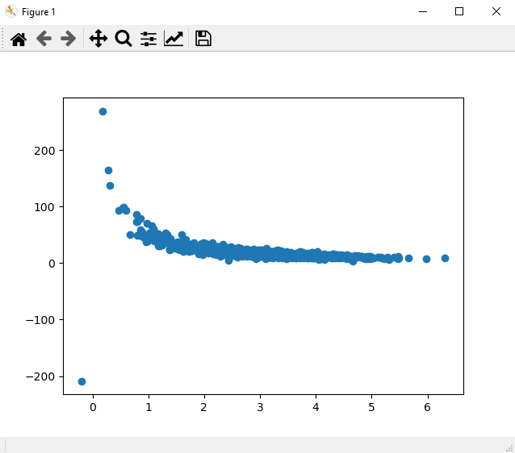
21.2 High Relation Example
https://www.udemy.com/course/data-science-and-machine-learning-with-python-hands-on/learn/lecture/15090172#overview
High Relation Example
If we divide the purchase data with pageSpeed, i.e., we cross the pageSpeed data out.
Then we have big relation in almost of itself data (pageSpeed, PurchaseAmount/pageSpeed).
We get big value of covariance.

Slide 12
21.2 High Relation Example
https://www.udemy.com/course/data-science-and-machine-learning-with-python-hands-on/learn/lecture/15090172#overview
High Relation Example
The curve here is tightly aligned. We have much larger covariance value.

Slide 13
21.3 Correlation

Slide 14
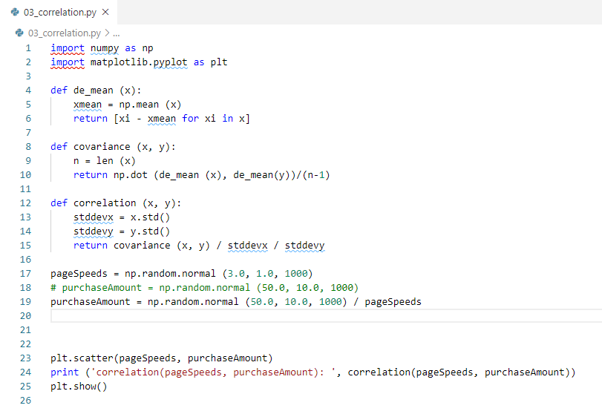
21.3 Correlation
https://www.udemy.com/course/data-science-and-machine-learning-with-python-hands-on/learn/lecture/15090172#overview
How to interpret the relation?
We use correlation to interpret the relation.
But, what does this value mean? Covariance is sensitive to the units used in the variables, which makes it difficult to interpret. Correlation normalizes everything by their standard deviations, giving you an easier to understand value that ranges from -1 (for a perfect inverse correlation) to 1 (for a perfect positive correlation):

Slide 15
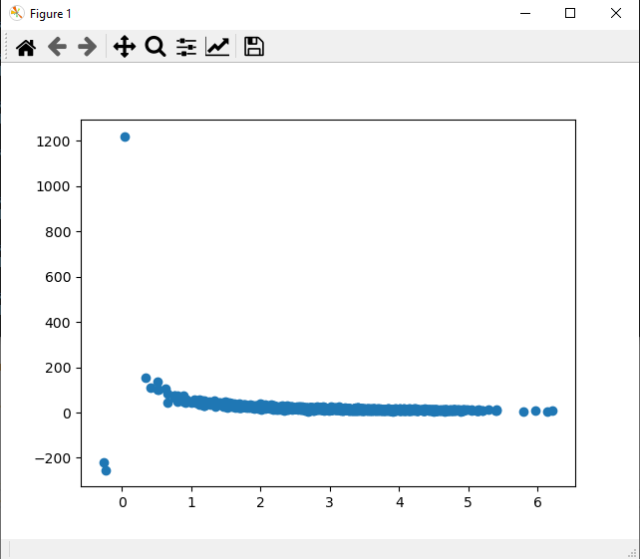
21.3 Correlation
https://www.udemy.com/course/data-science-and-machine-learning-with-python-hands-on/learn/lecture/15090172#overview
How to interpret the relation?
Scale to between -1 to 1.

Slide 16
21.4 Numpy Correlation

Slide 17

21.4 Numpy Correlation
https://www.udemy.com/course/data-science-and-machine-learning-with-python-hands-on/learn/lecture/15090172#overview
How to interpret the relation?
Use numpy.corrcoef() to calculate the correlation.
numpy can do all this for you with numpy.corrcoef. It returns a matrix of the correlation coefficients between every combination of the arrays passed in:

Slide 18
21.5 Correlation of Array with Linear Transformation

Slide 19
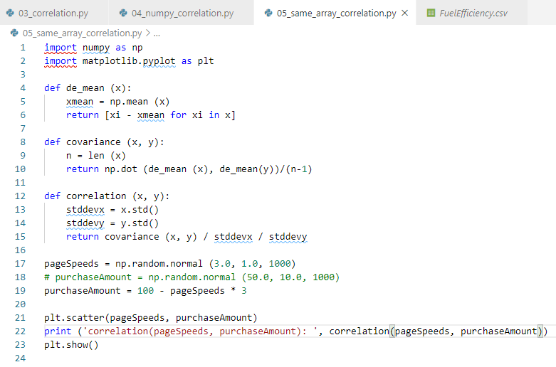
21.5 Correlation of Array with Linear Transformation
https://www.udemy.com/course/data-science-and-machine-learning-with-python-hands-on/learn/lecture/15090172#overview
Correlation of Array with linear transformation
We can force a perfect correlation by fabricating a totally linear relationship (again, it's not exactly -1 just due to precision errors, but it's close enough to tell us there's a really good correlation here):

Slide 20
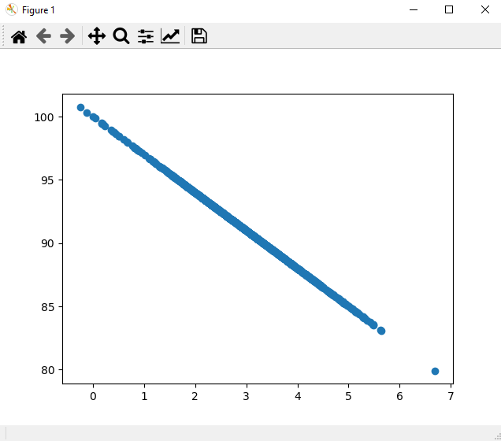
21.5 Correlation of Array with Linear Transformation
https://www.udemy.com/course/data-science-and-machine-learning-with-python-hands-on/learn/lecture/15090172#overview
Correlation of Same Array

Slide 21
21.6 Exercise

Slide 22
21.6 Exercise
https://www.udemy.com/course/data-science-and-machine-learning-with-python-hands-on/learn/lecture/15090172#overview
Exercise
numpy also has a numpy.cov amd numpy.corrcoef function that can compute Covariance for you.
Try using it for the pageSpeeds and purchaseAmounts data above. Interpret its results, and compare it to the results from our own covariance function above.

Slide 23
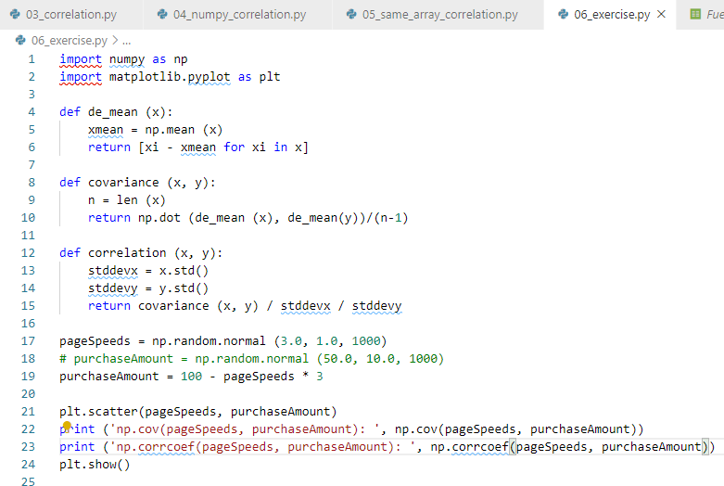
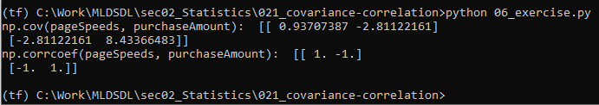
21.6 Exercise
https://www.udemy.com/course/data-science-and-machine-learning-with-python-hands-on/learn/lecture/15090172#overview
Exercise

Slide 24
End of Chapter

