Slide 1

26 Polynomial Regression
Peter H. Chen

Slide 2
26 Polynomial Regression
https://www.udemy.com/course/data-science-and-machine-learning-with-python-hands-on/learn/lecture/4020154#overview
Polynomial Regression
We fit the data with higher order polynomial.
Sometimes, the data may not fit for straight line.

Slide 3
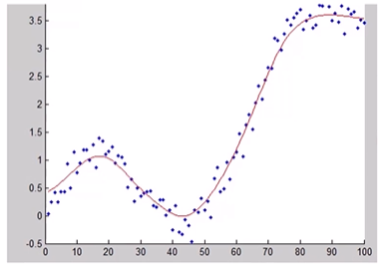
26 Polynomial Regression
https://www.udemy.com/course/data-science-and-machine-learning-with-python-hands-on/learn/lecture/4020154#overview
Why limit ourselves to straight lines?
Not all relationships are linear
Linear formula: y = mx + b
This is a “first order” or “first degree” polynomial, as the power of x is 1.
Second order polynomial: y = ax² + bx + c
Third order: y = ax³ + bx² + cx + d
Higher order produce more complex curves

Slide 4
26 Polynomial Regression
https://www.udemy.com/course/data-science-and-machine-learning-with-python-hands-on/learn/lecture/4020154#overview
Beware of overfitting
Note: More degree is not always better.
Do not use more degrees than you need. It fit all your current data with very complicate curve, it does not fit the data for future prediction.
Visualize your data first to see how complex of a curve to see you really need
Visualize the fit: Is your curve can accommodate for the outlier?
A high r-squared simple mean your curve fit your training data well but it may not fit for the test or prediction
We will discuss how to detect the overfit of training and test.
Right now, we just beware of not using the higher order more than we need.

Slide 5
26.1 Polynomial Regression Example

Slide 6
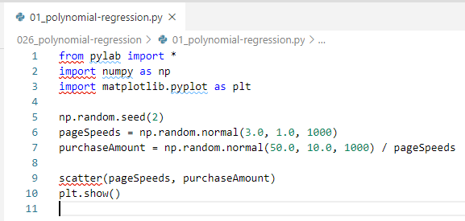
26.1 Polynomial Regression Example
https://www.udemy.com/course/data-science-and-machine-learning-with-python-hands-on/learn/lecture/4020154#overview
Polynomial Regression Example
What if your data doesn't look linear at all? Let's look at some more realistic-looking page speed / purchase data:

Slide 7
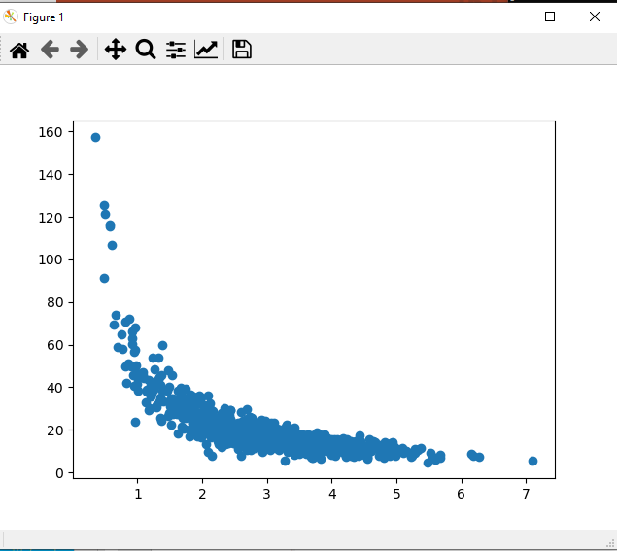
26.1 Polynomial Regression Example
https://www.udemy.com/course/data-science-and-machine-learning-with-python-hands-on/learn/lecture/4020154#overview
Polynomial Regression Example
Plot

Slide 8
26.2 polyfit() Function

Slide 9
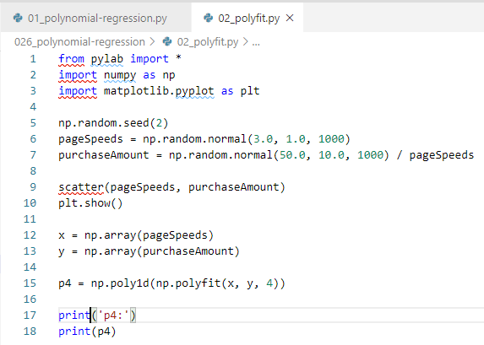
26.2 polyfit() Function
https://www.udemy.com/course/data-science-and-machine-learning-with-python-hands-on/learn/lecture/4020154#overview
Polyfit() Function
numpy has a handy polyfit function we can use, to let us construct an nth-degree polynomial model of our data that minimizes squared error. Let's try it with a 4th degree polynomial:

Slide 10
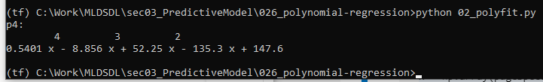
26.2 polyfit() Function
https://www.udemy.com/course/data-science-and-machine-learning-with-python-hands-on/learn/lecture/4020154#overview
Polyfit() Function
Result:

Slide 11
26.3 Plot Scatter and Polynomial

Slide 12
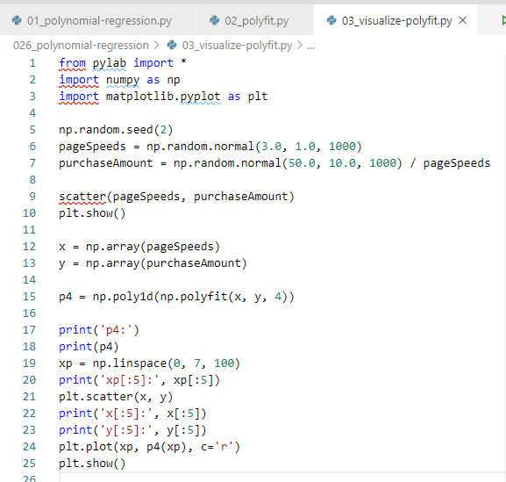
26.3 Plot Scatter and Polynomial
https://www.udemy.com/course/data-science-and-machine-learning-with-python-hands-on/learn/lecture/4020154#overview
Plot Scatter and Polynomial
We'll visualize our original scatter plot, together with a plot of our predicted values using the polynomial for page speed times ranging from 0-7 seconds:

Slide 13
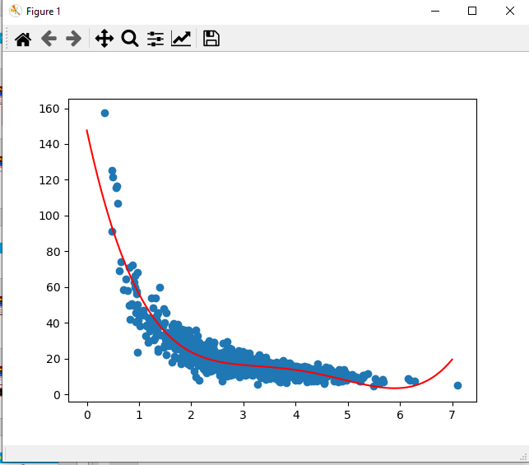
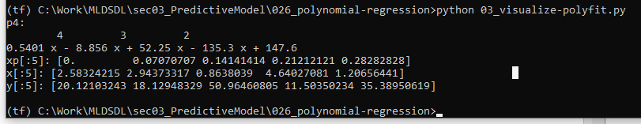
26.3 Plot Scatter and Polynomial
https://www.udemy.com/course/data-science-and-machine-learning-with-python-hands-on/learn/lecture/4020154#overview
Plot Scatter and Polynomial
Page speed times ranging from 0-7 seconds:

Slide 14
26.4 Measure r-square

Slide 15
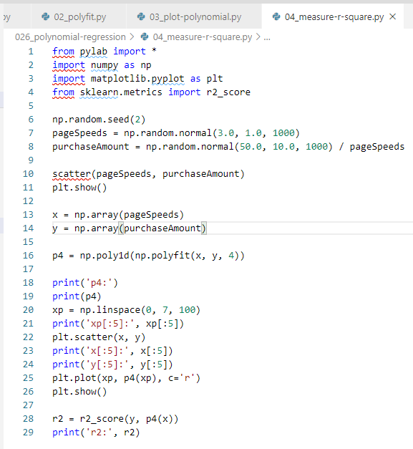
26.4 Measure r-square
https://www.udemy.com/course/data-science-and-machine-learning-with-python-hands-on/learn/lecture/4020154#overview
Plot Scatter and Polynomial
Looks pretty good! Let's measure the r-squared error:

Slide 16
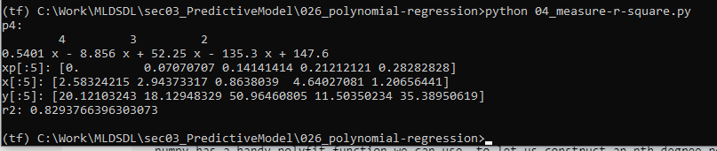
26.4 Measure r-square
https://www.udemy.com/course/data-science-and-machine-learning-with-python-hands-on/learn/lecture/4020154#overview
Plot Scatter and Polynomial
r2: 0.829

Slide 17
26.5 Exercise

Slide 18
26.5 Exercise
https://www.udemy.com/course/data-science-and-machine-learning-with-python-hands-on/learn/lecture/4020154#overview
Exercise
Try different polynomial orders.
Can we get a better fit with higher orders?
Do you start to see overfitting, even though the r-squared score looks good for this particular data set?

Slide 19
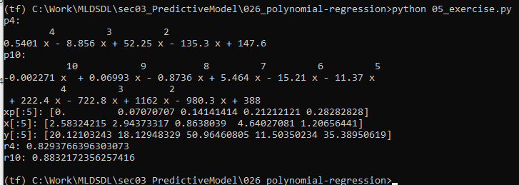
26.4 Measure r-square
https://www.udemy.com/course/data-science-and-machine-learning-with-python-hands-on/learn/lecture/4020154#overview
Plot Scatter and Polynomial
r4: 0.829,
r10: 0.8832
Polynomial degree 10 r2-square is closer to 1 thane degree 4’s for the training data.
Polynomial degree 10 is better (or not?) than degree 2’s.

Slide 20
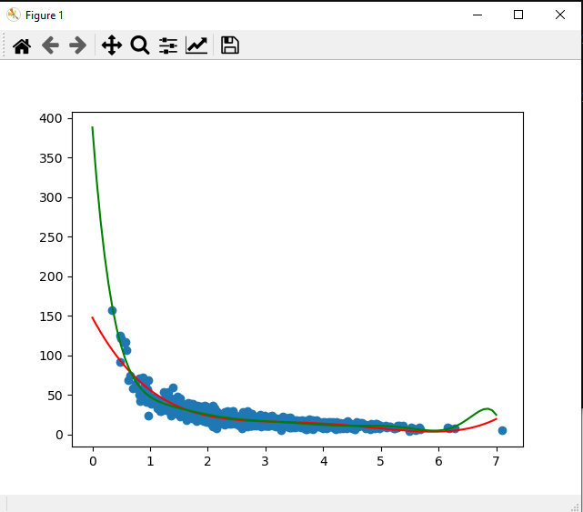
26.4 Measure r-square
https://www.udemy.com/course/data-science-and-machine-learning-with-python-hands-on/learn/lecture/4020154#overview
Plot Scatter and Polynomial
For the test data, higher degree may not better than lower degree.
For low page speed (below 0.2 sec), polynomial degree 10 is better fit than degree 4’s. For high page speed (higher than 6.5 sec), polynomial degree 10 is overfit and worse than degree 4’s.

Slide 21
End of Chapter

