Slide 1

27 Multiple Regression
Peter H. Chen

Slide 2
27 Multiple Regression
https://www.udemy.com/course/data-science-and-machine-learning-with-python-hands-on/learn/lecture/4020134#overview
Multiple Regression
Multiple regression take more than one variables to represent the data.

Slide 3
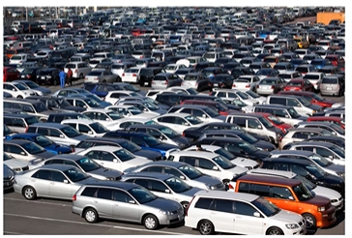
27 Multiple Regression
https://www.udemy.com/course/data-science-and-machine-learning-with-python-hands-on/learn/lecture/4020134#overview
Multiple Regression
What is more than one variable influences the one you are interested in?
Example:
Predict price for a care based on its many attributes (body style, brand, mileage, and etc.).
If you also have multiple dependent variables, such as, you are trying to predict, i.e., “multivariate regression”.

Slide 4
27 Multiple Regression
https://www.udemy.com/course/data-science-and-machine-learning-with-python-hands-on/learn/lecture/4020134#overview
Multiple Regression
What is more than one variable (more than on feature) influences the one you are interested in?
Example:
Predict price for a care based on its many attributes (body style, brand, mileage, and etc.).
If you also have multiple dependent variables, such as, you are trying to predict, i.e., “multivariate regression”.
Multiple regression: Multiple variable to predict the single output.
Multivariate regression: Multiple dependent variables. Predict more than one thing at the same time, for example, what is the price based on the car model and mileage. We also want to know how long it takes to sell?

Slide 5
27 Multiple Regression
https://www.udemy.com/course/data-science-and-machine-learning-with-python-hands-on/learn/lecture/4020134#overview
Still uses least squares
We just end up with coefficients for each factor
For example, price = α + β₁ x mileage + β₂ x age + β₃ x doors
These coefficients imply how important each factor is (if the data is all normalized)
Get rid of ones (features with small coefficients or feature selection) that do not matter. It is very import to build machine learning model.
Multiple regression still use least square. We use OLS (Ordinary Least Square).
Call still measure fit with r-squared
Need to assume the different factors are not themselves dependent on each other. Notice that we treat each features independently with their own coefficients.
If there is in facto a relationship between these features. This model will not capture that. For example, the mileage of the car may have relation with age of the car. We do not capture that relationship. We may get rid of one of them (age or mileage) if you have the relationship between them.

Slide 6
27.1 Multiple Regression Example

Slide 7
27.1 Multiple Regression Example
https://www.udemy.com/course/data-science-and-machine-learning-with-python-hands-on/learn/lecture/4020134#overview
Multiple Regression Example (MultipleRegression.ipynb)
There is statsmodel package makes it easy. The stats model offer OLS (Ordinary Least Square) model.

Slide 8
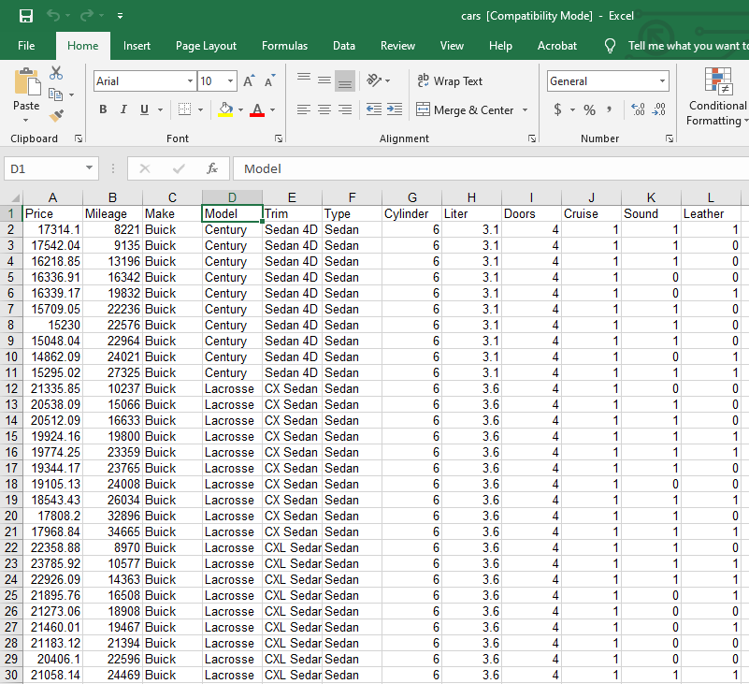
27.1 Multiple Regression Example
https://www.udemy.com/course/data-science-and-machine-learning-with-python-hands-on/learn/lecture/4020134#overview
Multiple Regression Example (MultipleRegression.ipynb)
Let's grab a small little data set of Blue Book car values:

Slide 9
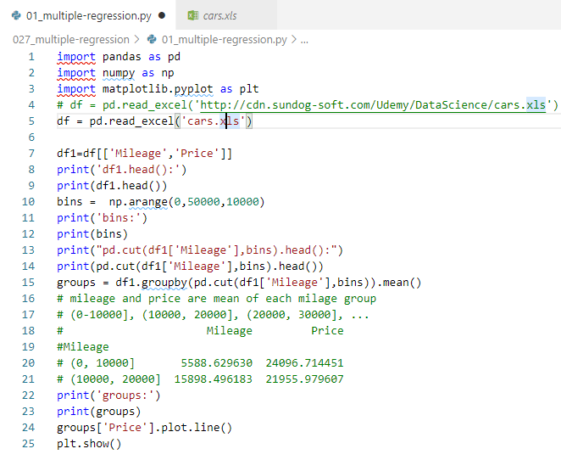
27.1 Multiple Regression Example
https://www.udemy.com/course/data-science-and-machine-learning-with-python-hands-on/learn/lecture/4020134#overview
Multiple Regression Example (MultipleRegression.ipynb)
Read excel format file cars.xls.
Get Mileage and Price columns
The Mileage and Price are average in each bins (0, 10000], [10000, 20000], (20000, 30000], (30000, 40000], (40000, 50000].

Slide 10
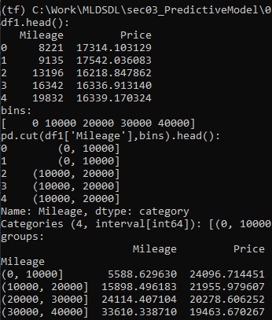
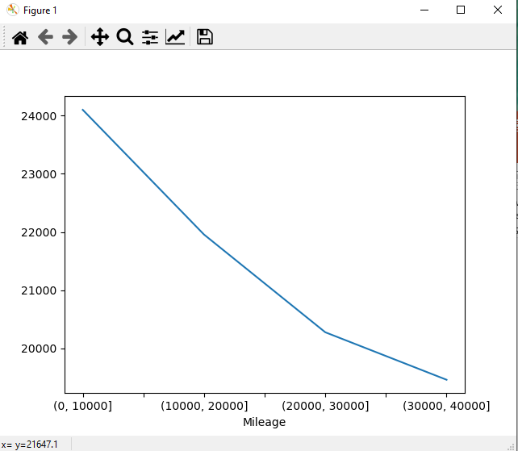
27.1 Multiple Regression Example
https://www.udemy.com/course/data-science-and-machine-learning-with-python-hands-on/learn/lecture/4020134#overview
Multiple Regression Example (MultipleRegression.ipynb)
Plot mileage (average of each bins) and price (average of each bins)

Slide 11
27.2 Multiple Regression by OLS

Slide 12
27.2 Multiple Regression by OLS
https://www.udemy.com/course/data-science-and-machine-learning-with-python-hands-on/learn/lecture/4020134#overview
Multiple Regression by OLS
We create feature vector (mileage, cylinder, doors) and predict/target (price).
We can use pandas to split up this matrix into the feature vectors we're interested in, and the value we're trying to predict.
Note how we are avoiding the make and model; regressions don't work well with ordinal values, unless you can convert them into some numerical order that makes sense somehow.
Let's scale our feature data into the same range so we can easily compare the coefficients we end up with.

Slide 13
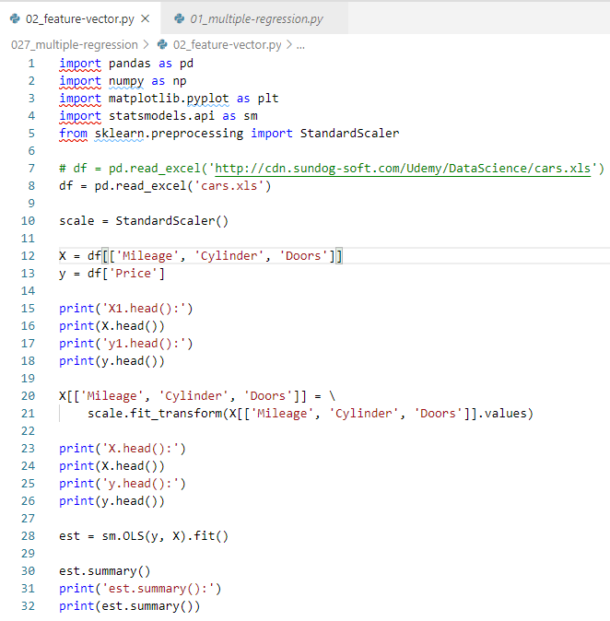
27.2 Multiple Regression by OLS
https://www.udemy.com/course/data-science-and-machine-learning-with-python-hands-on/learn/lecture/4020134#overview
Multiple Regression by OLS
Scale the X values.

Slide 14
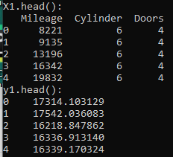
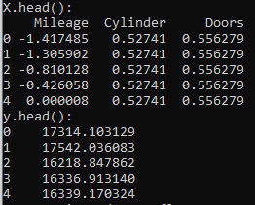
27.2 Multiple Regression by OLS
https://www.udemy.com/course/data-science-and-machine-learning-with-python-hands-on/learn/lecture/4020134#overview
Multiple Regression by OLS
Scale the X values.

Slide 15
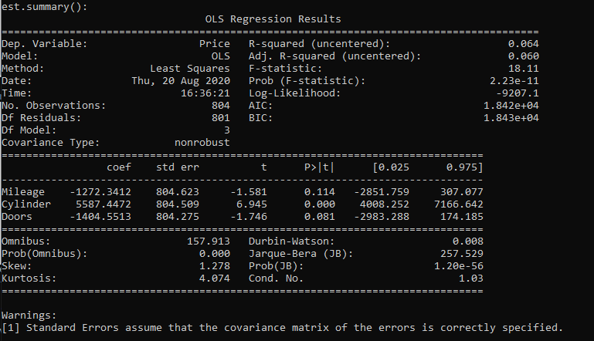
27.2 Multiple Regression by OLS
https://www.udemy.com/course/data-science-and-machine-learning-with-python-hands-on/learn/lecture/4020134#overview
Multiple Regression by OLS
Use statsmodel’s OLS (Ordinary Least Square) for multiple regression.

Slide 16
27.3 Feature Selection

Slide 17
27.3 Feature Selection
https://www.udemy.com/course/data-science-and-machine-learning-with-python-hands-on/learn/lecture/4020134#overview
Feature Selection
The table of coefficients above gives us the values to plug into an equation of form:
B0 + B1 * Mileage + B2 * cylinders + B3 * doors
In this example, it's pretty clear that the number of cylinders is more important than anything based on the coefficients.
Could we have figured that out earlier?

Slide 18
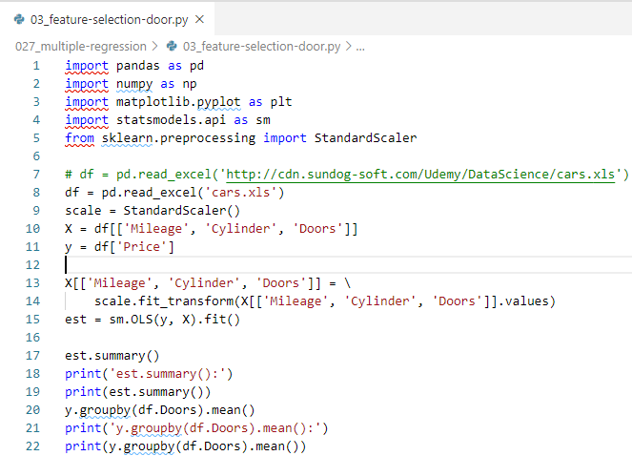

27.3 Feature Selection
https://www.udemy.com/course/data-science-and-machine-learning-with-python-hands-on/learn/lecture/4020134#overview
Feature Selection by doors

Slide 19

27.3 Feature Selection
https://www.udemy.com/course/data-science-and-machine-learning-with-python-hands-on/learn/lecture/4020134#overview
Feature Selection by doors
Surprisingly, more doors does not mean a higher price!
Maybe it implies a sport car in some cases?
So it's not surprising that it's pretty useless as a predictor here.
This is a very small data set however, so we can't really read much meaning into it.

Slide 20
27.4 Car Price Prediction

Slide 21
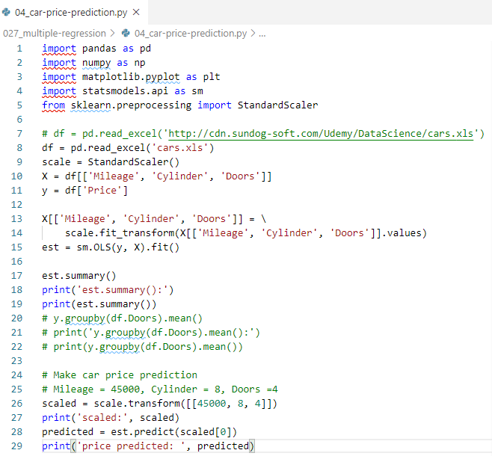

27.4 Car Price Prediction
https://www.udemy.com/course/data-science-and-machine-learning-with-python-hands-on/learn/lecture/4020134#overview
Car Price Prediction
How would you use this to make an actual prediction?
Start by scaling your multiple feature variables into the same scale used to train the model, then just call est.predict() on the scaled features:

Slide 22
27.5 Exercise

Slide 23
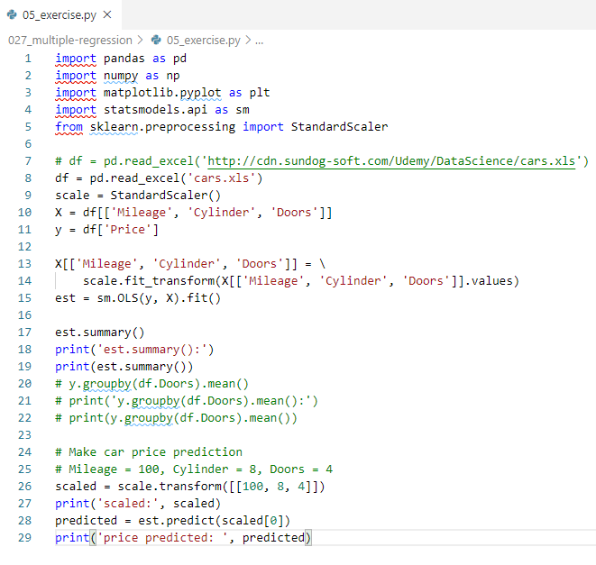
27.5 Exercise
https://www.udemy.com/course/data-science-and-machine-learning-with-python-hands-on/learn/lecture/4020134#overview
Exercise
Predict the car price for 100 mileage, 8 cylinders, 4 doors.

Slide 24
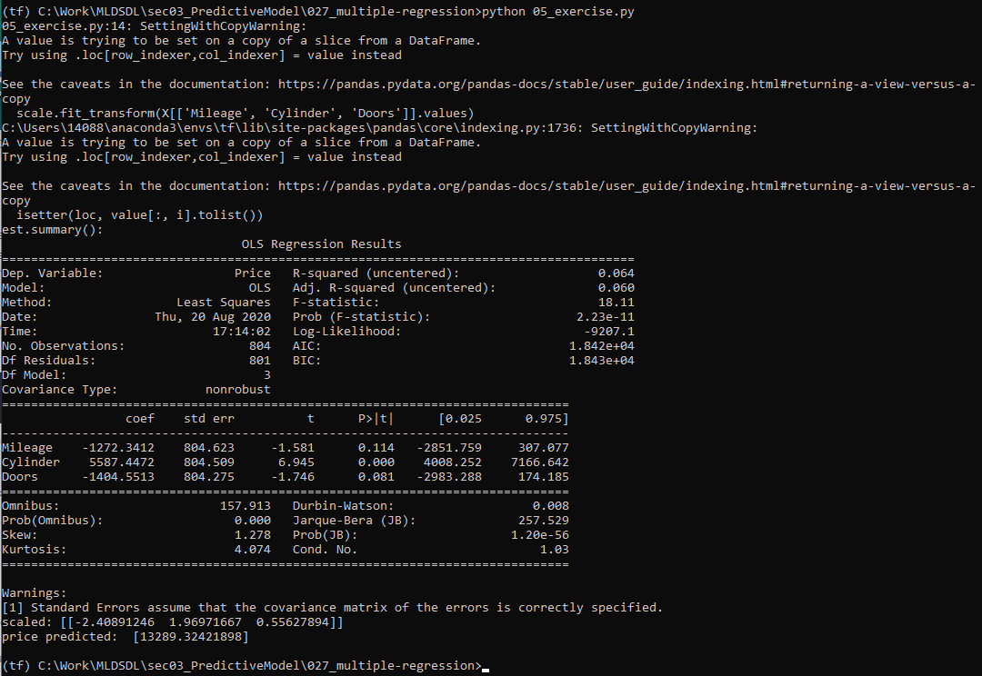
27.5 Exercise
https://www.udemy.com/course/data-science-and-machine-learning-with-python-hands-on/learn/lecture/4020134#overview
Exercise
Result

Slide 25
End of Chapter

