Slide 1

53 Dimension Reduction: PCA
Peter H. Chen

Slide 2
53 Dimension Reduction: PCA
https://www.udemy.com/course/data-science-and-machine-learning-with-python-hands-on/learn/lecture/4020652#overview
Dimension Reduction: PCA (Principal Component Analysis)
We discuss the higher dimension and dimension reduction.
We will talk dimension reduction and principal component analysis.

Slide 3
53.1 Dimensionality

Slide 4
53.1 Dimensionality
https://www.udemy.com/course/data-science-and-machine-learning-with-python-hands-on/learn/lecture/4020652#overview
Dimensionality: Principal Component Analysis
When we talk dimensionality, we called this PCA (Principal Component Analysis), specifically, called SVD (Singular Value Decomposition).
PCA or SVD are the topics in this discussion.

Slide 5
53.2 What is Dimensionality?

Slide 6
53.2 What is Dimensionality?
https://www.udemy.com/course/data-science-and-machine-learning-with-python-hands-on/learn/lecture/4020652#overview
What is Dimensionality?
Man problems can be thought pf having a huge number of “dimensions”.
For example, in recommendation movies, the rating vector for each movie may represent a dimension, every individual movie is its own dimension!
For flower classification problem, each flower have four different measurements/features of the flowers. Those four different features can represent four dimensions. Very hard to visualize.
They are very difficult to visualize and hard to figure out what is going on.
Dimensionality Reduction is to reduce the higher dimensional data into lower dimensional information. Not only can make easier to look at but also compressing the data.
Dimensionality Reduction preserves the variance of data while we reduce the number of dimensions. We have more compactly representing a data set while preserving the variance of the data set.
Very common application of dimensional reduction, not just for visualization but also for compression and for feature extraction.

Slide 7
53.3 K-Means Clustering

Slide 8
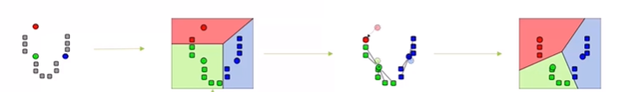
53.3 K-Means Clustering
https://www.udemy.com/course/data-science-and-machine-learning-with-python-hands-on/learn/lecture/4020652#overview
K-Means Clustering
K-Means Clustering is an example of dimension reduction algorithm.
K-Means Clustering reduces data down to K dimensions.

Slide 9
53.4 Principal Component Analysis

Slide 10
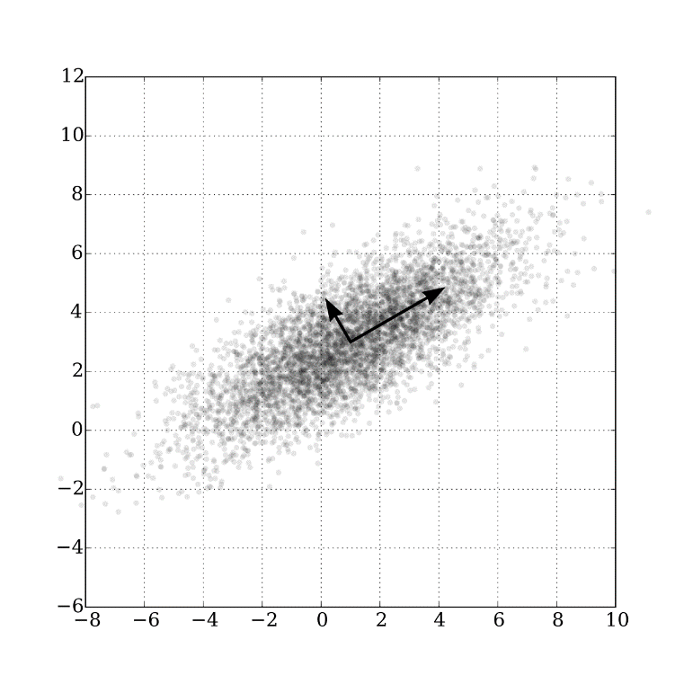
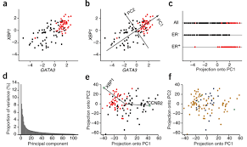
53.4 Principal Component Analysis
https://www.udemy.com/course/data-science-and-machine-learning-with-python-hands-on/learn/lecture/4020652#overview
PCA (Principal Component Analysis)
PCA (Principal Component Analysis) uses very fancy math and a lot of math.
In high level point of view of PCA, PCA finds eigenvectors in the higher dimensional data:
These define hyperplanes that split the data while preserve the most variance in it.
The high dimensional data gets projected one to these hyperplanes, which represent the lower dimensions you want to represent
A popular implementation of this is called SVD (Singular Value Decomposition)
PCA are very helpful for Image Compression and Facial Recognition.

Slide 11
53.4 Principal Component Analysis
https://www.udemy.com/course/data-science-and-machine-learning-with-python-hands-on/learn/lecture/4020652#overview
PCA (Principal Component Analysis) Explanation
PCA need fancy math and lots of math.
PCA takes high dimensional data into lower dimensional dataspaces and it finds planes within that data spaces. The high dimensional planes are called hyperplanes.
The hyperplanes are defined by things called eigenvectors.
You can take as many planes as you want dimensions in the end.
Project that high dimensional data into those planes. Those become the new axis in your lower dimensional data space.

Slide 12
53.4 Principal Component Analysis
https://www.udemy.com/course/data-science-and-machine-learning-with-python-hands-on/learn/lecture/4020652#overview
PCA (Principal Component Analysis) Explanation
In summary, we transform the higher dimensional data into lower dimensional data by projection them on the hyperplanes or eigenvectors.
If we want to educe the dimensionality in an image, we will use PCA.
Facial Recognition is another example, each face represent a third dimension of 2-D images and we want to reduce by SVD and Principal Component Analysis.

Slide 13
53.4 Principal Component Analysis
https://www.udemy.com/course/data-science-and-machine-learning-with-python-hands-on/learn/lecture/4020652#overview
PCA (Principal Component Analysis) Explanation
If we have a data set of faces.
The face image represent the third dimension of 2-D images and we want to reduce the image data.
SVD (Singular Value Decomposition) and PCA (Principal Component Analysis) can be a way to identify the features that really count into the face.
So, it might be end up focusing more on the eyes and mouth, for example, as important features that are necessary for preserving the variance within that data set.
So, it can produce some very interesting and very useful results.

Slide 14
53.5 4-D Iris Data Example

Slide 15
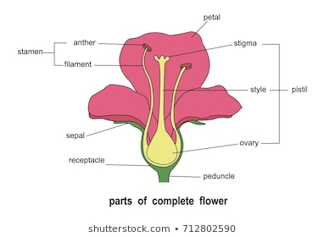


53.5 4-D Iris Data Example
https://www.udemy.com/course/data-science-and-machine-learning-with-python-hands-on/learn/lecture/4020652#overview
Example: Visualizing 4-D Iris Flower Data
The Iris Dataset comes with Scikit-Learn
An Iris flower has petals and sepals (The lower, supportive part of the flower).
We know the length and width of the petals and sepals for many Iris specimens
That is four dimension: length and width of the petals (2); length and width of the sepals (2)
We also the subspecies classification of each flower
PCA let us visualize this in 2 dimension instead of, while still preserving variance.

Slide 16
53.5 4-D Iris Data Example
https://www.udemy.com/course/data-science-and-machine-learning-with-python-hands-on/learn/lecture/4020652#overview
Example: Visualizing 4-D Iris Flower Data Explanation
The Iris Dataset comes with Scikit-Learn
The Iris has two different kinds of Iris flowers, one is petals and the other is called sepals which is support of the flower. It is a lower set of petals on the flower.
We can take a bunch of Irises and different species of the Iris and measure the petal length and width and sepal length and with.
Together, we have length and width of the petals and length and width of the sepals.
We have 2 dimensions of petal and 2 dimension in sepals that totally corresponds to four different dimensions in our dataset.
We want to use that 4 dimensions to classify what specifies an Iris might belong to.
PCA will let use visualize this two dimensions instead of four but still preserving the variance in that dataset.
We will set how that works in Python PCA code in the Iris Dataset.

Slide 17
53.6 Summary

Slide 18
53.6 Summary
https://www.udemy.com/course/data-science-and-machine-learning-with-python-hands-on/learn/lecture/4020652#overview
Summary
That is the concept of Dimensionality Reduction.

Slide 19
End of Chapter

