Slide 1

54 PCA Iris Dataset
Peter H. Chen

Slide 2
54 PCA Iris Dataset
https://www.udemy.com/course/data-science-and-machine-learning-with-python-hands-on/learn/lecture/4020654#overview
PCA Iris Dataset
We apply Principal Component Analysis to the Iris Dataset which is four dimensional dataset that we are going to reduce to two dimensions.
We are going to see what we can actually still preserve most of the information in that dataset even by throwing away half of the dimensions. It is very cool.

Slide 3
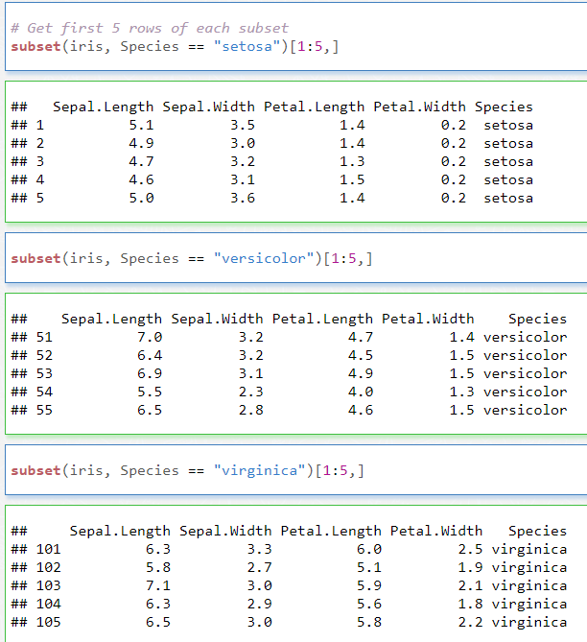
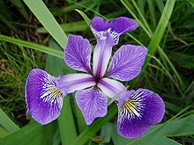
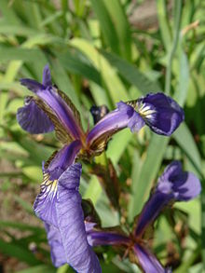
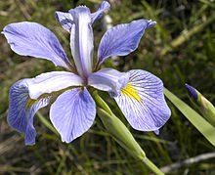
54.1 PCA
https://www.udemy.com/course/data-science-and-machine-learning-with-python-hands-on/learn/lecture/4020654#overview
PCA
The Iris can be classified into setosa, versicolor, or virginica, by the petals and sepals by petals and sepals sizes.
versicolor
setosa
virginica

Slide 4
54.1 PCA

Slide 5
54.1 PCA
https://www.udemy.com/course/data-science-and-machine-learning-with-python-hands-on/learn/lecture/4020654#overview
PCA
PCA is a dimensionality reduction technique; it lets you distill multi-dimensional data down to fewer dimensions, selecting new dimensions that preserve variance in the data as best it can.
We are not talking about Star Trek stuff here; let's make it real - a black & white image for example, contains three dimensions of data: X position, Y position, and brightness at each point.
We transform that data down to two dimensions can be useful for things like image compression and facial recognition, because it transforms out the information that contributes most to the variance in the data set.
Let's do this with a simpler example: the Iris data set that comes with scikit-learn.
Iris is a collection of data that has four dimensions of feature data for three different kinds of Iris flowers: The length and width of both the petals and sepals of many individual flowers from each species.

Slide 6
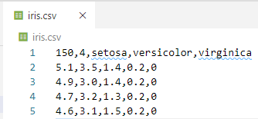
54.1 PCA
https://www.udemy.com/course/data-science-and-machine-learning-with-python-hands-on/learn/lecture/4020654#overview
PCA
From “from sklearn.datasets import load_iris”
We can find the data in
“C:\Users\14088\anaconda3\Lib\site-packages\sklearn\datasets\data”
The data is 150 rows and 4 features, for examples, 5.1, 3.5, 1.4, 0.2
Three targets are: setosa, versicolor, and virginica (0, 1, 2).
setosa
versicolor
virginica

Slide 7
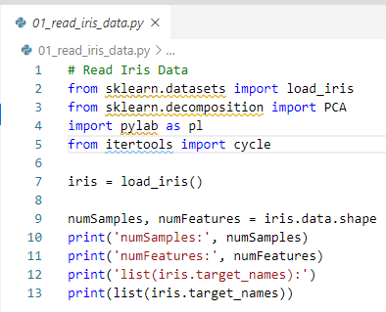

54.1 PCA
https://www.udemy.com/course/data-science-and-machine-learning-with-python-hands-on/learn/lecture/4020654#overview
PCA
> read iris data
setosa
versicolor
virginica

Slide 8
54.2 PCA Transform

Slide 9
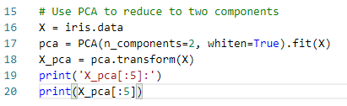
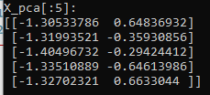
54.2 PCA Transform
https://www.udemy.com/course/data-science-and-machine-learning-with-python-hands-on/learn/lecture/4020654#overview
PCA Transform
Transform 4 dimension into 2 dimensions.
Our data set has 150 samples (individual flowers) in it.
It has 4 dimensions (length, width of septal and length, width of petal) - called features here, and three distinct Iris species (setosa, versicolor, virginica) that each flower is classified into.
While we can visualize 2 or even 3 dimensions of data pretty easily, visualizing 4D data isn't something our brains can do.
So let's distill this down to 2 dimensions (Variance of features and variance of species), and see how well it works.
We have few lines of code to do the PCA transformation.

Slide 10
54.3 PCA Components

Slide 11


54.3 PCA Components
https://www.udemy.com/course/data-science-and-machine-learning-with-python-hands-on/learn/lecture/4020654#overview
PCA Components
We distill our 4D data set down to 2D.
We project these 4D data down into two (orthogonal 4D) vectors.
The 4D orthogonal vectors are eigenvectors.
The PCA stands for Principal Components Analysis.
The principal components are the eigenvectors. These eigenvectors define our planes.
When we look at those eigenvectors, do not spend time to figure out what is going on here. Those data does not mean much to us.

Slide 12
54.4 PCA Result

Slide 13
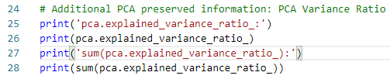

54.4 PCA Result
https://www.udemy.com/course/data-science-and-machine-learning-with-python-hands-on/learn/lecture/4020654#overview
PCA Result
The PCA results are called “explained_variance_ratio_”.
These data tell you how much of the variance in the original 4 dimensional data was preserved as I reduced it down to tow dimensions.
It tell us, the first dimension, we got the preserve of 92.46% of the variance in the data. In the second dimension, we have preserved 5.3% of data.
Then, we sum the first and second dimension together, we have 97.76%. This means, when we project from 4D into 2D data, we preserve 97.76% of the variance in the source data.
Conclusion: The 4-dimensional data are not necessary to capture all the information in this dataset. This is very interesting and pretty cool.

Slide 14
54.5 Plot PCA Data

Slide 15
54.5 Plot PCA Data
https://www.udemy.com/course/data-science-and-machine-learning-with-python-hands-on/learn/lecture/4020654#overview
Plot PCA Data
Now, We have 2-D data instead of 4-D Data.
This is very cool.
Although we have thrown away two of our four dimensions, PCA give us the two dimensions data which is well enough.
PCA have captured 92% of the variance in our data in a single first dimension data.
The second dimension just gives us an additional 5% accuracy. Altogether we have 97.76% accuracy (Only lost less than 3% of the variance) in our orginal data by projecting from 4 dimensions down to two dimensions.
Now, we have a 2D representation of our data, we can plot it:

Slide 16
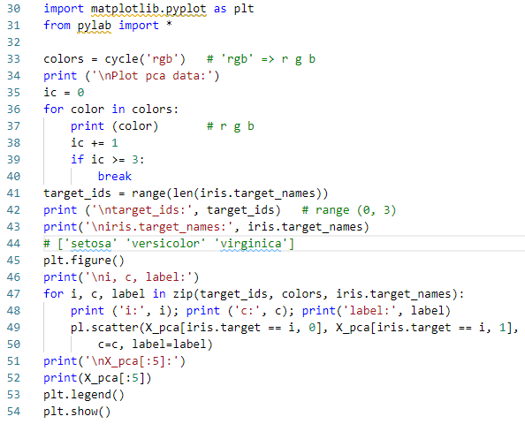
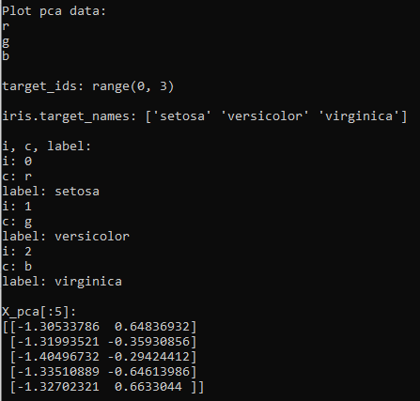
54.5 Plot PCA Data
https://www.udemy.com/course/data-science-and-machine-learning-with-python-hands-on/learn/lecture/4020654#overview
Plot PCA Data Code:

Slide 17
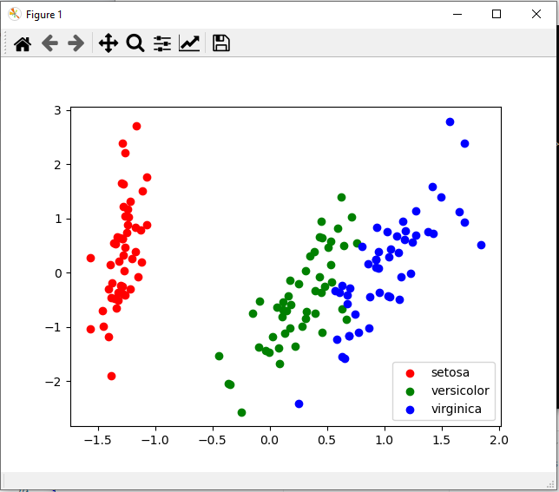
54.5 Plot PCA Data
https://www.udemy.com/course/data-science-and-machine-learning-with-python-hands-on/learn/lecture/4020654#overview
Plot PCA Data
You can see the three different types of Iris are still clustered pretty well.
If you think about it, this probably works well because the overall size of an individual flower probably makes both the petal and sepal sizes increase by a similar amount.
Although the actual numbers on this graph have no intuitive meaning, we see the measure of the ratio of width and height for petals and sepals.
PCA distilled our 4-dimensional data (height, width of petals and height, width sepals) down to 2-dimensional data (PCA variance) own with three groups of target data (setosa, versicolor, and virginica).

Slide 18
54.6 Exercsie

Slide 19
54.6 Exercise
https://www.udemy.com/course/data-science-and-machine-learning-with-python-hands-on/learn/lecture/4020654#overview
Exercise
We transform the from 4-D Iris Data down to a 2-D.
Try transform 4-D Iris data into 1-D and still preserve most of its variance.
1. Transform original Iris data and PCA 1-D Data and variance.
2. Plot the original Iris data and transform PCA 1-D Data.

Slide 20
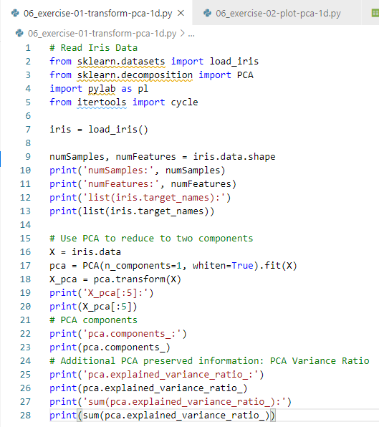
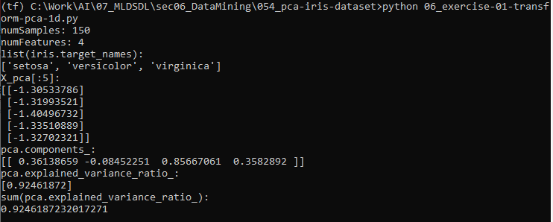
54.6 Exercise
https://www.udemy.com/course/data-science-and-machine-learning-with-python-hands-on/learn/lecture/4020654#overview
Ans:
1. Transform Original Iris Data into PCA 1-D data.

Slide 21
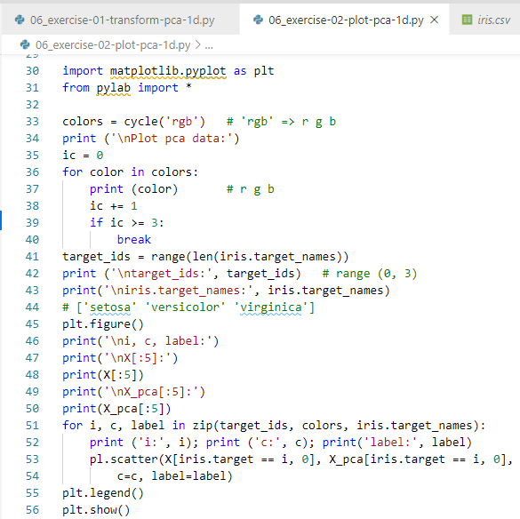
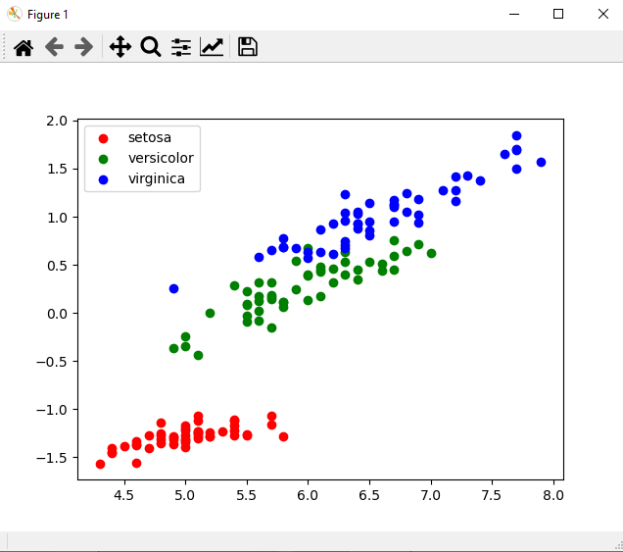
54.6 Exercise
https://www.udemy.com/course/data-science-and-machine-learning-with-python-hands-on/learn/lecture/4020654#overview
Ans:
2. Plot the original Iris data and transform PCA 1-D Data.
> python 06_exercise-02-plot-pca-1d.py

Slide 22
End of Chapter

