Slide 1

94 Run TF 2.0: Part 01 Examples
Peter H. Chen

Slide 2
94 Run TF 2.0: Part 01 Examples
https://github.com/peterhchen/930_Python_ML_DS_DL
Run Tensorflow 2.0: Part 01 Examples
We go through all the Tensorflow 2.0 Basic Examples

Slide 3
94.1 Add Two Numbers

Slide 4
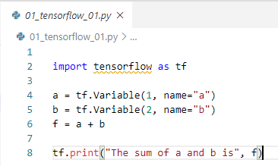
94.1 Add Two Numbers
https://github.com/peterhchen/930_Python_ML_DS_DL
Add Two Number
Let's begin by writing a really simple program to illustrate Tensorflow's main concepts.
We set up two Variables, named "a" and "b", which each contain a tensor which contains a single value - the number 1, and the number 2.
We then create a graph "f" that adds these two tensors together. But "f = a + b" just creates the graph; it doesn't actually perform the addition yet.
Next we need to initialize any global variables before we run the graph.
And finally, we create a Tensorflow Session object, run our variable initializer, and execute the graph with eval().
This returns the sum of 1 + 2 in a rather complex, yet highly scalable manner.

Slide 5
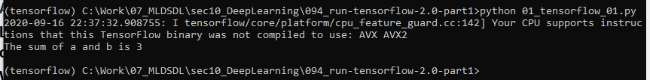
94.1 Add Two Numbers
https://github.com/peterhchen/930_Python_ML_DS_DL
Add Two Number
> conda activate tensroflow
> cd [work-folder]
> python 01_tensorflow_01.py

Slide 6
94.2 Handwriting Recognition

Slide 7
94.2 Handwriting Recognition
https://github.com/peterhchen/930_Python_ML_DS_DL
Handwriting Recognition
The standard example for machine learning these days is the MNIST data set.
The MNIST a collection of 70,000 handwriting samples of the numbers 0-9.
Each image is 28 x 28 grayscale pixels, so we can treat each image as just a 1D array, or tensor, of 784 numbers.
People who write from 0 to 9, our challenge is to create a neural network that look at those images and try to figure out what number they represent?
This is a very common and very good example when people are learning tensorflow.
MNIST
28 x 28 = 784 pixels
70,000 images (from 0-9)
…
28 x 28 = 784 pixels
28 x 28 = 784 pixels
28 x 28 = 784 pixels

Slide 8
94.3 Read MNIST Data

Slide 9
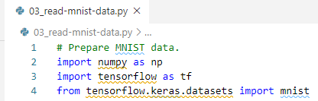
94.3 Read MNIST Data
https://github.com/peterhchen/930_Python_ML_DS_DL
Import Libraries
We import the data libraries.
1. import numpy
2. import tensroflow
3. tensroflow.keras.datset import mnist.
The mnist class is part of tensroflow.keras.datset package.

Slide 10

94.3 Read MNIST Data
https://github.com/peterhchen/930_Python_ML_DS_DL
Define Target Classes and Features
We define some convenient variables here, num classes is 10, that represents the total number of classifications for each one of these images. These can represent the numbers 0 through 9. That is a total of 10 possible classifications.
Our features are 784 in number. And we get that by saying that each image is a 28 by 28 image. We have 28 times 28, which is 780 for individual pixels, for every training image that we have.
Our training features are each individual pixel of every individual image that we are using.
Features: 784
Target: Predict 10 classes
000
001
…
783
0
…
8
9

Slide 11

94.3 Read MNIST Data
https://github.com/peterhchen/930_Python_ML_DS_DL
load MNIST Data
Load the dataset by mnist.load_data().
The mnist.load_data() retrieve that data from tensorflow packages.
The mnist.load_data() put the data set into these variables here.
The convention that we usually use is that x refers to the feature data, in our case, the images data.
And y refers to your labels, the classes. This target represents the numbers 0 through 9.
We split dataset into training (x_train, y_train) and testing data sets (x_test, y_test).
With mnist, we have 60000 training samples and 10000 test samples.

Slide 12
94.3 Read MNIST Data
https://github.com/peterhchen/930_Python_ML_DS_DL
load MNIST Data
That means that we're only going to train our neural network using that 60000 set of training samples and we're holding aside 10000 test samples.
We can actually do 10000 samples test to verify how well our training network works on data that its never seen before.
This is how we prevent over fitting.

Slide 13

94.3 Read MNIST Data
https://github.com/peterhchen/930_Python_ML_DS_DL
Flatten Images to 1-D Vectors of 784 Features (for 28 * 28 images)
When we then flatten those images down.
It flatten 2-dimensional 28 by 28 images into 1-dimensional vector with 784 features.
There are ways of constructing neural networks that can deal with two dimensional data.
We can use 1-D or 2-D for feature images, in this case, we treat each image as a 1-dimensional array (vector or tensor) of 784 features, 784 pixels. The reshape command is what does that.
We will use 2-D images in future discussion.

Slide 14
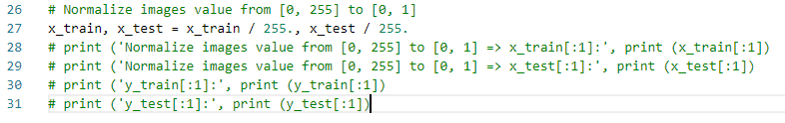
94.3 Read MNIST Data
https://github.com/peterhchen/930_Python_ML_DS_DL
Normalize Image Data from [0, 255] to [0, 1]
We need to normalize our data which in the incomes and age examples.
The raw data coming in from this dataset has every pixel represented as an integer value between 0 and 255.
0 represents a black pixel, 255 represents a white pixel, and values in between represent various shades of grey.
We need to scale that down to the range of 0 to 1.
To do that, very simply we just divide everything by 255 and we're done.

Slide 15
94.3 Read MNIST Data
https://github.com/peterhchen/930_Python_ML_DS_DL
Question: Where is the dataset of mnist.load_data()?
https://www.tensorflow.org/api_docs/python/tf/keras/datasets/mnist/load_data
The data set located at ~/.keras/datasets
Since my user name (~) “14088”, you can find the mnist data is stored at:
”C:\Users\14088\.keras\datasets”
The data name is ”mnist.npz” in zip format. Unzip it are in mnist folder with binary format.
They are all unreadable.

Slide 16
94.3 Read MNIST Data
https://github.com/peterhchen/930_Python_ML_DS_DL
Question: What is mnist.load_data() data structure looks like?
https://www.tensorflow.org/api_docs/python/tf/keras/datasets/mnist/load_data
This is a dataset of 60,000 28x28 grayscale images of the 10 digits, along with a test set of 10,000 images.
More info can be found at the MNIST homepage (http://yann.lecun.com/exdb/mnist/)
The MNIST database of handwritten digits, available from this page, has a training set of 60,000 examples, and a test set of 10,000 examples. It is a subset of a larger set available from NIST. The digits have been size-normalized and centered in a fixed-size image.
It is a good database for people who want to try learning techniques and pattern recognition methods on real-world data while spending minimal efforts on preprocessing and formatting.

Slide 17
94.3 Read MNIST Data
https://github.com/peterhchen/930_Python_ML_DS_DL
Read MNIST Data
What is mnist.load_data() data structure looks like?
Four files are available on this site:
train-images-idx3-ubyte.gz: training set images (9912422 bytes) train-labels-idx1-ubyte.gz: training set labels (28881 bytes) t10k-images-idx3-ubyte.gz: test set images (1648877 bytes) t10k-labels-idx1-ubyte.gz: test set labels (4542 bytes)

Slide 18
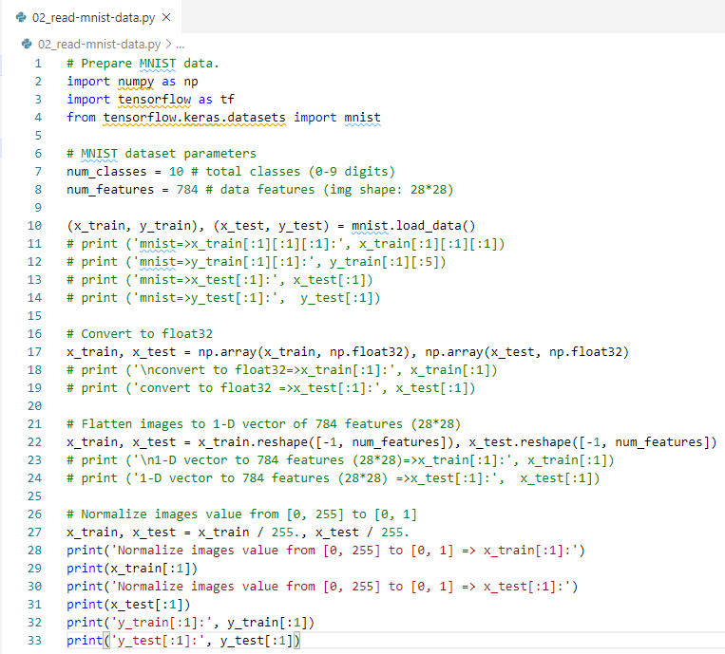
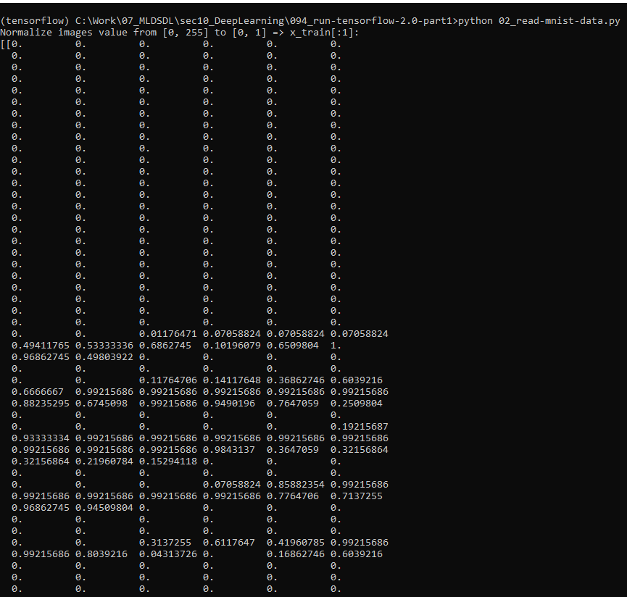
94.3 Read MNIST Data
https://github.com/peterhchen/930_Python_ML_DS_DL
Read MNIST Data
Code and Result

Slide 19
94.4 Visualize Data

Slide 20
94.4 Visualize Data
https://github.com/peterhchen/930_Python_ML_DS_DL
Visualize Data
6:02/13:11

Slide 21
End of Chapter

