Slide 1

94 Run TF 2.0: Part 01 Examples
Peter H. Chen

Slide 2
94 Run TF 2.0: Part 01 Examples
https://github.com/peterhchen/930_Python_ML_DS_DL
Run Tensorflow 2.0: Part 01 Examples
We go through all the Tensorflow 2.0 Basic Examples

Slide 3
94.1 Add Two Numbers

Slide 4
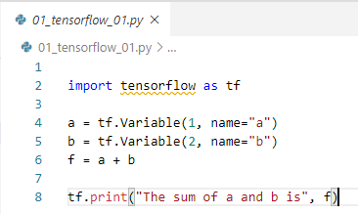
94.1 Add Two Numbers
https://github.com/peterhchen/930_Python_ML_DS_DL
Add Two Number
Let's begin by writing a really simple program to illustrate Tensorflow's main concepts.
We set up two Variables, named "a" and "b", which each contain a tensor which contains a single value - the number 1, and the number 2.
We then create a graph "f" that adds these two tensors together. But "f = a + b" just creates the graph; it doesn't actually perform the addition yet.
Next we need to initialize any global variables before we run the graph.
And finally, we create a Tensorflow Session object, run our variable initializer, and execute the graph with eval().
This returns the sum of 1 + 2 in a rather complex, yet highly scalable manner.

Slide 5
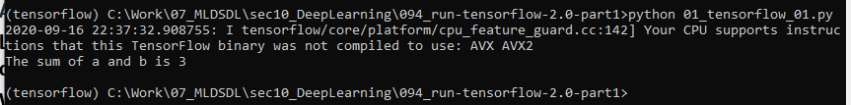
94.1 Add Two Numbers
https://github.com/peterhchen/930_Python_ML_DS_DL
Add Two Number
> conda activate tensroflow
> cd [work-folder]
> python 01_tensorflow_01.py

Slide 6
94.2 Handwriting Recognition

Slide 7
94.2 Handwriting Recognition
https://github.com/peterhchen/930_Python_ML_DS_DL
Handwriting Recognition
The standard example for machine learning these days is the MNIST data set.
The MNIST a collection of 70,000 handwriting samples of the numbers 0-9.
Each image is 28 x 28 grayscale pixels, so we can treat each image as just a 1D array, or tensor, of 784 numbers.
People who write from 0 to 9, our challenge is to create a neural network that look at those images and try to figure out what number they represent?
This is a very common and very good example when people are learning tensorflow.
MNIST
28 x 28 = 784 pixels
70,000 images (from 0-9)
…
28 x 28 = 784 pixels
28 x 28 = 784 pixels
28 x 28 = 784 pixels

Slide 8
94.3 Read MNIST Data

Slide 9
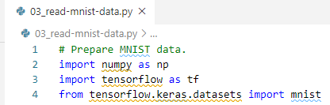
94.3 Read MNIST Data
https://github.com/peterhchen/930_Python_ML_DS_DL
Import Libraries
We import the data libraries.
1. import numpy
2. import tensroflow
3. tensroflow.keras.datset import mnist.
The mnist class is part of tensroflow.keras.datset package.

Slide 10

94.3 Read MNIST Data
https://github.com/peterhchen/930_Python_ML_DS_DL
Define Target Classes and Features
We define some convenient variables here, num classes is 10, that represents the total number of classifications for each one of these images. These can represent the numbers 0 through 9. That is a total of 10 possible classifications.
Our features are 784 in number. And we get that by saying that each image is a 28 by 28 image. We have 28 times 28, which is 780 for individual pixels, for every training image that we have.
Our training features are each individual pixel of every individual image that we are using.
Features: 784
Target: Predict 10 classes
000
001
…
783
0
…
8
9

Slide 11

94.3 Read MNIST Data
https://github.com/peterhchen/930_Python_ML_DS_DL
load MNIST Data
Load the dataset by mnist.load_data().
The mnist.load_data() retrieve that data from tensorflow packages.
The mnist.load_data() put the data set into these variables here.
The convention that we usually use is that x refers to the feature data, in our case, the images data.
And y refers to your labels, the classes. This target represents the numbers 0 through 9.
We split dataset into training (x_train, y_train) and testing data sets (x_test, y_test).
With mnist, we have 60000 training samples and 10000 test samples.

Slide 12
94.3 Read MNIST Data
https://github.com/peterhchen/930_Python_ML_DS_DL
load MNIST Data
That means that we're only going to train our neural network using that 60000 set of training samples and we're holding aside 10000 test samples.
We can actually do 10000 samples test to verify how well our training network works on data that its never seen before.
This is how we prevent over fitting.

Slide 13

94.3 Read MNIST Data
https://github.com/peterhchen/930_Python_ML_DS_DL
Flatten Images to 1-D Vectors of 784 Features (for 28 * 28 images)
When we then flatten those images down.
It flatten 2-dimensional 28 by 28 images into 1-dimensional vector with 784 features.
There are ways of constructing neural networks that can deal with two dimensional data.
We can use 1-D or 2-D for feature images, in this case, we treat each image as a 1-dimensional array (vector or tensor) of 784 features, 784 pixels. The reshape command is what does that.
We will use 2-D images in future discussion.

Slide 14
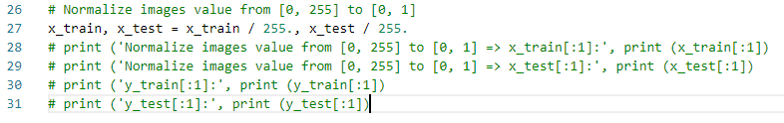
94.3 Read MNIST Data
https://github.com/peterhchen/930_Python_ML_DS_DL
Normalize Image Data from [0, 255] to [0, 1]
We need to normalize our data which in the incomes and age examples.
The raw data coming in from this dataset has every pixel represented as an integer value between 0 and 255.
0 represents a black pixel, 255 represents a white pixel, and values in between represent various shades of grey.
We need to scale that down to the range of 0 to 1.
To do that, very simply we just divide everything by 255 and we're done.

Slide 15
94.3 Read MNIST Data
https://github.com/peterhchen/930_Python_ML_DS_DL
Question: Where is the dataset of mnist.load_data()?
https://www.tensorflow.org/api_docs/python/tf/keras/datasets/mnist/load_data
The data set located at ~/.keras/datasets
Since my user name (~) “14088”, you can find the mnist data is stored at:
”C:\Users\14088\.keras\datasets”
The data name is ”mnist.npz” in zip format. Unzip it are in mnist folder with binary format.
They are all unreadable.

Slide 16
94.3 Read MNIST Data
https://github.com/peterhchen/930_Python_ML_DS_DL
Question: What is mnist.load_data() data structure looks like?
https://www.tensorflow.org/api_docs/python/tf/keras/datasets/mnist/load_data
This is a dataset of 60,000 28x28 grayscale images of the 10 digits, along with a test set of 10,000 images.
More info can be found at the MNIST homepage (http://yann.lecun.com/exdb/mnist/)
The MNIST database of handwritten digits, available from this page, has a training set of 60,000 examples, and a test set of 10,000 examples. It is a subset of a larger set available from NIST. The digits have been size-normalized and centered in a fixed-size image.
It is a good database for people who want to try learning techniques and pattern recognition methods on real-world data while spending minimal efforts on preprocessing and formatting.

Slide 17
94.3 Read MNIST Data
https://github.com/peterhchen/930_Python_ML_DS_DL
Read MNIST Data
What is mnist.load_data() data structure looks like?
Four files are available on this site:
train-images-idx3-ubyte.gz: training set images (9912422 bytes) train-labels-idx1-ubyte.gz: training set labels (28881 bytes) t10k-images-idx3-ubyte.gz: test set images (1648877 bytes) t10k-labels-idx1-ubyte.gz: test set labels (4542 bytes)

Slide 18
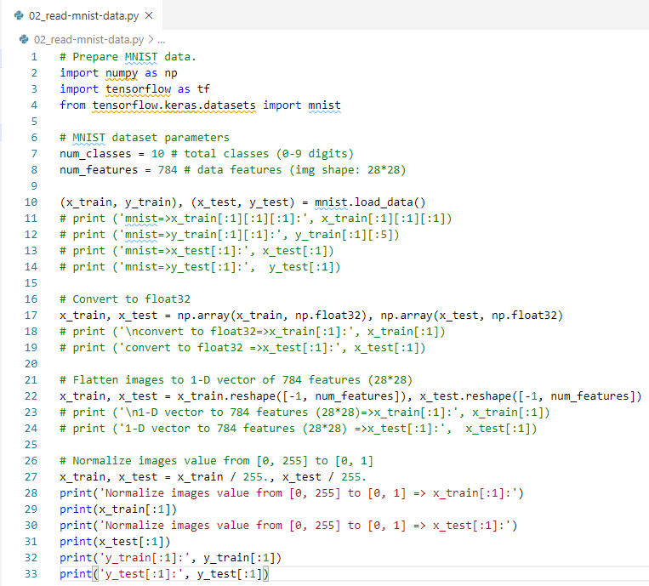
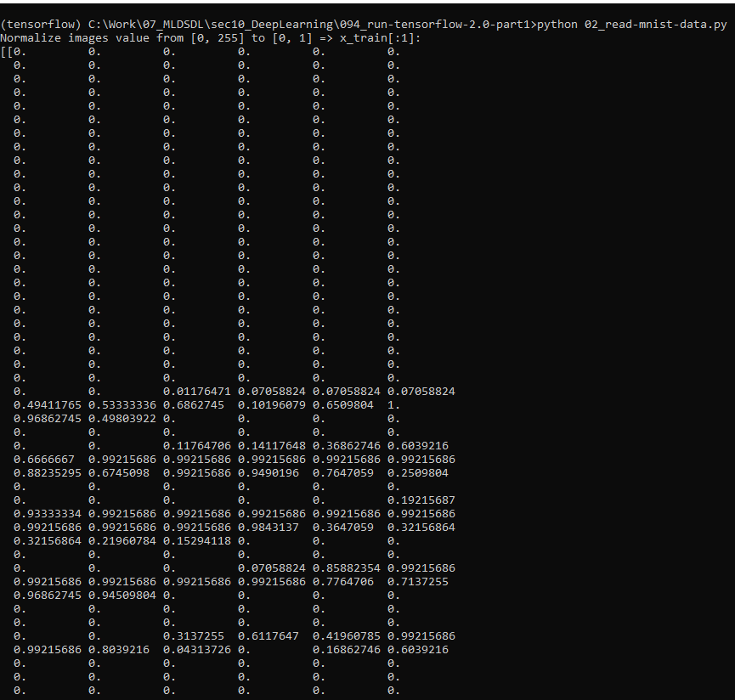
94.3 Read MNIST Data
https://github.com/peterhchen/930_Python_ML_DS_DL
Read MNIST Data
Code and Result

Slide 19
94.4 Display Training Label Image

Slide 20
94.4 Display Training Label Image
https://github.com/peterhchen/930_Python_ML_DS_DL
Display Training Label Image
MNIST provides 60,000 samples in a training data set, and 10,000 samples in a test data set.
From the concept of train/test, we use train dataset for modeling and unknown dataset for test the model.
It similar to give students a known math problems with answers for preparation and then unknown set of problems for tests.
We use a set of images to train the model of our neural network and then use the unknown images for model testing.
The training images are therefore a tensor of shape [60,000, 784]: 60,000 instances of 784 numbers that represent each image.
The training labels are a one-dimensional tensor of 60,000 labels that range from 0 to 9.
We define function to display the training labels with index:

Slide 21
94.4 Display Training Label Image
https://github.com/peterhchen/930_Python_ML_DS_DL
Display Training Label Image (Explanation)
It is a good idea to visualize your data before you implement an algorithm.
We define a display function to take as input a specific number of a sample from our training data of the label.
The y is the label. The y_train is the training label. The y_train contains the numbers 0 through 9 of image represents.
We reshape numbers 0 to 9 into two dimensional 28 by 28 image and display it on the screen.
We give it a title.
Display two dimensional images grade scale.
Show it.

Slide 22
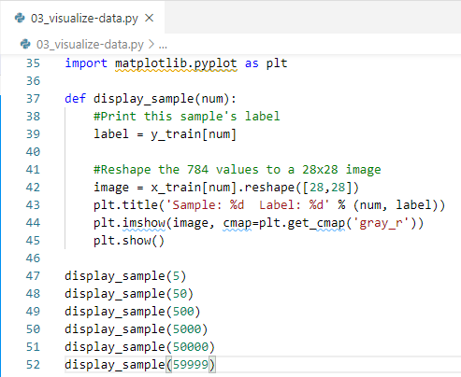
94.4 Display Training Label Image
https://github.com/peterhchen/930_Python_ML_DS_DL
Display Training Label Image (Explanation)
Display sample number 5, 50, 500, 5000, 50000, 59999, respectively.

Slide 23
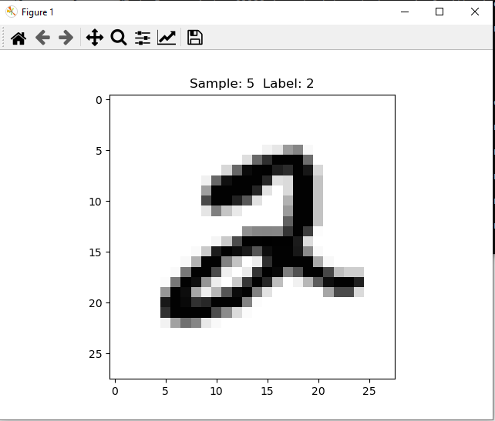
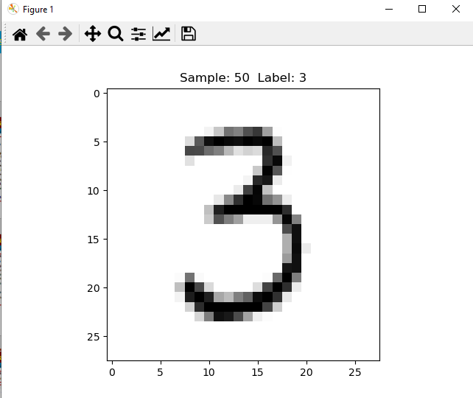
94.4 Display Training Label Image
https://github.com/peterhchen/930_Python_ML_DS_DL
Display Training Label Image (Explanation)
Display sample number 5, 50, 500, 5000, 50000, 59999, respectively.

Slide 24
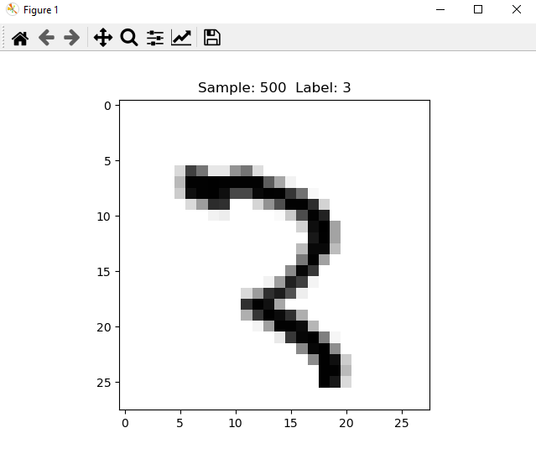
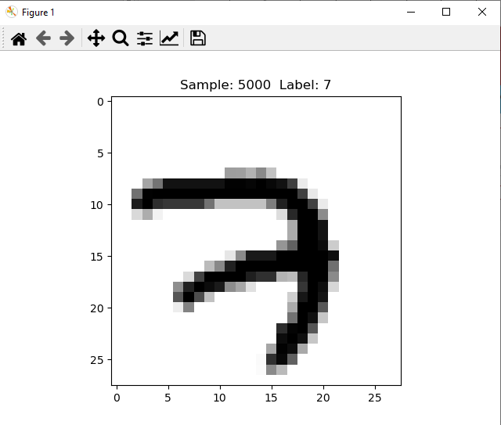
94.4 Display Training Label Image
https://github.com/peterhchen/930_Python_ML_DS_DL
Display Training Label Image (Explanation)
Display sample number 5, 50, 500, 5000, 50000, 59999, respectively.

Slide 25
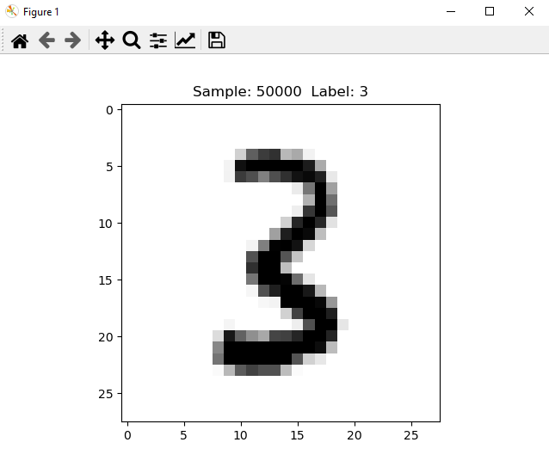
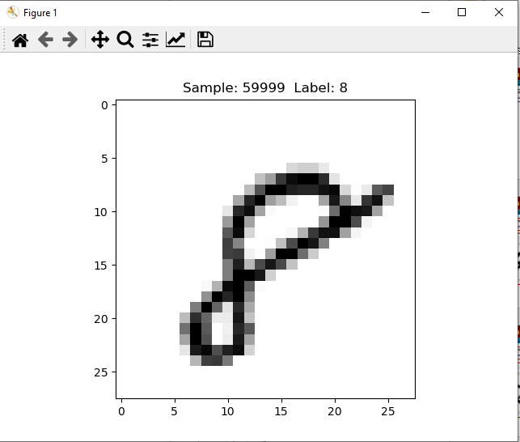
94.4 Display Training Label Image
https://github.com/peterhchen/930_Python_ML_DS_DL
Display Training Label Image (Explanation)
Display sample number 5, 50, 500, 5000, 50000, 59999, respectively.

Slide 26
94.4 Display Training Label Image
https://github.com/peterhchen/930_Python_ML_DS_DL
Display Training Label Image (Explanation)
We display the training label for image index 5, 50, 500, 5000, 50000, and 59999 (Between 0 and 60000).
We can see some of the training labels are very difficult to classify.
We are flattening each image to a 1D array of 784 (28 x 28) numerical values.
Each one of those values (784 or 28 x 28) will be an input node into our deep neural network.
We display the input images.

Slide 27
94.5 Display Input Flatten Image

Slide 28
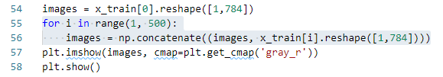
94.5 Display Input Flatten Image
https://github.com/peterhchen/930_Python_ML_DS_DL
Display Input Flatten Image
We display the first 500 training samples, one on each row.
Imagine each pixel on each row getting fed into the bottom layer of a neural network 768 neurons (or "units") wide as we train our neural network.
We define few training parameters (or "hyperparameters") and use tf.data API to shuffle our data and divide it into batches.
Think of these as parameters. We build up our neural network model without knowledge of the actual data that will be fed into it. We just need to construct it in such a way that our data will fit in.

Slide 29
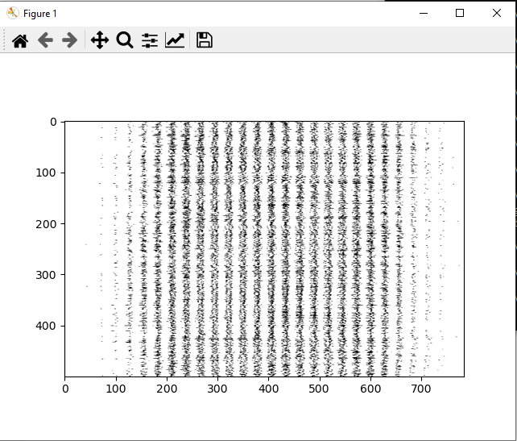
94.5 Display Input Flatten Image
https://github.com/peterhchen/930_Python_ML_DS_DL
Display Input Flatten Image (Explanation)
We take this visualization to the next step.
We flatten the 2-D image array (28x28) of into 1-D image array (784 pixels).
We then concatenate the 500 1-D image in the second dimension.
We take basically the first 500 training images.
Each row contains a flatten image with 1-D arrays of 784 pixels, and then combine that all together to a single two dimensional image and then plot.
This is interesting.
This shows you the input is going into our neural network for every individual image for the first 500 images.

Slide 30
94.5 Display Input Flatten Image
https://github.com/peterhchen/930_Python_ML_DS_DL
Display Input Flatten Image (Explanation)
You can see that your brain does not recognize of all of figures.
Every single row of this image represents the input data going into our neural network.
Our neural network take every one of those rows of one dimensional data
Figure out what number that represents in two dimensional space.
You can see that it's thinking about the world, or perceiving the world, or perceiving these images
It is a very different way than your own brain does.

Slide 31
94.6 Setup Parameter

Slide 32
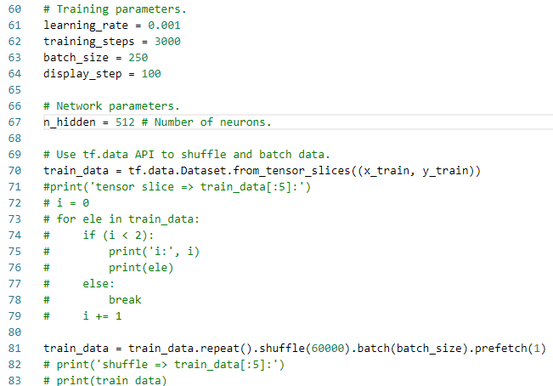
94.6 Setup Parameter
https://github.com/peterhchen/930_Python_ML_DS_DL
Setup Training Parameters and Network Parameters
We use a Dataset within Tensorflow to wrap our training features and labels.
We use functions of the Dataset to randomly shuffle it and batch it up into smaller chunks for each iteration of training.

Slide 33
94.6 Setup Parameter
https://github.com/peterhchen/930_Python_ML_DS_DL
Setup Training Parameters and Network Parameters (Explanation)
We set up our neural network.
We some parameters (or hyper parameters) that define how our training will actually work.
We define the learning rate = 0.001. The learning rate is how quickly will descend through gradient descent.
The trainig_step is how many training in a batch.
The batch_size is how many random samples we'll take from our training data.
The display_step is how often we display the data.
The n_hidden = 152 is the how many hidden neurons in hidden layer.

Slide 34
94.6 Setup Parameter
https://github.com/peterhchen/930_Python_ML_DS_DL
Setup Training Parameters and Network Parameters (Explanation)
These parameters are determined through experimentation.
We use tf.data.Dataset.from_tensor_slices ((x_train, y_train)) to merge training images and training labels into one dataset object.
We will then use that data set to create our individual batches that we use to train the neural network.
We randomly shuffle 60,000 training images.
Then batch them up into batches of 250.
Then prefetch the first batch (1) as the default dataset.

Slide 35
94.7 Setup ANN

Slide 36
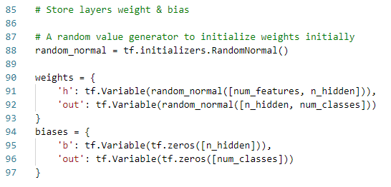
94.7 Setup ANN
https://github.com/peterhchen/930_Python_ML_DS_DL
Setup ANN
We set up that artificial neural network. We'll start by creating variables to store and keep track of weights and biases of different layers.
We need an input layer with one node per input pixel per image, or 784 nodes.
That will feed into a hidden layer of some arbitrary size: hidden nodes, given by n_hidden (512).
That hidden layer will output 10 values given by num_classes, each value corresponds to scores for each classification to be fed into softmax.

Slide 37
94.8 Create Model

Slide 38
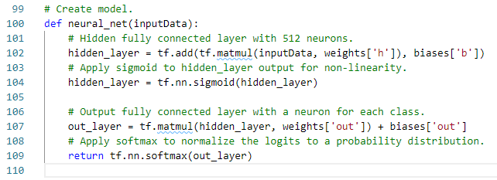
94.8 Create Model
https://github.com/peterhchen/930_Python_ML_DS_DL
Create Model
We feed our input data into the first layer of our neural network.
All this layer does is multiply these inputs by our weight "h" tensor which will be learned over time.
Then we will feed that into our hidden layer, which applies the sigmoid activation function to the weighted inputs with our learned biases added in as well.
Finally our output layer, called out_layer, multiplies in the learned weights of the hidden layer and adds in the hidden layer's bias term

Slide 39
94.9 Define Loss Function

Slide 40
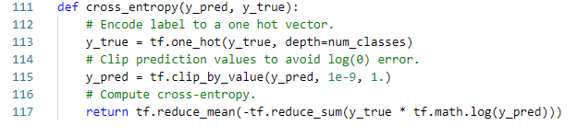
94.9 Define Loss Function
https://github.com/peterhchen/930_Python_ML_DS_DL
Define Loss Function
We define our loss function for use in measuring our progress in gradient descent: cross-entropy, which applies a logarithmic scale to penalize incorrect classifications much more than ones that are close. In this function, y_pred is the output of our final layer, and we're comparing that against the target labels used for training in y_true.
To compare our known "true" labels of 0-9 to the output of our neural network, we need to convert the labels to "one-hot" encoding. Our output layer has a neuron for each possible label of 0-9, not a single neuron with an integer in it. For example, let's say a known "true" label for an image is 1.
We would represent that in one-hot format as [0, 1, 0, 0, 0, 0, 0, 0, 0, 0] (remember we start counting at 0.) This makes it easier to compare the known label to the output neurons.

Slide 41
94.10 Setup Optimizer

Slide 42
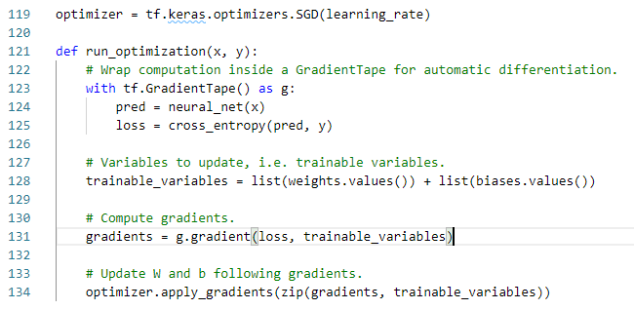
94.10 Setup Optimizer
https://github.com/peterhchen/930_Python_ML_DS_DL
Setup Optimizer
We set up our stochastic gradient descent optimizer, based on our previously defined hyperparameters and our loss function defined above.
That learning rate is an example of a hyperparameter that may be worth experimenting with and tuning.
We use Tensorflow 2.0 new feature of Gradient Tape (to know further why we use this, follow this amazing answer given on stackoverflow, https://stackoverflow.com/a/53995313/8804853).
It's the new way of setting up neural nets from scratch in Tensorflow 2.

Slide 43
94.11 Train and Accuracy

Slide 44
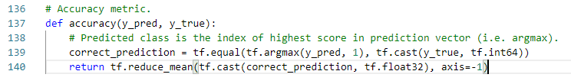
94.11 Train and Accuracy
https://github.com/peterhchen/930_Python_ML_DS_DL
Train and Measure Accuracy
We train our neural network and measure its accuracy. First let's define some methods for measuring the accuracy of our trained model.
The correct_prediction will look at the output of our neural network (in digit_weights) and choose the label with the highest value, and see if that agrees with the target label given. During testing, digit_weights will be our prediction based on the test data we give the network, and target_labels is a placeholder that we will assign to our test labels. Ultimately this gives us a 1 for every correct classification, and a 0 for every incorrect classification.
For "accuracy“, we then takes the average of all the classifications to produce an overall score for our model's accuracy.

Slide 45
94.12 Run

Slide 46
94.12 Run
https://github.com/peterhchen/930_Python_ML_DS_DL
Run
We train and see how it works.
Tensorflow 2 removed the need to set up a session object an explicitly initialize your variables.
We can jump right into training our network in 3000 steps (or "epochs", given by training_steps) with batches of 250 samples set up earlier in our training data. At each step, we assign run our optimization function on the current batch of images and labels from the training data.

Slide 47
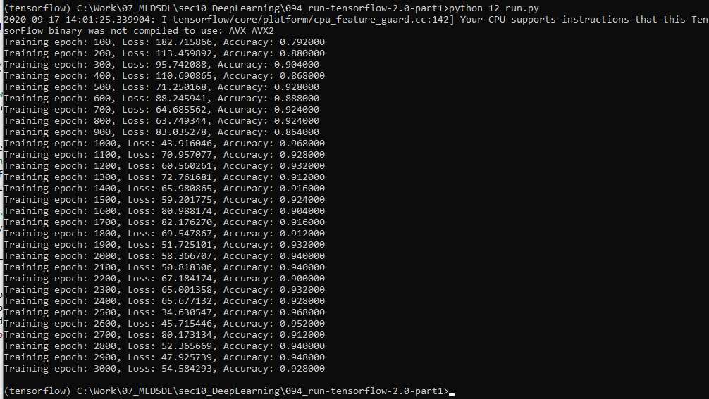
94.12 Run
https://github.com/peterhchen/930_Python_ML_DS_DL
Run
At every 100 epochs (given by display_step), we print out the current values of the loss function and our accuracy metric, by comparing our predicted labels against the known "true" labels. To do this we run our neural network using our trained weights and biases at each point on the current batch of training images, and compute cross entropy and accuracy of the resulting predictions ("pred") to the known correct labels ("batch_y").

Slide 48
94.13 Validation

Slide 49

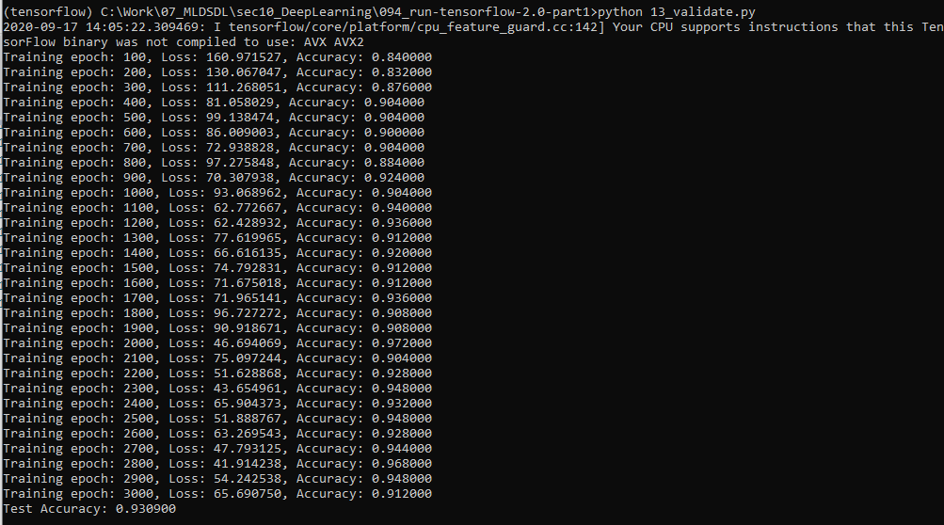
94.13 Validation
https://github.com/peterhchen/930_Python_ML_DS_DL
Validation
You should have about 93% accuracy. Not bad! But hey, we're just starting.

Slide 50
94.14 Verify Misclassified

Slide 51
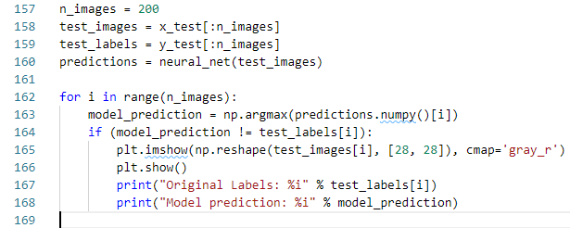
94.14 Verify Misclassified
https://github.com/peterhchen/930_Python_ML_DS_DL
Verify Misclassified
Let's take a look at some of the misclassified images and see just how good or bad our model is, compared to what your own brain can do.
We'll go through the first 200 test images and look at the ones that are misclassified:

Slide 52
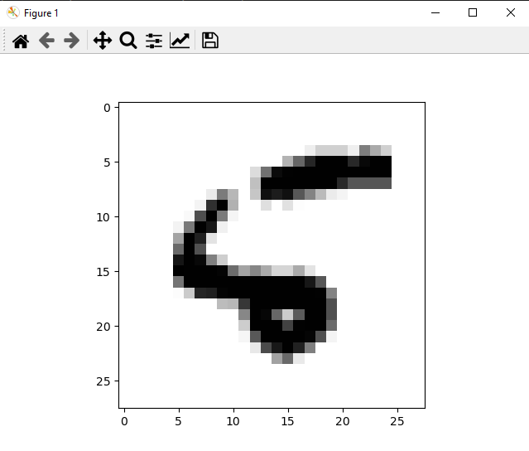
94.14 Verify Misclassified
https://github.com/peterhchen/930_Python_ML_DS_DL
Verify Misclassified
Original labels: 5
Model Prediction: 6

Slide 53
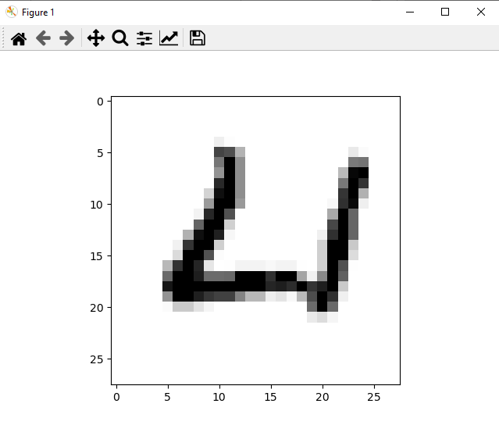
94.14 Verify Misclassified
https://github.com/peterhchen/930_Python_ML_DS_DL
Verify Misclassified
Original labels: 4
Model Prediction: 6

Slide 54
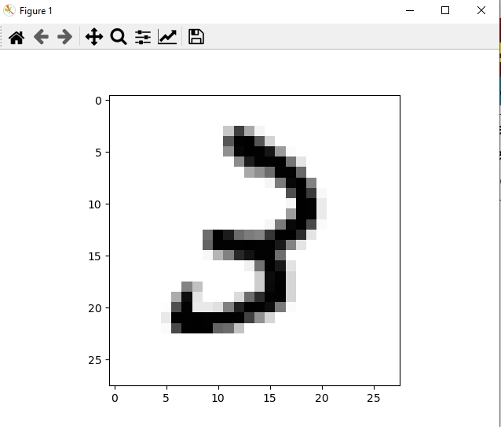
94.14 Verify Misclassified
https://github.com/peterhchen/930_Python_ML_DS_DL
Verify Misclassified
Original labels: 3
Model Prediction: 2

Slide 55
94.15 Exercise

Slide 56
94.15 Exercise
https://github.com/peterhchen/930_Python_ML_DS_DL
Exercise
Improve upon the accuracy.
1. Try using more hidden neurons (nodes).
2. Try using fewer.
3. Try a different learning rate.
4. Try adding another hidden layer.
5. Try different batch sizes.
6. What's the best accuracy you can get from this multi-layer perceptron?

Slide 57
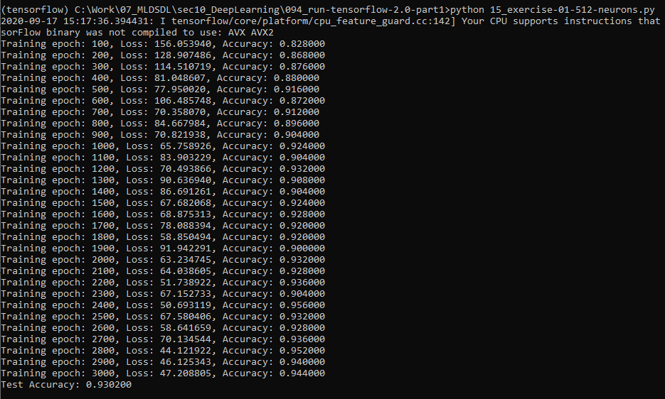
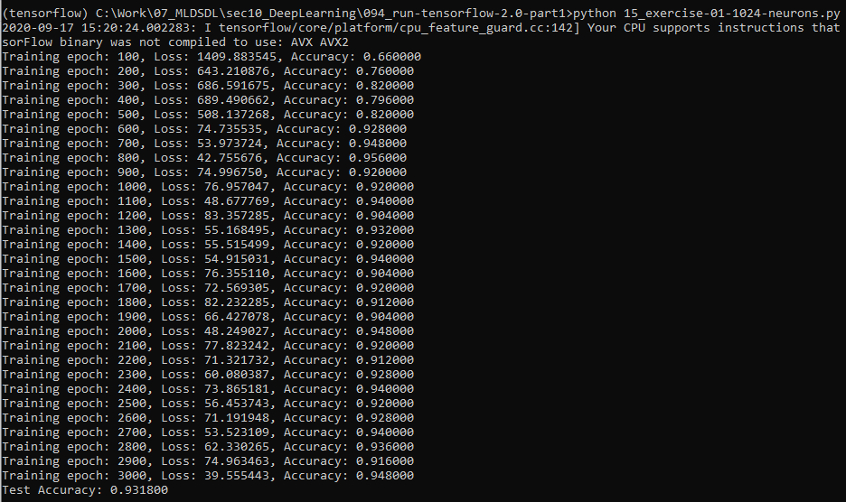
94.15 Exercise
https://github.com/peterhchen/930_Python_ML_DS_DL
Exercise
Improve upon the accuracy.
1. Try using more hidden neurons (nodes).
Ans:
A) h_hidden = 512 => Accuracy = 0.9302
B) h_hidden = 1024 => Accuracy = 0.9318
C) h_hidden = 4096 => Accuracy = 0.1032 (Overfit)

Slide 58
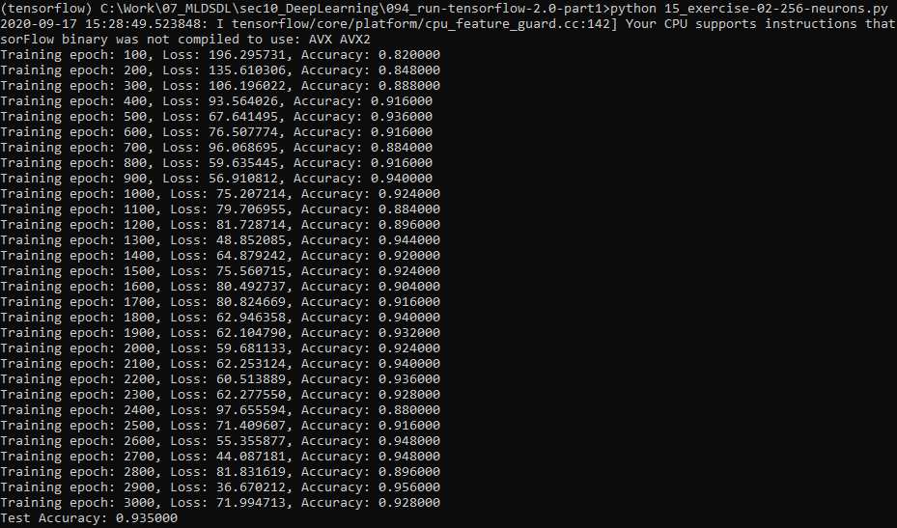
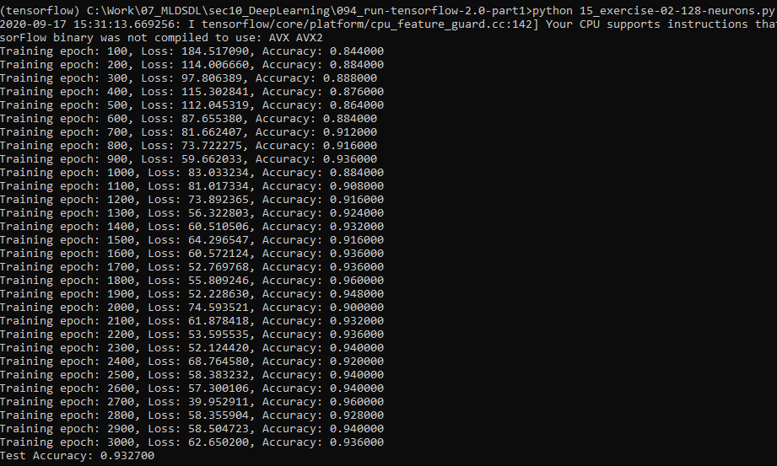
94.15 Exercise
https://github.com/peterhchen/930_Python_ML_DS_DL
Exercise
Improve upon the accuracy.
2. Try using fewer.
A) n_hidden = 512 => Accuracy = 0.9302
B)n_hidden = 256 => Accuracy = 0.9350
B) n_hidden = 125 => Accuracy = 0.9327

Slide 59
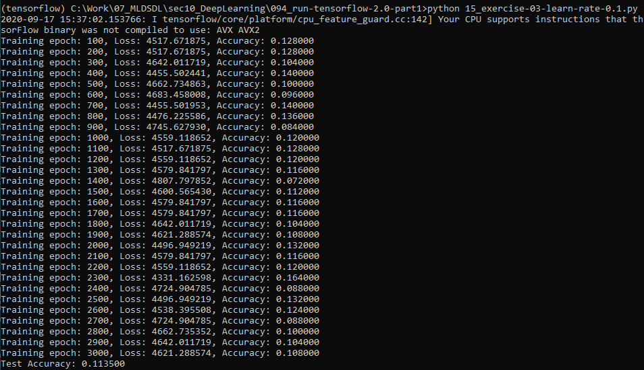
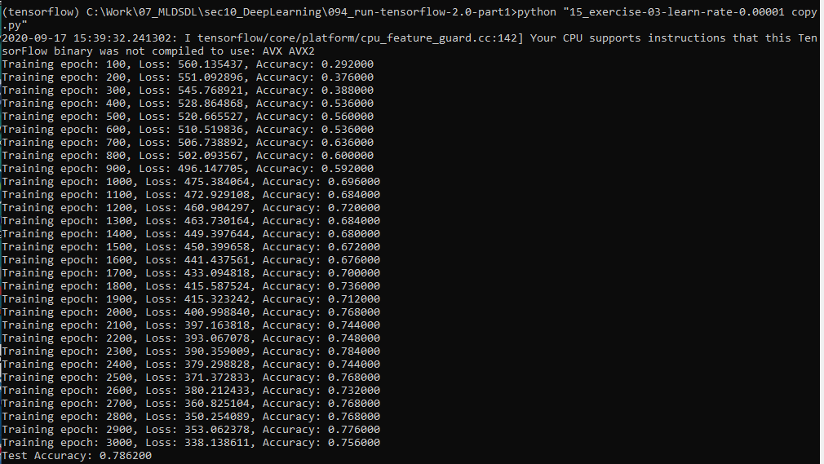
94.15 Exercise
https://github.com/peterhchen/930_Python_ML_DS_DL
Exercise
Improve upon the accuracy.
3. Try a different learning rate.
A) h_hidden = 512, Learning rate = 0.001 => Accuracy = 0.9302
B) h_hidden = 512, Learning rate = 0.1 => Accuracy = 0.113
C) h_hidden = 512, Learning rate = 0.00001 => Accuracy = 0.7862

Slide 60
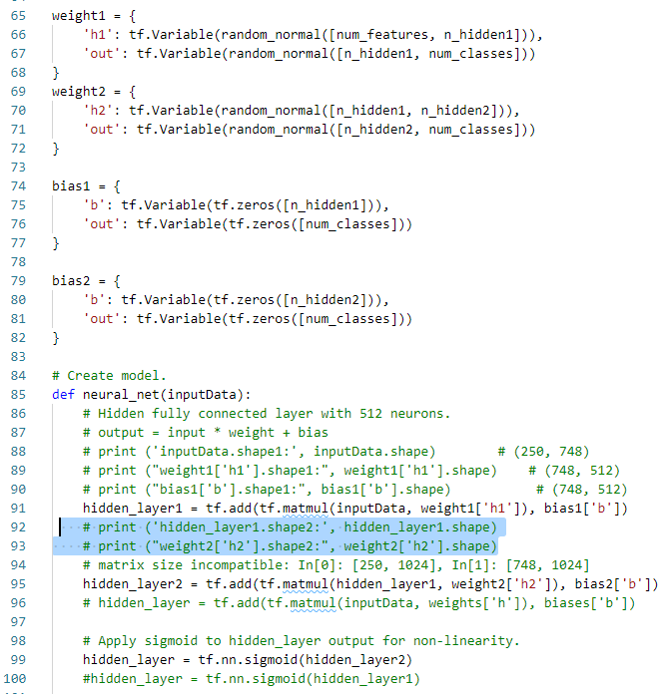
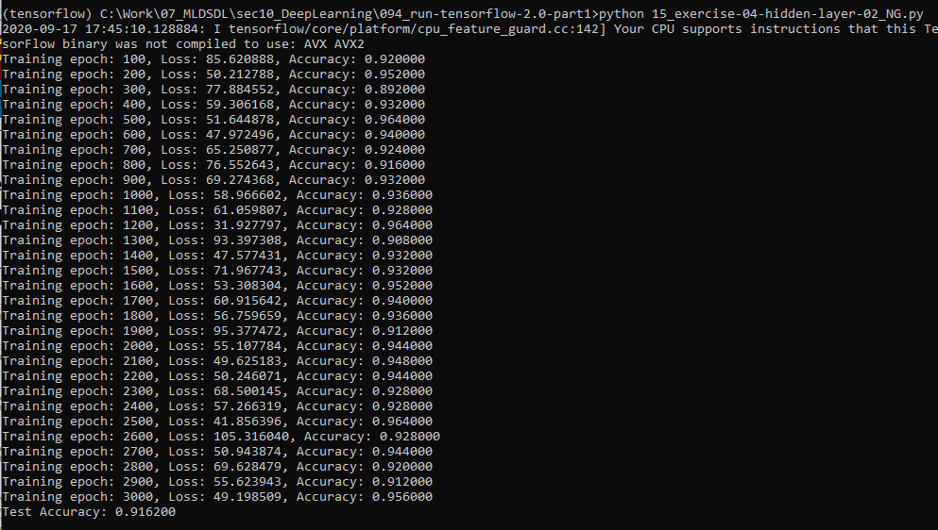
94.15 Exercise
https://github.com/peterhchen/930_Python_ML_DS_DL
Exercise
Improve upon the accuracy.
4. Try adding another hidden layer.
Ans: Add another layers.

Slide 61
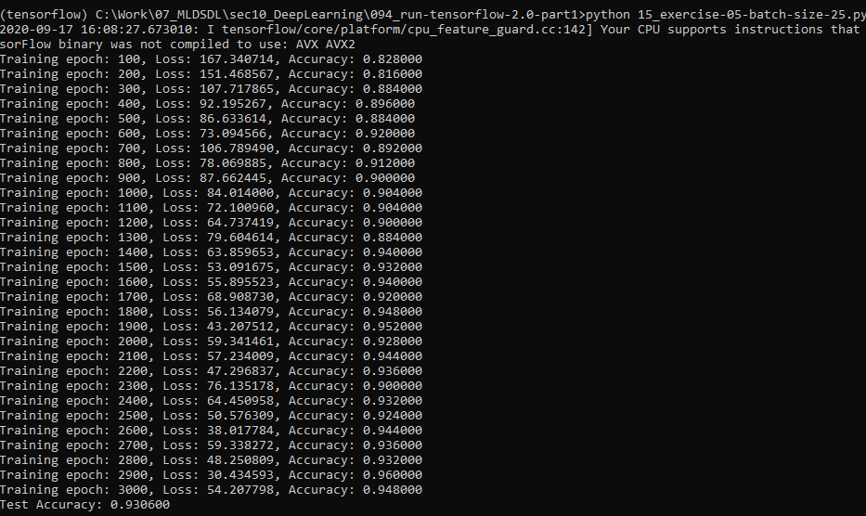
94.15 Exercise
https://github.com/peterhchen/930_Python_ML_DS_DL
Exercise
Improve upon the accuracy.
5. Try different batch sizes.
A) h_hidden = 512, Learning rate = 0.001, batch_size = 250 => Accuracy = 0.9302
B) h_hidden = 512, Learning rate = 0.1 , batch_size = 250 => Accuracy = 0.9306

Slide 62
94.15 Exercise
https://github.com/peterhchen/930_Python_ML_DS_DL
Exercise
Improve upon the accuracy.
6. What's the best accuracy you can get from this multi-layer perceptron?
Ans:
B) h_hidden = 1024 => Accuracy = 0.9318

Slide 63
End of Chapter

