Slide 1

95 Run Tensorflow 2.0: Part 02
Peter H. Chen

Slide 2
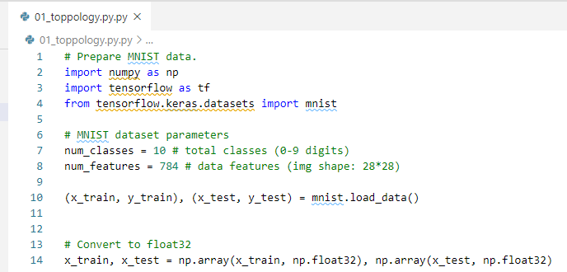
95 Run Tensorflow 2.0: Part 02
https://github.com/peterhchen/930_Python_ML_DS_DL
Tensorflow 2.0: Part 02
We discussed the neural network topology.
We have matrix multiplication and addition functions here.
Open the “Tensorflow.ipynb” or “01_topology.py.

Slide 3
95.1 Multiply and Add Matrix

Slide 4
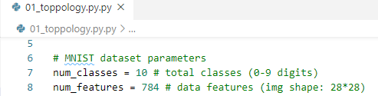
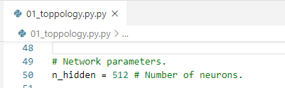
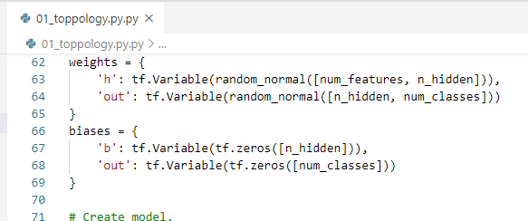
95.1 Multiply and Add Matrix
https://github.com/peterhchen/930_Python_ML_DS_DL
Multiply and Add Matrix
We define num_features = 784 (28 * 28). 784 is the input neurons.
The number of hidden layer of neurons is 512.
The weight is a matrix of num of features (784) x number of neurons in hidden layer (512).
The bias is 512 (number of neurons in hidden layer) x 10 (number of classes)

Slide 5
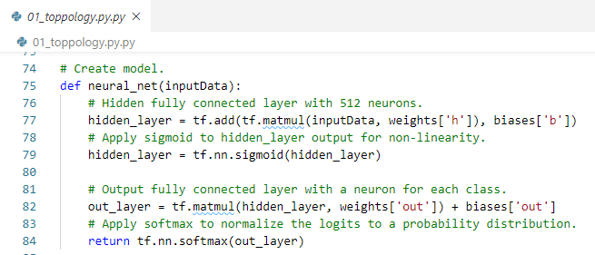
95.1 Multiply and Add Matrix
https://github.com/peterhchen/930_Python_ML_DS_DL
Multiply and Add Matrix
First, td.matmul (inputData, weights): We multiply each one of those input Data by the weights in hidden layer. The tf.add (multiply-result, bias): We add multiplication result and biased terms.
Next, the sigmoid function to the output of that hidden layer. The sigmoid is the activation function on each hidden neuron.

Slide 6
95.1 Multiply and Add Matrix
https://github.com/peterhchen/930_Python_ML_DS_DL
Multiply and Add Matrix
The output layer: matrix multiplication with our output weights, and the hidden layer, and then add in those output biases.

Slide 7
95.1 Multiply and Add Matrix
https://github.com/peterhchen/930_Python_ML_DS_DL
Multiply and Add Matrix
The softmax: normalize those output neurons to a final probability of each individual classification.
The softmax takes the outputs of these neural networks and converts those output neuron values to a probability of each individual classification.

Slide 8
95.1 Multiply and Add Matrix
https://github.com/peterhchen/930_Python_ML_DS_DL
Construct Graph and Topology
At this point, we only define the graph and constructed the topology of the neural network.
We are not training anything or running anything yet.

Slide 9
95.2 Cross Entropy

Slide 10
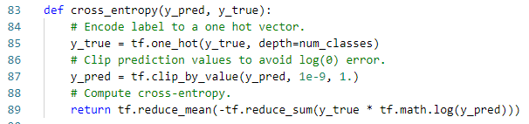
95.2 Cross Entropy
https://github.com/peterhchen/930_Python_ML_DS_DL
Cross Entropy
We define loss function: It uses cross-entropy to calculate the loss.
The loss function performs gradient descent. The loss function penalizes incorrect classifications. That makes training go quickly.

Slide 11
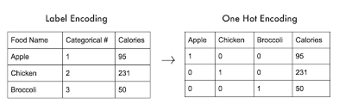
95.2 Cross Entropy
https://github.com/peterhchen/930_Python_ML_DS_DL
Train Neurons
We use one hot encoding for y_true.
What is one hot encoding? We encode the Category label into different digit string.

Slide 12
95.2 Cross Entropy
https://github.com/peterhchen/930_Python_ML_DS_DL
Train Neurons
Next we will define our loss function for use in measuring our progress in gradient descent: cross-entropy, which applies a logarithmic scale to penalize incorrect classifications much more than ones that are close.
In this function, y_pred is the output of our final layer, and we're comparing that against the target labels used for training in y_true.
To compare our known "true" labels of 0-9 to the output of our neural network, we need to convert the labels to "one-hot" encoding.
Our output layer has a neuron for each possible label of 0-9, not a single neuron with an integer in it, for example, [1, 0, 0, 0, 0, 0, 0, 0, 0, 0] represent for ‘0’, [0, 1, 0, 0, 0, 0, 0, 0, 0, 0] represent for ‘2’, [0, 0, 1, 0, 0, 0, 0, 0, 0, 0] represent for ‘3’, …, and [0, 0, 0, 0, 0, 0, 0, 0, 0, 1] represent for ‘9’.
For example, if we have "true" label for an image is ‘1’, we represent that in one-hot format as [0, 1, 0, 0, 0, 0, 0, 0, 0, 0].
This makes it easier to compare the known label to the output neurons.
Each one-hot encoding array has the probability with that.

Slide 13
95.2 Cross Entropy
https://github.com/peterhchen/930_Python_ML_DS_DL
Train Neurons
The tf.clip_by_value (y_pred, clip_value_min, clip_value_max) scale the value sof p_pred between min and max.
Tf.reduce_main () compute the cross-entropy: H(x) = -sum { x in P(x) * log [P(x)]}

Slide 14
95.3 Optimizer

Slide 15
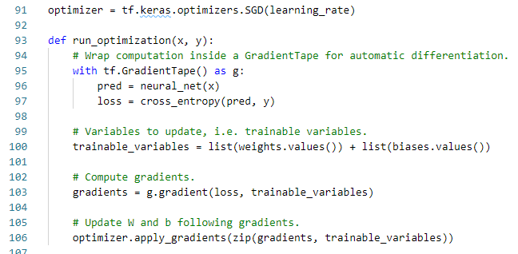
95.3 Optimizer
https://github.com/peterhchen/930_Python_ML_DS_DL
Optimizer
Next, we call tk.keras.optimizers.SGD (learning_rate).
The optimizer uses SGD (stochastic gradient descent) algorithm with learning rate as hyper parameter.
In Machine Learning, the hyper parameter is to control the learning process. The other parameters, such as, weight are derived via training.

Slide 16
95.3 Optimizer
https://github.com/peterhchen/930_Python_ML_DS_DL
Optimizer
We define run_optimization().
This will be very easy if we use high level Keras API.
Right now, we use low level TensorFlow API to understand the internal of optimizer.

Slide 17
95.3 Optimizer
https://github.com/peterhchen/930_Python_ML_DS_DL
Optimizer
We call tf.GradientTape() for differentiation of neural_net() which defines the topology of our neural network.
Compute the lost function (or cross_entropy()) that we defined.
This allows us to optimize this neural network.

Slide 18
95.3 Optimizer
https://github.com/peterhchen/930_Python_ML_DS_DL
Optimizer
We update the trainable variables with weights and bias at each training step.
Compute the gradients with loss and trainable variables.

Slide 19
95.4 Accuracy Metric

Slide 20
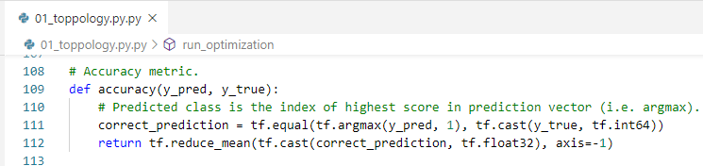
95.4 Accuracy Metric
https://github.com/peterhchen/930_Python_ML_DS_DL
Accuracy Metric
Accuracy Metric compute an accuracy metric at each prediction of each stage.
We use argmax (maximum argument) to compare each output array that is correspond to our one hot encoded value and compare that to the one hot encoded known value that we had for that label.
We call reduce.mean() to compute the accuracy of each individual prediction and average that across the entire dataset.

Slide 21
95.4 Accuracy Metric
https://github.com/peterhchen/930_Python_ML_DS_DL
Accuracy Metric
Now we have everything we need.
1. We have the topology of our network defined.
2. We have the variables defined for our weights and biases.
3. We have a loss function defined which is cross entropy.
4. And we have an optimization function that ties it all together called Run optimization.
5. We have accuracy metric to measure the accuracy of each training process.

Slide 22
95.5 Training Process/Accuracy

Slide 23
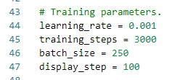
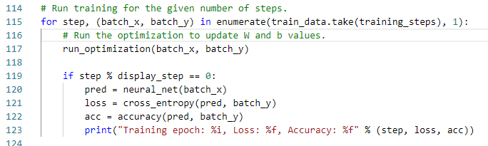
95.5 Training Process/Accuracy
https://github.com/peterhchen/930_Python_ML_DS_DL
Training Process
The Training process contains 3000 training steps. We divide 60000 samples into 250 batches. Each batch contains 240 samples [= (60000 samples)/(250 batches)].
We run optimization at each 3000 training step (Each training step contains 240 samples).
We display the progress every 100 steps of current batch.
Each display the predictions that combined of 250 batches (with cross entropy, loss function, and accuracy metric).
We display the progress every 100 steps of current batch.

Slide 24
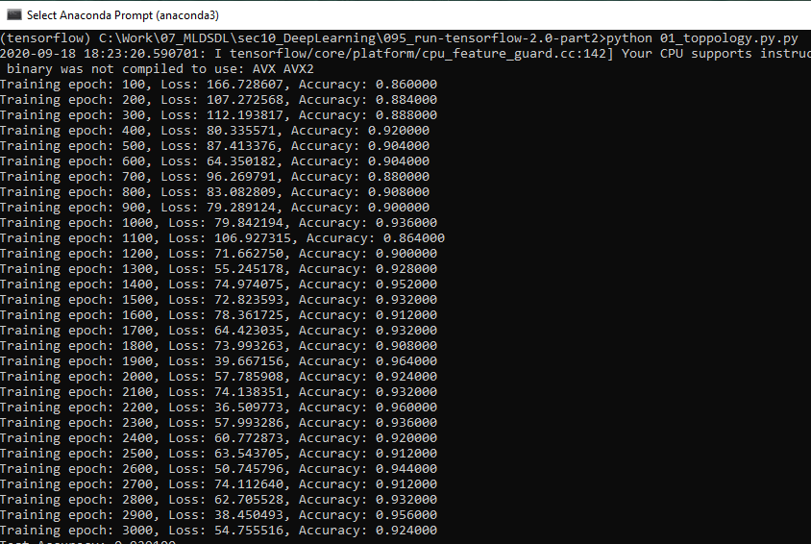
95.5 Training Process/Accuracy
https://github.com/peterhchen/930_Python_ML_DS_DL
Training Accuracy
Each display the predictions that combined of 250 batches (with loss function, and accuracy metric).
We iterative 3000 training steps (or epochs) and we can see that accuracy changing at each steps (or epoch).
The accuracy is fluctuating at each training step (epoch).
We can see the accuracy is tween 86% and 96%.
Note: This accuracy is training accuracy, not the final accuracy.

Slide 25
95.6 Test Accuracy

Slide 26
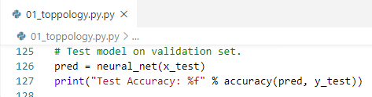
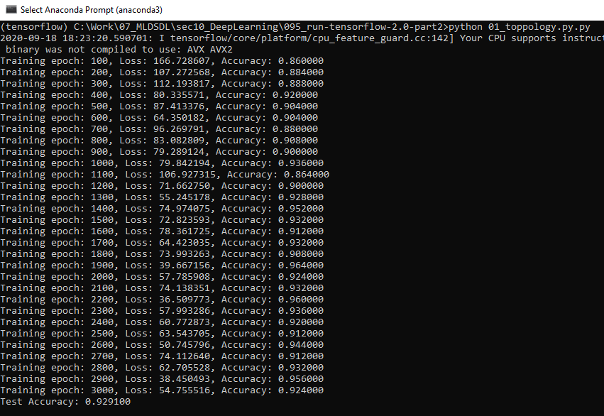
95.6 Test Accuracy
https://github.com/peterhchen/930_Python_ML_DS_DL
Test Accuracy
Now, we have trained the model with weight and bias with 60,000 training samples.
We need to test with rest testing samples (10,000).
We have final training accuracy 92.6% with 60000 traiing samples.
The testing accuracy for 10,000 testing samples is 92%

Slide 27
95.7 Review Misclassified

Slide 28
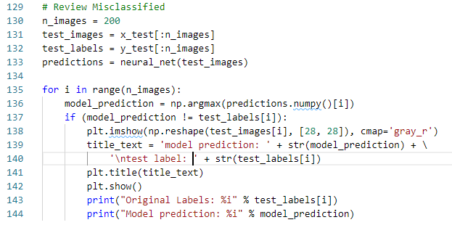
95.7 Review Misclassified
https://github.com/peterhchen/930_Python_ML_DS_DL
Review Misclassified
We test with 15,000 images.
92% (10,000X 92% = 9,200) are correct classified.
8% (10,000 X 8% = 800 images) are incorrect classified.
We will select 200 images to review from 800 misclassified images.

Slide 29
95.7 Review Misclassified
https://github.com/peterhchen/930_Python_ML_DS_DL
Review Misclassified
We take argmax on the output array there of the output neuron layer and comparing that to the known correct labels.
For example, argmax(1000000000) = ‘0’, argmax(0100000000) = ‘1’, argmax(0010000000) = ‘2’, and ....
Check the result with test_label.

Slide 30
95.7 Review Misclassified
https://github.com/peterhchen/930_Python_ML_DS_DL
Review Misclassified
It the prediction is inccrect, then we display the misclassified image.

Slide 31
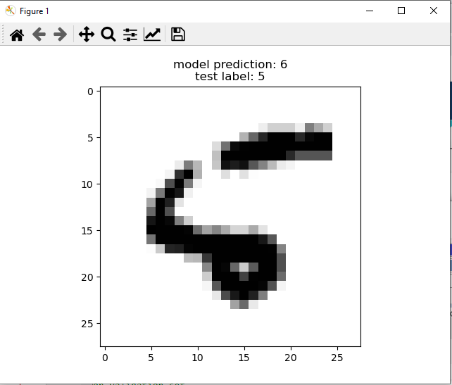
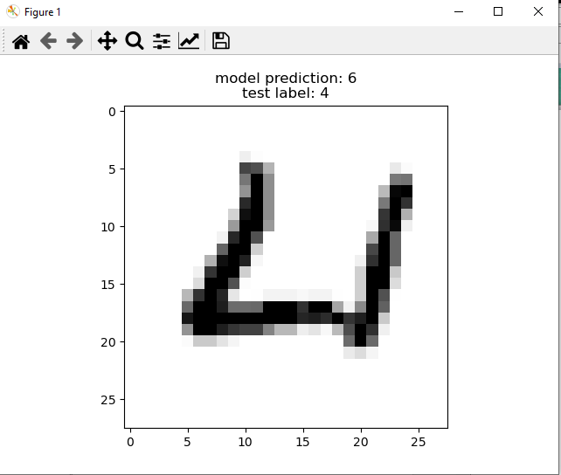
95.7 Review Misclassified
https://github.com/peterhchen/930_Python_ML_DS_DL
Review Misclassified
Misclassified Images: Here, we only show 2 of 200 as below.

Slide 32
End of Chapter

