Slide 1

92 Tensorflow Introduction
Peter H. Chen

Slide 2
92 Tensorflow Introduction
https://github.com/peterhchen/920_Python_ML_DS_DL
Tensorflow Introduction
Deep learning have very famous tensorflow framework.

Slide 3
92.1 Why Tensorflow?

Slide 4
92.1 Why Tensorflow?
https://github.com/peterhchen/920_Python_ML_DS_DL
Why Tensorflow?
Tensorflow is not specifically for neural networks: Tensorflow is an architecture for executing a graph of numerical operations.
Tensorflow can optimize the processing if the graph and distribute its processing across a network.
  Tensorflow is a lot like Apache Spark form distributed computing point of view.
Tensorflow can also distribute work across GPUs.
  Tensorflow can handle massive scale: It was made by Google.
Run on about anything
Highly efficient C++ code with easy to use Python APIs.

Slide 5
92.1 Why Tensorflow?
https://github.com/peterhchen/920_Python_ML_DS_DL
Why Tensorflow? (Explanation)
Tensorflow is a general purpose tool that Google developed. It is useful for developing deep learning and neural networks.
It is an architecture for executing a graph of numerical operations.
It is not just about neural networks, you can have any sequence of operations and define a graph of how those operations fit together.
Tensorflow figures out how to distribute that processing across the various GPU cores on your computer, or across various computers on a network, and run massive distributed computing in a cloud.
In distributed computing, Tensorflow is a lot like Apache Spark.
In big data, Apache spark is also developing machine learning, AI, and deep learning capabilities of its own.
In distributed computing, tensorflow is a competitor to Apache Spark, but there are some key differences.

Slide 6
92.1 Why Tensorflow?
https://github.com/peterhchen/920_Python_ML_DS_DL
Why Tensorflow? (Explanation)
Tensorflow is not just about distributing graphs of computation across a cluster or across your GPU.
For example, Tensorflow can run on iPhone if we want to.
Tensorflow does not limited to run on computers in a cluster in some data center.
This is important because in the real world we want to run in any device and any environment.
For example, we have a self-driving car.
We do not want our car to suddenly crash into a wall just because it lost its network connection to the cloud.
We need to train neural network in car (not in the cloud environment) and run neural network on computer and on embedded system on your car.
You can do training on your computer offline, upload the weights to the embedded system on your car.

Slide 7
92.1 Why Tensorflow?
https://github.com/peterhchen/920_Python_ML_DS_DL
Why Tensorflow? (Explanation)
The embedded system on your car is very small.
We can run the trained neural network completely within our car itself.
The Tensorflow can run deep learning on a various devices with different purposes. It opens all the possibilities of deep learning on the edge.
On the actual devices where you're trying to use it on. Tensor flow is written in C++ under the hood, whereas spark is written in Scala, which ultimately runs on top of a JVM. By going down to the C++ level with tensorflow, that is going to give you greater efficiency, but at the same time it has a python interface so you can talk to it just like you would any other python library, that makes it easy to program and easy to use as a developer, but very efficient and very fast under the hood.
The other key difference between tensor flow and something like spark is that it can work on GPUs.

Slide 8
92.1 Why Tensorflow?
https://github.com/peterhchen/920_Python_ML_DS_DL
Why Tensorflow? (Explanation)
A GPU is just your video card, the same video card that you're using to play fortnight on or whatever it is you play.
In Tensorflow, you can actually distribute the work across the GPU cores on your Computer. It is a very common configuration to even have multiple video cards on a single computer and actually use that to gain more performance on clusters that are purpose built for deep learning.
Tensorflow is free and it is made by Google.
Just the fact that it's made by Google has led to a lot of adoption.
There are competing libraries, such as, Amazon SageMaker, Apache MXNet, but tensorflow by far the most popular.

Slide 9
92.1 Why Tensorflow?
https://github.com/peterhchen/920_Python_ML_DS_DL
Why Tensorflow? (Explanation)
A GPU is just your video card, the same video card that you're using to play fortnight on or whatever it is you play.
In Tensorflow, you can actually distribute the work across the GPU cores on your Computer. It is a very common configuration to even have multiple video cards on a single computer and actually use that to gain more performance on clusters that are purpose built for deep learning.
Tensorflow is free and it is made by Google.
Just the fact that it's made by Google has led to a lot of adoption.
There are competing libraries, such as, Amazon SageMaker, Apache MXNet, and etc. but tensorflow by far the most popular.

Slide 10
92.2 Tensorflow Basics

Slide 11
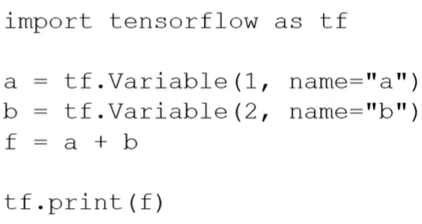
92.2 Tensorflow Basics
https://github.com/peterhchen/920_Python_ML_DS_DL
Tensorflow Basics
Install tensorflow:
  > conda install tensorflow
  Or
  > conda install tensorflow-gpu
A tensor is an array or matrix of values
To use tensorflow, we have to:
Construct a graph to computer your tensor
Initialize your variables
Execute that graph: nothing will happens until execute the graph.
Tensorflow Python code example:

Slide 12
92.2 Tensorflow Basics
https://github.com/peterhchen/920_Python_ML_DS_DL
Tensorflow Basics
Install tensorflow:
  > conda install tensorflow
  Or
  > conda install tensorflow-gpu
A tensor is an array or matrix of values
To use tensorflow, we have to:
Construct a graph to computer your tensor
Initialize your variables
Execute that graph: nothing will happens until execute the graph.
Tensorflow Python code example:

Slide 13
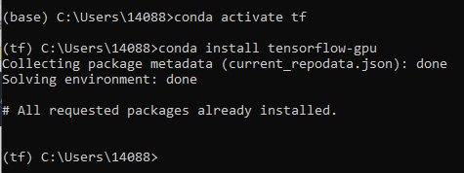
92.2 Tensorflow Basics
https://github.com/peterhchen/920_Python_ML_DS_DL
Tensorflow Basics (Explanation)
Installing tensor flow is really easy.
All you have to do is use the conda command in your Anaconda environment to install tensor flow, or you can use Anaconda Navigator to do it all through a graphical user interface.
You can install tensorflow-gpu on Windows-10 or Linux as below.

Slide 14
92.2 Tensorflow Basics
https://github.com/peterhchen/920_Python_ML_DS_DL
Tensorflow Basics (Explanation)
What is a tensor anyway?
A tensor is just a fancy name for an array or a matrix of values.
For example, a tensor can be stored in the NVIDIA GPU cores.
You computer may include Intel CPU, Intel Math Co-processor, and NVIDIA Graphic Card.
The NVIDIA Graphic card has several thousands of cores can perform parallel thread computation using NVIDIA/GPU cuda libraries.
A Tensor is just a structured collection of numbers.
The tensorflow is similar to Apache Spark, it does not execute right away.
First, Tensorflow build up a graph of how to execute.
Next, Tensor flow will figure out the optimal way to distribute and parallelize that work across your entire set of GPUs and computers in your cluster.

Slide 15
92.2 Tensorflow Basics
https://github.com/peterhchen/920_Python_ML_DS_DL
Tensorflow Basics (Explanation)
Tensorflow Python code example:
We have “1 + 2”. In Tensorflow, we will parallelize add them with GPU across the cluster computer.
We importing the tensorflow as tf (as a shorthand for tensorflow).
Assign 1 to tensor a = tf.Variable (1, name = “a”), internally, Python name = “a”
Assign 2 to tensor b = tf.Vraible (2, name= “b”)
Then f = a + b
Tensorflow Python code example:
f is a graph. f is the connection that you're building up between the a and b tensors to add them together.
f = a + b does not do anything except establish that relationship between a and b and their dependency together on that f graph that you're creating.

Slide 16
92.2 Tensorflow Basics
https://github.com/peterhchen/920_Python_ML_DS_DL
Tensorflow Basics (Explanation)
Nothing actually happens until we called eager execution to execute that graph.
The graph is executed across the entire cluster.
After execution is done, tensorflow print the value 3 in the form of a new tensor f.
For large tensors with larger datasets, for example, a huge array or a matrix of weights and a neural network, the distributed computing becomes very important.
Tensorflow Python code example:

Slide 17
92.3 Tensorflow Neural Network

Slide 18
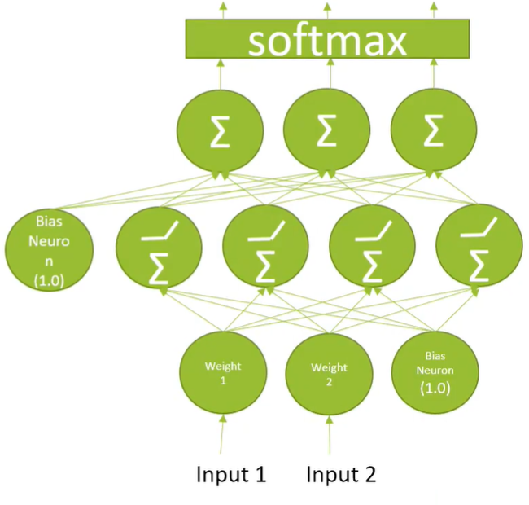
92.3 Tensorflow Neural Network
https://github.com/peterhchen/920_Python_ML_DS_DL
Create Neural Network with Tensorflow
Mathematical insights:
  All those interconnected arrows multiplying weights can be thought as a big matrix multiplication.
  The bias term is added onto the result of the matrix multiplication.
In Tensorflow, we can define a layer of a neural networks.
> output = tf.matmul (previous_layer, layer_weigths) + layer_biases
The above is the “hard way.”
Tensorflow API uses much simpler of doing this.

Slide 19
92.3 Tensorflow Neural Network
https://github.com/peterhchen/920_Python_ML_DS_DL
Create Neural Network with Tensorflow (Explanation)
How do we extend this idea to neural networks?
With tensor flow, it is not only made for neural networks, but also can do things like matrix multiplication.
You can think about applying all the different weights and sums that happen within a single layer of a perceptron, and model that as just a matrix multiplication.

Slide 20
92.3 Tensorflow Neural Network
https://github.com/peterhchen/920_Python_ML_DS_DL
Create Neural Network with Tensorflow (Explanation)
You can just take the output of the previous layer and your multi-layer perceptron, and do a matrix multiplication with a matrix that describes the weights between each neuron of the two layers that you’re computing.
Then you can add in a vector that contains the biased terms as well, so you can modify this fancy diagram here of what a perceptron looks like.
And just model it as a matrix multiplication in vector addition.

Slide 21
92.3 Tensorflow Neural Network
https://github.com/peterhchen/920_Python_ML_DS_DL
Create Neural Network with Tensorflow (Explanation)
Go back and read up on your linear algebra if you want to know more about how that works mathematically.
But this is just a straightforward matrix multiplication operation with a vector addition at the end for the bias terms. By using tensor flows lower level API.
We're kind of doing this the hard way.
But there are higher level APIs in tensor flow that make it much simpler and more intuitive to define deep neural networks, as we're describing tensor flow at a low level right now.

Slide 22
92.3 Tensorflow Neural Network
https://github.com/peterhchen/920_Python_ML_DS_DL
Create Neural Network with Tensorflow (Explanation)
Tensorflow purpose is to distribute mathematical operations on groups of numbers or tensors, and it is up to us how to describe what to do in mathematical terms.
It is really not that hard to do with a neural network.

Slide 23
92.4 Create NN with Tensorflow

Slide 24
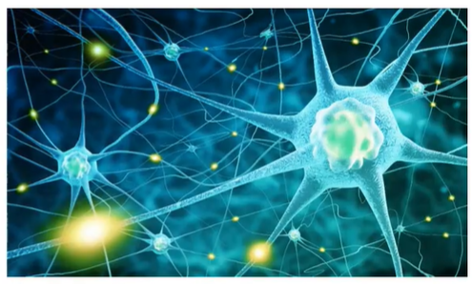
92.4 Create NN with Tensorflow
https://github.com/peterhchen/920_Python_ML_DS_DL
Create Neural Network with Tensorflow
Load up our training and testing data
Construct a graph describing our neural network
Associate an optimizer, i.e., gradient descent, to the network
Run the optimizer with your training data
Evaluate your trained network with your testing data.

Slide 25
92.4 Create NN with Tensorflow
https://github.com/peterhchen/920_Python_ML_DS_DL
Create Neural Network with Tensorflow (Explanation)
For us to actually compute a complete deep learning network from end to end.
There's more to it than just computing the weights between different layers of neurons.
We have to actually train this thing somehow and actually run it when we're done.
So the first thing we need to do is load up the training data that contains the features that we want to train on, and the target labels to train a neural network.

Slide 26
92.4 Create NN with Tensorflow
https://github.com/peterhchen/920_Python_ML_DS_DL
Create Neural Network with Tensorflow (Explanation)
You need to have a set of known inputs, with a set of known correct answers.
You need to use gradient descent, converge to the correct solution of weights that lead to the behavior that you want.
After that we need to associate some sort of an optimizer to the network. Tensor flow makes that very easy to do.
It can be gradient descent, or some variation thereof such as Adam.
We will then run our optimizer using our training data.

Slide 27
92.4 Create NN with Tensorflow
https://github.com/peterhchen/920_Python_ML_DS_DL
Create Neural Network with Tensorflow (Explanation)
And again tensorflow makes that pretty easy to do as well.
Finally we'll evaluate the results of our training network using our test data set.

Slide 28
92.4 Create NN with Tensorflow
https://github.com/peterhchen/920_Python_ML_DS_DL
Create Neural Network with Tensorflow (Explanation)
To recap at a high level.
We're going to create a given network topology and fit the training data using gradient descent to actually converge on the optimal weights between each neuron in our network.
When we're done, we can evaluate the performance of this network using a test dataset that it's never seen before and see if it can correctly classify that data that it was not trained on.

Slide 29
92.5 Normalize Features

Slide 30
92.5 Normalize Features
https://github.com/peterhchen/920_Python_ML_DS_DL
Make Sure your Features are Normalized
Neural Network usually work best if your input data is normalized.
  That is, 0 mean and unit variance
  The real goal is that every input features is comparable in terms of magnitude
scikit_learn’s StandardScaler can do this for us
Many data sets are normalized to begin with, such as, the one we are going to use.

Slide 31
92.5 Normalize Features
https://github.com/peterhchen/920_Python_ML_DS_DL
Make Sure your Features are Normalized (Explanation)
One other Gotcha (Trap)
When you're using neural networks, it's very important to make sure that your input data is normalized, meaning that's all scaled into the same range.
Generally speaking, you want to make sure that your input data has a mean value of zero and unit variance.
That's just the best way to make the various activation functions work out mathematically.
What's really important is that your input features are comparable in terms of magnitude.
Otherwise it's hard to combine those weights together in a meaningful way.
Your inputs are all the same level at the bottom of your neural network and fitting into that bottom layer.
It's important that there are comparable in terms of magnitude so you don't end up skewing things and weighting things in weird ways.

Slide 32
92.5 Normalize Features
https://github.com/peterhchen/920_Python_ML_DS_DL
Make Sure your Features are Normalized (Explanation)
For example, if I already created a neural network that tries to classify people based on their age and their income, age might range from zero to one hundred but income might range from zero to a million.
Those are wildly different ranges.
So those are going to lead to real mathematical problems if they're not scaled down to the correct range at first.
Fortunately, Python scikit-learn library has a StandardScaler package that you can use that will automatically do that with just one line of code.
All you have to do is remember to use it.
And many datasets that we use while researching will be normalized to begin with, the one we're about to use is already normalized, so we don't actually have to do that.
But later on, we will use StandardScaler.

Slide 33
92.5 Normalize Features
https://github.com/peterhchen/920_Python_ML_DS_DL
Make Sure your Features are Normalized (Explanation)
We've talked about how this all works at a low level.
In tensorflow 2, it is still possible to implement a complete neural network basically from scratch.
In tensorflow 2, they have replaced much of that low level functionality with a higher level API called Keras.
There is value in understanding how it all works under the hood first.
So let's work through a simple example of a neural network using the lower level APIs next.
After that, we will use the Keras API which simplifies common neural network setups, and hides a lot of this complexity from you.

Slide 34
End of Chapter

