Slide 1

77 Spark Decision Tree
Peter H. Chen

Slide 2
77 Spark Decision Tree
https://github.com/peterhchen/900_Python_ML_DS_DL
Spark Decision Tree
Let's look at some actual Spark code to make a decision tree using MLLib.

Slide 3
77 Spark Decision Tree
https://github.com/peterhchen/900_Python_ML_DS_DL
Open Anaconda Terminal
Open up your Anaconda prompt or your terminal depending on your operating system.
Cannot run Spark under the Jupyter Notebook.
We need VS Code editor (or Spyder).
01_spark-decision-tree.py
In the real world project, we run python code on a cluster. We use script called Spark-submit that comes with spark that will interpret that Python script and distribute it throughout the rest of the cluster for us.
Use Jupyter Notebook takes a little bit more work to do.

Slide 4
77.1 Import Spark Machine Learning Package

Slide 5
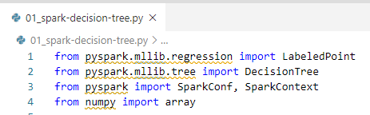
77.1 Import Spark Machine Learning Package
https://github.com/peterhchen/900_Python_ML_DS_DL
Import Spark Machine Learning Package
For regression of Spark Machine Learning, we need import labeledPoint package
For decision tree of Spark Machine Leering, we need tree package.
For Spark, we need import SparkConf and SparkContext package.
For array, we import numpy package.
Note:
Keep in mind that spark is not going to make everything from numpy and scikit learn distributable and parallelized across a cluster.
If your code contains numpy and scikit-learn functions, they will run inside the specific node. They will not run distribute in the cluster.
We have to call function in MLLib to distribute them to the cluster.

Slide 6
77.2 Spark Configuration and Context

Slide 7

77.2 Spark Configuration and Context
https://github.com/peterhchen/900_Python_ML_DS_DL
Spark Configuration and Spark Context
First, we need to SparkConf for object configuration.
Second, we need to set up a SparkContext. Spark Context is environment that we run spark and distribute in cluster. Spark distribute the code, organize the submit order, run them, and assembled results back together across your cluster.
SparkConf: Setup local computer. If we have a cluster, we have to specify the cluster name. Then, we specify the application name.
SparkContext (): Pass the configuration object to the Spark Context.

Slide 8
77.3 Python Function

Slide 9
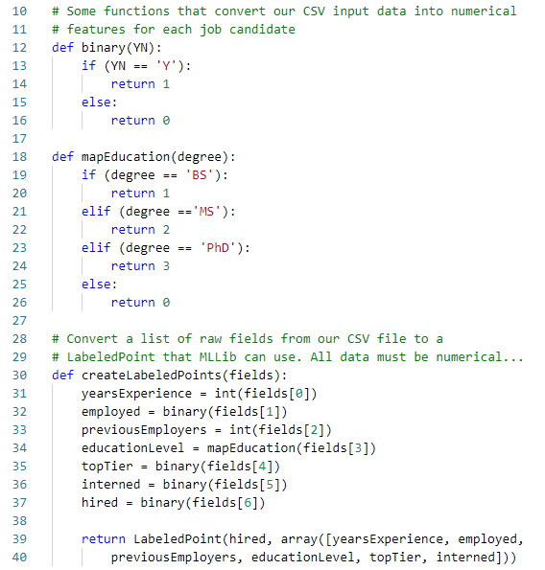
77.3 Python Function
https://github.com/peterhchen/900_Python_ML_DS_DL
Python Function
There are some Python Functions.

Slide 10
77.4 Read and Filter PastHires.csv

Slide 11

77.4 Read and Filter PastHires.csv
https://github.com/peterhchen/900_Python_ML_DS_DL
Read PastHires.csv
Rad data from the PastHires.csv file by textFile from Spark Context.
We read the first line header with first() of Spark Context.
Then, we filter out the header and read into raw data with filter() of Spark Context.

Slide 12
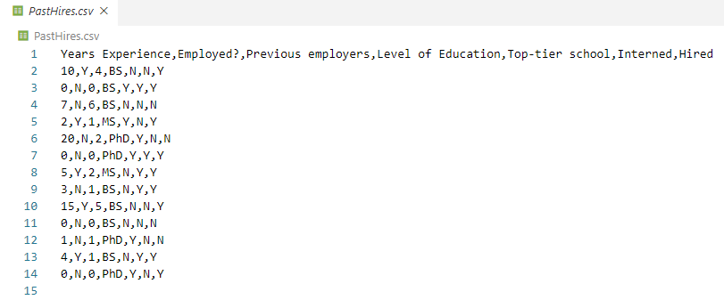
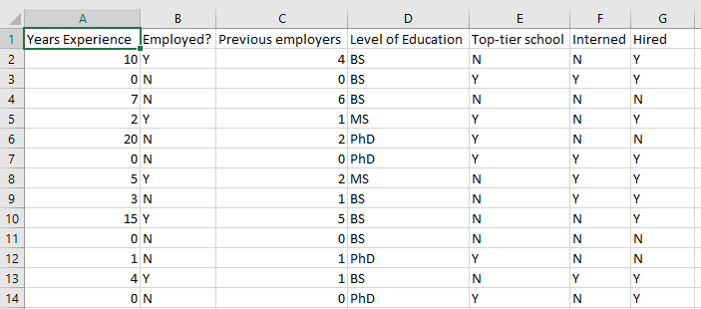
77.4 Read and Filter PastHires.csv
https://github.com/peterhchen/900_Python_ML_DS_DL
Open PastHires.csv
Open PastHores.csv and check the content.
It is a CSV (Comma Separated Value) format. We can open it by Excel as well.

Slide 13
77.4 Read and Filter PastHires.csv
https://github.com/peterhchen/900_Python_ML_DS_DL
Read data
Because of convenient purpose, people are migrating more using datasets instead of complicated distributed rdds (resilient distributed dataset).
We can also use rdds or SQL as well. It does not make any difference.
In this case, we use simple datasets.
For all the text data, such as, BS, MS, or PHD, we need to convert the text data into numerical data format because regression only recognize the digital data value only.

Slide 14
77.5 Split Line to List

Slide 15
77.5 Split Line to List
https://github.com/peterhchen/900_Python_ML_DS_DL
Split Line to List
Split on the actual line using the comma.
We call a map function to map to a List/Array.

Slide 16
77.6 Convert List to LabeledPoints

Slide 17

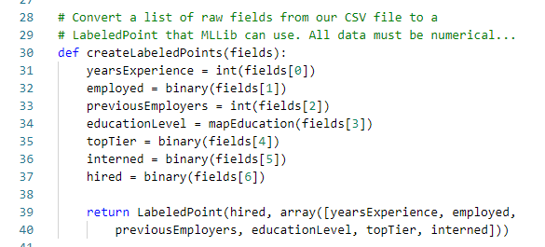
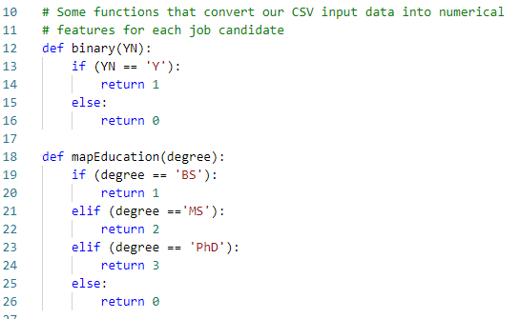
77.6 Convert List to LabeledPoints
https://github.com/peterhchen/900_Python_ML_DS_DL
Convert List to LabeledPoints
We call map with our function named createLabeledPoints.
Our createLabeledPoints convert the all Label Texts, Year into integer, Ye/No (employed, top tier university, interned, hired) into 0/1, Education (BS, MS, PHD) into digital values (0, 1, 2). Machine Learning only recognize the numerical value.
Return the LabeledPoints data at the end of createLabeledPoints() function.

Slide 18

77.6 Convert List to LabeledPoints
https://github.com/peterhchen/900_Python_ML_DS_DL
Convert List to LabeledPoints
We have a new rdd (Resilient Distributed Dataset) called trainingData that contains all of our training data converted into numerical data and ultimately converted into labeled points which is what MLLib expects.

Slide 19
77.7 Test Candidate for Spark RDD

Slide 20
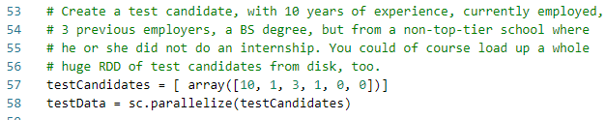
77.7 Test Candidate for Spark RDD
https://github.com/peterhchen/900_Python_ML_DS_DL
Create Test Candidate for Spark RDD
Now, we have all the data. We can start playing with MLLib.
Let's create a set of test candidates to try this out with this example.
We will just set up one person here.
We are going to set up an array [10, 1, 3, 1, 0, 0].
This array contains information that represents 10 years of prior experience (10), they are currently employed (1), they had three previous employers (3), they currently have a B.S. degree (1), they are not from a top tier school (0), and they did not do an internship (0).
We have set up this testCandidate to see if we can actually make a prediction.
We create an rdd (resilient distributed dataset) for spark using the parallelize function for testCandidate.

Slide 21
77.8 Train Model

Slide 22

77.8 Train Model
https://github.com/peterhchen/900_Python_ML_DS_DL
Train Spark model by MLLib Decision Tree Classifier
Next, we create decision tree classifier.
We call MLLib DecisionTree package and trainClassifier() function.
trainingData (rdd labeled training data)
numClasses = 2 (hire/not hire).
categorical features: categoricalFeatresInfo={1:2, 3:4, 4:2, 5:2}
impurity function = ‘gini’ (entropy measurement for classification)
maximum depth = 5, and
maximum number of bins = 32.

Slide 23
77.8 Train Model
https://github.com/peterhchen/900_Python_ML_DS_DL
Train Spark model by MLLib Decision Tree Classifier
https://spark.apache.org/docs/2.2.0/mllib-decision-tree.html
categoricalFeaturesInfo:
Specifies which features are categorical and how many categorical values each of those features can take. This is given as a map from feature indices to feature arity (number of categories).
Any features not in this map are treated as continuous.
For example, Map(0 -> 2, 4 -> 10) specifies that feature 0 is binary (taking values 0 or 1) and that feature 4 has 10 categories (values {0, 1, ..., 9}).
Note that feature indices are 0-based: features 0 and 4 are the 1st and 5th elements of an instance’s feature vector.
Note that you do not have to specify categoricalFeaturesInfo.
The algorithm will still run and may get reasonable results. However, performance should be better if categorical features are properly designated.

Slide 24
77.8 Train Model
https://github.com/peterhchen/900_Python_ML_DS_DL
Train Spark model by MLLib Decision Tree Classifier
categorical features: categoricalFeatresInfo={1:2, 3:4, 4:2, 5:2}
Started from index 0:
Index 1: Employed? Value = 2 (Yes/No)
Index 3: Level of Education; 4 (None/BS/MS/PHD)
Index 4: Top-Tier School; 2 (Yes/No)
Index 5: Interned; 2 (Yes/No)
0
1
3
4
5

Slide 25
77.9 Predict Result

Slide 26
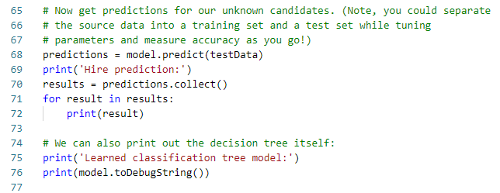
77.9 Predict Result
https://github.com/peterhchen/900_Python_ML_DS_DL
Predict Result
Once we have that model trained. We use model to make predictions.
We call model.predict for rdd = testCandidate.
We print out the result prediction.

Slide 27
77.10 Collect Result

Slide 28
77.10 Collect Result
https://github.com/peterhchen/900_Python_ML_DS_DL
Collect Result
We collect the result by predictions.collect().
This call ask Spark to give me an answer after the distributed submission to clouds computing.
It is not collect the result until this point that spark finish the cloud computing.
The Spark will construct DAG (Directed Acyclic Graph) with available resource and find the optimal way to submit the jobs and then collect the cloud computing result.

Slide 29
77.11 Spark Submit Python

Slide 30
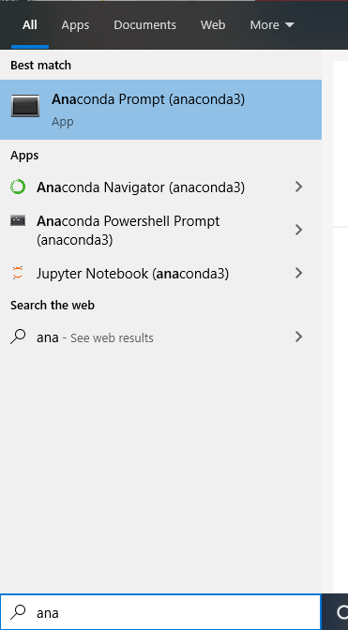
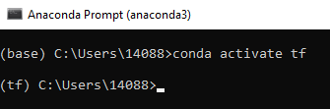
77.11 Spark Submit Python
https://github.com/peterhchen/900_Python_ML_DS_DL
Spark Submit Python
1. In windows, search for anaconda prompt:
2. Activate the tf (tensorflow) environment:
(base) …> conda activate tf
(tf) …>
1
2

Slide 31
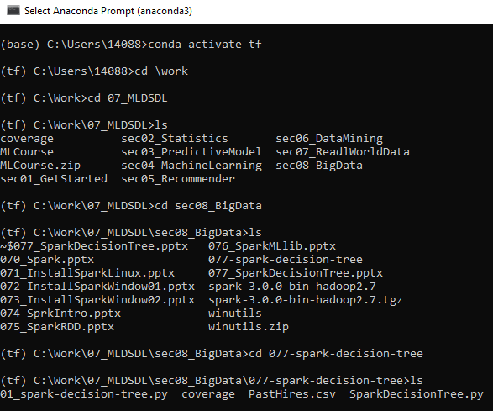
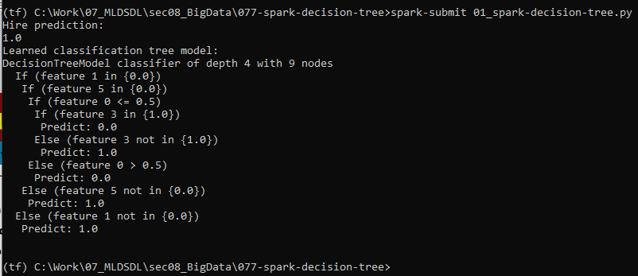
77.11 Spark Submit Python
https://github.com/peterhchen/900_Python_ML_DS_DL
Spark Submit Python
In anaconda prompt with Python environment:
1. change the folder to working directory
(tf) > cd <working-directory)
2. submit python code to Spark cloud
(tf) … > spark-submit 01_spark-decision-tree.py
1
2

Slide 32
77.12 Spark Result Discussion

Slide 33
77.12 Spark Result Discussion
https://github.com/peterhchen/900_Python_ML_DS_DL
Spark Result Discussion
Result
The test prediction shows that we would hire that person.
We also see the actual decision tree printed out here.
We do not have nice pretty graphical representation like we did before because we are in the command console here.
But you can still interpret this.

Slide 34
77.12 Spark Result Discussion
https://github.com/peterhchen/900_Python_ML_DS_DL
Spark Result Discussion
Result say:
if feature 1 in {0.0}. (Feature 1 is “Employed?”, Y is interpret as {1.0} and N is {0.0}). If he is not employed, then ....
1
3
4
5

Slide 35
77.12 Spark Result Discussion
https://github.com/peterhchen/900_Python_ML_DS_DL
Spark Result Discussion
Result say:
if feature 5 in {0.0}. (Feature 5 is “Interned”, N is interpret as {0.0})
If he is Not Employed (N) and he is are not interned (N), then …
1
3
4
5

Slide 36
77.12 Spark Result Discussion
https://github.com/peterhchen/900_Python_ML_DS_DL
Spark Result Discussion
Result say:
if feature 0 <= 0.5. (Feature 0 is “Years of experience”) , then …
0
1
3
4
5

Slide 37
77.12 Spark Result Discussion
https://github.com/peterhchen/900_Python_ML_DS_DL
Spark Result Discussion
Result say:
Finally, it print the result “Predicts: 1.0”. 1.0 means Y.
The result is “Hire”.

Slide 38
End of Chapter

