Slide 1

94 Run Tensorflow 2.0: Part 01
Peter H. Chen

Slide 2
94 Run Tensorflow 2.0
https://github.com/peterhchen/930_Python_ML_DS_DL
Tensorflow 2.0
Tensorflow 2.0 has dependencies for Windows 10, Anaconda 3, Python 3, and numpy, scipy, and associated frameworks.
After environment update, it is very difficult to fix with tons of error messages.
Thanks Jeff Heaton who provide the video and yaml file tensorflow.yml.
YouTube video:
https://www.youtube.com/watch?v=RgO8BBNGB8w&t=376s
Jeff Heaton GitHub:
https://github.com/jeffheaton/t81_558_deep_learning

Slide 3
94.1 Create Tensorflow Environment

Slide 4
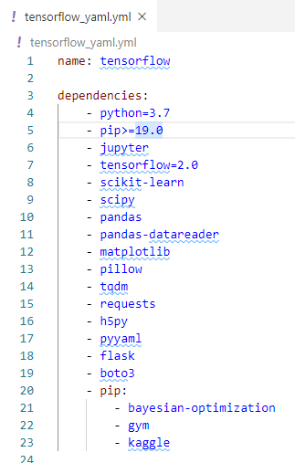
94.1 Create Tensorflow Environment
https://github.com/peterhchen/930_Python_ML_DS_DL
Create Tensorflow Environment
2020, Installing TensorFlow 2.0, Keras, & Python 3.7 in Windows 10
Download the tensroflow.yml
This file contains the environment setup for us.

Slide 5
94.2 Install Jupyter

Slide 6

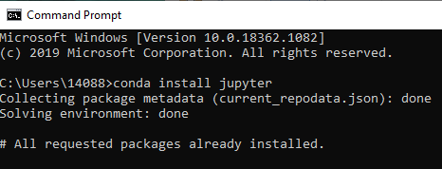
94.2 Install Jupyter
https://github.com/peterhchen/930_Python_ML_DS_DL
Install Jupyter
Download Anaconda or MiniConda on window 10.
Under window 10
> conda install jupyter

Slide 7
94.3 Install Tensorflow Environments

Slide 8
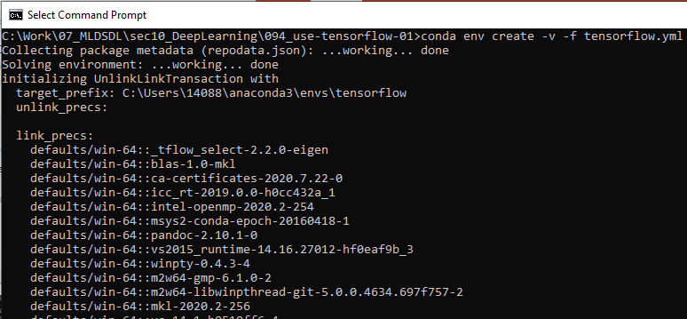
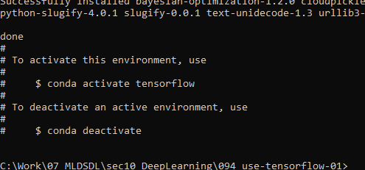
94.3 Install Tensorflow Environments
https://github.com/peterhchen/930_Python_ML_DS_DL
Install Tensorflow and Associated Environments
This is very important: The provided tensorflow.yml includes the verified dependencies and frameworks.
This prevent us to use incompatible dependencies and very difficult to fix.
C:\[work-folder] > conda env create –v -f tensorflow.yml

Slide 9
94.4 Start Tensorflow Environments

Slide 10
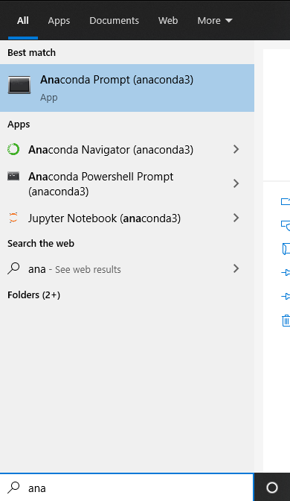
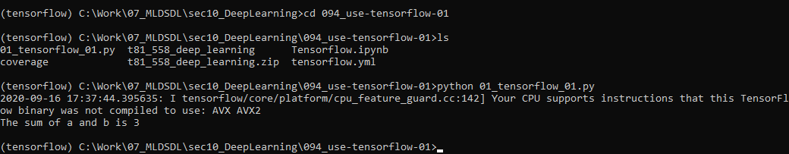
94.4 Start Tensorflow Environments
https://github.com/peterhchen/930_Python_ML_DS_DL
Start Tensorflow Environments
start anaconda prompt
> conda activate tensorflow
> cd <work-folder>

Slide 11
94.5 Run Jupyter Tensorflow

Slide 12
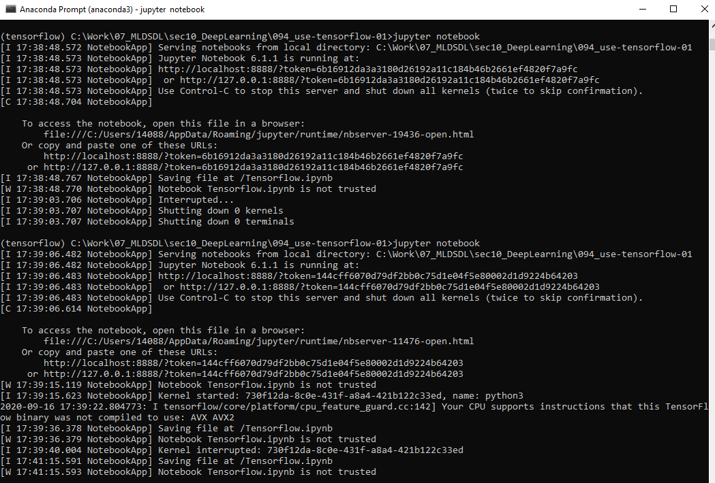
94.5 Run Jupyter Tensorflow
https://github.com/peterhchen/930_Python_ML_DS_DL
Start Jupyter Notebook
> ls
> jupyter notebook

Slide 13
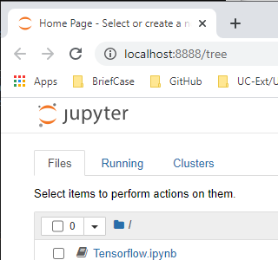
94.5 Run Jupyter Tensorflow
https://github.com/peterhchen/930_Python_ML_DS_DL
Use Tensorflow 01
We can see “Tensorflw.ipynb”
Double click to open

Slide 14
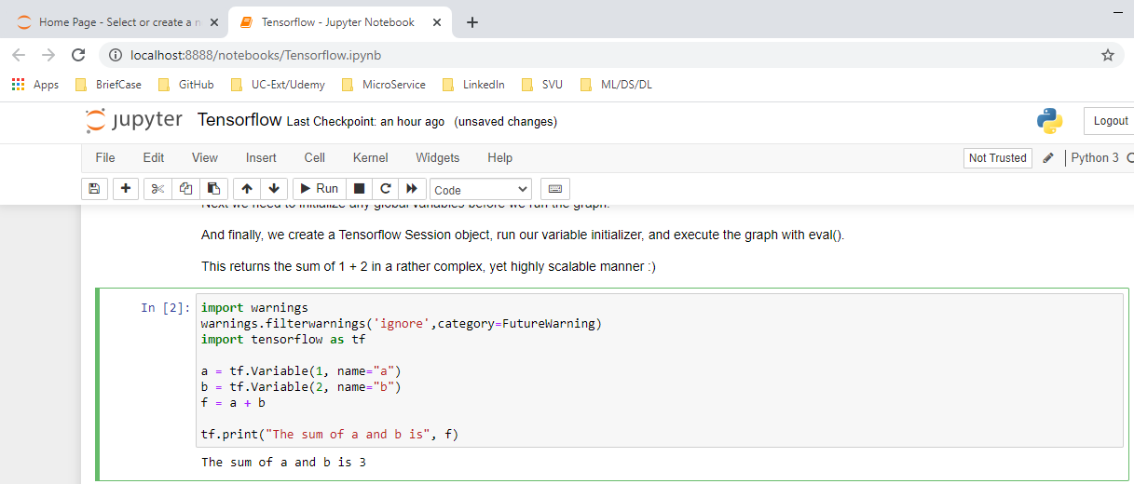
94.5 Run Jupyter Tensorflow
https://github.com/peterhchen/930_Python_ML_DS_DL
Use Tensorflow 01
We can see “Tensorflw.ipynb”
Double click to open

Slide 15
94.6 Run Python Tensorflow
Peter H. Chen

Slide 16
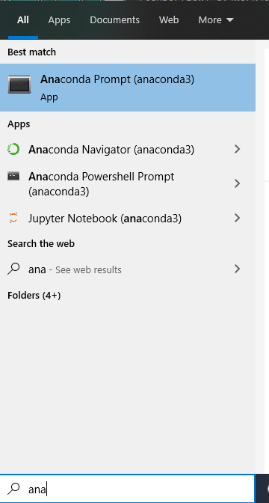
94.6 Run Python Tensorflow
https://github.com/peterhchen/930_Python_ML_DS_DL
Run Python Tensorflow
Under window 10
Search “anaconda”

Slide 17
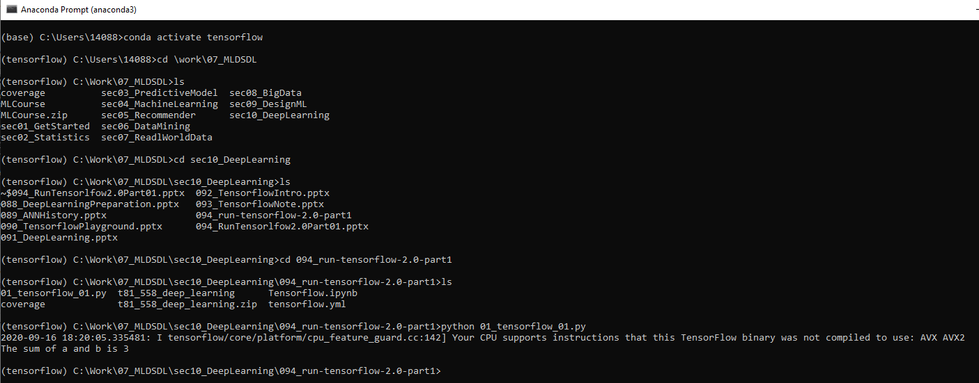
94.6 Run Python Tensorflow
https://github.com/peterhchen/930_Python_ML_DS_DL
Run Python Tensorflow
Activate TensorFlow environment
(base) > conda activate tensorflow
(tensorflow) > cd [work folder]
(tensorflow) > [work folder] > python 01_tnesorflow_01.py

Slide 18
End of Chapter

