Slide 1

1 Python Machine Learning
Peter H. Chen

Slide 2
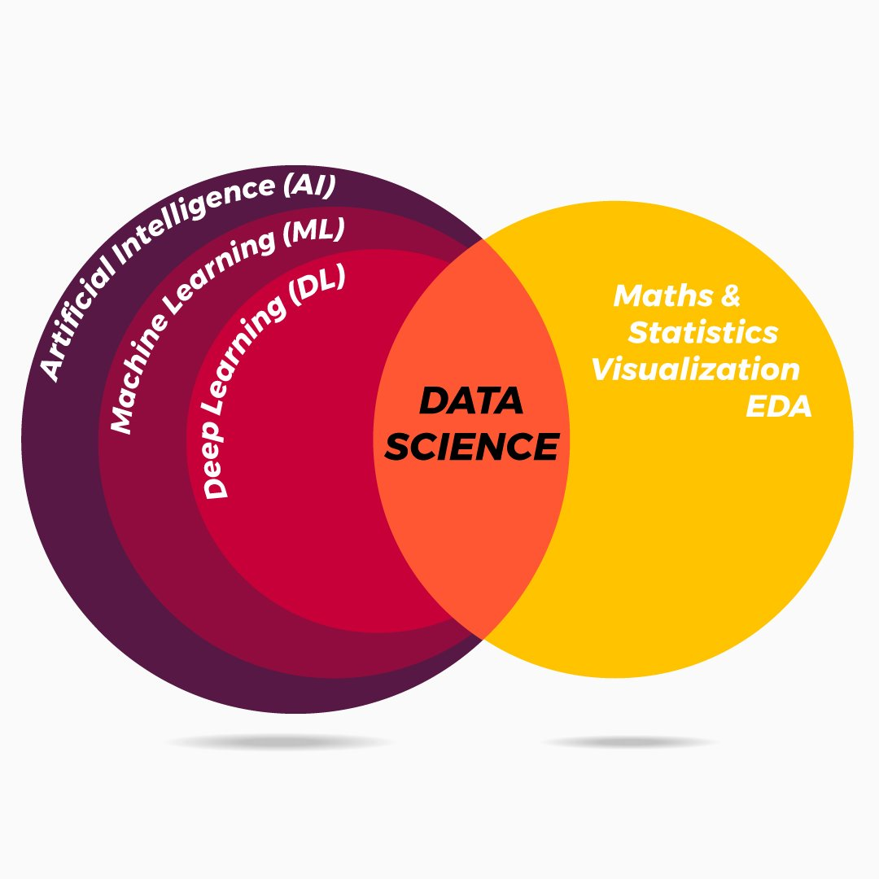
1 Python Machine Learning
https://www.udemy.com/course/data-science-and-machine-learning-with-python-hands-on/learn/lecture/4020038#overview
Recommender System, Spam classifier, Search Engine, Apache Spark, Handwriting Recognition, Sentiment (emotion) Analysis, and Artificial Intelligence.

Slide 3
End of Chapter

