Slide 1
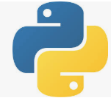
4 Get Course Material
Peter H. Chen

Slide 2
4 Get Course Material
https://www.udemy.com/course/data-science-and-machine-learning-with-python-hands-on/learn/lecture/15109038#overview
Install pydotplus
> conda install pydoplus
Install tensofrflow
> conda install tensorflow-gpu

Slide 3
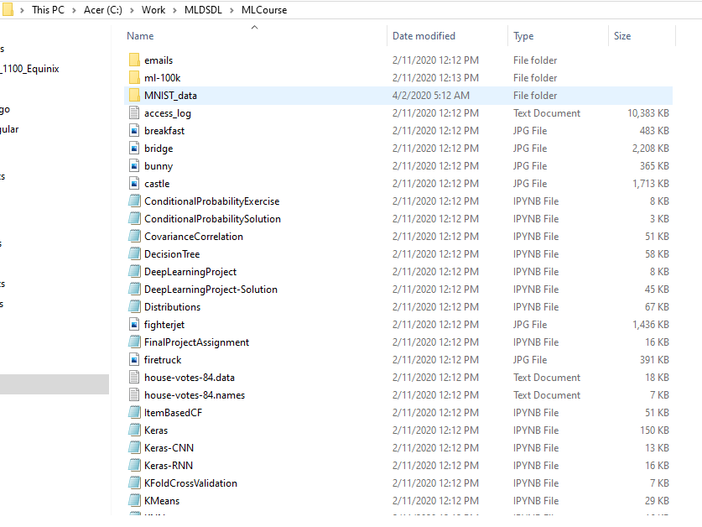
4 Get Course Material
https://www.udemy.com/course/data-science-and-machine-learning-with-python-hands-on/learn/lecture/15109038#overview
Get Course Material
https://sundog-education.com/machine-learning/
These are ipynb (interactive python notebook) extension called jupyter notebook files.

Slide 4
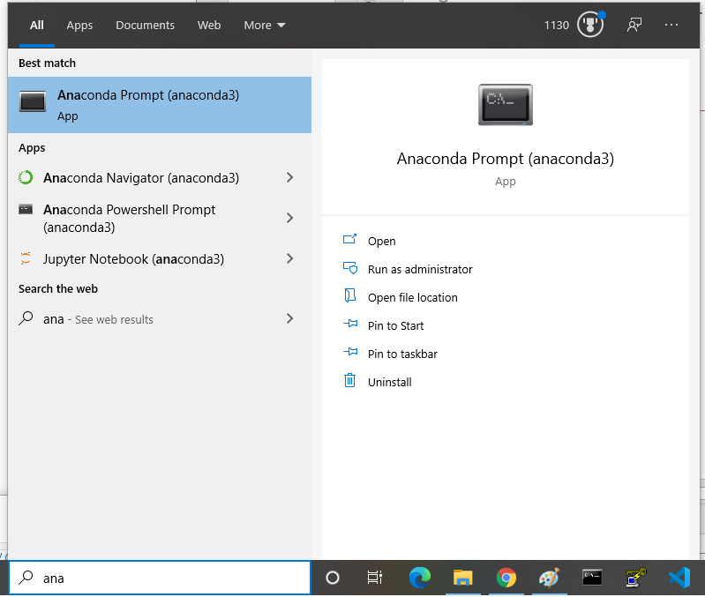
4 Get Course Material
https://www.udemy.com/course/data-science-and-machine-learning-with-python-hands-on/learn/lecture/15109038#overview
How to bring up the jupyter notebook?
Window Search
> anaconda prompt

Slide 5

4 Get Course Material
https://www.udemy.com/course/data-science-and-machine-learning-with-python-hands-on/learn/lecture/15109038#overview
How to bring up the jupyter notebook?
Create virtual environment tf
Actuate the virtual environment tf
> conda activate tf
Got to the ipynb folder and type “jupyter notebook”
(tf) > …\Mlcourse> jupyter notebook

Slide 6
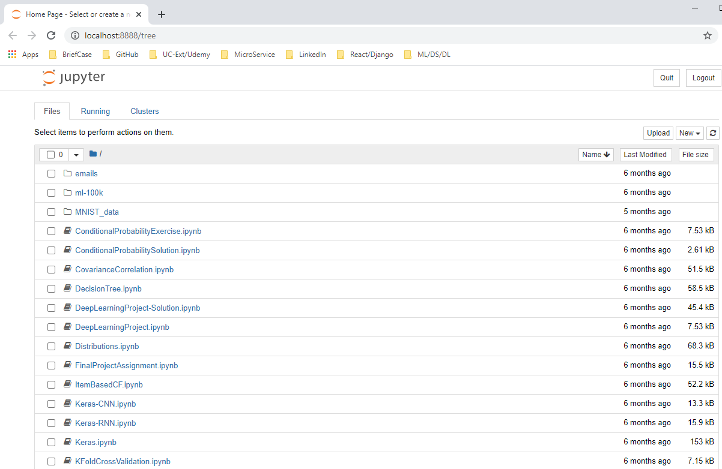
4 Get Course Material
https://www.udemy.com/course/data-science-and-machine-learning-with-python-hands-on/learn/lecture/15109038#overview
Now, we have jupyter notebook

Slide 7
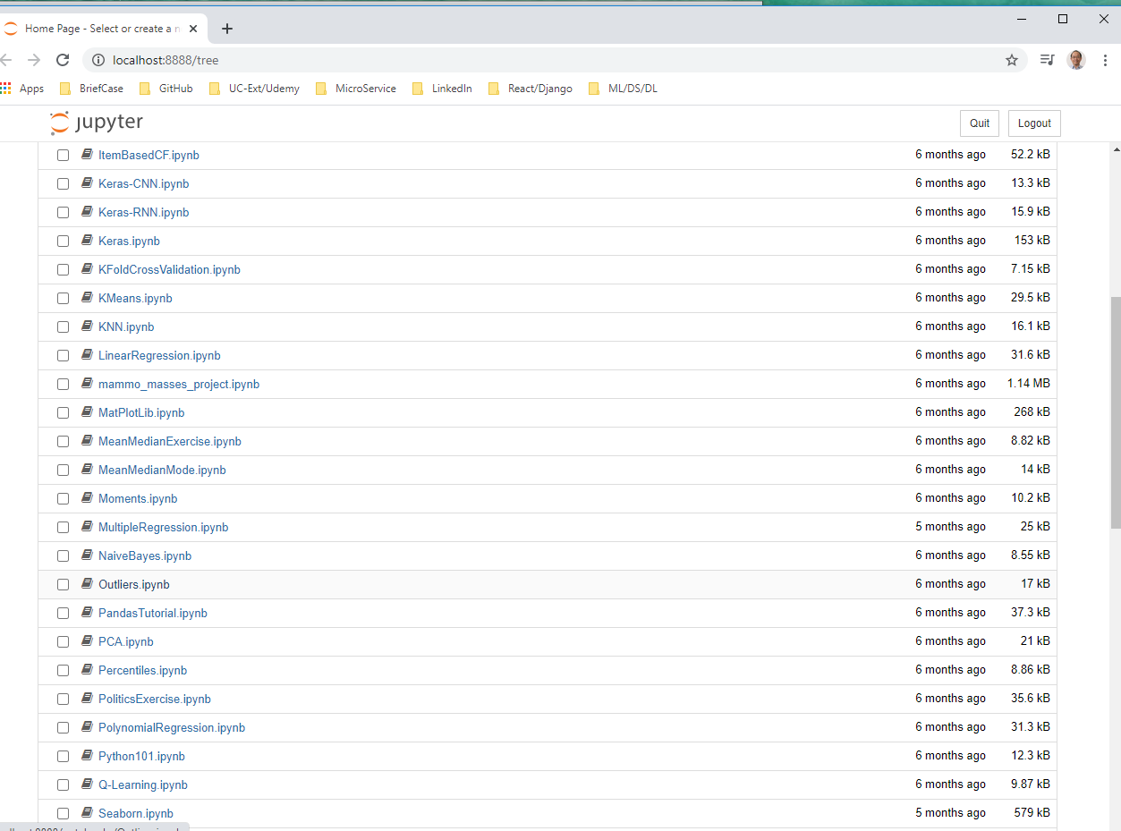
4 Get Course Material
https://www.udemy.com/course/data-science-and-machine-learning-with-python-hands-on/learn/lecture/15109038#overview
Open “outliers.ipynb”

Slide 8
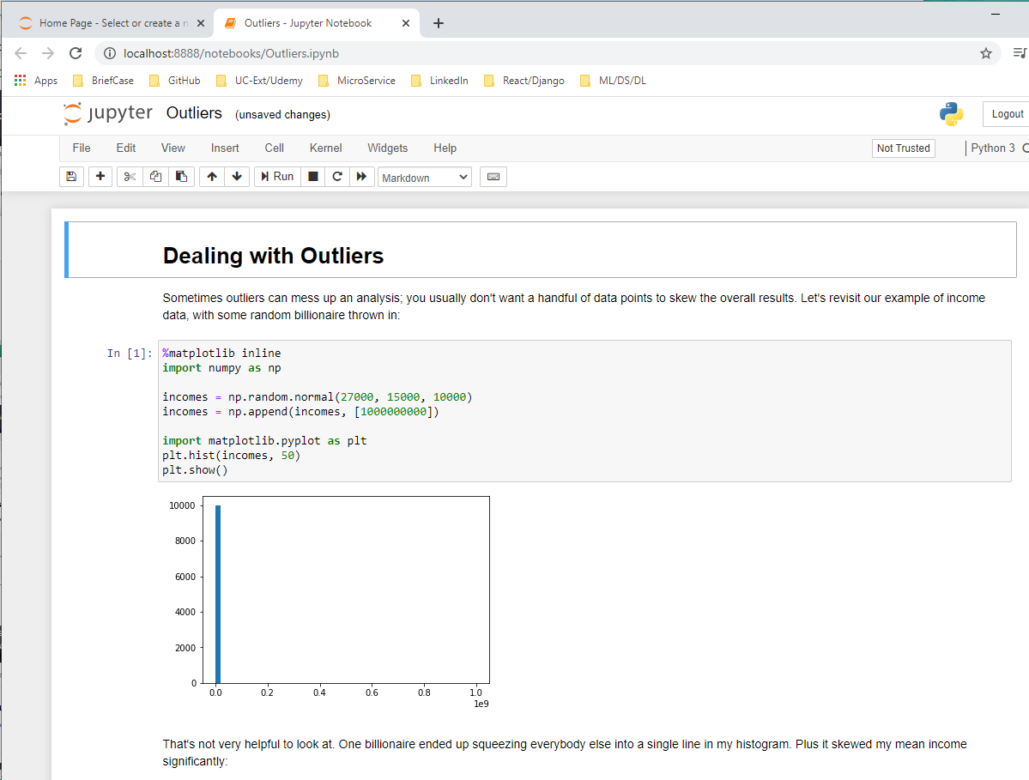
4 Get Course Material
https://www.udemy.com/course/data-science-and-machine-learning-with-python-hands-on/learn/lecture/15109038#overview
Open “outliers.ipynb”

Slide 9
End of Chapter

