Slide 1

11 Pandas
Peter H. Chen

Slide 2
11 Pandas
https://www.udemy.com/course/data-science-and-machine-learning-with-python-hands-on/learn/lecture/7936758#overview
Introduction of Pandas
Pandas is a Python Library that handle tabular data.
Pandas: uses “Data Frames” and “Series” tat allow you to slice (sheet) and dice (cube) rows and columns of information.
NumPy: multi-dimensional arrays. It is easy for create Pandas DataFrame from NumPy array.
Sckit_Learn is also called sklearn. The input is NumPy array.
Very import to understand the Pandas Library.
> df = pd.read_csv()
> sf.shape [(row, column)=(13 , 7)]
> df.size (row x columns)
> len (df) (row count)
> df [‘Hired’] (row of column ‘Hired’]
> df.clumns (columns title)

Slide 3
11 Pandas
https://www.udemy.com/course/data-science-and-machine-learning-with-python-hands-on/learn/lecture/7936758#overview
Introduction of Pandas
> degree_counts = df[‘Level Of Education].value_counts()
> degree_counts
>> BS 7
>> PhD 4
>> MS 2
> degree_counts.plot (kind=‘bar’)

Slide 4
11.1 Code
Peter H. Chen

Slide 5
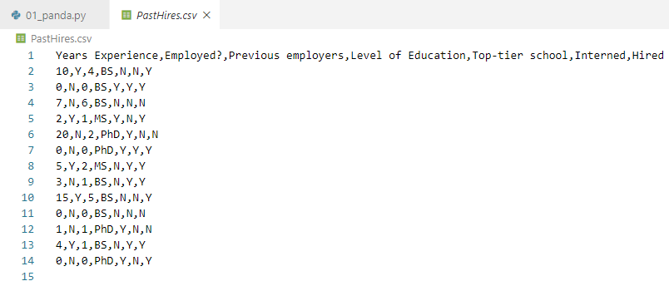
11.1 Code
https://www.udemy.com/course/data-science-and-machine-learning-with-python-hands-on/learn/lecture/7936758#overview
Code

Slide 6
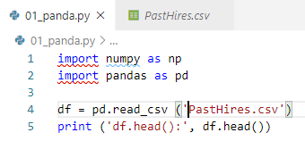
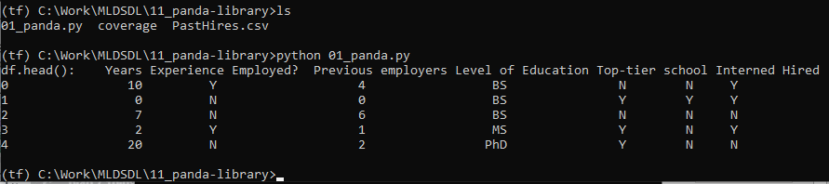
11.1 Code
https://www.udemy.com/course/data-science-and-machine-learning-with-python-hands-on/learn/lecture/7936758#overview
Code
Normally, we use pandas to load data, translate into numpy array, and feed into scikit learn.
Very import to understand pandas.
We use panda to read the comma separated value file and put data into data frame.
We head df.head() or df.tail() to get the first five rows or the last five rows of data.

Slide 7
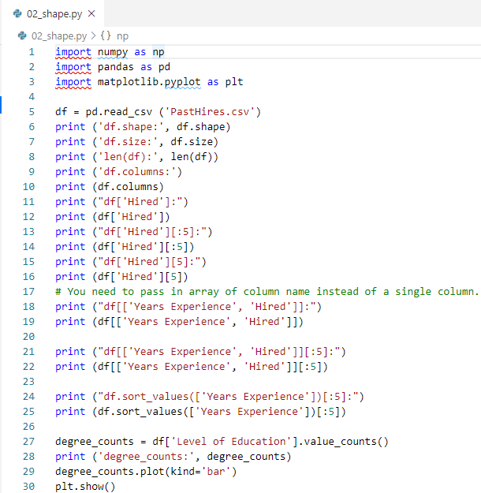
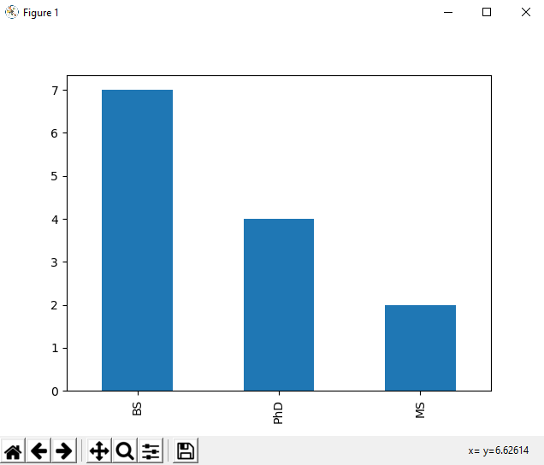
11.1 Code
https://www.udemy.com/course/data-science-and-machine-learning-with-python-hands-on/learn/lecture/7936758#overview
Code

Slide 8
11.2 Exercise
Peter H. Chen

Slide 9
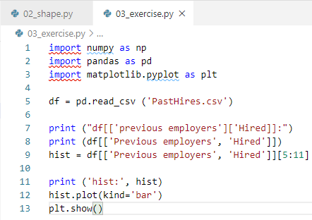
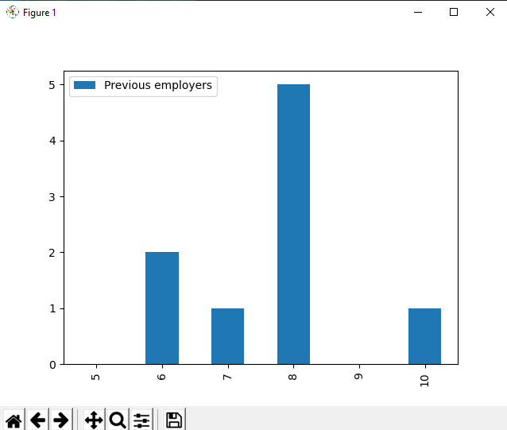
11.2 Exercise
https://www.udemy.com/course/data-science-and-machine-learning-with-python-hands-on/learn/lecture/7936758#overview
Exercise
Extract rows 5-10 of DataFrame of “previous employers” and “Hire” columns.
Assign to a new DatFrame
Create a histogram plotting the distribution of previous employers.

Slide 10
End of Chapter

