Slide 1

88 Deep Learning Pre-Requisite
Peter H. Chen

Slide 2
88 Deep Learning Pre-Requisite
https://github.com/peterhchen/900_Python_ML_DS_DL
Deep Learning Pre-Requisite
We will discussed Neural Networks, Multi-Layer Perceptrons, and CNN (Convolutional Neural Networks), and RNN (Recurrent Neural Networks).
Make sure you have Python 3.7 and anaconda are required by tensorflow. Make sure they are installed on your computer.

Slide 3
88.1 Anaconda and Tensorflow

Slide 4
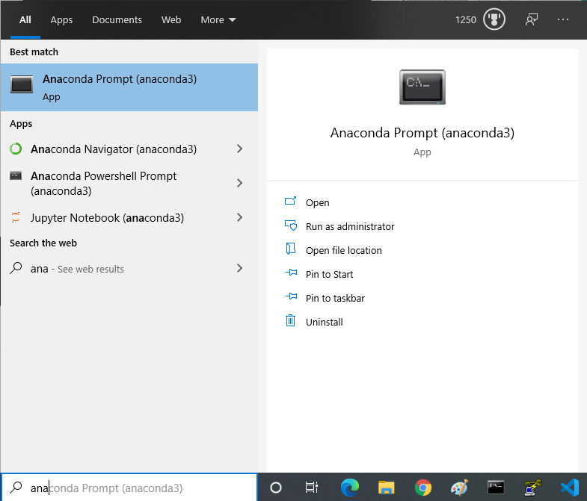
88.1 Anaconda and Tensorflow
https://github.com/peterhchen/900_Python_ML_DS_DL
Anaconda
On windows (MacOS or Linux), you need to go to the anaconda prompt.

Slide 5
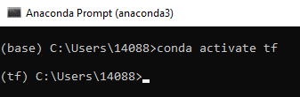
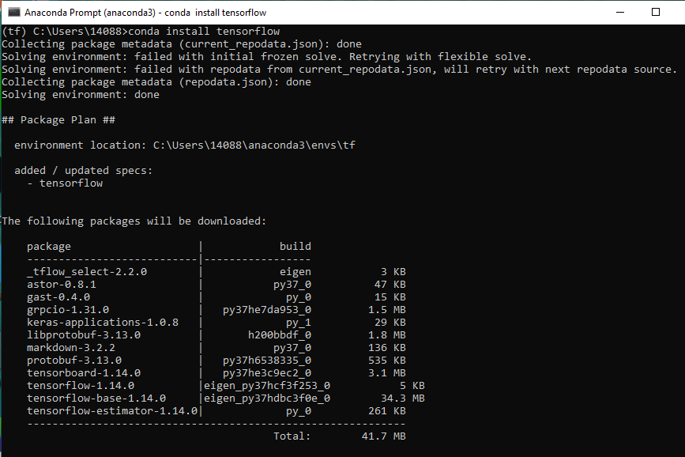
88.1 Anaconda and Tensorflow
https://github.com/peterhchen/900_Python_ML_DS_DL
In Anaconda,
> “conda activate tf” (activate tensorflow environment)
> “conda install tensorflow“ to install tensorflow in Anaconda environment.

Slide 6
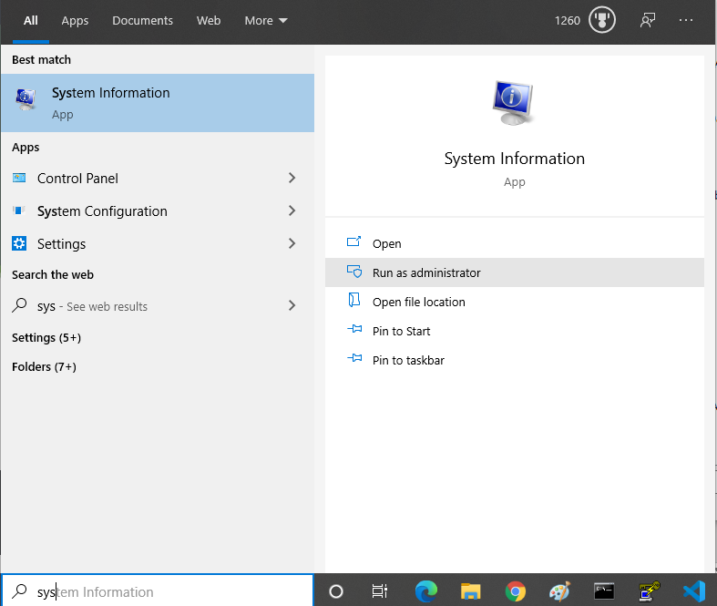
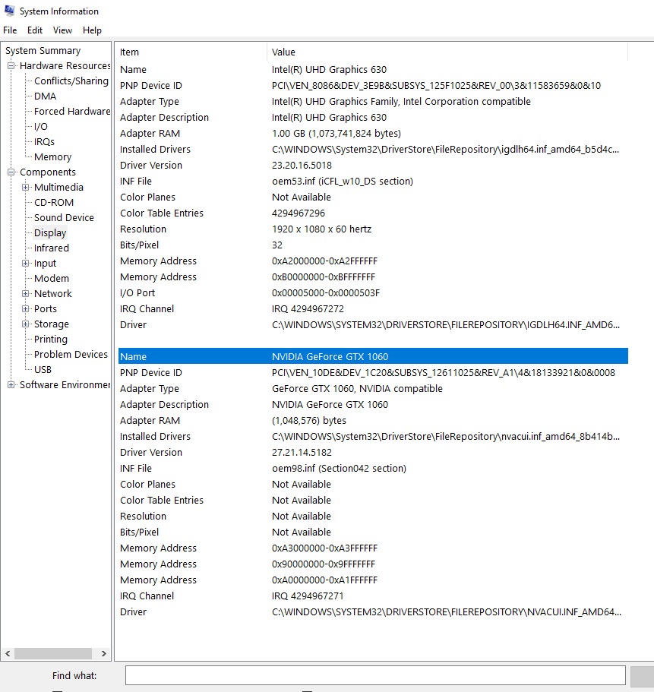
88.1 Anaconda and Tensorflow
https://github.com/peterhchen/900_Python_ML_DS_DL
If you have NVIDIA GPU on your system, check NVIDIA Graphic card on your system:
> system
I have NVIDIA GPU On my system. NVIDIA GPU is not required but it makes tensorflow run faster.

Slide 7
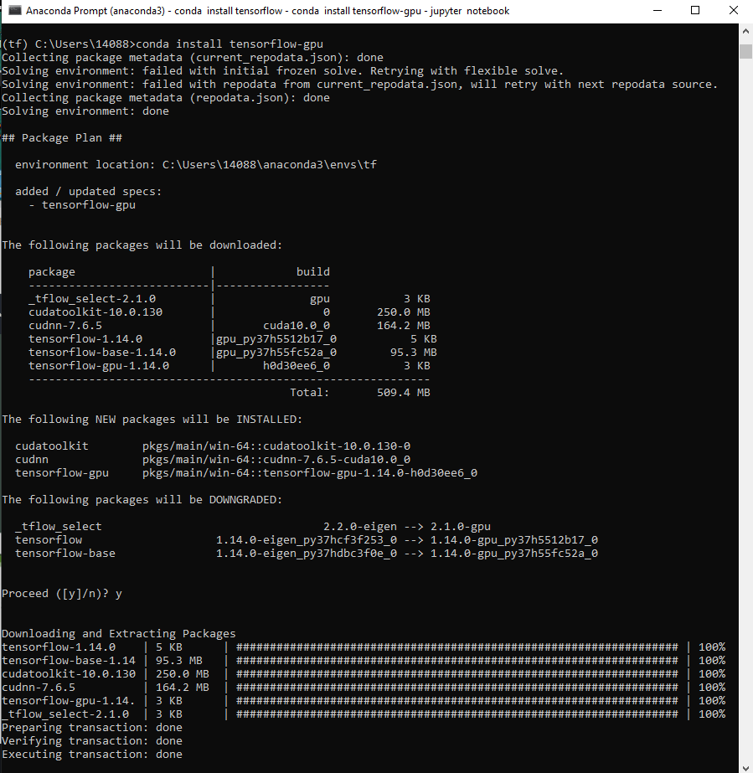
88.1 Anaconda and Tensorflow
https://github.com/peterhchen/900_Python_ML_DS_DL
If you have NVIDIA GPU on your system,
You can install tensorflow-gpu
> “conda install tensorflow-gpu“ to install tensorflow-gpu in Anaconda environment.
The following NVIDIA GPU libraries are installed:
> cudatoolkit
> cudacnn
> tensoflow-gpu

Slide 8
88.2 Jupyter Notebook

Slide 9
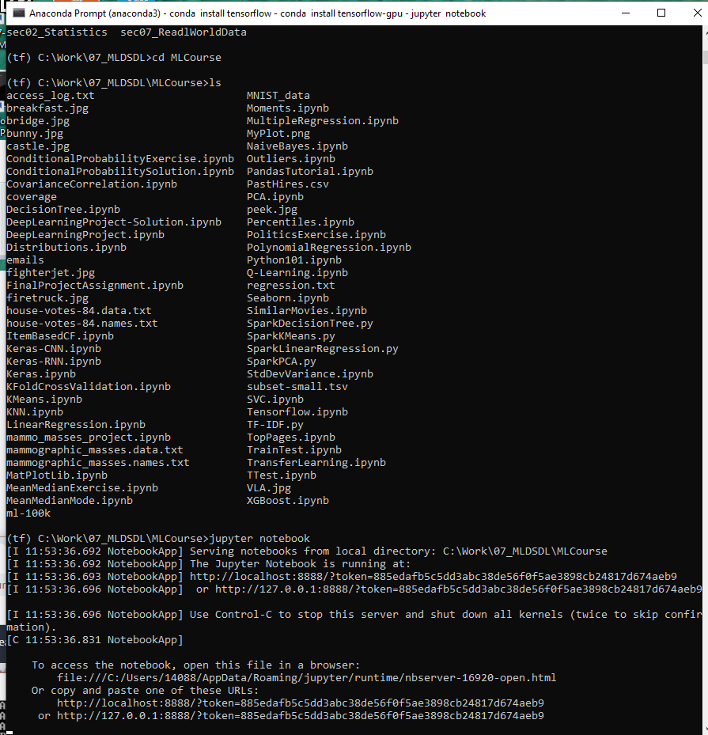
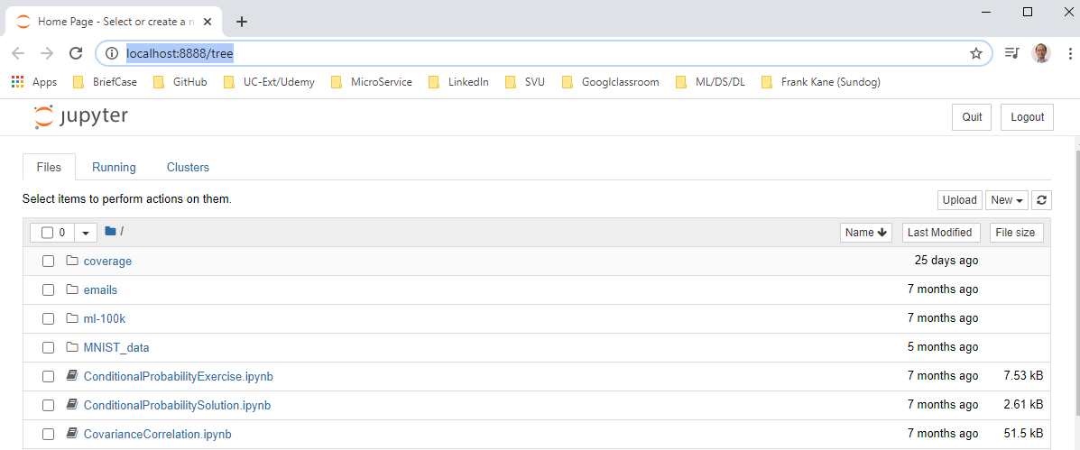
88.2 Jupyter Notebook
https://github.com/peterhchen/900_Python_ML_DS_DL
Jupyter Notebook
Go to folder with *.ipynb (Jupyter notebook)
> cd MLCourse
> jupyter notebook

Slide 10
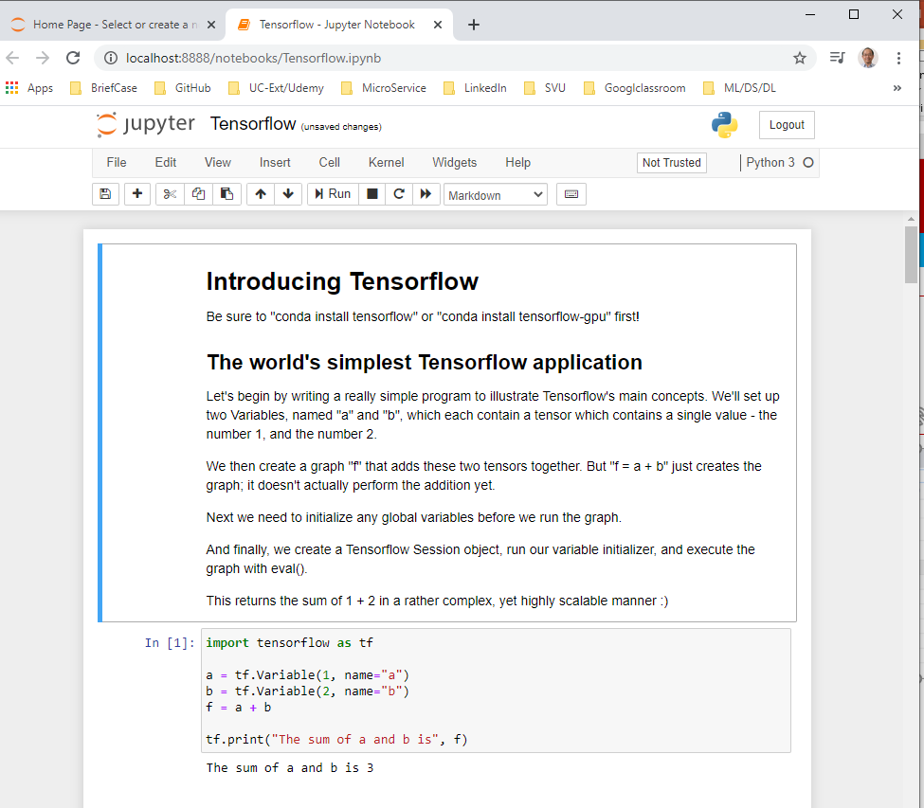
88.2 Jupyter Notebook
https://github.com/peterhchen/900_Python_ML_DS_DL
Jupyter Notebook
Open “tensoflow.ipynb”

Slide 11
88.3 Mathematics

Slide 12
88.3 Mathematics
https://github.com/peterhchen/900_Python_ML_DS_DL
Mathematics:
We have mathematics in Gradient Descent, autodiff, and softmax

Slide 13
88.4 Gradient Descent

Slide 14
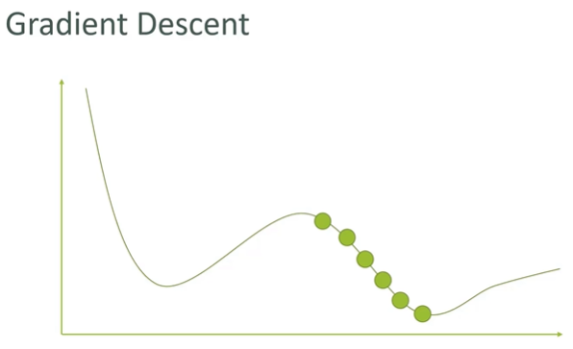
88.4 Gradient Descent
https://github.com/peterhchen/900_Python_ML_DS_DL
Gradient Descent
First, gradient descent.
Gradient Descent is optimization technique to find the optimal solution (optimal set of parameters) for a given problem.
What we are plotting here is some cost function, some measurement of the error of your learning system, and this applies to machine learning.
The cost function that defines how close to the result you want your model produces results for.

Slide 15
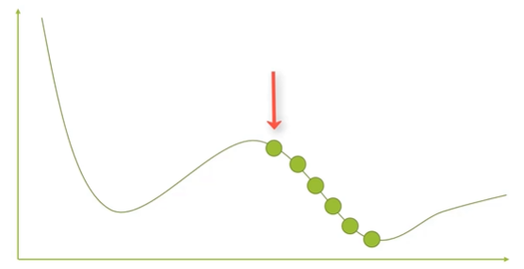
88.4 Gradient Descent
https://github.com/peterhchen/900_Python_ML_DS_DL
Gradient Descent
We do the supervised learning for our model.
You have a group of parameters that we have tuned the model and we need to identify different values of those parameters that produce the optimal results.
The idea of gradient descent is that you pick some point at random and each one of these dots represents some set of parameters to your model.
We try some set of parameters to start with and we will then measure whatever the error is that that produces on our system and then what we do is we move on down the curve here right.

Slide 16
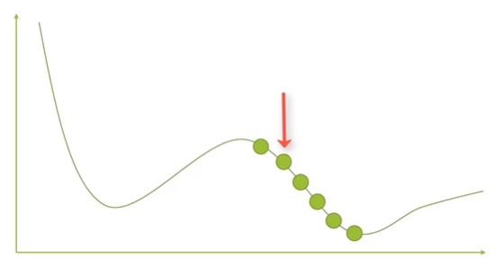
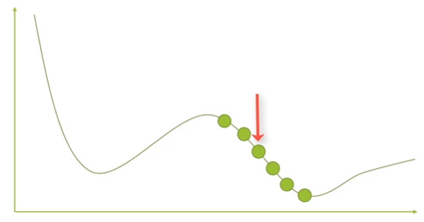
88.4 Gradient Descent
https://github.com/peterhchen/900_Python_ML_DS_DL
Gradient Descent
We may try a different set of parameters here.
We move in a given direction with different parameter values and we then measure the error that we get from that.
And in this case we actually achieved less error by trying this new set of parameters.
We are heading in the right direction here.
Let's change them even more in the same way.

Slide 17
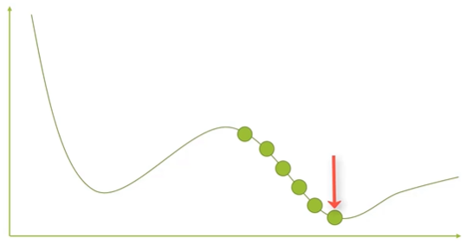
88.4 Gradient Descent
https://github.com/peterhchen/900_Python_ML_DS_DL
Gradient Descent
We keep on doing this at different steps until finally we hit the bottom of a curve here and our error starts to increase after that point.
So at that point we'll know that we actually hit the bottom of this gradient.

Slide 18
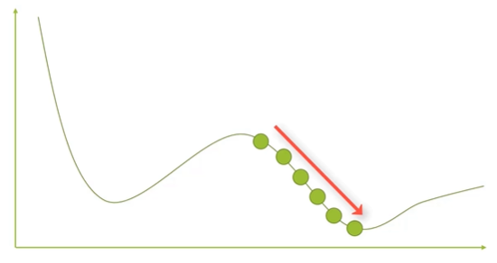
88.4 Gradient Descent
https://github.com/peterhchen/900_Python_ML_DS_DL
Gradient Descent
Basically we are picking some point at random with a given set of parameters.
We measure the error for and we keep on pushing those parameters in a given direction until the error minimizes itself and starts to come back up some other value.

Slide 19
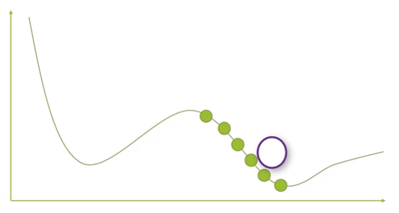
88.4 Gradient Descent
https://github.com/peterhchen/900_Python_ML_DS_DL
Gradient Descent
That is how gradient descent works in a nutshell.
Because gradient descent is how we actually train our neural networks to find an optimal solution.
Now you can see there are some areas of improvement here for this idea.
First of all you can actually think of this as sort of a ball rolling downhill.
One optimization that we'll talk about later is using the concept of momentum you can actually have that ball gain speed as it goes down the hill here if you will and slow down as it reaches the bottom and you know kind of bottoms out there.
That's the way to make it to converge more quickly when you're doing things that can make actual training your neural networks even faster.

Slide 20
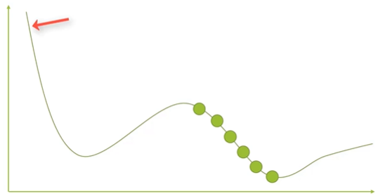
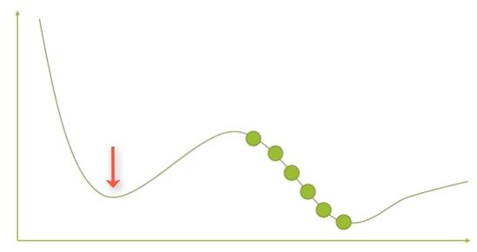
88.4 Gradient Descent
https://github.com/peterhchen/900_Python_ML_DS_DL
Gradient Descent
What if I randomly picked a point that ended up over here on this curve I might end up settling into this minima here which isn't actually the point of the least error play the least error in this graph is over here.
That's a problem.
That's a general problem in greater gradient descent.

Slide 21
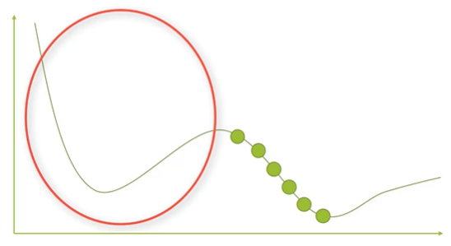
88.4 Gradient Descent
https://github.com/peterhchen/900_Python_ML_DS_DL
Gradient Descent
How do you make sure that you don't get stuck in what's called a local minima?

Slide 22
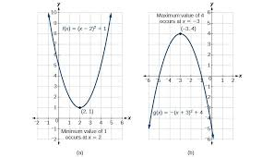
88.4 Gradient Descent
https://github.com/peterhchen/900_Python_ML_DS_DL
Gradient Descent
We can not solve more than quadratic (more than polynomial degree 2) with multiple local minima.
All (100%) of our engineering system can be converted and formulated into quadratic system (degree 2) as below.
After formulated into quadratic system, we can solve them by deep learning.
The quadratic system have only have one local minima. They never have multiple local minima problem.

Slide 23
88.4 Gradient Descent
https://github.com/peterhchen/900_Python_ML_DS_DL
Gradient Descent
That is the most important point.
For long time, people think AI cannot solve very complicate problems, such as, million gates placement and wire routing in semiconductor, and etc.
With formulated into quadratic form, tensorflow/TPU are able to solve these problems.

Slide 24
88.5 Autodiff

Slide 25
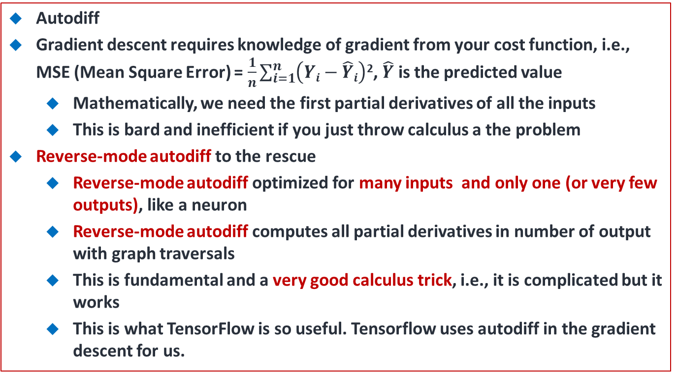
88.5 Autodiff
https://github.com/peterhchen/900_Python_ML_DS_DL
Autodiff
Gradient descent requires knowledge of gradient from your cost function, i.e., MSE (Mean Square Error) = $\frac{1}{n}\sum_{i=1}^{n}{\left(Yi−\hat{Y}i\right)}$², $\hat{Y}$ is the predicted value
Mathematically, we need the first partial derivatives of all the inputs
This is bard and inefficient if you just throw calculus a the problem
Reverse-mode autodiff to the rescue
Reverse-mode autodiff optimized for many inputs and only one (or very few outputs), like a neuron
Reverse-mode autodiff computes all partial derivatives in number of output with graph traversals
This is fundamental and a very good calculus trick, i.e., it is complicated but it works
This is what TensorFlow is so useful. Tensorflow uses autodiff in the gradient descent for us.

Slide 26
88.5 Autodiff
https://github.com/peterhchen/900_Python_ML_DS_DL
Autodiff (Explanation)
We need to measure what is the slope that we are taking along our cost function or MSE (Mean Square Error).
If you try to find the slope of a curve with multiple parameters of partial derivatives.
This is very mathematically intensive and inefficient for computers to do so.
By doing the brute force approach to gradient descent that gets very expensive very quickly, the autodiff is a technique for speeding that up.
Specifically, we use something called reverse mode autodiff.
What you need to know is that it can compute all the partial derivatives you need just by traversing your graph in the number of outputs +1.
This works out really well on neural networks because in a neural network you tend to have an artificial neurons that have very many inputs but probably only one output or very few outputs (in comparison to the inputs).

Slide 27
88.5 Autodiff
https://github.com/peterhchen/900_Python_ML_DS_DL
Autodiff (Explanation)
This turns out to be a pretty good calculus trick.
It's complicated but it works and that's important.
What is also important is the tensorflow library uses under the hood to implement its gradient descent.
We never have to actually implement gradient descent from scratch or implement autodiff from scratch.
These are all baked into the tensorflow libraries that we are using.
Libraries such as tensorflow for doing deep learning but they are terms that we throw around a lot.
So it's important that you at least know what they are and why they are important.
The gradient descent is the technique we use to find the local minima of the error.

Slide 28
88.5 Autodiff
https://github.com/peterhchen/900_Python_ML_DS_DL
Autodiff (Explanation)
We are trying to optimize for given a certain set of parameters and autodiff is a way of accelerating that process.
We don't have to do as much math computation to actually measure that gradient of the gradient descent.

Slide 29
88.6 Softmax

Slide 30
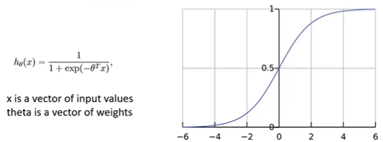
88.6 Softmax
https://github.com/peterhchen/900_Python_ML_DS_DL
Softmax
Used for classification
Given a score (weight) for each class
Softmax convert he score (weight) into a probability of each class
The class with the highest probability is the “answer” you get

Slide 31
88.6 Softmax
https://github.com/peterhchen/900_Python_ML_DS_DL
Softmax (Explanation)
One other thing we need to talk about is softmax.
What is softmax?
When we have the end result of a neural network, we have a bunch of scores that come out of the neural network.
How we make use of that how do we make practical use of the output of our neural networks?
Well that is where softmax comes in.
The softmax converts each of the final weights that come out of your neural network into a probability.
If we are trying to classify something in your neural network, for example, decide if a an image is a picture of a face, or a picture of a dog, or a picture of a stop sign, and etc., you might use softmax at the end to convert those final outputs of the neurons into normalized probabilities for each class.
Then, we can just pick the class that has the highest probability.

Slide 32
88.6 Softmax
https://github.com/peterhchen/900_Python_ML_DS_DL
Softmax (Explanation)
The softmax function from the various outputs you end up with the best choice of classification.
The softmax converts the final output of your neural network to an actual answer for a classification problem.
For example, the neural network try to drive the car for you and it needs to identify pictures of stop signs or yield signs or traffic lights.
You need softmax at the end of neural network that will take your image and classify it as one of those sign types.

Slide 33
88.7 Summary

Slide 34
88.7 Summary
https://github.com/peterhchen/900_Python_ML_DS_DL
Summary
The gradient descent and algorithm for minimizing error over multiple steps.
We started some random set of parameters measure the error move those parameters in a given direction see if that results in more error or less error and just try to move in the direction of minimizing error until we find the actual bottom of the curve there where we have a set of parameters that minimizes the error.
The autodiff is a calculus trick for making gradient descent faster. The autodiff makes it easier to find the gradients and gradient descent just by using some calculus trickery
The softmax is used at end of our neural network to convert the final output of our neural network to classify our object.
Those are the basic mathematical terms or algorithmic terms that you need to understand to talk about artificial neural networks (deep learning).

Slide 35
End of Chapter

