Slide 1

12 Data Type
Peter H. Chen

Slide 2
12 Data Type
https://www.udemy.com/course/data-science-and-machine-learning-with-python-hands-on/learn/lecture/15090158#overview
Major Types of Data:
Numerical
Categorical
Ordinal

Slide 3

12 Data Type
https://www.udemy.com/course/data-science-and-machine-learning-with-python-hands-on/learn/lecture/15090158#overview
Numerical:
Represents some sort of quantitative measurement
Heights of people, page load times, stock prices, and etc.
Discrete Data
Integer based; often counts of some event
How many purchases did a customer make in a year?
How many times flip “heads”, and etc.
Continuous Data
Has an infinite number of possible values
How much time did it take for a user to check out?
How much rain fell on a given day?

Slide 4
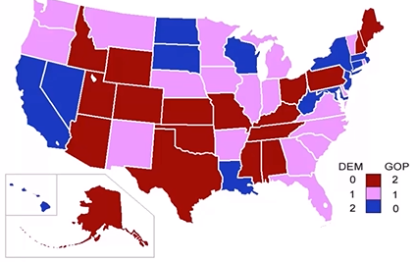
12 Data Type
https://www.udemy.com/course/data-science-and-machine-learning-with-python-hands-on/learn/lecture/15090158#overview
Categorical
Qualitative data that has no inherent mathematical meaning
Gender, Yes/No (binary data), Race, state of Residence, Product Category, Political Party, and etc.
You can assign numbers to categories in order to represent them more compactly, but the numbers do not have mathematical meaning

Slide 5

12 Data Type
https://www.udemy.com/course/data-science-and-machine-learning-with-python-hands-on/learn/lecture/15090158#overview
Ordinal
A mixture of numerical and categorical
Categorical data that has mathematical meaning
Example: Movie rating on a 1-5 scale.
Rating must be 1, 2,3, 4, or 5
But these value have a mathematical meaning, 1 means it is a worse movie than a 2.

Slide 6
12 Data Type
https://www.udemy.com/course/data-science-and-machine-learning-with-python-hands-on/learn/lecture/15090158#overview
Quiz
1. How much gas is in your gas tank?
Ans: numerical. Can be infinity number.
2. A rating of your overall health where choice are 1, 2, 3, or 4, corresponding to “poor”, “moderate”, “good”, and “excellent”
Answer: ordinal data
3. The race of your classmates?
Answer: categorical
4. Ages in years in your classmates?
Ans: integer value of numerical data.
5. Money spent in a store
Ans: continuous value of numerical data.

Slide 7
End of Chapter

