Slide 1
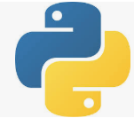
82 Deploy Model for Real-Time System
Peter H. Chen

Slide 2
82 Deploy Model for Real-Time System
https://github.com/peterhchen/900_Python_ML_DS_DL
How to deploy the model in an App for real world?
Our external apps cannot run a Jupyter Notebook.
Separate your training from your prediction
Train the model periodically offline. That is happened in backend.
Push the model (or its results) to w web service. Copy and export the mode to the web service. Push the model the cloud.
Your app call the web service. Use web service API.

Slide 3
82 Deploy Model for Real-Time System
https://github.com/peterhchen/900_Python_ML_DS_DL
How to deploy the model in an App for real world? (Explanation)
A question we often get is how to deploy model within a Jupyter Notebook.
How would I use these models in the real world?
How to actually connect the output of these models?
These machine learning models to a real application like a mobile phone app or a Web site.
We are getting into the world of actually designing larger systems.
We have some high level guidance anyway.
Your external applications are not going to be running Jupyter notebooks and getting its results that way locally.
What we need to do is separate the process of training and tuning our model from the process of actually making predictions based on that model.
So the training part can all be done offline.

Slide 4
82 Deploy Model for Real-Time System
https://github.com/peterhchen/900_Python_ML_DS_DL
How to deploy the model in an App for real world? (Explanation)
We can do that within our notebook or we can export a standalone python script that gets run periodically perhaps to pick up new training data as it comes in.
We even running in a streaming environment but that can all happen on the back end.
You can still use Jupyter Notebooks for that if you want to refine it but then when you actually have a trained model.
Remember we just have a model like a classifier that's sitting there in scikit learn at that point and all we have to do is call predict on it to actually get a result.
It is possible to actually export that model to a file and execute that model on a web service.
The idea would be to push the model out to a web service fleet.

Slide 5
82 Deploy Model for Real-Time System
https://github.com/peterhchen/900_Python_ML_DS_DL
How to deploy the model in an App for real world? (Explanation)
You know this could be like something on the cloud somewhere where it's just running a distributed set of services where hopefully you don't have to take care of the actual servers themselves and all that service does is respond to web service requests over rest or some other interface it says here's the feature data that I want a prediction for.
Give me a prediction and that pre trained model that's deployed to that entire web service can then quickly provide that result back at large scale and hopefully low latency and high transaction rates reliably.
So your app would call the web service that actually just generates predictions based on the model.
But the model itself is created off line and then the results of that model the model itself is pushed to the web service.

Slide 6
82.1 Example: Google Cloud ML

Slide 7
82.1 Example: Google Cloud ML
https://github.com/peterhchen/900_Python_ML_DS_DL
Example: Google Cloud ML
Dump your trained classifier using sklearn.externals
> from sklearn.externals import joblib
> joblib.dump (clf, ‘model.joblib’)
Upload model.joblib to Google cloud storage, specifying the scikit-learn framework.
Cloud ML engine expose a REST that you can call to make predictions in real-time.
Exported Classifier
Cloud Storage
Cloud ML Engine
Applications

Slide 8
82.1 Example: Google Cloud ML
https://github.com/peterhchen/900_Python_ML_DS_DL
Example: Google Cloud ML (Explanation)
Let's talk about some more specific examples here to make it real.
Let's say you're using Google cloud services.
One way you could do this very easily is to just use the SK learn externals job lib method here with it you can just say job lib dot dump with whatever your model is you know any classifier which can be anything.
K means you can even like have a deep learning classifier and there if you want as well.
Scikit learn can dump that out to a file after it's been trained you just give it a file name.
For Google Cloud it wants it to be called model.joblib.
You would then upload the resulting model.joblib which contains the model itself to Google cloud storage.

Slide 9
82.1 Example: Google Cloud ML
https://github.com/peterhchen/900_Python_ML_DS_DL
Example: Google Cloud ML (Explanation)
From there you can just say this is going to run within the scikit learn framework and it will know what to do with it at that point you can just tie a cloud ML engine into it the Google Cloud ML engine and that will expose a REST API that you can call to make predictions in real time based on that model that you uploaded to the Google cloud see how that works.
Basically, you would train your classifier offline in a notebook or whatever however you want to do it export that classifier to a file upload that file into Google Cloud storage and then Google Cloud’s ML engine could actually interact with that with your applications over a REST API.
If you do not know the REST API as it is basically the same protocol that you use for looking at Web sites.
When we go to your web browser to look at this URL.
We send a REST request to a server somewhere to get the results of this URL.
The server gives it back to get a prediction and give it back to us.

Slide 10
82.2 Example: AWS (Recommender System)

Slide 11
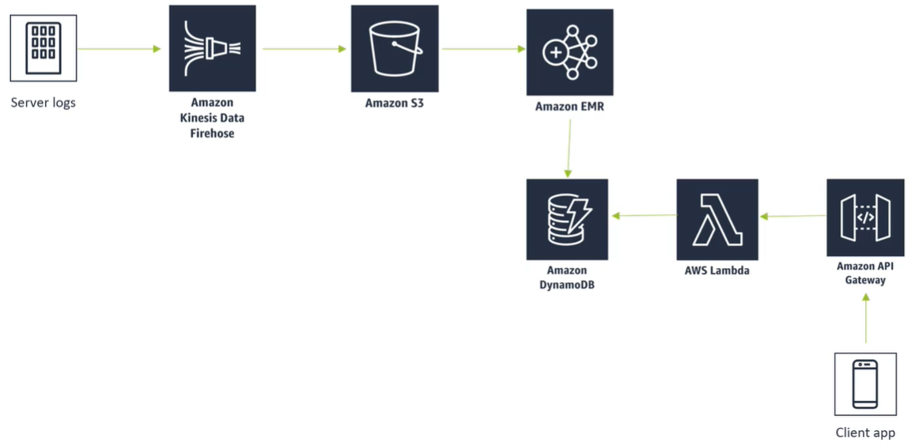
82.2 Example: AWS (Recommender System)
https://github.com/peterhchen/900_Python_ML_DS_DL
Use AWS end to end service system to build.

Slide 12
82.2 Example: AWS (Recommender System)
https://github.com/peterhchen/900_Python_ML_DS_DL
Example: Google Cloud ML (Explanation)
In SWS (Amazon Web Services), you want to build an entire end to end system that makes product recommendations.
One way to do this in AWS would be if you have a fleet of servers that are generating order data.
If you are actually monitoring the servers where people are placing orders we could have a service called Kinesis data (Process and analyze Data) firehose running on top of those servers.

Slide 13
82.2 Example: AWS (Recommender System)
https://github.com/peterhchen/900_Python_ML_DS_DL
Example: Google Cloud ML (Explanation)
That is feeding those log data information into Amazon S3 storage.
The Amazon's Elastic MapReduce service consume the log data from S3.

Slide 14
82.2 Example: AWS (Recommender System)
https://github.com/peterhchen/900_Python_ML_DS_DL
Example: Google Cloud ML (Explanation)
The S3 data may contains all the purchase information or all the view information or all the ratings information that we want to recommend.
The Amazon Elastic MapReduce can run Apache Spark across an entire cluster that consume that data from S3 and create predictions creating recommendations based on that data.

Slide 15
82.2 Example: AWS (Recommender System)
https://github.com/peterhchen/900_Python_ML_DS_DL
Example: Google Cloud ML (Explanation)
Now, we push the actual model itself out to a web service.
We push the results of it out.
We pre-generate recommendations for every user ahead of time.
After consuming all of the latest data from S3 all the latest purchase data or ratings data, we use Apache Spark to generate predicted recommended items that people might like for every user in my system.

Slide 16
82.2 Example: AWS (Recommender System)
https://github.com/peterhchen/900_Python_ML_DS_DL
Example: Google Cloud ML (Explanation)
Then, we publish that to Amazon Dynamo DB (no SQL database) that allow us to quickly associate a list of item identifiers with a list of user identifiers.
That is very fast way of looking up what items should I recommend for a given user.

Slide 17
82.2 Example: AWS (Recommender System)
https://github.com/peterhchen/900_Python_ML_DS_DL
Example: Google Cloud ML (Explanation)
I take the output of the model and I publish the output to something more scalable like Dynamo DB.
Dynamo DB is horizontally scalable so it can handle very high transaction rates at very low latency then to expose that to the outside world.

Slide 18
82.2 Example: AWS (Recommender System)
https://github.com/peterhchen/900_Python_ML_DS_DL
Example: Google Cloud ML (Explanation)
We could use AWS lambda which is their serverless functionality that lets you write very simple functions that would access that Dynamo DB database for a given user and retrieve the results back for some application.
You may have the Amazon API Gateway which actually would provide the REST interface that your mobile apps or web sites would actually talk to retrieve that data.

Slide 19
82.2 Example: AWS (Recommender System)
https://github.com/peterhchen/900_Python_ML_DS_DL
Example: Google Cloud ML (Explanation)
Your client application could say I want to get recommendations for this user ID.
Amazon API Gateway give me recommendations for this user ID through some REST query behind the scenes that would transfer that request to AWS Lambda.

Slide 20
82.2 Example: AWS (Recommender System)
https://github.com/peterhchen/900_Python_ML_DS_DL
Example: Google Cloud ML (Explanation)
The scalable lambda would take this and execute a JavaScript code to retrieve the actual item ID in Dynamo DB for that user ID.
That was all pre generated by Apache Spark running on EMR creating recommendations off of Amazon S3.

Slide 21
82.2 Example: AWS (Recommender System)
https://github.com/peterhchen/900_Python_ML_DS_DL
Example: Google Cloud ML (Explanation)
This is a more complicated way that that is more of an example of sort of the things you might see in the real world.
You know these systems do tend to get rather complicated because as soon as you start dealing with massive scale you need to deal with the cloud at some point and you have to deal with technologies like Apache Spark that can scale up to massive datasets.

Slide 22
82.2 Example: AWS (Recommender System)
https://github.com/peterhchen/900_Python_ML_DS_DL
Example: Google Cloud ML (Explanation)
So this is sort of a more advanced example but a very real one of how you might actually implement something like that in the real world.
The key is that the actual generation of the model is separate from the vending of the data the results from it.

Slide 23
82.2 Example: AWS (Recommender System)
https://github.com/peterhchen/900_Python_ML_DS_DL
Example: Google Cloud ML (Explanation)
So on the top row there.
That's the process of actually building the recommendations themselves.

Slide 24
82.2 Example: AWS (Recommender System)
https://github.com/peterhchen/900_Python_ML_DS_DL
Example: Google Cloud ML (Explanation)
Then, we push the actual recommendations down to something that's more scalable to Dynamo DB fronted by Lambda which is ultimately fronted by Amazon API Gateway and then we have a end to end system that can actually handle vending the results of our model at massive scale.

Slide 25
82.3 Other Approaches

Slide 26
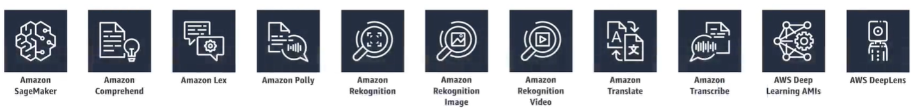
82.3 Other Approaches
https://github.com/peterhchen/900_Python_ML_DS_DL
Other Approaches
Roll your own web service with Flask or another framework
Then you have servers to provision and maintain.
Go all in within a platform.

Slide 27
82.3 Other Approaches
https://github.com/peterhchen/900_Python_ML_DS_DL
Other Approaches (Explanation)
There are other ways of doing it as well.
You could write your own web service if you wanted to using flask or something or whatever web service framework you like.
You would then have to obviously provision your own servers and maintain them which is not a whole lot of fun.
That is why people use services, such as, AWS, Google Cloud, and Azure these days.
Also you can all go all in with a platform.
All of these cloud providers tend to have their own systems and technologies for doing machine learning these days. Below is like a partial list of the AWS services that are available in the machine learning space right now for example.

Slide 28
82.3 Other Approaches
https://github.com/peterhchen/900_Python_ML_DS_DL
Other Approaches (Explanation)
If you just want to do speech recognition or image recognition they have services that are available off the shelf that will just do that for you and you can obviously integrate those very easily with other AWS services to build larger systems like the ones that we've been looking at here.
Something to consider, it is always a good idea of prototype new ideas offline in a Jupyter Notebook.
But ultimately the way that you implement them for a larger system could be very different.
Now, we have a high level idea of how we may expose our models to a real world system.

Slide 29
82.3 Other Approaches
https://github.com/peterhchen/900_Python_ML_DS_DL
Other Approaches (Explanation)
The key insight is to separate the generation of the model itself and its results from the problem of actually serving those results to a massive fleet of consumers of that data.
Whether we go with AWS, Google Cloud services, or Microsoft Azure, those are all the topics of entire courses of their own.
These give us a starting point of where to deploy model results to someplace real.

Slide 30
End of Chapter

