Slide 1

20 Seaborn
Peter H. Chen

Slide 2
20 Seaborn
https://www.udemy.com/course/data-science-and-machine-learning-with-python-hands-on/learn/lecture/15090172#overview
Seaborn
Seaborn is a visualization library that sets on top of matplotlib, making it nicer to look at and adding some extra capabilities too.

Slide 3
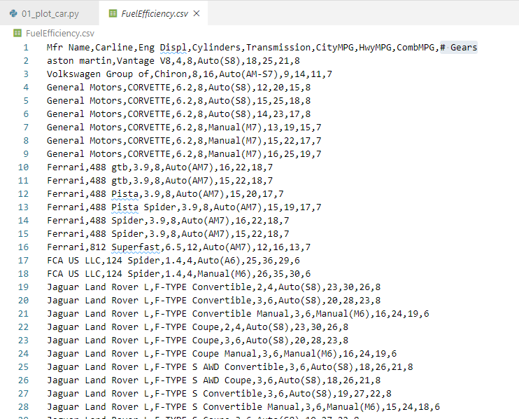
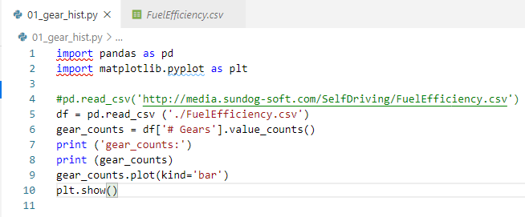
20 Seaborn
https://www.udemy.com/course/data-science-and-machine-learning-with-python-hands-on/learn/lecture/15090172#overview
Seaborn
Read file FueldEfficiency.csv. This file is from US government.

Slide 4
20 Seaborn
https://www.udemy.com/course/data-science-and-machine-learning-with-python-hands-on/learn/lecture/15090172#overview
Seaborn
Extract number of gears (‘# Gears’).
Histogram: Count the unique number of how many times by value_counts().

Slide 5
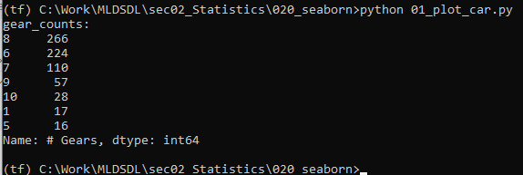
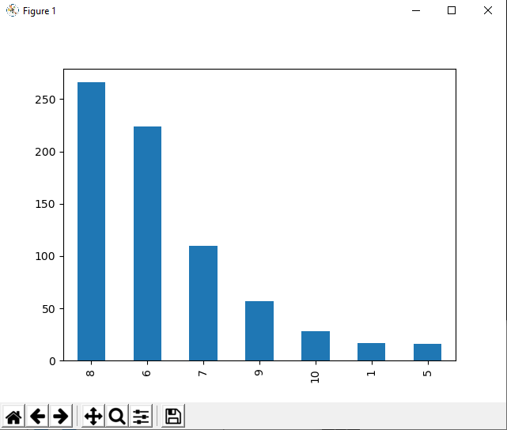
20 Seaborn
https://www.udemy.com/course/data-science-and-machine-learning-with-python-hands-on/learn/lecture/15090172#overview
Seaborn
Histogram of ‘# Gears”: (8, 266), …, (5, 16)

Slide 6
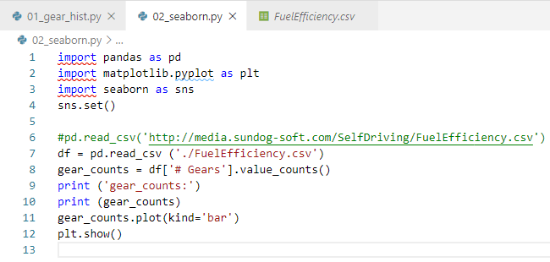
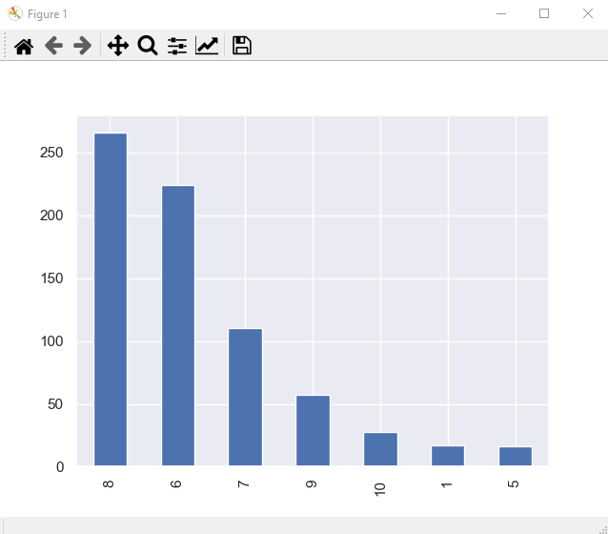
20 Seaborn
https://www.udemy.com/course/data-science-and-machine-learning-with-python-hands-on/learn/lecture/15090172#overview
Seaborn
We can have the Seaborn and just call set() on it to change matplotlib’s default settings for more visualization.
The matplotlib is based on matplot. Its visualization default are pretty old.

Slide 7
20.1 distplot

Slide 8
20.1 distplot
https://www.udemy.com/course/data-science-and-machine-learning-with-python-hands-on/learn/lecture/15090172#overview
distplot
Column CombMPG: Combined MPG (Mile Per Gallon) for city MPG and Highway MPG.

Slide 9
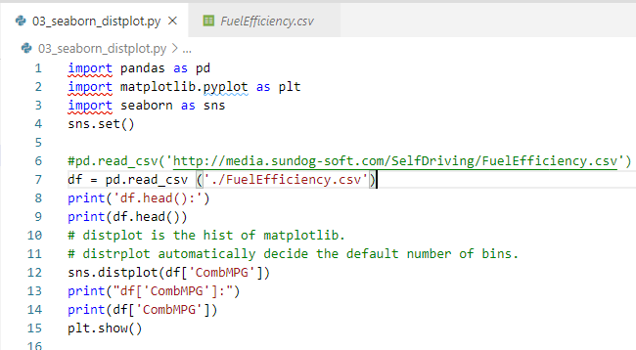
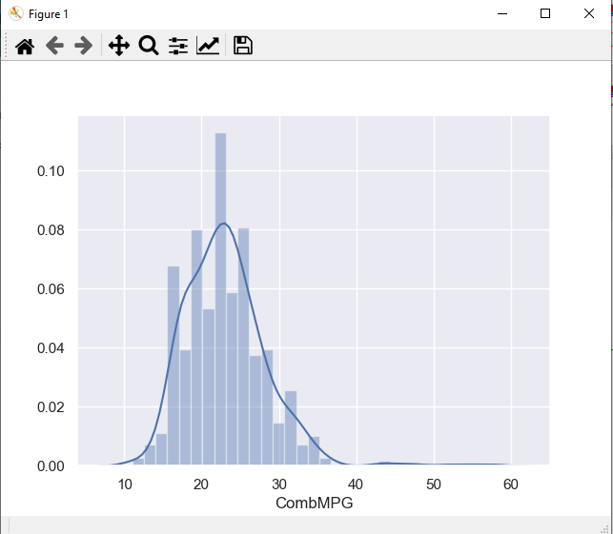
20.1 distplot
https://www.udemy.com/course/data-science-and-machine-learning-with-python-hands-on/learn/lecture/15090172#overview
distplot
The distplot is similar to matplotlib.hist.
It is used to plot the histogram of given array. If the default bin is not given, the number of bins is determined by distplot.
Seaborn add another plot for easier visualization.

Slide 10
20.4 pairplot

Slide 11
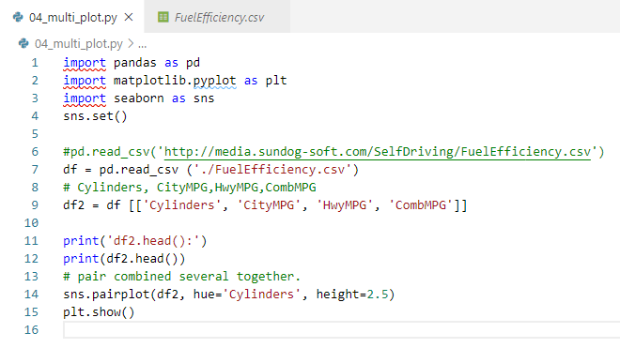
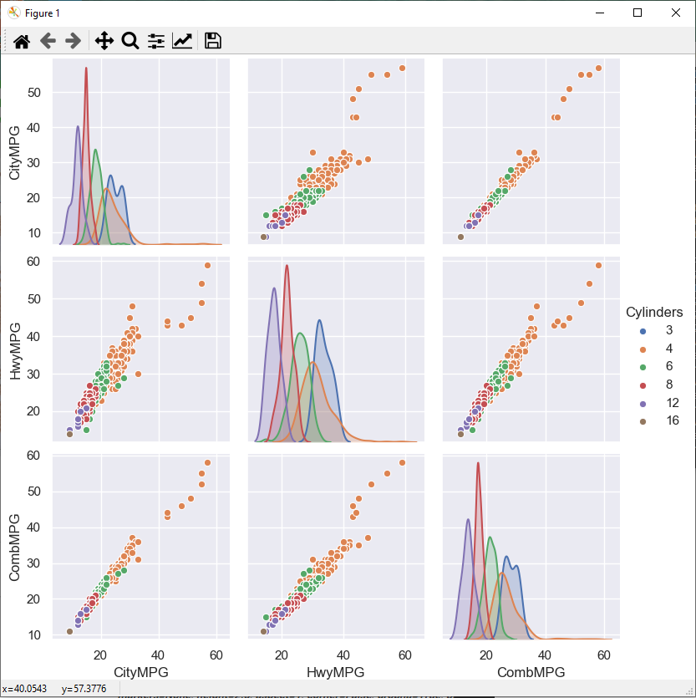
20.4 pairplot
https://www.udemy.com/course/data-science-and-machine-learning-with-python-hands-on/learn/lecture/15090172#overview
pairplot
We use pairplot to plot several columns.
hue: select the column for parameter for different colors.
height: height of each sub-plot.

Slide 12
20.5 scatterplot

Slide 13
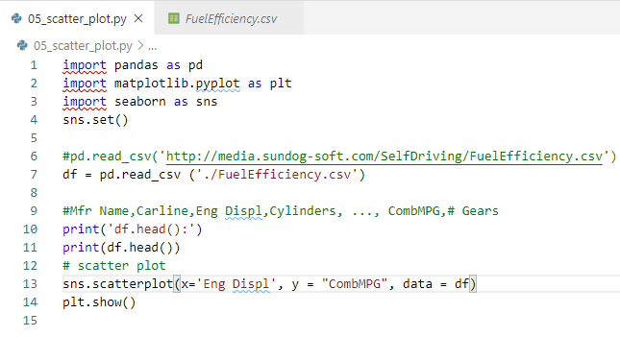
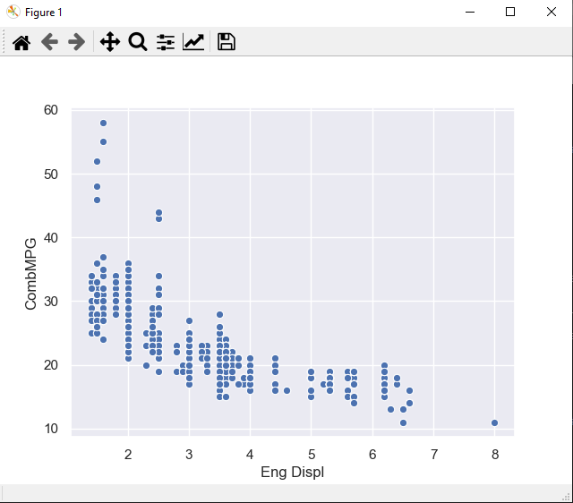
20.5 scatterplot
https://www.udemy.com/course/data-science-and-machine-learning-with-python-hands-on/learn/lecture/15090172#overview
scatterplot
Scatterplot (X, Y, data)

Slide 14
20.6 jointplot

Slide 15
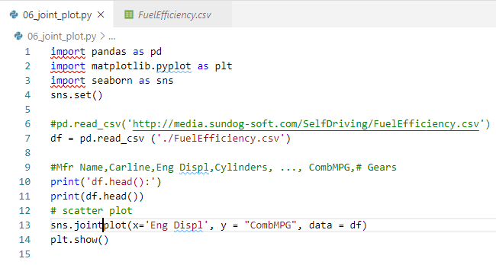
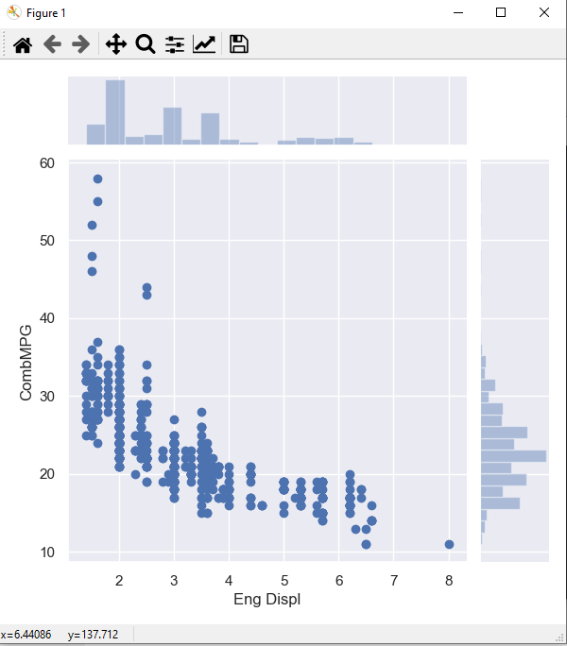
20.6 jointplot
https://www.udemy.com/course/data-science-and-machine-learning-with-python-hands-on/learn/lecture/15090172#overview
Jointplot
Same as scatter with extra histogram
jointplot (X, Y, data)

Slide 16
20.7 lmplot

Slide 17
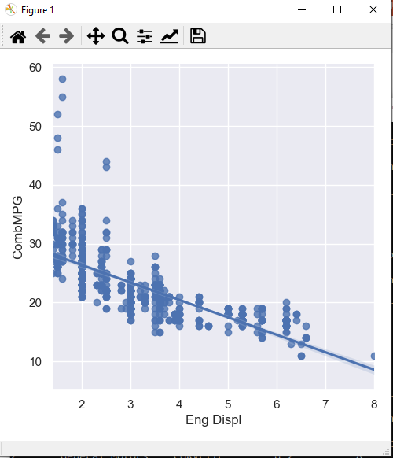
20.7 lmplot
https://www.udemy.com/course/data-science-and-machine-learning-with-python-hands-on/learn/lecture/15090172#overview
lmplot
Same as scatter with extra slope
lmplot (X, Y, data)

Slide 18
20.8 boxplot

Slide 19
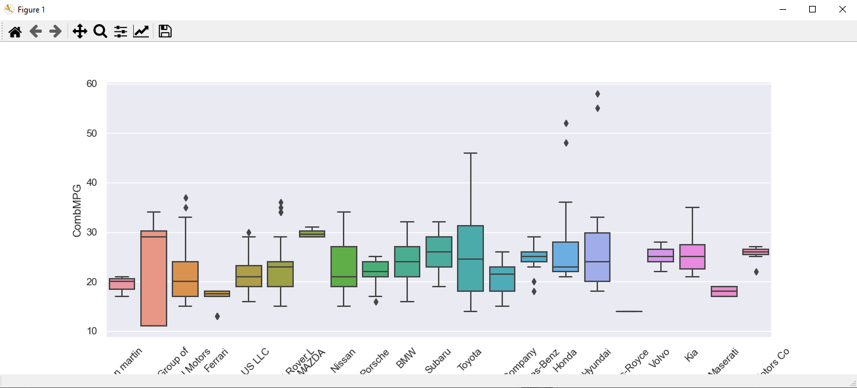
20.8 boxplot
https://www.udemy.com/course/data-science-and-machine-learning-with-python-hands-on/learn/lecture/15090172#overview
boxplot

Slide 20
20.9 swarmplot

Slide 21
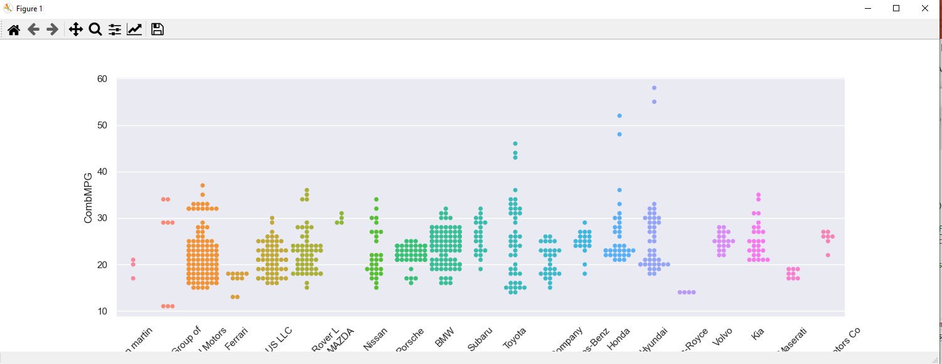
20.9 swarmplot
https://www.udemy.com/course/data-science-and-machine-learning-with-python-hands-on/learn/lecture/15090172#overview
swarmplot

Slide 22
20.10 countplot

Slide 23
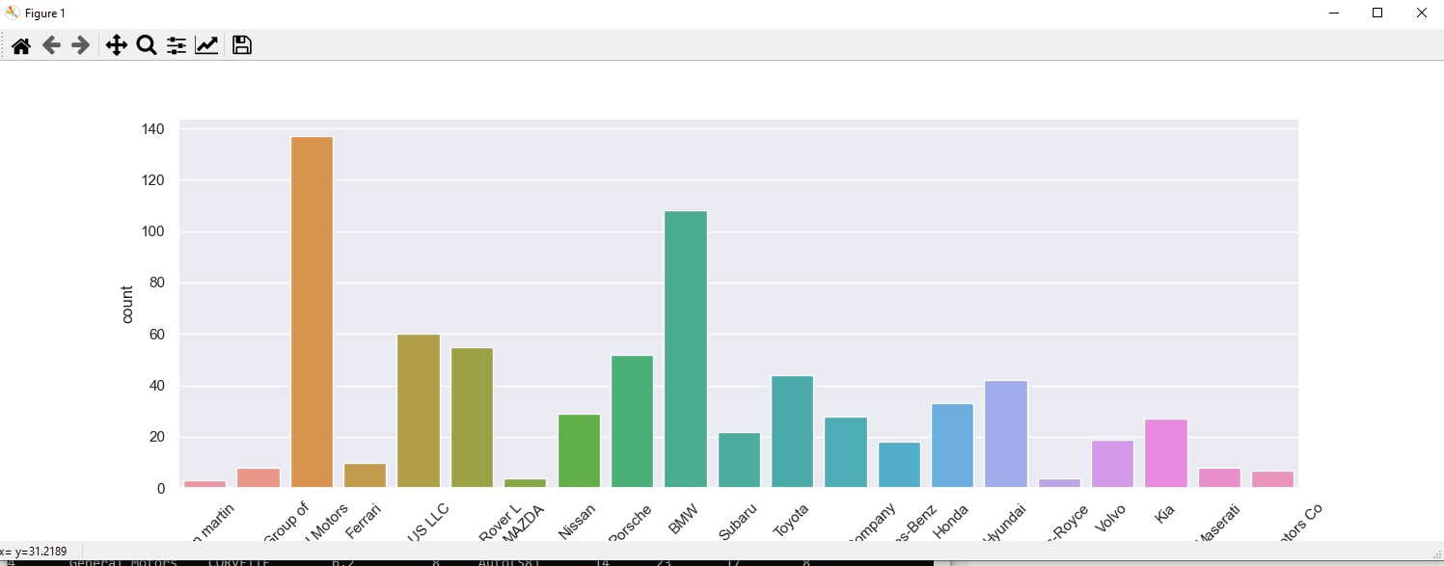
20.10 countplot
https://www.udemy.com/course/data-science-and-machine-learning-with-python-hands-on/learn/lecture/15090172#overview
countplot

Slide 24
20.11 pivot_table

Slide 25
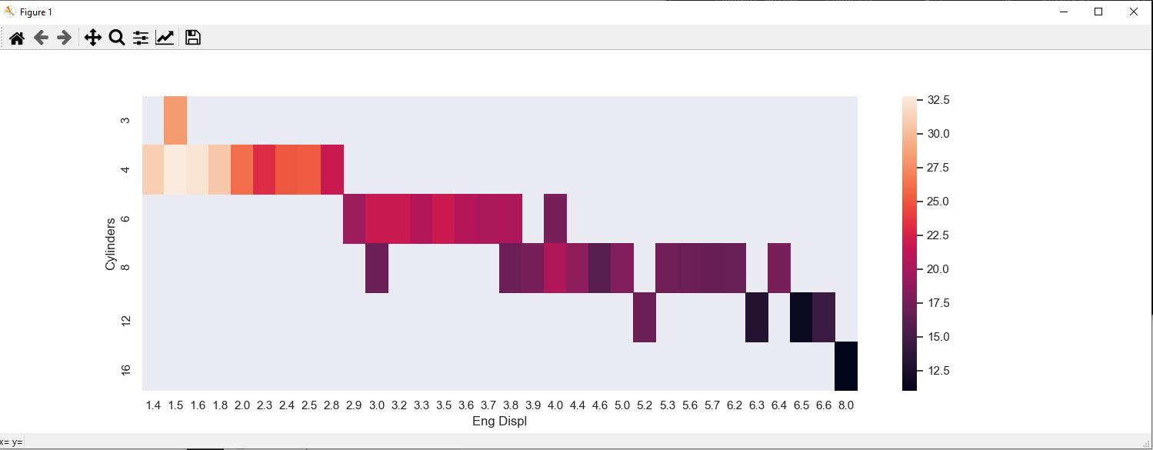
20.11 pivot_table
https://www.udemy.com/course/data-science-and-machine-learning-with-python-hands-on/learn/lecture/15090172#overview
Pivot_table

Slide 26
20.12 Exercise

Slide 27
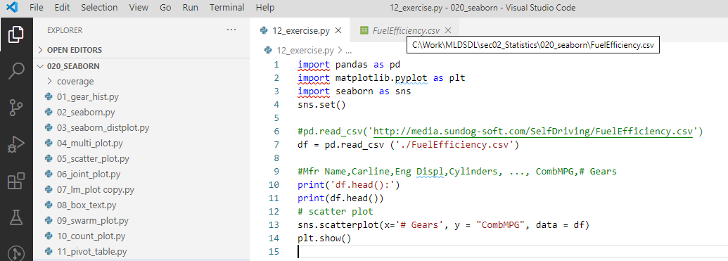
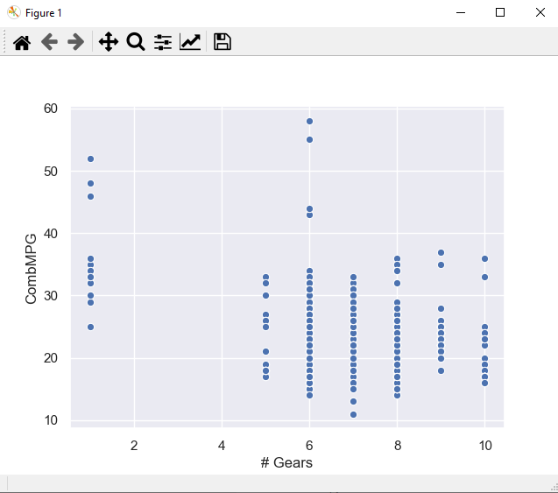
20.12 Exercise
https://www.udemy.com/course/data-science-and-machine-learning-with-python-hands-on/learn/lecture/15090172#overview
Explore the relationship between the number of gears a car has and its combined MPG rating.
Visualize these two dimensions using a scatter plot, lmplot, jointplot, boxplot, and swarmplot.

Slide 28
End of Chapter

