Slide 1
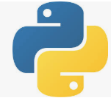
3.1 Python
Peter H. Chen

Slide 2
3.1 Python
https://github.com/peterhchen/900_Python_ML_DS_DL
Python Basic
We discuss some Python Basic for Data Science, Machine Learning, and Deep Learning.

Slide 3
3.1.1 Jupyter Notebook and Python

Slide 4
3.1.1 Jupyter Notebook and Python
https://github.com/peterhchen/900_Python_ML_DS_DL
Jupyter Notebook and Python
Python is a scripting languages.
We will go through Python in Jupyter Notebook and Python in the Anaconda prompt.
Python in Jupyter Notebook is for teaching only.
Python in Anaconda prompt is for product release.
Python in Jupyter Notebook Python in Anaconda prompt have subtle differences, especially, in import plot library and plot function.

Slide 5
3.1.2 Python in Jupyter Notebook

Slide 6
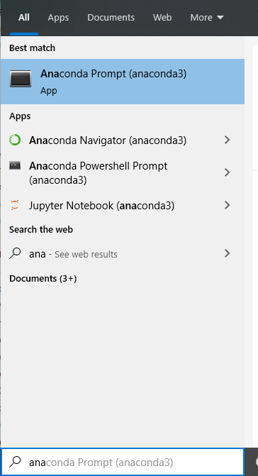
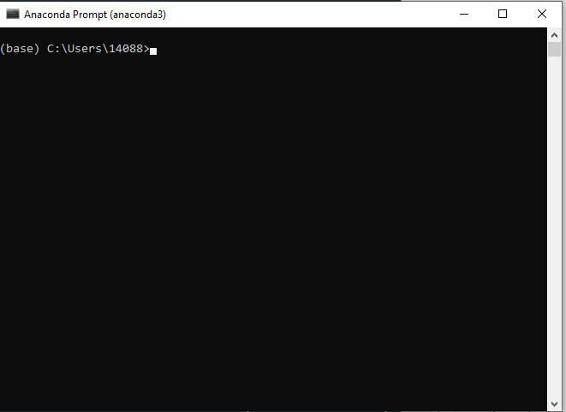
3.1.2 Python in Jupyter Notebook
https://github.com/peterhchen/900_Python_ML_DS_DL
Python in Jupyter Notebook
Python in Jupyter Notebook is used for teaching only.
To execute the Python in Jupyter Notebook
Start Anaconda prompt
> Anaconda prompt

Slide 7
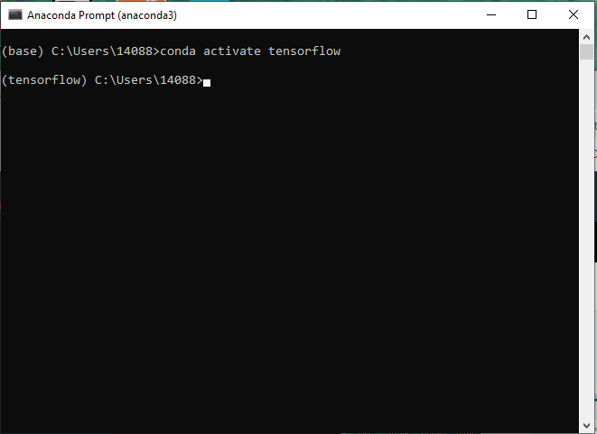
3.1.2 Python in Jupyter Notebook
https://github.com/peterhchen/900_Python_ML_DS_DL
Python in Jupyter Notebook
To execute the Python in Jupyter Notebook
Start Anaconda prompt
(base) [~] > conda activate tensorflow
(tensorflow) [~] >cd [work-folder]

Slide 8
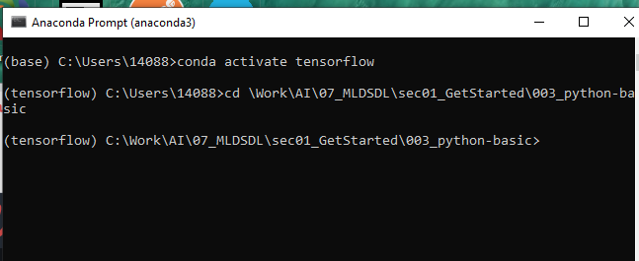
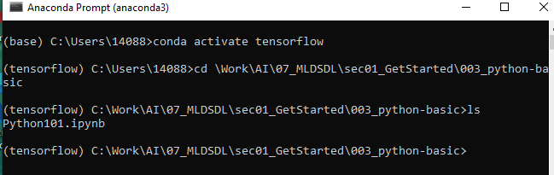
3.1.2 Python in Jupyter Notebook
https://github.com/peterhchen/900_Python_ML_DS_DL
Python in Jupyter Notebook
(tensorflow) [~] >cd [work-folder]
(tensorflow) [~/work-folder] >ls
(tensorflow) [~/work-folder] >python101.ipynb

Slide 9
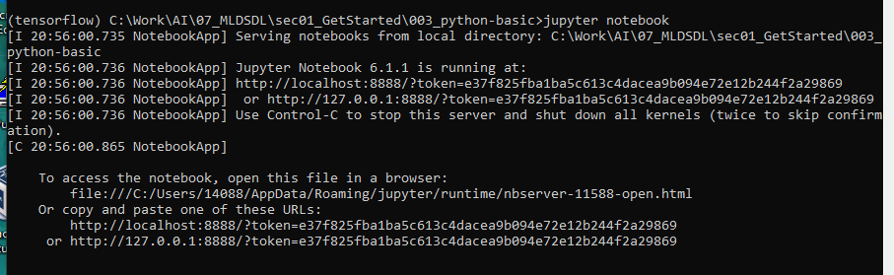
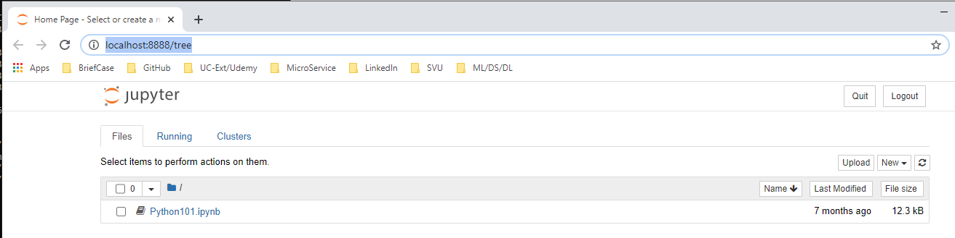
3.1.2 Python in Jupyter Notebook
https://github.com/peterhchen/900_Python_ML_DS_DL
Python in Jupyter Notebook
> Open chrome
(tensorflow) [~/work-folder] >jupyter notebook

Slide 10
3.1.3 Run Python in Jupyter Notebook

Slide 11
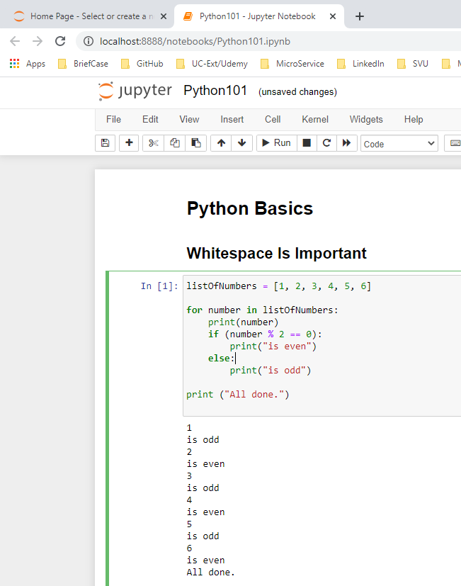
3.1.3 Run Python in Jupyter Notebook
https://github.com/peterhchen/900_Python_ML_DS_DL
Run Python in Jupyter Notebook
1. Click the In [1]: Cell
2. Click “Run”
3.Result Display
2
1
3

Slide 12
3.1.4 Run Python in Anaconda Prompt

Slide 13
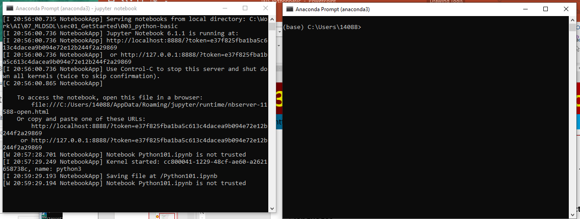
3.1.4 Run Python in Anaconda Prompt
https://github.com/peterhchen/900_Python_ML_DS_DL
Python in Anaconda Prompt
Python in Anaconda Prompt is used in development ab=nd product release
> Open Another anaconda prompt

Slide 14


3.1.4 Run Python in Anaconda Prompt
https://github.com/peterhchen/900_Python_ML_DS_DL
Python in Anaconda Prompt
(base) [~] > conda activate tensorflow
(tensorflow) [~] > cd [work-fodler]
(tensorflow) [~] > ls
2020/9/26

Slide 15
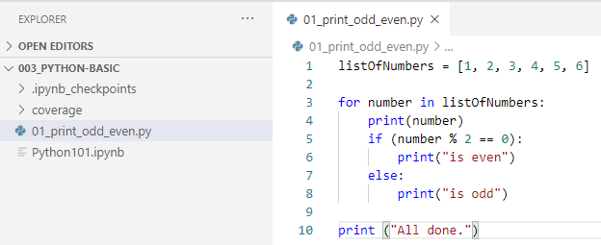
3.1.4 Run Python in Anaconda Prompt
https://github.com/peterhchen/900_Python_ML_DS_DL
Python in Anaconda Prompt
(tensorflow) [~] > code 01_print_odd_even.py
Note: “code” is command to bring up VS code (Microsoft Visual Studio Code)
2020/9/26

Slide 16
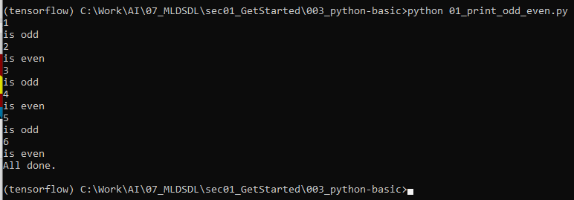
3.1.4 Run Python in Anaconda Prompt
https://github.com/peterhchen/900_Python_ML_DS_DL
Python in Anaconda Prompt
(tensorflow) [~] > python *_print_odd_even.py
2020/9/26

Slide 17
3.1.5 Normal Distribution

Slide 18
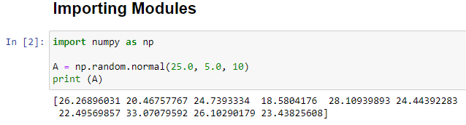
3.1.5 Normal Distribution
https://github.com/peterhchen/900_Python_ML_DS_DL
Normal Distribution
We will use both Jupyter Notebook or Python .
We import numpy (Numerical Python) and run normal function in the random class.
We have mean = 25.0, and deviation 5.0, with 10 points (from index 0 to 9).
> A = np.random.normal (25.0, 5.0, 10)
2020/9/26

Slide 19
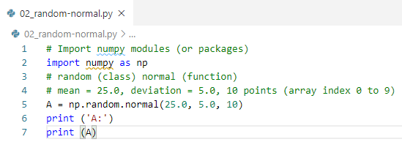
3.1.5 Normal Distribution
https://github.com/peterhchen/900_Python_ML_DS_DL
Normal Distribution
We will use both Jupyter Notebook or Python .
We import numpy (Numerical Python) and run normal function in the random class.
We have mean = 25.0, and deviation 5.0, with 10 points (from index 0 to 9).
> A = np.random.normal (25.0, 5.0, 10)
(tensorflow) [..] > python *_random-normal.py
2020/9/26

Slide 20
End of Chapter

