Slide 1

3.3 Function
Peter H. Chen

Slide 2
3.3.1 Function
https://github.com/peterhchen/900_Python_ML_DS_DL
Python Function
2020/9/26

Slide 3
3.3.1 Function

Slide 4
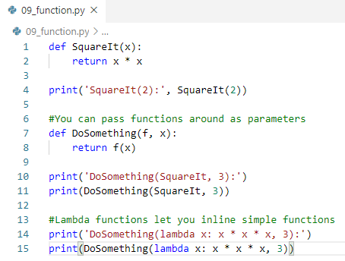

3.3.1 Function
https://github.com/peterhchen/900_Python_ML_DS_DL
Lists: Python Anaconda Prompt
2020/9/26

Slide 5
End of Chapter

