Slide 1

3.4 Boolean and Loop
Peter H. Chen

Slide 2
3.4 Boolean and Loop
https://github.com/peterhchen/900_Python_ML_DS_DL
We discuss Python Boolean and Loop.

Slide 3
3.4.1 Boolean

Slide 4
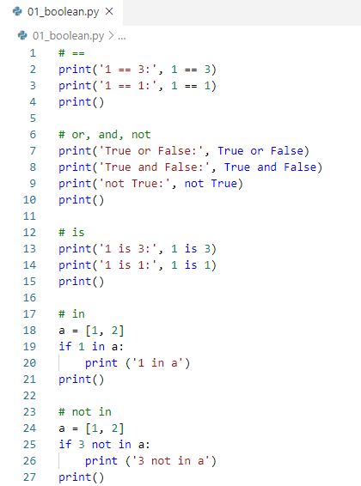
3.4.1 Boolean
https://github.com/peterhchen/900_Python_ML_DS_DL
Python Anaconda:
Python uses ‘==‘ for logical comparison.
Operator is ‘and’, ‘or’, or ‘not’.
Python use Capitalized True and False.
2020/9/26

Slide 5
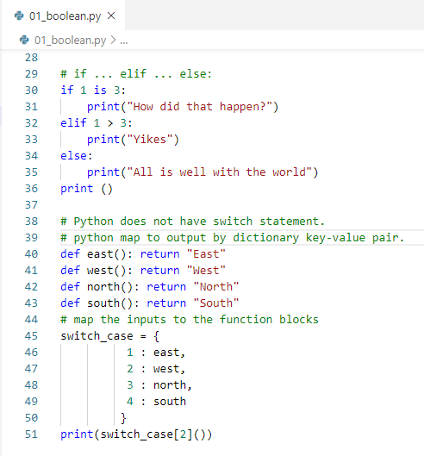
3.4.1 Boolean
https://github.com/peterhchen/900_Python_ML_DS_DL
Python Anaconda:
If … elif … else:
Python does not have switch statement.
Python uses key-value pair to select value for matched key.
2020/9/26

Slide 6
10.2 Loop

Slide 7
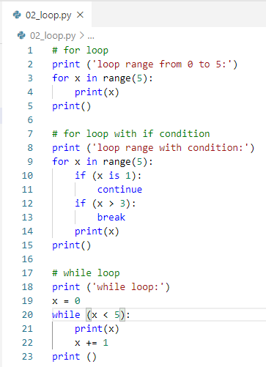
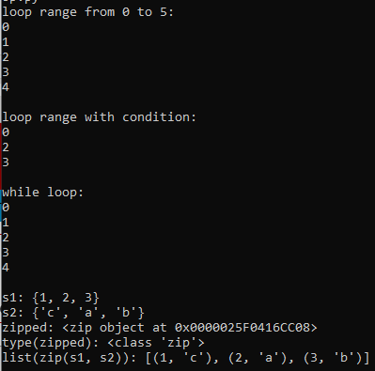
10.2 Loop
https://github.com/peterhchen/900_Python_ML_DS_DL
Loop: for x in range(n), while loop.
2020/9/26

Slide 8
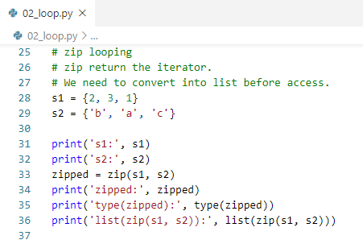
10.2 Loop
https://github.com/peterhchen/900_Python_ML_DS_DL
zip looping
zip return the iterator.
We need to convert into list before access.
2020/9/26

Slide 9
10.3 Exercise

Slide 10
10.3 Exercise
https://github.com/peterhchen/900_Python_ML_DS_DL
Exercise:
1. Given
list_a = [1, 2, 3, 4, 5]
Use for x in range (len (list_a)) to loop and print each element of the list and print the even number.
2. Given
list_b = [1, 2, 3]
List_c = [‘a’, ‘b’, ‘c’]
Use zip to loop and print all the key-value pairs.
2020/9/26

Slide 11
End of Chapter

