Slide 1
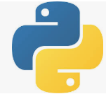
002 Install TensorFlow
Peter H. Chen

Slide 2
002 Install TensorFlow
https://github.com/peterhchen/930_Python_ML_DS_DL
Install Tensorflow
Under the Windows 10 (Linux or MacOS), Tensorflow 2.0 has dependencies for Anaconda 3, Python 3, and numpy, scikit-learn (formal name is SciKits or SciPy Toolkit), and associated frameworks.
After environment update for many years, it is very difficult to fix with tons of error messages.
It is easier to install a clean system with Python and associated Tensorflow dependencies.
Jeff Heaton provides the video and yaml file tensorflow.yml.
YouTube video:
https://www.youtube.com/watch?v=RgO8BBNGB8w&t=376s
Jeff Heaton GitHub:
https://github.com/jeffheaton/t81_558_deep_learning

Slide 3
94.1 Create Tensorflow Environment

Slide 4
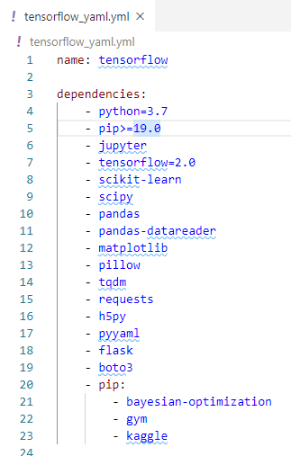
94.1 Create Tensorflow Environment
https://github.com/peterhchen/930_Python_ML_DS_DL
Create Tensorflow Environment
2020, Installing TensorFlow 2.0, Keras, and Python 3.7 in Windows 10
Download the tensroflow.yml
This file contains the environment setup for us.

Slide 5
94.2 Install Jupyter

Slide 6

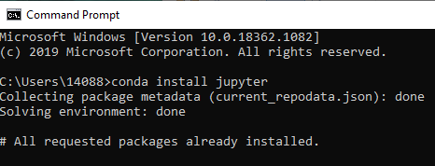
94.2 Install Jupyter
https://github.com/peterhchen/930_Python_ML_DS_DL
Install Jupyter
Download Anaconda or MiniConda on window 10.
Under window 10
> conda install jupyter

Slide 7
94.3 Install Tensorflow Environments

Slide 8
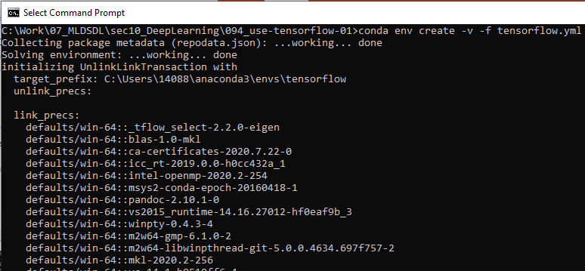
94.3 Install Tensorflow Environments
https://github.com/peterhchen/930_Python_ML_DS_DL
Install Tensorflow and Associated Environments
This is very important:
Download tensorflow.yml includes the verified dependencies and frameworks.
This prevent us to use incompatible dependencies and very difficult to fix.
C:\[work-folder] > conda env create -v -f tensorflow.yml

Slide 9
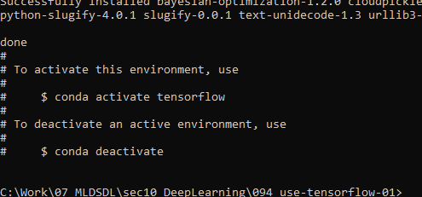
94.3 Install Tensorflow Environments
https://github.com/peterhchen/930_Python_ML_DS_DL
Install Tensorflow and Associated Environments
After tensroflow.yml installed, we have the following message:
Start anaconda prompt
(base) > conda activate tensroflow
(tensorflow) > conda deactivate

Slide 10
94.4 Start Tensorflow Environments

Slide 11
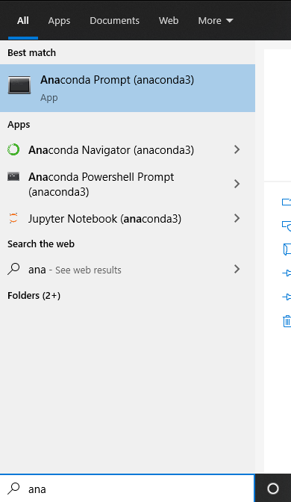
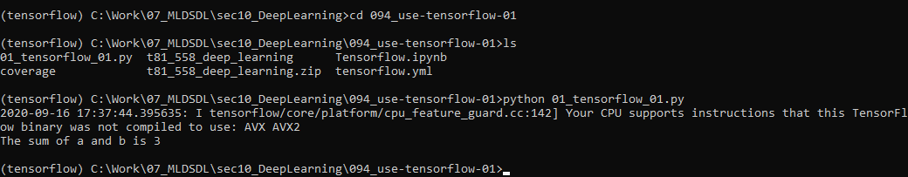
94.4 Start Tensorflow Environments
https://github.com/peterhchen/930_Python_ML_DS_DL
Start Tensorflow Environments
start anaconda prompt
> conda activate tensorflow
> cd [work-folder]

Slide 12
94.5 Run Jupyter Tensorflow

Slide 13
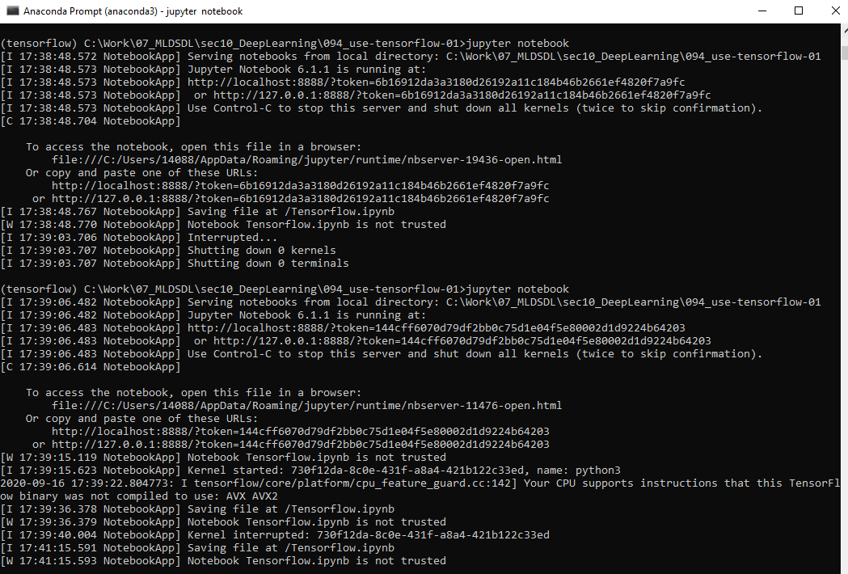
94.5 Run Jupyter Tensorflow
https://github.com/peterhchen/930_Python_ML_DS_DL
Start Jupyter Notebook
> ls
> jupyter notebook

Slide 14
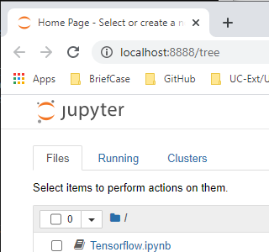
94.5 Run Jupyter Tensorflow
https://github.com/peterhchen/930_Python_ML_DS_DL
Use Tensorflow 01
We can see “Tensorflw.ipynb”
Double click to open

Slide 15
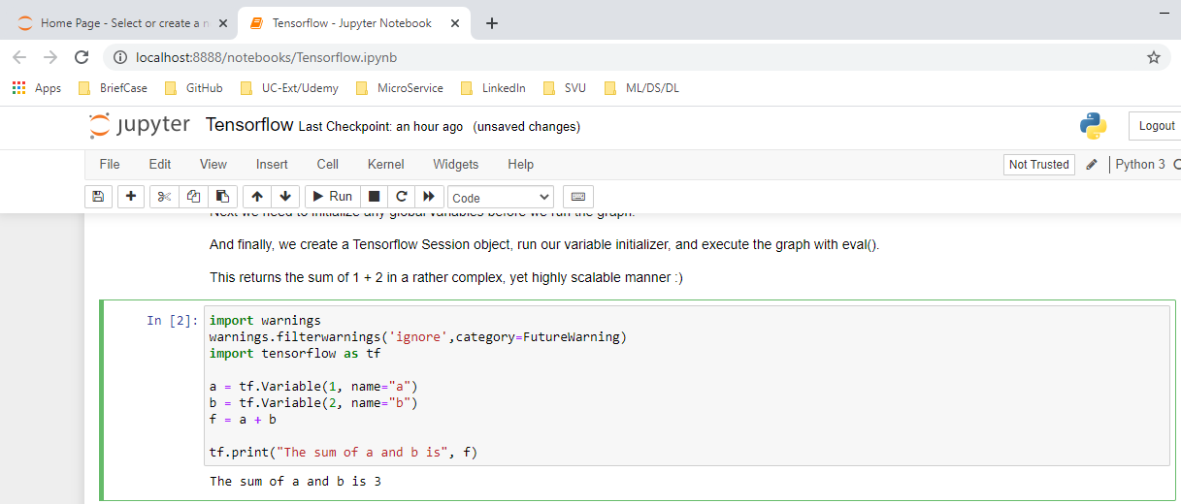
94.5 Run Jupyter Tensorflow
https://github.com/peterhchen/930_Python_ML_DS_DL
Use Tensorflow 01
We can see “Tensorflw.ipynb”
Double click to open

Slide 16
94.6 Run Python Tensorflow
Peter H. Chen

Slide 17
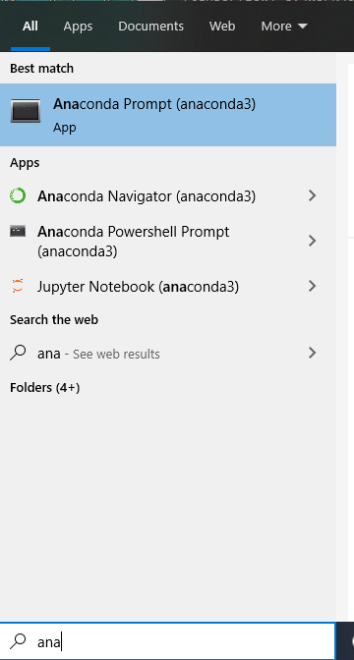
94.6 Run Python Tensorflow
https://github.com/peterhchen/930_Python_ML_DS_DL
Run Python Tensorflow
Under window 10
Search “anaconda”

Slide 18
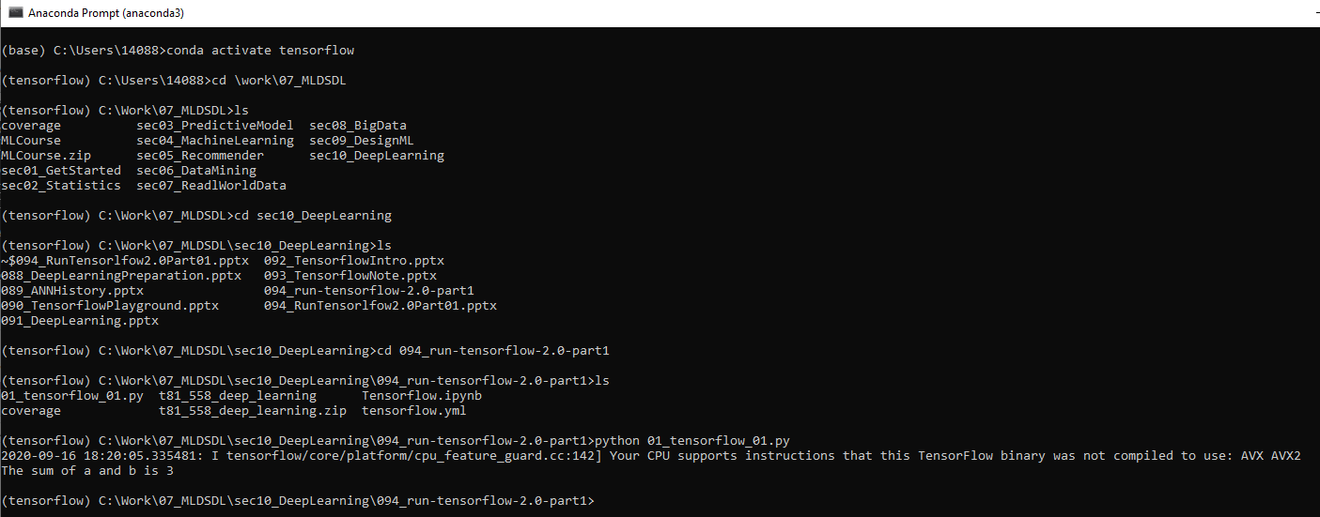
94.6 Run Python Tensorflow
https://github.com/peterhchen/930_Python_ML_DS_DL
Run Python Tensorflow
Activate TensorFlow environment
(base) > conda activate tensorflow
(tensorflow) > cd [work folder]
(tensorflow) > [work folder] > python 01_tnesorflow_01.py

Slide 19
End of Chapter

