Slide 1

104 Regularization
Peter H. Chen

Slide 2
104 Regularization
https://github.com/peterhchen/930_Python_ML_DS_DL
Neural Network Regularization Techniques
We discuss Regularization in the neural networks.

Slide 3
104.1 What Is Regularization?

Slide 4
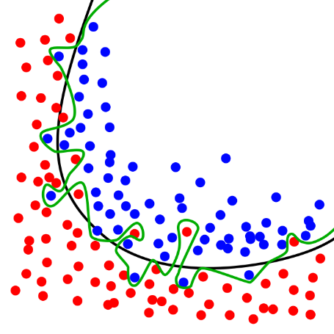
104.1 What Is Regularization?
https://github.com/peterhchen/930_Python_ML_DS_DL
What is Regularization?
Prevent Overfitting
Models that are good at making prediction on the data they were trained on, but not on new data it has not seen before.
Overfitted models have learned patterns to the training data that do not generate the real world
Often seen as high accuracy on training data set but lower accuracy on test or evaluation data set
When training and evaluating a model, we use training, evaluation, and testing data set.
Regularization techniques are intended to prevent overfitting.
https://commons.wikimedia.org/wiki/File:Overfitting.svg

Slide 5
104.1 What Is Regularization?
https://github.com/peterhchen/930_Python_ML_DS_DL
What is Regularization? (Explanation)
What is regularization anyway?
Well basically, regularization is any technique that is intended to prevent overfitting.
What is over fitting?
If you have a model that's good at making predictions on the data it was trained on, but it doesn’t do so well on new data that it hasn't seen before, then we say that model is overfitted.
That means that it's learned patterns in your training data that don't really exist in the general sense in the real world.

Slide 6
104.1 What Is Regularization?
https://github.com/peterhchen/930_Python_ML_DS_DL
What is Regularization? (Explanation)
If you see a high accuracy on your training data set but a lower accuracy on your test set or your evaluation data set, that's nature's way of telling you that your model is overfitting.
In the world of Deep Learning, typically, we talk about three different data sets.
We have the training data set, test data set, and evaluation data set.
The training data fed into your neural network and train the network on.
You got the weights of the our model when the training is done.
As we train each epoch, we can evaluate the results of that network against an evaluation dataset.

Slide 7
104.1 What Is Regularization?
https://github.com/peterhchen/930_Python_ML_DS_DL
What is Regularization? (Explanation)
The evaluation dataset is a set of the training set, that's set aside to evaluate the results and the accuracy of your model as it's being trained.
And then we can also have a testing dataset that lives outside of all of that.
Once we have a fully trained model we can then use our testing data set to evaluate the complete finished model if you will.
If you're seeing your training accuracy being a lot more than the accuracy measured against your evaluation data, or your testing data at the end, that means you are overfitting to the training data.

Slide 8
104.1 What Is Regularization?
https://github.com/peterhchen/930_Python_ML_DS_DL
What is Regularization? (Explanation)
This graph on the below makes a little bit more easy to understand.
Assume we want to build a model that separates out the blue ball and red ball.
You can figure out the black curve is the best curve to separate the blue ball is and red ball.
If a model were over fitting, it might actually learn that green curve. It separate all the red and blue ball but it is overfitting. The green curve does not work well the evaluation data set.
So that is the regularization technique come in.

Slide 9
104.2 Too Many Neurons/Layers?

Slide 10
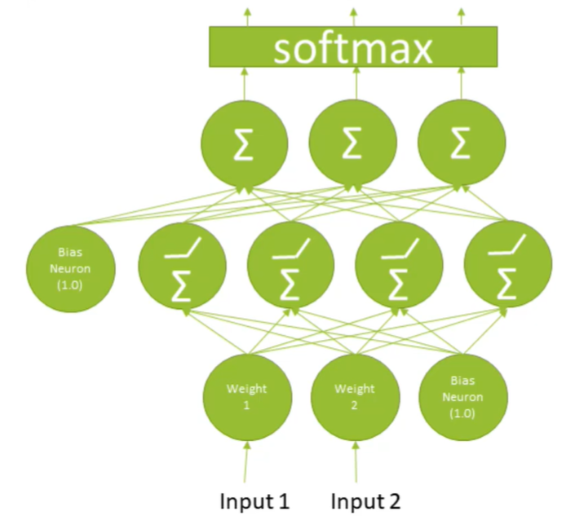
104.2 Too Many Neurons/Layers?
https://github.com/peterhchen/930_Python_ML_DS_DL
Too Many Layers? Too Many Neurons?

Slide 11
104.2 Too Many Neurons/Layers?
https://github.com/peterhchen/930_Python_ML_DS_DL
Too Many Layers? Too Many Neurons? (Explanation)
A very simple thing might be, you might just have too complex of a model.
You have too many layers, too many neurons, you have a deep neural network that is too deep or too wide, or maybe both.
By simplifying your model, that restricts those more complicated patterns that is overfitting.
A very simple model that is just a simple curve like that, that could probably be achieved through a regression with a simpler model.
The simplest regularization technique is simply to use fewer neurons or use fewer layers.

Slide 12
104.2 Too Many Neurons/Layers?
https://github.com/peterhchen/930_Python_ML_DS_DL
Too Many Layers? Too Many Neurons? (Explanation)
That is a totally valid and good way to do.
Sometimes you need to experiment with that.
If you find that your model is overfitting, the simplest thing is just to use a simpler model.
Try to use fewer layers, use fewer neurons in each layer, and see what kind of effect that has.
If you can still have the same accuracy in your test dataset, but not overfit to your training dataset, then why use more neurons than you need.

Slide 13
104.3 Dropout

Slide 14
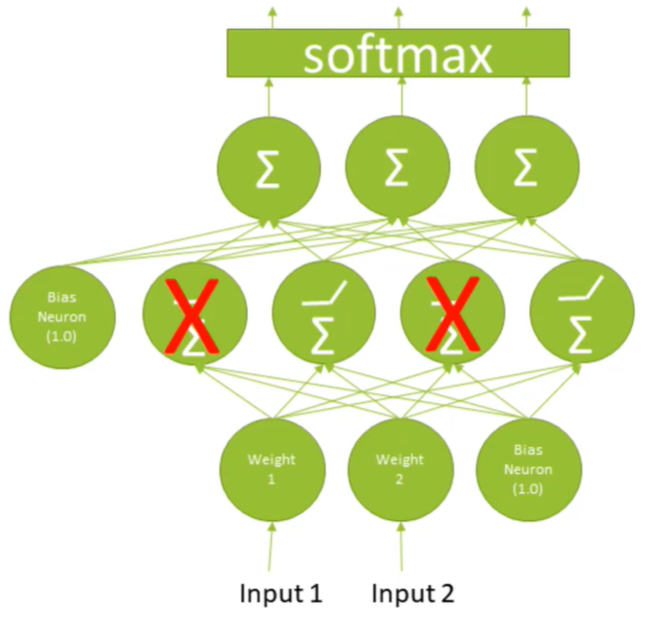
104.3 Dropout
https://github.com/peterhchen/930_Python_ML_DS_DL
Dropout

Slide 15
104.3 Dropout
https://github.com/peterhchen/930_Python_ML_DS_DL
Dropout (Explanation)
Another technique is called dropout, and this is kind of an interesting one.
The idea with a dropout layer is that it actually removes some of the neurons in your network at each spot as its training, and this has the effect of basically forcing your model to learn and spread out its learning amongst the different neurons and layers within your network.
By dropping out specific neurons that are chosen at random at each training step, we are forcing the learning to spread itself out more.
Dropout has the effect of preventing any individual neuron from over fitting to a specific data point.

Slide 16
104.3 Dropout
https://github.com/peterhchen/930_Python_ML_DS_DL
Dropout (Explanation)
It is a little bit counter-intuitive that actually removing neurons from your own network can make it actually train better, but that's what happens that prevents overfitting.
That is what dropout is all about.
Again a very effective regularization technique.
We see this a lot in CNNs, for example, it is pretty standard to have a pretty aggressive dropout layer, like maybe even 50 percent being held out for each training pass.
So, that's all dropout is, its just removing some neurons at random at each training step to force your model to spread it's learning out a little bit better.
Another very simple solution is called early stopping.
So let's take a look at this printout, as we're actually training a real neural network. So you can see
that if you look at the accuracy on the validation set, that's the right hand column there,
we're going from 95 percent to 97 percent, and things are getting better, and then all of a sudden we
get up to like around 98 percent, and things start to get weird, it starts to oscillate, right?
So we can say just by looking at this, that after around epoch five, we're not doing any more benefit
by training further. In fact we might be doing more harm than good because at this point we're probably
starting to over fit.
And indeed if you look at the training set accuracy, that's that first column of accuracy, the second
column of numbers that you see in this display,
the accuracy and the training set continues to increase as we train more and more epochs.
But the accuracy on the validation set pretty much stopped getting better at around epoch five.
So this is pretty clearly starting to over fit beyond the fifth epoch.
All right.
All early stopping is is a way of automatically detecting that, and it's an algorithm that will just
say "OK, the validation accuracy has leveled out, my training accuracy is still increasing.
We should probably just stop now". So early stopping just means,
OK,
I know you wanted 10 epochs, but I can see here that after five, things are just getting worse as far
as overfitting goes, so we're gonna stop at five, guys, we're done here.
That's it.
That's all early stopping is about. It's just making sure that you're not training your neural network further
than you should, and that prevents over fitting.
Very simple solution there.

Slide 17
104.4 Early Stopping

Slide 18
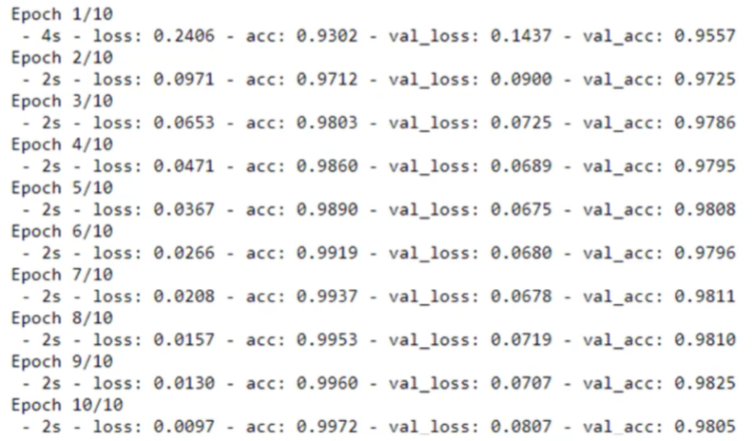
104.4 Early Stopping
https://github.com/peterhchen/930_Python_ML_DS_DL
Early Stopping
Model
Overfitting
for training data
Evaluating is
Oscillating

Slide 19
104.4 Early Stopping
https://github.com/peterhchen/930_Python_ML_DS_DL
Early Stopping (Explanation)
Another very simple solution is called early stopping.
let's take a look at this printout, as we're actually training a real neural network.
You can see that if you look at the accuracy on the validation set, that's the right hand column there, we're going from 95 percent to 97 percent, and things are getting better, and then all of a sudden we get up to like around 98 percent, and things start to get weird, it starts to oscillate, right?
So we can say just by looking at this, that after around epoch five, we're not doing any more benefit by training further.

Slide 20
104.4 Early Stopping
https://github.com/peterhchen/930_Python_ML_DS_DL
Early Stopping (Explanation)
In fact we might be doing more harm than good because at this point we're probably starting to overfit.
And indeed if you look at the training set accuracy, that's that first column of accuracy, the second column of numbers that you see in this display, the accuracy and the training set continues to increase as we train more and more epochs.
But the accuracy on the validation set pretty much stopped getting better at around epoch five.
So this is pretty clearly starting to over fit beyond the fifth epoch.

Slide 21
104.4 Early Stopping
https://github.com/peterhchen/930_Python_ML_DS_DL
Early Stopping (Explanation)
All early stopping is a way of automatically detecting that, and it's an algorithm that will just say "OK, the validation accuracy has leveled out, my training accuracy is still increasing.
We should probably just stop now". So early stopping just means, OK, I know you wanted 10 epochs, but I can see here that after five, things are just getting worse as far as overfitting goes, so we're going to stop at five, guys, we're done here. That's it. That's all early stopping is about. It's just making sure that you're not training your neural network further than you should, and that prevents over fitting.
Very simple solution there.

Slide 22
End of Chapter

