Slide 1

90 Tensorflow Playground
Peter H. Chen

Slide 2
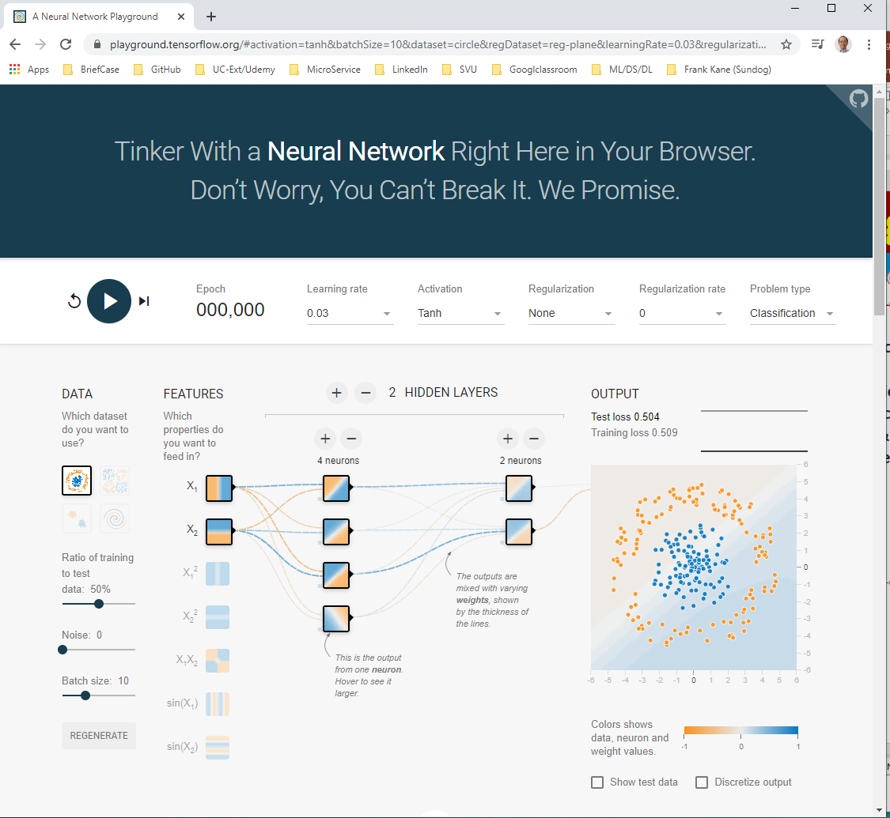
90 Tensorflow Playground
https://github.com/peterhchen/900_Python_ML_DS_DL
Playground.tensorflow.org
https://playground.tensorflow.org/#activation=tanh&batchSize=10&dataset=circle&regDataset=reg-plane&learningRate=0.03&regularizationRate=0&noise=0&networkShape=4,2&seed=0.38344&showTestData=false&discretize=false&percTrainData=50&x=true&y=true&xTimesY=false&xSquared=false&ySquared=false&cosX=false&sinX=false&cosY=false&sinY=false&collectStats=false&problem=classification&initZero=false&hideText=false

Slide 3
90 Tensorflow Playground
https://github.com/peterhchen/900_Python_ML_DS_DL
Playground.tensorflow.org (Explanation):
We understand the concepts of artificial neural networks and Deep Learning.
Go to playground.tensorflow.org which created by Google.
We can exercise and see what is going on of deep learning and tensorflow.
We can exercise and see what is going on of deep learning and tensorflow.
We will create our neural networks without writing code.
We will classify a lot of points just based on their location in this 2D image.

Slide 4
90.1 Circular Pattern

Slide 5
90.1 Circular Pattern
https://github.com/peterhchen/900_Python_ML_DS_DL
Playground.tensorflow.org (Explanation):
We have a lot of points.
The points in the middle are classified as blue and the points on the outside are classified as orange.
Our objective is to create a neural network that given no prior knowledge can actually figure out if a given point should be blue or orange and predicts successfully which classification it should be.
Tensorflow is a very powerful tool.
We know ahead of time what the correct classifications are for each one of these points and we’re going to use this information to train our neural network to hopefully learn that stuff in the middle should be blue and stuff on the outside should be orange.

Slide 6
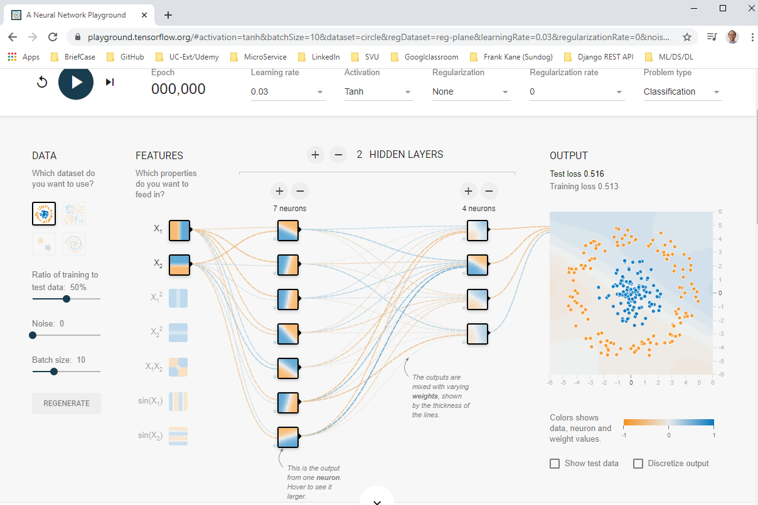
90.1 Circular Pattern
https://github.com/peterhchen/900_Python_ML_DS_DL
Playground.tensorflow.org (Explanation):
Here we have a diagram of the neural network itself and we can play around with it.
We can manipulate it, add layers to it, take layers out, add more neurons to layer as whatever you want to do.

Slide 7
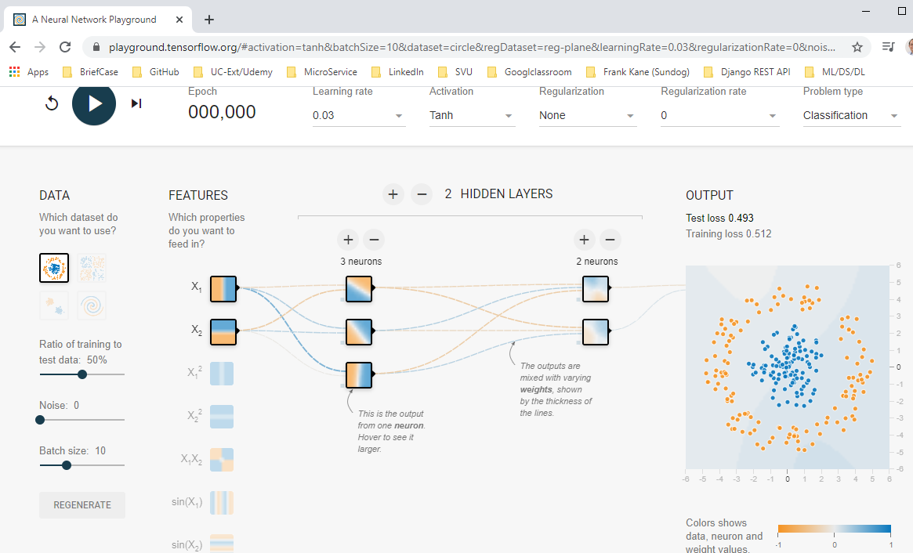
90.1 Circular Pattern
https://github.com/peterhchen/900_Python_ML_DS_DL
Playground.tensorflow.org (Explanation):
Let's review what's going on here.
First, we are selecting the dataset that we want to play with.
We started with this default one that's called circle, the inputs are simply the x and y coordinates, the vertical and horizontal position of each data point.
As our neural network is given a point to classify, all it has to work with are those two values.
Its horizontal position and its vertical position and those start off as equally weighted being horizontal or vertical.
We can define the position of any one of these points in terms of its horizontal and vertical position.

Slide 8
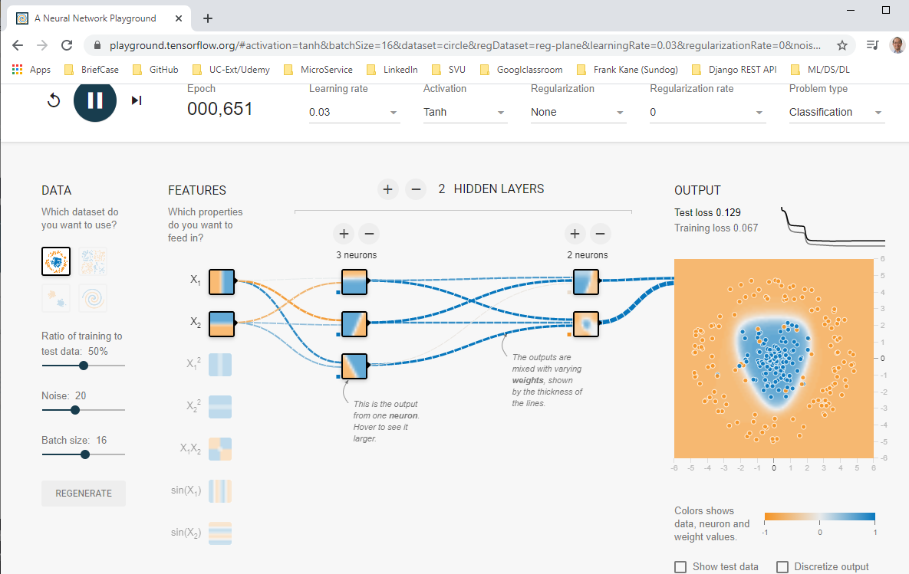
90.1 Circular Pattern
https://github.com/peterhchen/900_Python_ML_DS_DL
Playground.tensorflow.org (Explanation):
For example, this point here would have a horizontal position of negative one and a vertical position of about negative 5.
Then we feed it into our network, you can see that these input nodes have connections to each one of these four neurons in our hidden layer.
We can manipulate the weights between each one of these connections to create the learning that we want, those in turn feed into two output neurons here that will ultimately decide which classification we want.
Keep in mind this is a binary classification problem, it's either blue or orange.

Slide 9
90.1 Circular Pattern
https://github.com/peterhchen/900_Python_ML_DS_DL
Playground.tensorflow.org (Explanation):
We just need a single signal and that's what comes into this output here.
Let's go ahead hit play and see what happens.
What is going to do is start a bunch of iterations where it learns from this training data, so we’re going to keep feeding it input from this training dataset and as it goes, as it iterates through it.
It will start to reinforce the connections that lead to the correct classifications through gradient descent or some similar mechanism.
If we do that enough times, it should converge to a neural network that is capable of reliably classifying these things.

Slide 10
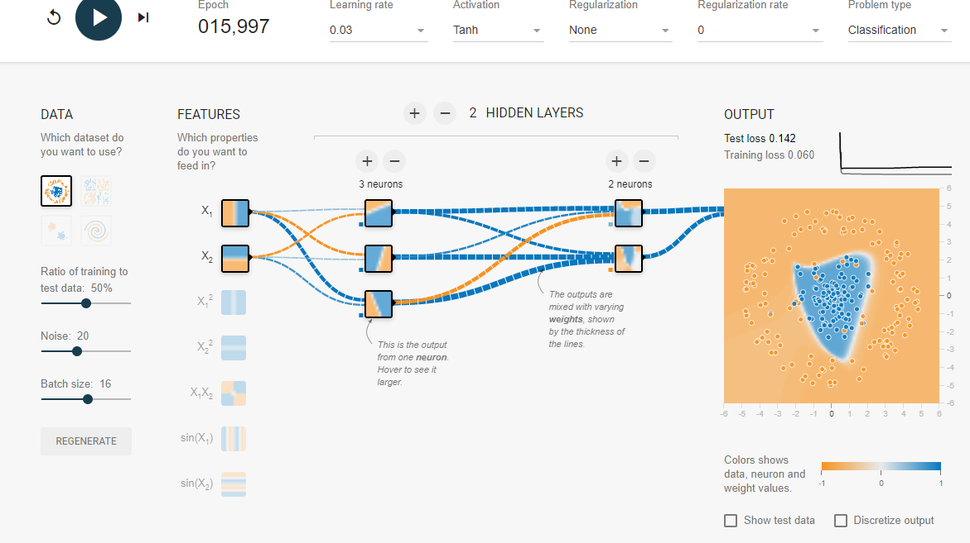
90.1 Circular Pattern
https://github.com/peterhchen/900_Python_ML_DS_DL
Playground.tensorflow.org (Explanation):
Let's hit play and just watch it in action.
Keep your eye on that image to the right there.
You can see that we've already converged on a solution,
We can go ahead and pause that now.

Slide 11
90.1 Circular Pattern
https://github.com/peterhchen/900_Python_ML_DS_DL
Playground.tensorflow.org (Explanation):
You can see it has successfully created this pattern where stuff that fits into this middle area here is classified as blue and stuff on the outside is classified as orange.

Slide 12
90.1 Circular Pattern
https://github.com/peterhchen/900_Python_ML_DS_DL
Playground.tensorflow.org (Explanation):
So we can dive into what actually happened here.
The thickness of all these connections represent their weights.
You can see the individual weights that are wired between each one of these neurons.

Slide 13
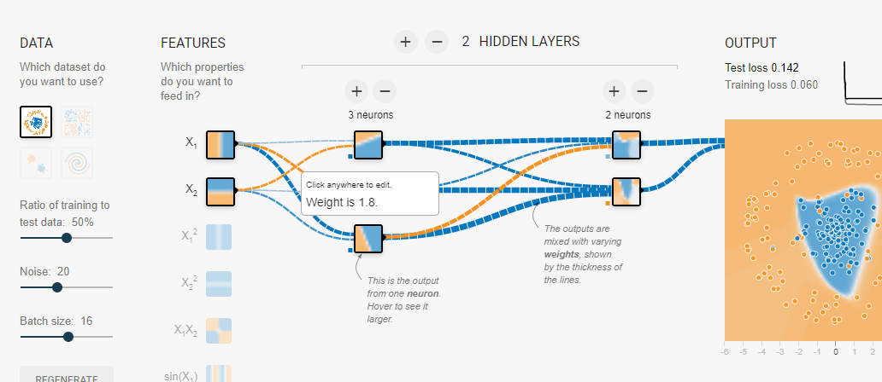
90.1 Circular Pattern
https://github.com/peterhchen/900_Python_ML_DS_DL
Playground.tensorflow.org (Explanation):
We start off here.
You can see these are more or less equally weighted.
Well, not exactly equal either, some of these are kind of weak, but what it leads to is this behavior in the middle.

Slide 14
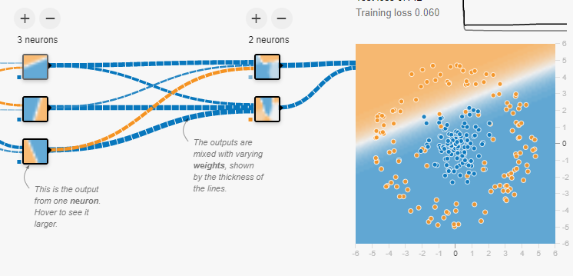
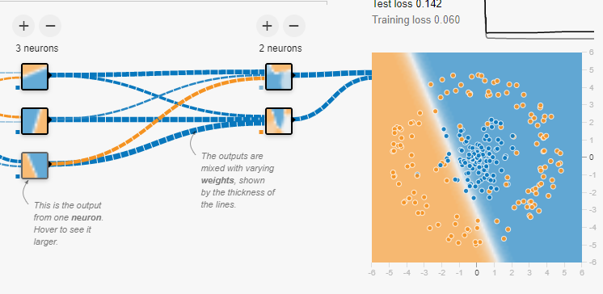
90.1 Circular Pattern
https://github.com/peterhchen/900_Python_ML_DS_DL
Playground.tensorflow.org (Explanation):
We start off with equally weighted x and y coordinates, those go to this layer here.
For example, this hidden layer here:
The first hidden neuron is: "I want to weight things a little bit more heavily in this corner.“
The bottom neurons is more bottom right heavy.
You combine these things together, you end up with these output layers that look like this.

Slide 15
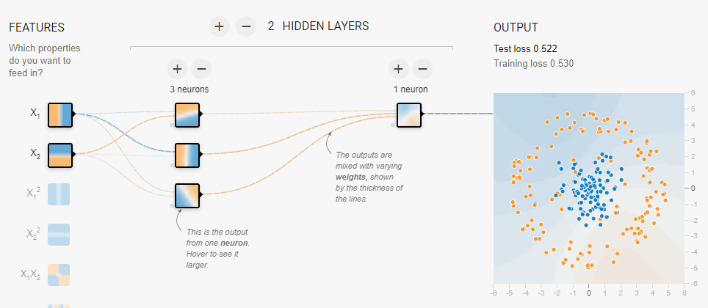
90.1 Circular Pattern
https://github.com/peterhchen/900_Python_ML_DS_DL
Playground.tensorflow.org (Explanation):
We have look different from run to run, you know, there is some random, some randomness to how this is all initialized.
Do we need a deep neural network to do this though?
One optimization is to remove layers to see if we can get away with it, maybe we don't even need Deep Learning,
I mean, really this is kind of a simple thing, you know, stuff in the middle is blue, stuff on the outside is orange.
Let's go ahead and remove one of these neurons from the output layer

Slide 16
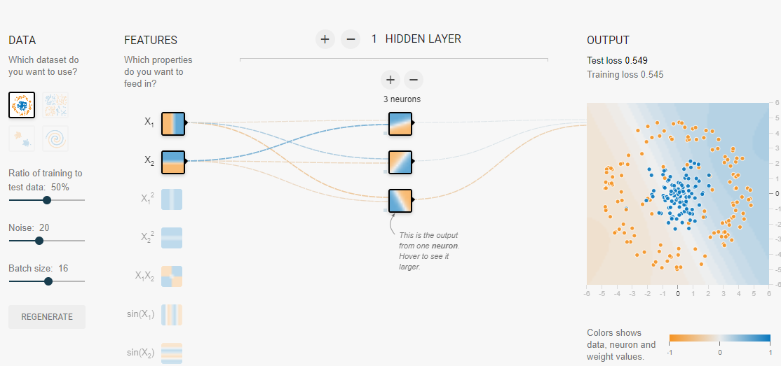
90.1 Circular Pattern
https://github.com/peterhchen/900_Python_ML_DS_DL
Playground.tensorflow.org (Explanation):
We remove one hidden layer.
It still work.
For this very basic problem, we don't even need to do Deep Learning, all I have here is a single layer. It is just a perceptron.

Slide 17
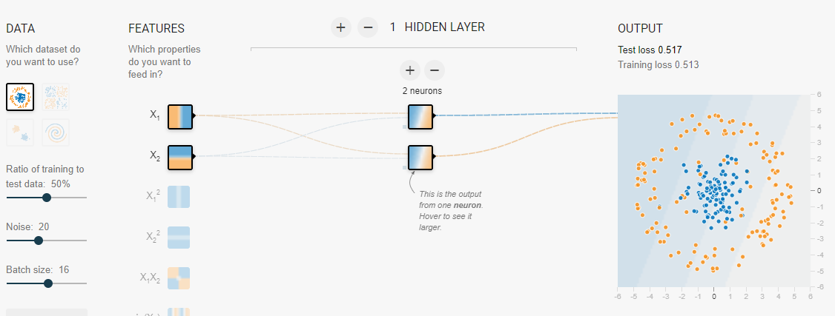
90.1 Circular Pattern
https://github.com/peterhchen/900_Python_ML_DS_DL
Playground.tensorflow.org (Explanation):
Do I even need three neurons in there?
Get rid one.
We have two neurons and still working.

Slide 18
90.2 Spiral Pattern

Slide 19
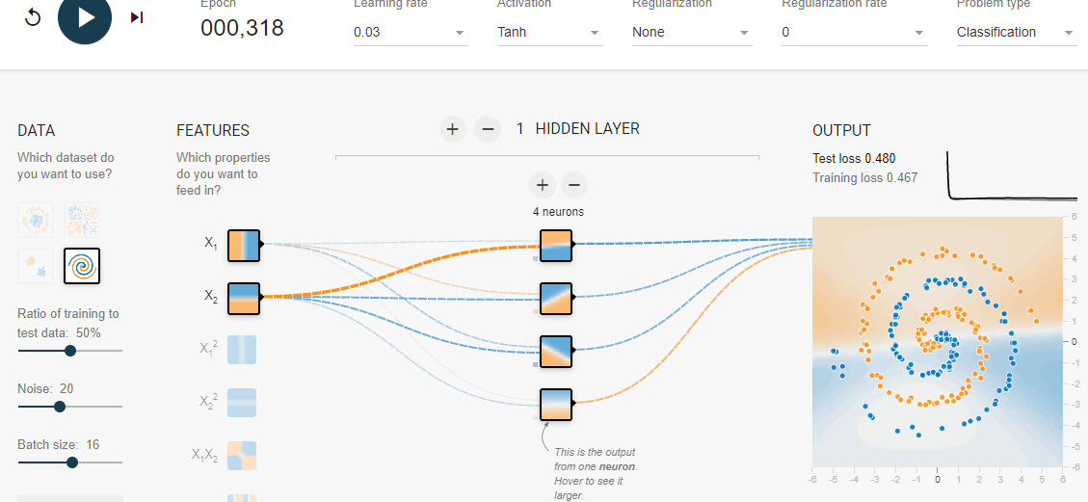
90.2 Spiral Pattern
https://github.com/peterhchen/900_Python_ML_DS_DL
Playground.tensorflow.org (Explanation):
Try a spiral pattern. The Spiral Pattern is very hard to classify.
We add four neurons for hidden layer and hit run.
I does not work.

Slide 20
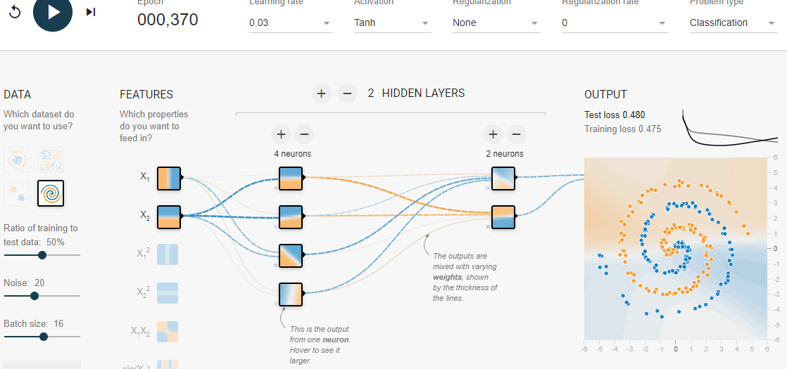
90.2 Spiral Pattern
https://github.com/peterhchen/900_Python_ML_DS_DL
Playground.tensorflow.org (Explanation):
Add one more layer and hit run.
It does not classify properly.

Slide 21
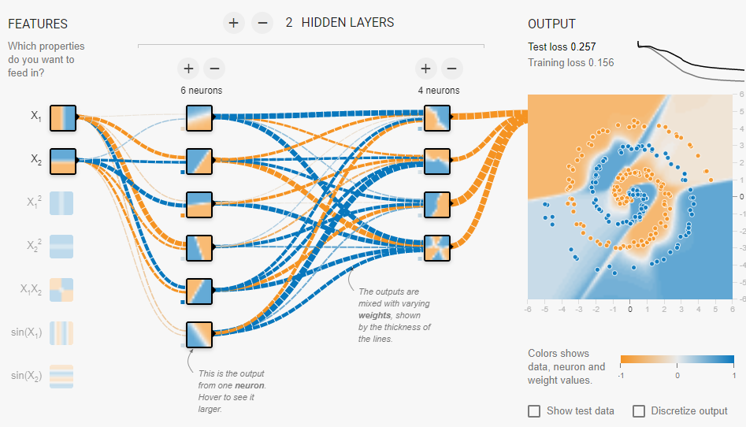
90.2 Spiral Pattern
https://github.com/peterhchen/900_Python_ML_DS_DL
Playground.tensorflow.org (Explanation):
Add more neurons and hit run.
It still does not classify properly.

Slide 22
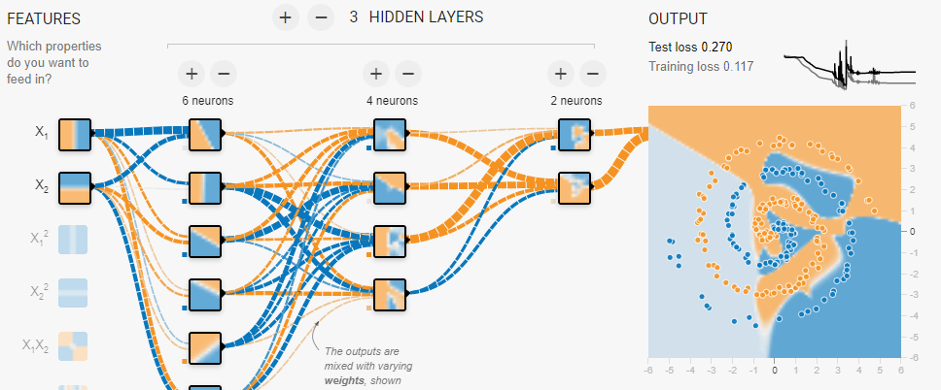
90.2 Spiral Pattern
https://github.com/peterhchen/900_Python_ML_DS_DL
Playground.tensorflow.org (Explanation):
Add more layers.
It almost did all classification, but not quite yet.

Slide 23
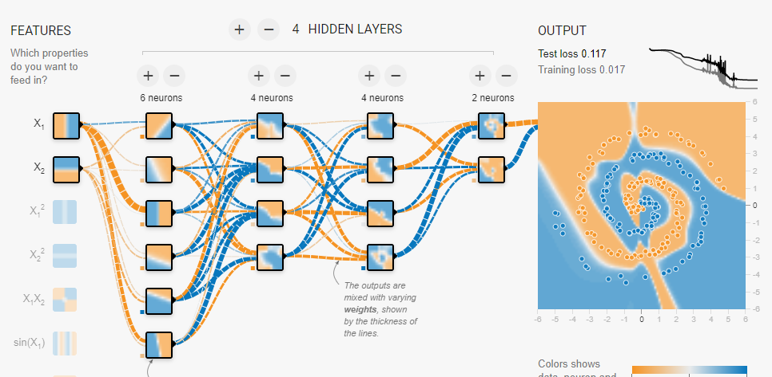
90.2 Spiral Pattern
https://github.com/peterhchen/900_Python_ML_DS_DL
Playground.tensorflow.org (Explanation):
Add more layers and neurons and hit run again.
It looks like we need three hidden layers and 16 neurons for this classification.
Now, this is "overfitting“. The model is too complicated with higher degree of orders.

Slide 24
90.3 Input Parameters

Slide 25
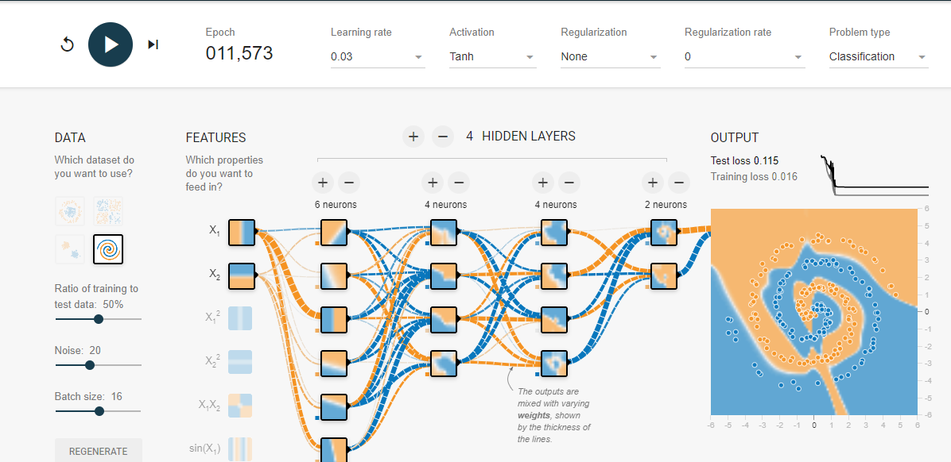
90.3 Input Parameters
https://github.com/peterhchen/900_Python_ML_DS_DL
Playground.tensorflow.org (Explanation):
There are other the other parameters:

Slide 26
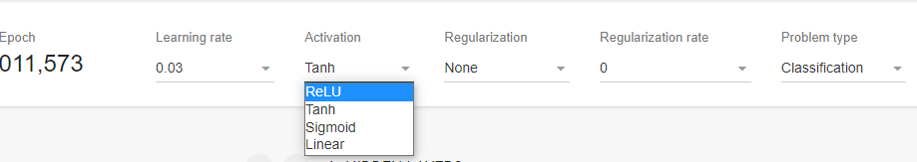
90.2 Spiral Pattern
https://github.com/peterhchen/900_Python_ML_DS_DL
Playground.tensorflow.org (Explanation):
The Activation function: ReLU, Tanh, Sigmoid, and Linear.

Slide 27
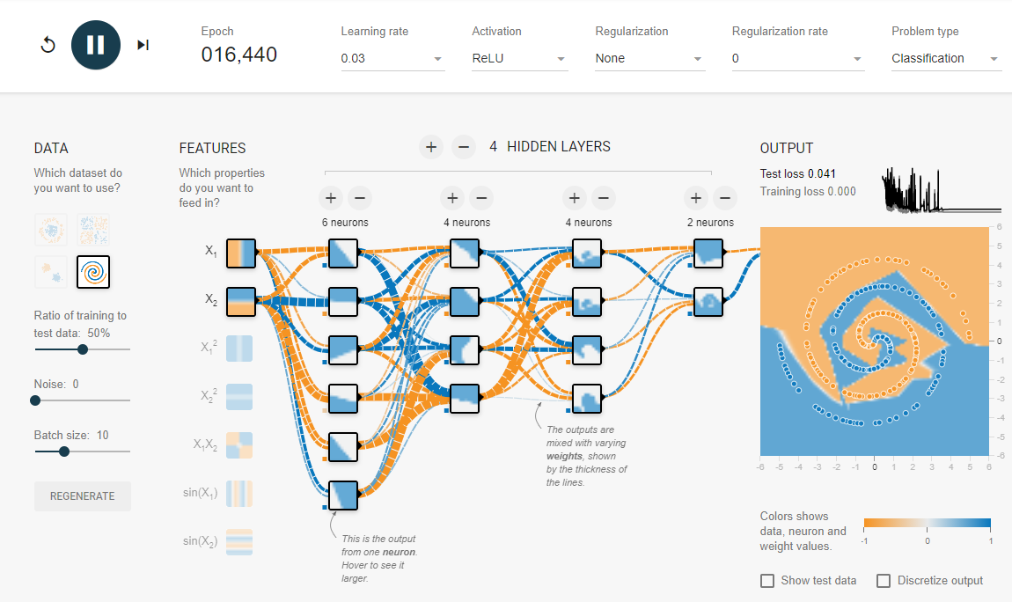
90.2 Spiral Pattern
https://github.com/peterhchen/900_Python_ML_DS_DL
Playground.tensorflow.org (Explanation):
It seems like ReLU, 2 output neurons, 3 hidden layers (6/4/414) can almost do the binary classification for spiral pattern.

Slide 28
End of Chapter

