Slide 1
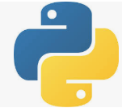
60 Bias/Variance
Peter H. Chen

Slide 2
60 Bias/Variance
https://www.udemy.com/course/data-science-and-machine-learning-with-python-hands-on/learn/lecture/4020712#overview
Bias/Variance
We discuss how to deal with the real-world data.
We start with the Bias and Variance tradeoff.
We have different ways to model the data and may have overfit and underfit the data and how it all inter-relates with each other.

Slide 3
60.1 Bias/Variance Tradeoff

Slide 4
60.1 Bias/Variance Tradeoff
https://www.udemy.com/course/data-science-and-machine-learning-with-python-hands-on/learn/lecture/4020712#overview
Bias/Variance Tradeoff
So one of the basic challenge that we face the deal with real world data is:
Overfitting versus underfitting your regression or your models, or your predictions.
And when we talk about under-fitting and over-fitting, we often talk about the bias and variance and the Bias/Variance Trade-off.

Slide 5
60.2 Bias and Variance

Slide 6
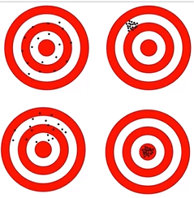
60.2 Bias and Variance
https://www.udemy.com/course/data-science-and-machine-learning-with-python-hands-on/learn/lecture/4020712#overview
Bias and Variance
So conceptually, bias and variance are pretty simple.
Bias is just how far off you are from the correct values. So, how good are your predictions overall in predicting the right overall value.
If you take the mean of all your predictions are they more or less at the right spot. Or are your errors all consistently skewed in one direction or another. If so, then your predictions are biased in a certain direction.
Variance is just a measure of how spread-out, how scattered your predictions are.
So if your predictions are all over the place, then that's high variance, but if they're very tightly focused on what the correct values are, or even an incorrect value in the case of high bias, then your variance is small.

Slide 7
60.2 Bias and Variance
https://www.udemy.com/course/data-science-and-machine-learning-with-python-hands-on/learn/lecture/4020712#overview
Bias and Variance
So let's look at these examples here.
Let's imagine that this dartboard represents a bunch of predictions we're making where the real value we're trying to predict is in the center of the bullseye.
So, starting in the upper left-hand corner, you can see that our points are all scattered about the center.
So, overall, you know, the mean error, comes out to be, you know, pretty close to reality.
Our bias is actually very low because our predictions are all around the same correct point.
However, we have very high variance because these points are scattered about all over the place.
So, this is an example of low bias and high variance.

Slide 8
60.2 Bias and Variance
https://www.udemy.com/course/data-science-and-machine-learning-with-python-hands-on/learn/lecture/4020712#overview
Bias and Variance
If we move on to this one, to the upper-right corner, we see here that our points are all consistently skewed from where they should be to the, the northwest here.
So this is an example of high bias in our predictions, where they're consistently off by a certain amount.
And we have low variance because they're all clustered tightly around this wrong spot, but at least they're close together, so we're being consistent in our predictions and that's low variance but the bias is high.
So again, this is high bias, low variance.

Slide 9
60.2 Bias and Variance
https://www.udemy.com/course/data-science-and-machine-learning-with-python-hands-on/learn/lecture/4020712#overview
Bias and Variance
This example in the lower-left corner, you can see that our predictions are scattered around the wrong mean point.
So we have high bias, everything's skewed to some place where it shouldn't be, but our variance is also high, so this is kind of the worse of both worlds here.
We have high bias and high variance in this example.

Slide 10
60.2 Bias and Variance
https://www.udemy.com/course/data-science-and-machine-learning-with-python-hands-on/learn/lecture/4020712#overview
Bias and Variance
And finally, in a wonderful, perfect world, you would have an example like the lower-right image here, where we have low bias, where everything’s centered around where it should be, and low variance, where things are all clustered pretty tightly around where they should be.
So in a perfect world, that's what you end up with.

Slide 11
60.3 Between Bias and Variance

Slide 12
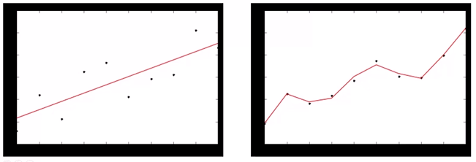
60.3 Between Bias and Variance
https://www.udemy.com/course/data-science-and-machine-learning-with-python-hands-on/learn/lecture/4020712#overview
Between Bias and Variance
But in reality, you often need to choose between one or the other.
So let's take a look at this example. A little bit of a different way of thinking of bias and variance here.
So, here we have a straight line, and you can think of that as having a very low variance relative to these observations?
So, there's not a lot of variance in this line, low variance, but the bias, you know, the error from each individual point, is actually high?

Slide 13
60.3 Between Bias and Variance
https://www.udemy.com/course/data-science-and-machine-learning-with-python-hands-on/learn/lecture/4020712#overview
Between Bias and Variance
Now, contrast that to this over-fitted data here, where we've kind of gone out of our way to fit these observations, this line has high variance but low bias because each individual point is pretty close to where it should be.
So this is an example of where we traded off variance for bias.

Slide 14
60.4 Care About Error

Slide 15
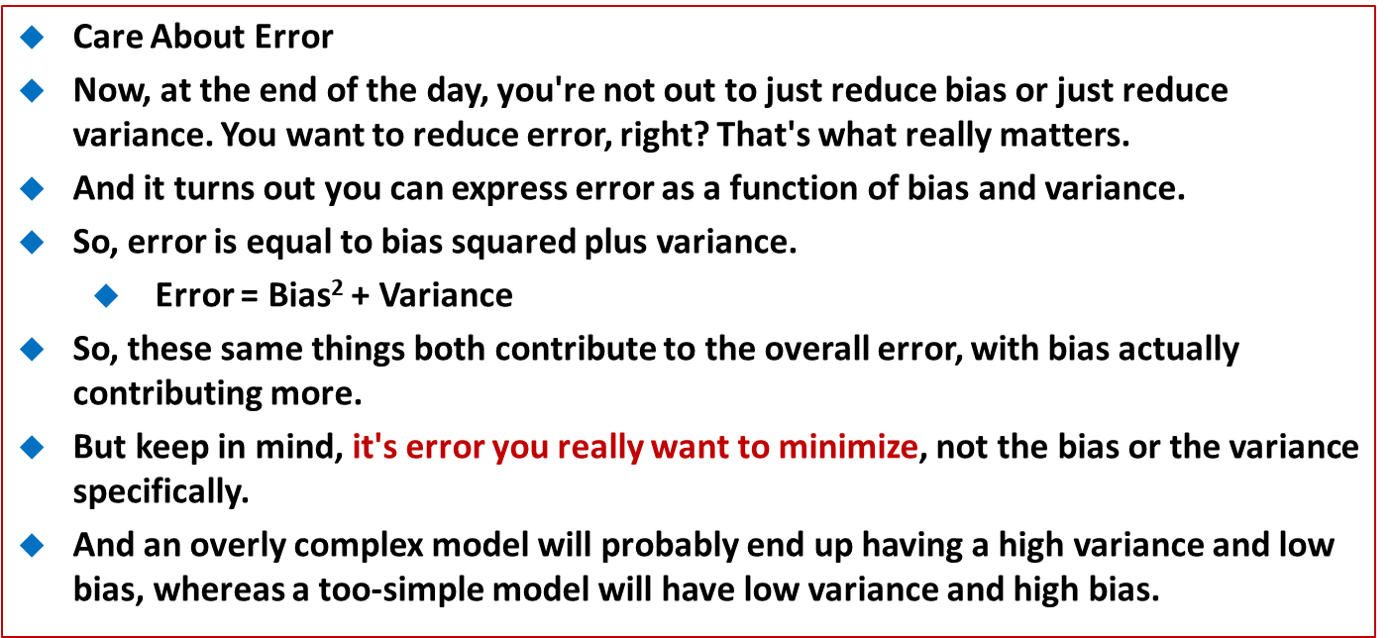
60.4 Care About Error
https://www.udemy.com/course/data-science-and-machine-learning-with-python-hands-on/learn/lecture/4020712#overview
Care About Error
Now, at the end of the day, you're not out to just reduce bias or just reduce variance. You want to reduce error, right? That's what really matters.
And it turns out you can express error as a function of bias and variance.
So, error is equal to bias squared plus variance.
Error = Bias² + Variance
So, these same things both contribute to the overall error, with bias actually contributing more.
But keep in mind, it's error you really want to minimize, not the bias or the variance specifically.
And an overly complex model will probably end up having a high variance and low bias, whereas a too-simple model will have low variance and high bias.

Slide 16
60.4 Care About Error
https://www.udemy.com/course/data-science-and-machine-learning-with-python-hands-on/learn/lecture/4020712#overview
Care About Error
But they could both end up having similar error terms at the end of the day.
So you just have to find the right happy medium of these two things when you're trying to fit your data. And we'll talk about some more principled ways of actually avoiding over-fitting in our forthcoming lectures.
But, it's just the concept of bias and variance that I want to get across.
Because people do talk about it, you're going be expected to know what it means.

Slide 17
60.5 Review Earlier Lessons

Slide 18
60.5 Review Earlier Lessons
https://www.udemy.com/course/data-science-and-machine-learning-with-python-hands-on/learn/lecture/4020712#overview
Review Earlier Lessons
If we tie that back to some earlier concepts
For example, in K-Nearest-Neighbors, if we increase the value of K, we start to spread out our neighborhood that we're averaging across to a larger area. So that has the affect of decreasing variance because we are smoothing things out over a larger space, but it might increase our bias because we'll be picking up, you know, a larger population that may be less and less relevant to the point we started from.
So by smoothing out K-N-N over a larger number of neighbors, we can decrease the variance because we are smoothing things out over more values, but we might be introducing bias because were introducing more and more points that are less and less related to the point we started with.

Slide 19
60.5 Review Earlier Lessons
https://www.udemy.com/course/data-science-and-machine-learning-with-python-hands-on/learn/lecture/4020712#overview
Review Earlier Lessons
Decision tree is another example.
So, we know that a single decision tree is prone to over-fitting, so that might imply that it has a high variance.
But random forests seek to trade off some of that variance for bias reduction and it does that by having multiple trees that are randomly variant and averages all of their solutions together.
So kind of like when we average things out by increasing K in K-N-N, we can average out the results of a decision tree by using more than one decision tree using random forests.
Similar idea.
So that's the basic idea of Bias/Variance and the Bias/Variance Trade-off.
I hope it makes a little bit of sense.

Slide 20
60.5 Review Earlier Lessons
https://www.udemy.com/course/data-science-and-machine-learning-with-python-hands-on/learn/lecture/4020712#overview
Review Earlier Lessons
Let's move on.
So that's Bias/Variance Trade-off.
You know, again, there's sometimes a decision you have to make between how overall accurate your values are and how spread-out, or how tightly clustered they are.
So that's the Bias/Variance Trade-off and they both contribute to the overall error, which is the thing you really care about minimizing.
So, keep those terms in mind.

Slide 21
End of Chapter

