Slide 1

61 Bias/Variance
Peter H. Chen

Slide 2
61 Bias/Variance
https://www.udemy.com/course/data-science-and-machine-learning-with-python-hands-on/learn/lecture/4020714#overview
Bias/Variance
We discussed train and test for preventing overfitting and predicting how well of our model can perform on data.
We will take the model to the next level with technique called K-fold cross validation.

Slide 3
61 Bias/Variance
https://www.udemy.com/course/data-science-and-machine-learning-with-python-hands-on/learn/lecture/4020714#overview
Avoid Overfitting using K-Fold Cross Validation
We have a powerful tool to avoid overfitting called K-fold cross validation.

Slide 4

61 Bias/Variance
https://www.udemy.com/course/data-science-and-machine-learning-with-python-hands-on/learn/lecture/4020714#overview
Review: K-Fold Cross Validation
One way to protect overfitting is K-Fold Cross Validation.
The idea of K-Fold Cross Validation is very simple:
Split your data into K randomly-assigned segments (or buckets)
Reserve one segment (bucket) as your test data
Train on the combined remaining K-1 segments (buckets) and measure their performance against the test set
Repeat for each segment (bucket)
Take the average of the K r-squared scores
Prevent you from overfitting to a single train/test split

Slide 5
61 Bias/Variance
https://www.udemy.com/course/data-science-and-machine-learning-with-python-hands-on/learn/lecture/4020714#overview
Using K-Fold Cross Validation
Scikit-learn makes this really easy.
Even easier than just a single (normal) train/test split.
In practice, you need to try different variations of your model, for example, the degree of polynomial for a polynomial fit. So the idea is to try different values of your model with different variations.
Measure the mean accuracy using K-Fold Cross Validation and find the one with minimum error against your test dataset. And that is your sweet spot there.

Slide 6
61 Bias/Variance
https://www.udemy.com/course/data-science-and-machine-learning-with-python-hands-on/learn/lecture/4020714#overview
Using K-Fold Cross Validation
Conclusion
You want to use K-Fold Cross Validation against your test dataset and just keep refining your model.
Try different values within it, keep trying different variations of that model or change the model entirely, until you find the minimum errors.

Slide 7

61 Bias/Variance
https://www.udemy.com/course/data-science-and-machine-learning-with-python-hands-on/learn/lecture/4020714#overview
K-Fold Cross Validation for Iris Example
Use K-Fold Cross Validation with a SVC (Support Vector Classifier) model of Iris Classification.
In this example, we will see that without K-Fold. We can have model with problem overfitting.

Slide 8
61.1 Read Iris Data

Slide 9
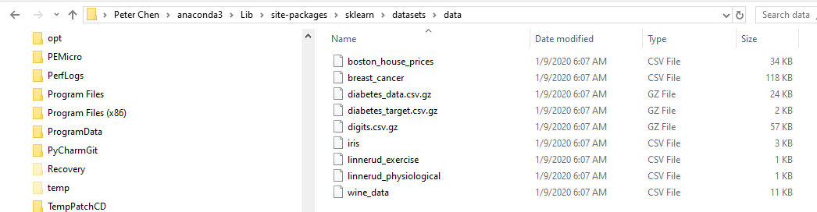
61.1 Read Iris Data
https://www.udemy.com/course/data-science-and-machine-learning-with-python-hands-on/learn/lecture/4020714#overview
Read Iris Data
You can find sklearn dataset under:
C:\Users\14088\anaconda3\Lib\site-packages\sklearn\datasets\data
We copy the iris.csv into our local folder our easier browse the data

Slide 10
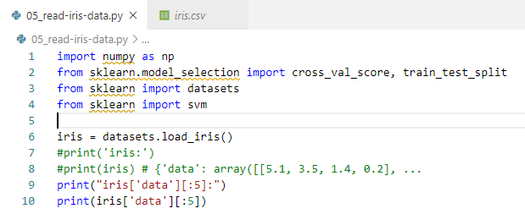
61.1 Read Iris Data
https://www.udemy.com/course/data-science-and-machine-learning-with-python-hands-on/learn/lecture/4020714#overview
Read Iris Data
In order to see the data structure inside the dataset.load_iris(), we can print the object with print (iris).
{ ‘data’: array() … }: It is a dictionary structure and then follow by an array.
We use [‘data’] to access the dictionary and then use [:5] to access first five rows of array.
Iris.csv contains 150 rows of Iris flowers.

Slide 11
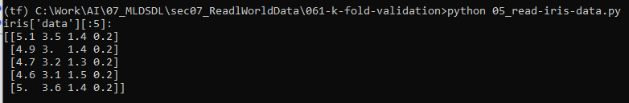
61.1 Read Iris Data
https://www.udemy.com/course/data-science-and-machine-learning-with-python-hands-on/learn/lecture/4020714#overview
Read Iris Data
Result of first five rows of data.

Slide 12
61.2 Single Train/Test Split

Slide 13
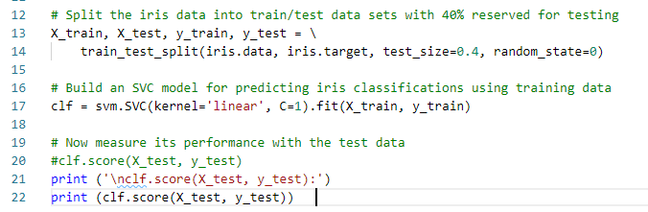

61.2 Single Train/Test Split
https://www.udemy.com/course/data-science-and-machine-learning-with-python-hands-on/learn/lecture/4020714#overview
Single Train/Test Split
A single train/test split is made easy with the train_test_split function in the cross_validation library:
We print the score of the model from single train/test.
The SVC (Support Vector Classifier) model set to ‘linear’.
We split 60% for training an 40% for test.
The score = 0.966. Model fit Very well.

Slide 14
61.3 Single Train/Test vs. K-Fold CV

Slide 15
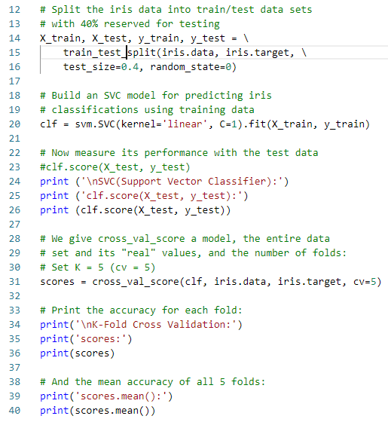
61.3 Single Train/Test vs. K-Fold CV
https://www.udemy.com/course/data-science-and-machine-learning-with-python-hands-on/learn/lecture/4020714#overview
K-Fold Cross Validation
We take K=5 for cross validation.
We have model clf for SVC (Support Vector Classifier) model.
We use the function cross_val_score from scikit-learn cross validation library.
We split the iris data into 5-Fold. That means we have 5 different training segments (buckets).
We need to run model fit for 5 times.
The CV (Cross Validation) automatically evaluate our model against the entire dataset split up to 5 different ways and give back the individual results.

Slide 16
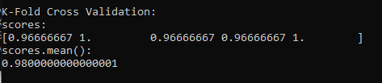
61.3 Single Train/Test vs. K-Fold CV
https://www.udemy.com/course/data-science-and-machine-learning-with-python-hands-on/learn/lecture/4020714#overview
K-Fold Cross Validation
We print the output scores of the individual results of 5-fold cross validation.
The we get the overall average of the 5-Fold CV model = 0.98

Slide 17
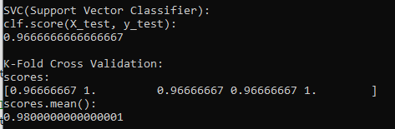
61.3 Single Train/Test vs. K-Fold CV
https://www.udemy.com/course/data-science-and-machine-learning-with-python-hands-on/learn/lecture/4020714#overview
Single Train Test vs. K-Fold Cross Validation
1. Single Train Test:
Model score = 96%
1
2. K-Fold Cross Validation
K-Fold cross validation is easy.
We use a K of 5.
Model score= 98% better than single train/test 96%.
2

Slide 18
61.4 Poly Model for Single vs. K-Fold CV

Slide 19
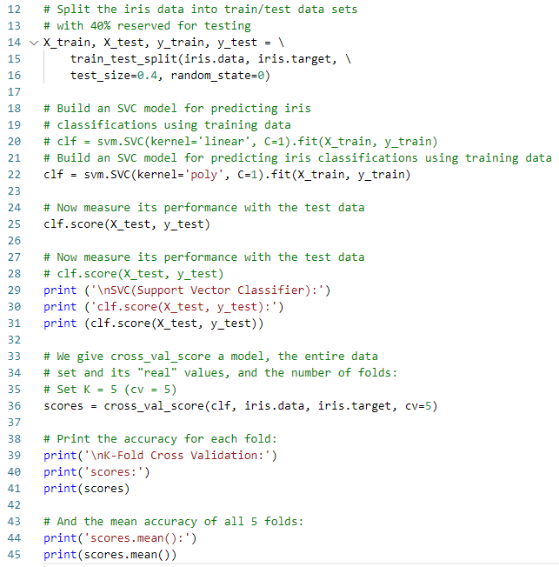
61.4 Poly Model for Single vs. K-Fold CV
https://www.udemy.com/course/data-science-and-machine-learning-with-python-hands-on/learn/lecture/4020714#overview
Poly Model for Single Train/Test vs. K-Fold Cross Validation
We set the SVC (Support Vector Classifier) classifier kernel to ‘ploy’ instead of ‘linear’

Slide 20
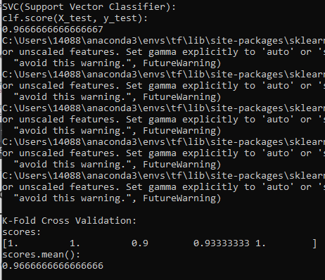
61.4 Poly Model for Single vs. K-Fold CV
https://www.udemy.com/course/data-science-and-machine-learning-with-python-hands-on/learn/lecture/4020714#overview
Poly Model for Single Train/Test vs. K-Fold Cross Validation
You can see SVC classifier model score remain the same 96%, however, the K-fold score get worse. Model Score reduced from 98% to 96%. This means the poly mode is overfit.

Slide 21
61.5 Exercise

Slide 22
61.5 Exercise
https://www.udemy.com/course/data-science-and-machine-learning-with-python-hands-on/learn/lecture/4020714#overview
Exercise
The "poly" kernel for SVC (Support Vector Classifier) actually has another attribute for the number of degrees of the polynomial used, which defaults to 3. For example, svm.SVC (kernel='poly', degree=3, C=1). The results show the default third-degree polynomial is overfitting, based on the results above.
Set the poly model (degree=2, degree=3, and degree=4) and compare it to the linear kernel, i.e., degree=1.

Slide 23

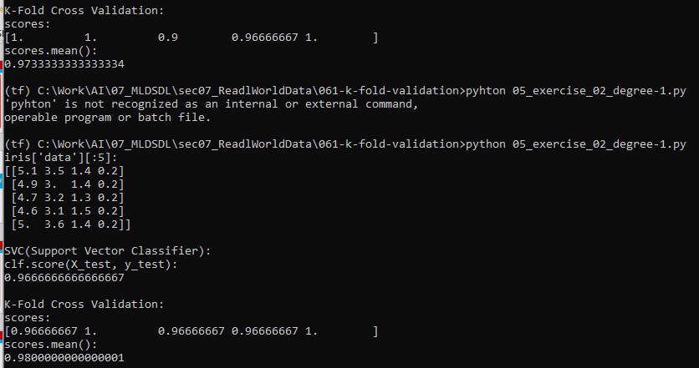
61.5 Exercise
https://www.udemy.com/course/data-science-and-machine-learning-with-python-hands-on/learn/lecture/4020714#overview
Exercise
Answer:
Degree = 1 (Linear)
Single Train/Test: Score = 96%
5-Fold CV: Score = 98%

Slide 24
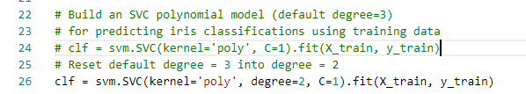
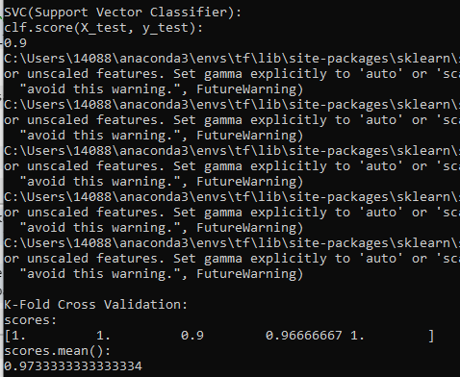
61.5 Exercise
https://www.udemy.com/course/data-science-and-machine-learning-with-python-hands-on/learn/lecture/4020714#overview
Exercise
Answer:
Poly Degree = 2.
Single Train/Test: Score = 90%
5-Fold CV: Score = 97%
Conclusion: Overfit

Slide 25
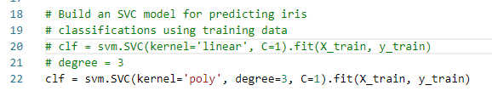
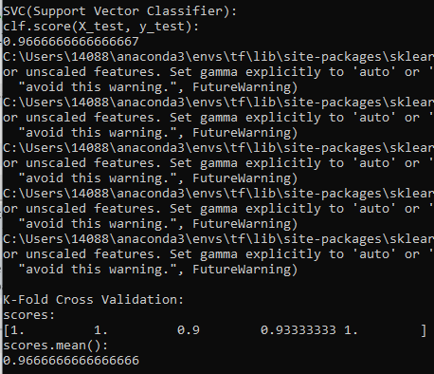
61.5 Exercise
https://www.udemy.com/course/data-science-and-machine-learning-with-python-hands-on/learn/lecture/4020714#overview
Exercise
Answer:
Poly Degree = 3.
Single Train/Test: Score = 96.6%
5-Fold CV: Score = 96.6%
Conclusion: Overfit

Slide 26
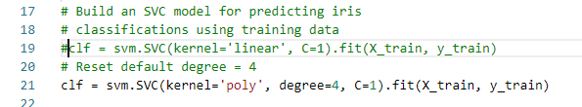
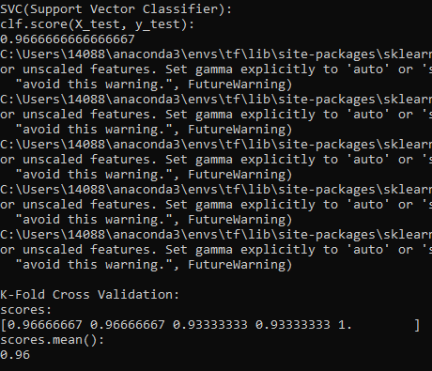
61.5 Exercise
https://www.udemy.com/course/data-science-and-machine-learning-with-python-hands-on/learn/lecture/4020714#overview
Exercise
Answer:
Poly Degree = 4.
Single Train/Test: Score = 96.6%
5-Fold CV: Score = 96.6%
Conclusion: Overfit

Slide 27
End of Chapter

