Slide 1
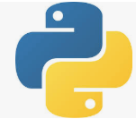
14 Python Mean, Median, and Mode
Peter H. Chen

Slide 2
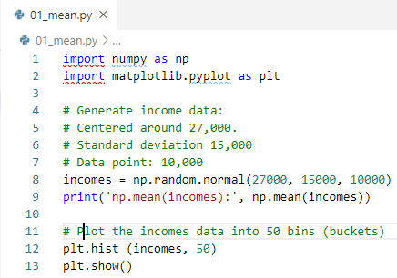
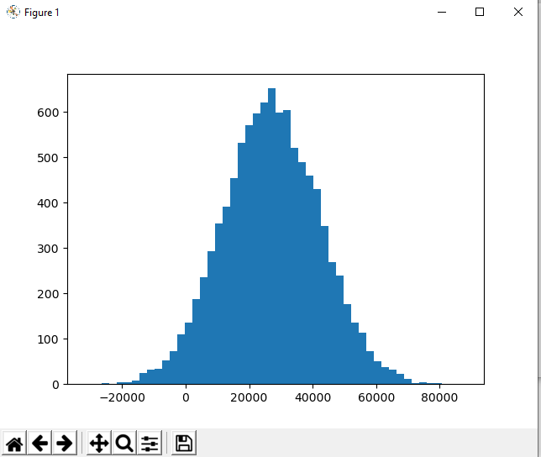

14 Mean, Median, and Mode
https://www.udemy.com/course/data-science-and-machine-learning-with-python-hands-on/learn/lecture/4020084#overview
Python Mean

Slide 3
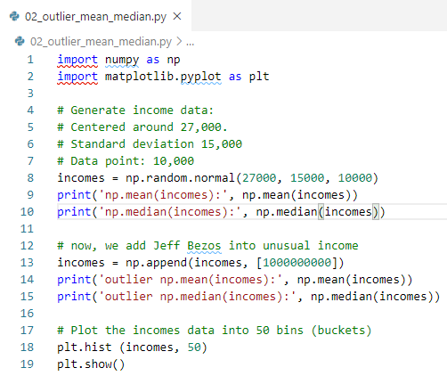
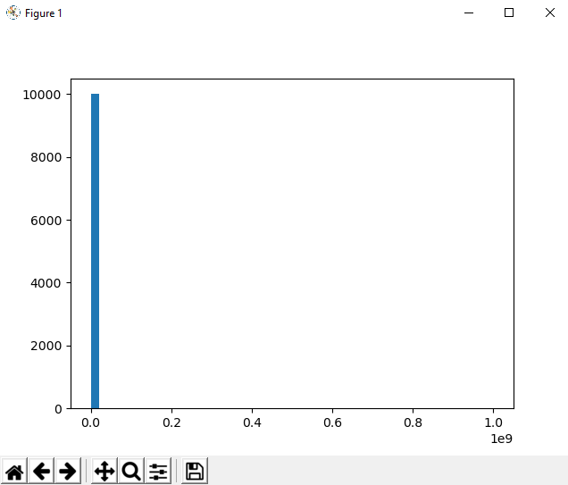
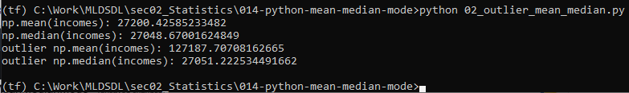
14 Mean, Median, and Mode
https://www.udemy.com/course/data-science-and-machine-learning-with-python-hands-on/learn/lecture/4020084#overview
Outlier Mean and Median:
Now, we add Jeff Bezos annual income $1B. The outlier data skewed the mean. The median gives better idea for distribution.

Slide 4
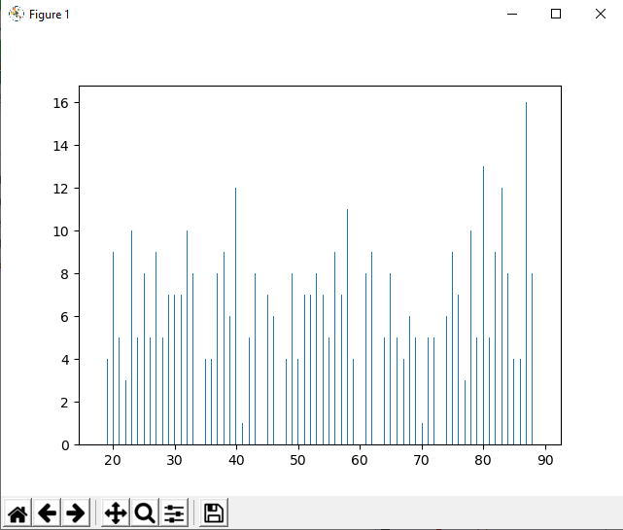
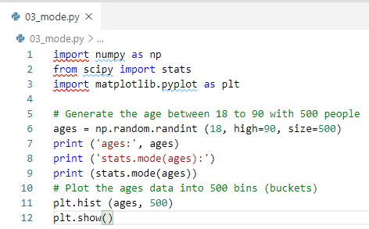
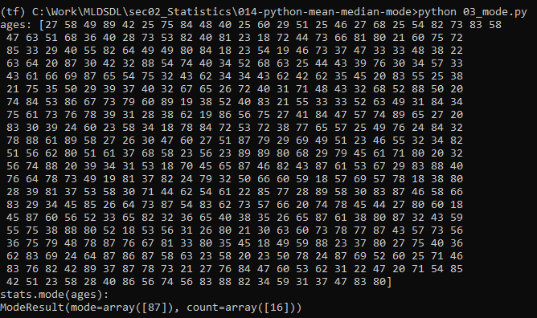
14 Mean, Median, and Mode
https://www.udemy.com/course/data-science-and-machine-learning-with-python-hands-on/learn/lecture/4020084#overview
Mode
Mode = 87, count = 16

Slide 5
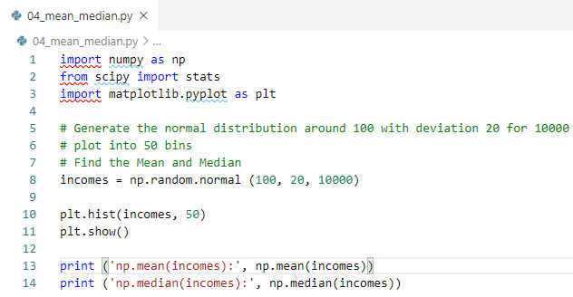
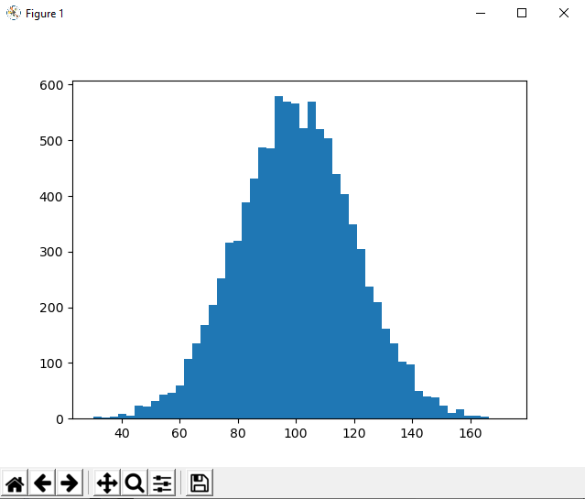

14 Mean, Median, and Mode
https://www.udemy.com/course/data-science-and-machine-learning-with-python-hands-on/learn/lecture/4020084#overview
Exercise
Generate some random e-commerce data. Find he Mean, Median

Slide 6
End of Chapter

