Slide 1
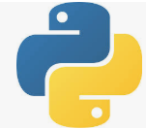
1 Python Data Science, ML, and DL
Peter H. Chen

Slide 2
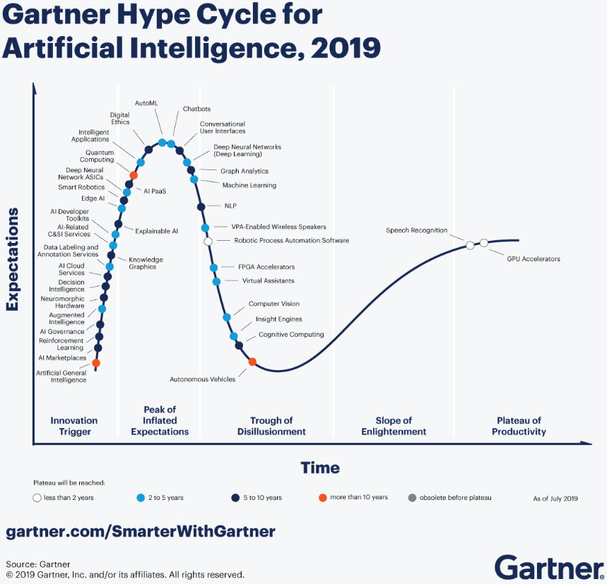
1 Python Data Science, ML, and DL
https://github.com/peterhchen/900_Python_ML_DS_DL
Gartner: “Hype Cycle for Artificial Intelligence, 2019” contains over 37 AI-specific technologies, with more than 50% of them predicted to take over five years to reach mainstream adoption.
https://www.pm360online.com/ai-contains-a-lot-of-current-hype-but-offers-great-promise-for-the-future/

Slide 3
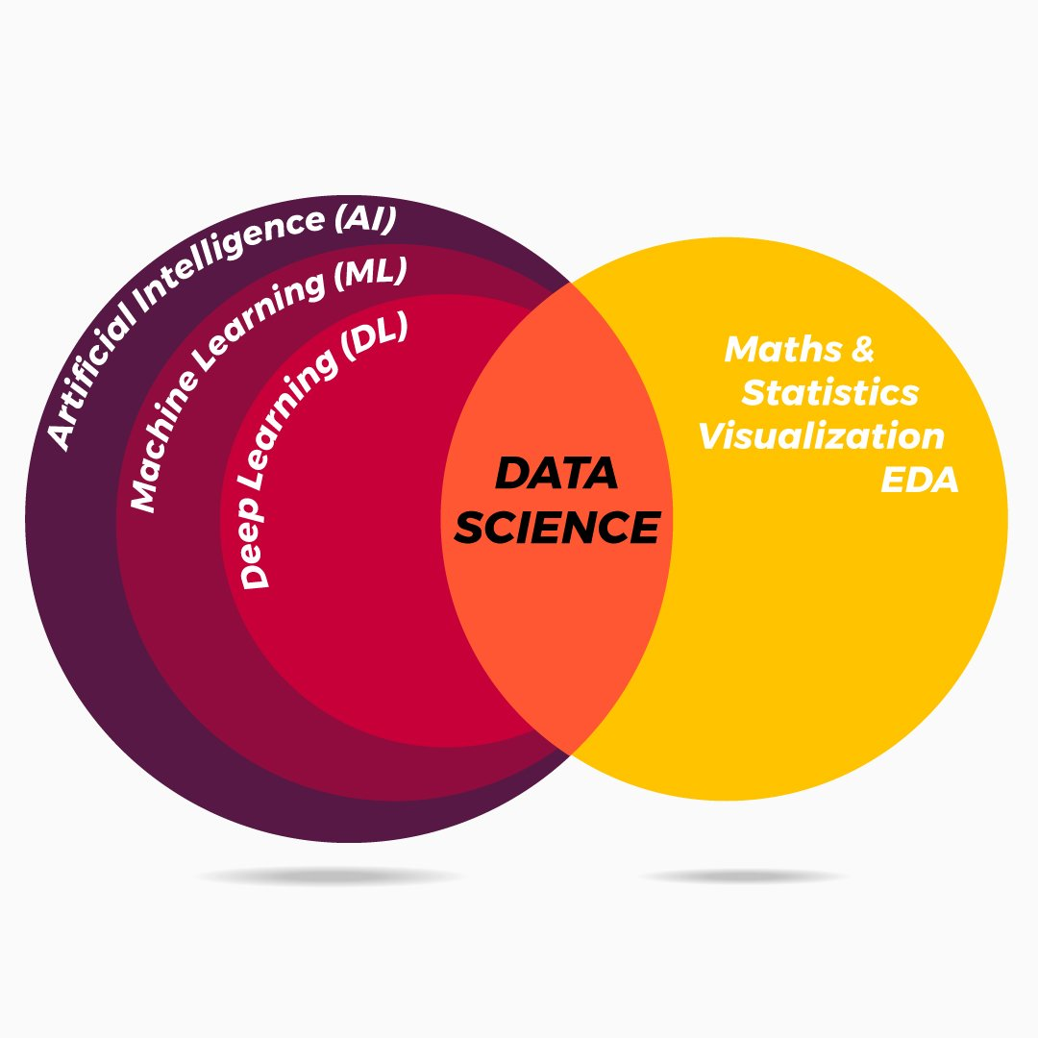
1 Python Data Science, ML, and DL
https://github.com/peterhchen/900_Python_ML_DS_DL
Welcome to Data Science, ML (Machine Learning), and DL (Deep Learning) with Python.

Slide 4
1 Python Data Science, ML, and DL
https://github.com/peterhchen/900_Python_ML_DS_DL
Below diagram, we can see Data Science include math, statistics, visualization, EDA (Electronic Design Automation), and etc.
Data Science is the fundamental for Artificial Intelligence, Machine Learning, and Deep Learning.
Artificial Intelligence is the machine with cognitive function.
Machine Learning build the math model with Data set.

Slide 5
1 Python Data Science, ML, and DL
https://github.com/peterhchen/900_Python_ML_DS_DL
Full Stack Development:
Frontend
Backend
Server/REST API: Django/Flask
NodeJS
Sprint Boot
Data Science, Machine, Spark
ReactJS
Angular
VueJS
Dataset
Database:
NoSQL, SQL
DevOps Deployment:
AWS Web Host: Beanstalk, EC2, S3
Host API Management: Kubernetes/Minikube, Docker
CI/CD: GitLab, bitBucket, GitHub, Jenkins

Slide 6
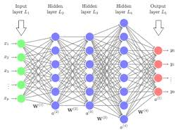
1 Python Data Science, ML, and DL
https://github.com/peterhchen/900_Python_ML_DS_DL
In Deep Learning, we build mathematical model by ANN (Artificial Neural Network) to solve very complicated problems.
We can not use matrix inversion for solving very complicated problem. Instead, we use neurons, gradient descent, and backpropagation to replace the matrix inversion.
If more than 2 layers of hidden layers, we call Deep Learning.

Slide 7
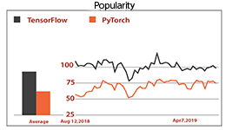
1 Python Data Science, ML, and DL
https://github.com/peterhchen/900_Python_ML_DS_DL
Among the Deep Learning frameworks, Google Tensorflow and Facebook Pytorch frameworks are the most famous ones.
In Deep Learning, Tensorflow and Pytorch replace the Apache Spark for in-memory processing (instead of Hadoop map-reduce in disk) and distributed computing.
PyTorch is famous for dynamic graph, R&D and firmware prototyping versus TensorFlow in static graph and product release.

Slide 8
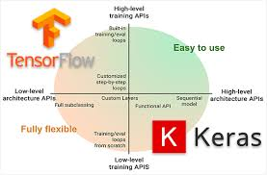
1 Python Data Science, ML, and DL
https://github.com/peterhchen/900_Python_ML_DS_DL
Both Pytorch and Tensorflow are low level implementation of ANN (Artificial Neural Network).
Keras is the API for PyTorch and Tensorflow.

Slide 9
1.1 Application

Slide 10

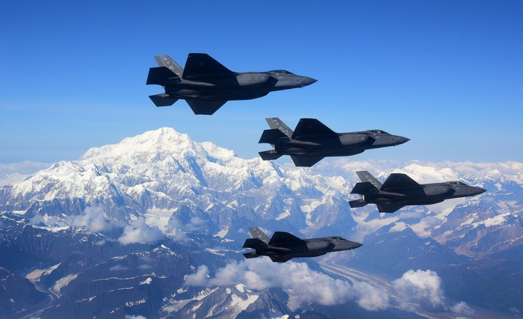
1.1 Application
https://github.com/peterhchen/900_Python_ML_DS_DL
Some of the well known applications, such as, “Product Recommendations”, “Spam classifier”, “Search Engine”, “Apache Spark Distributed Computing”, “Handwriting Recognition”, “Sentiment Analysis“, “Fighter Jet Identifications”, “Benign/Malignant Tumor Classifier”, “Self-Driving Car”, and etc.

Slide 11
1.2 Python and Jupyter Notebook

Slide 12
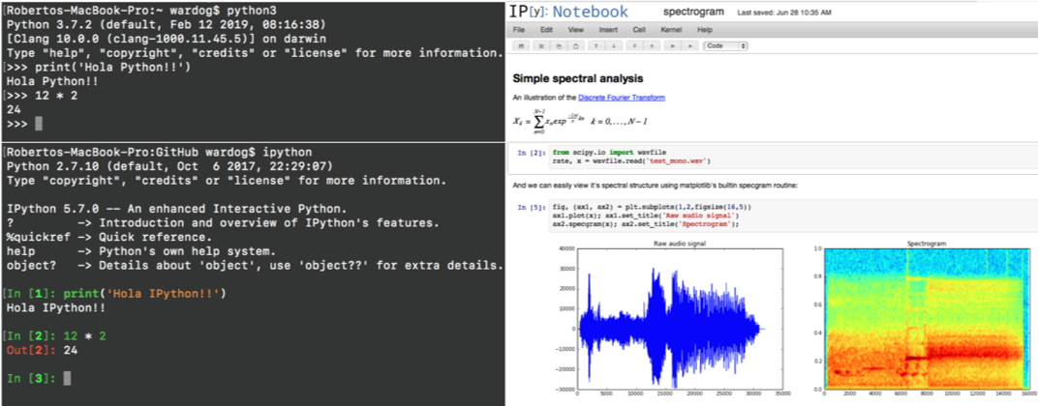
1.2 Python and Jupyter Notebook
https://github.com/peterhchen/900_Python_ML_DS_DL
We will use both Python for final product implementation and Jupyter Notebook (*.ipynb for interactive Python Jupyter notebook file) with embedded function for classroom use.

Slide 13
1.3 Exercise

Slide 14
1.3 Exercise
https://github.com/peterhchen/900_Python_ML_DS_DL
Questions:
1. What is Data Science, Artificial Intelligence, Machine Learning, and Deep Learning?
2. What is difference between Machine Learning and Deep Learning?
3. What is full stack developer?
4. What is Spark for? Hint: In-Memory processing for distributed computing
5. What is ReactJS for? Hint: SPA (Single Page Application) in-Memory Virtual DOM (Document Object Model) to replace multiple HTML element and Pages.
6. What is DevOps doing? Hint: Deploy/Manage Healthy Applications
7. What is component name of AWS Host? Hint: Beanstalk
8. What is difference between Jupyter Notebook and Python? Hint: Jupyter Notebook for teaching purpose, Python code for final product release.

Slide 15
End of Chapter

