Slide 1
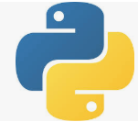
6 Install TensorFlow
Peter H. Chen

Slide 2
6 Install TensorFlow
https://github.com/peterhchen/930_Python_ML_DS_DL
Install Tensorflow
Under the Windows 10 (Linux or MacOS), Tensorflow 6.0 has dependencies for Anaconda 3, Python 3, and numpy, scikit-learn (formal name is SciKits or SciPy Toolkit), and associated frameworks.
YouTube video for Linux:
https://m.youtube.com/watch?v=6-eEpq7ChKg

Slide 3
End of Chapter

