Slide 1

44 SVC for Clustering People
Peter H. Chen

Slide 2
44 SVC for Clustering People
https://www.udemy.com/course/data-science-and-machine-learning-with-python-hands-on/learn/lecture/4020604#overview
SVC for Clustering People
In this discussion, we implement SVC (Support Vector Classification) and SVM (Support Vector Machine) for clustering people by age and income.

Slide 3
44.1 Generate/Scale Age and Income

Slide 4
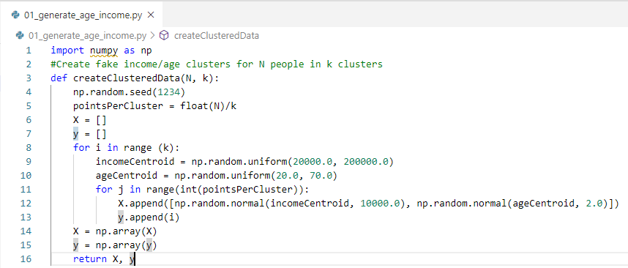
44.1 Generate/Scale Age and Income
https://www.udemy.com/course/data-science-and-machine-learning-with-python-hands-on/learn/lecture/4020604#overview
Generate/Scale Age and Income Data
Create the same income / age clustered data that we used for our K-Means clustering example.

Slide 5
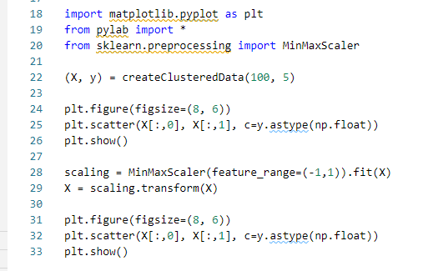
44.1 Generate/Scale Age and Income
https://www.udemy.com/course/data-science-and-machine-learning-with-python-hands-on/learn/lecture/4020604#overview
Generate/Scale Age and Income Data
Plot Income vs. age and scale.

Slide 6
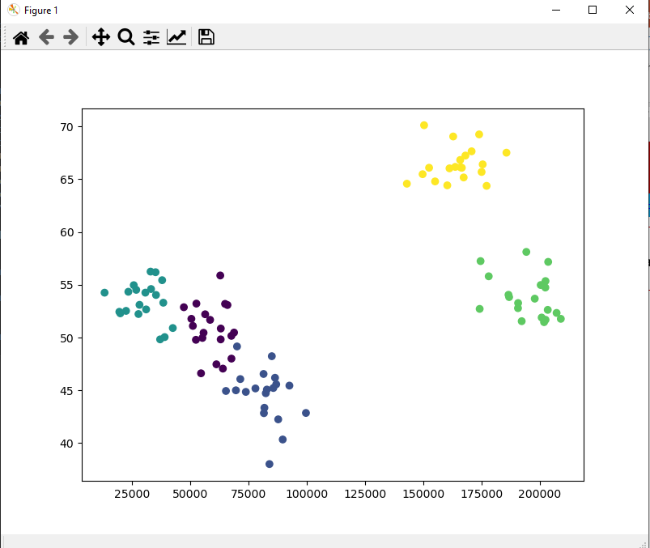
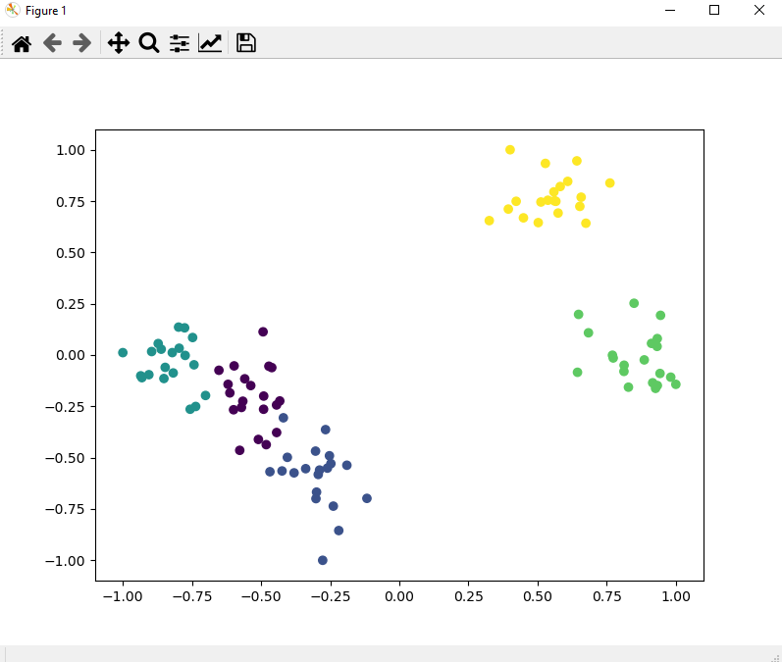
44.1 Generate/Scale Age and Income
https://www.udemy.com/course/data-science-and-machine-learning-with-python-hands-on/learn/lecture/4020604#overview
Plot Age and Income Data

Slide 7
44.2 Partition Data into Cluster

Slide 8
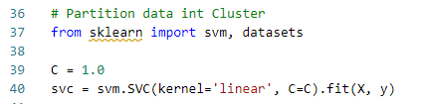
44.2 Partition Data into Cluster
https://www.udemy.com/course/data-science-and-machine-learning-with-python-hands-on/learn/lecture/4020604#overview
Partition Data into Cluster
Now we'll use linear SVC to partition our graph into clusters:

Slide 9
44.3 Render Cluster Color

Slide 10
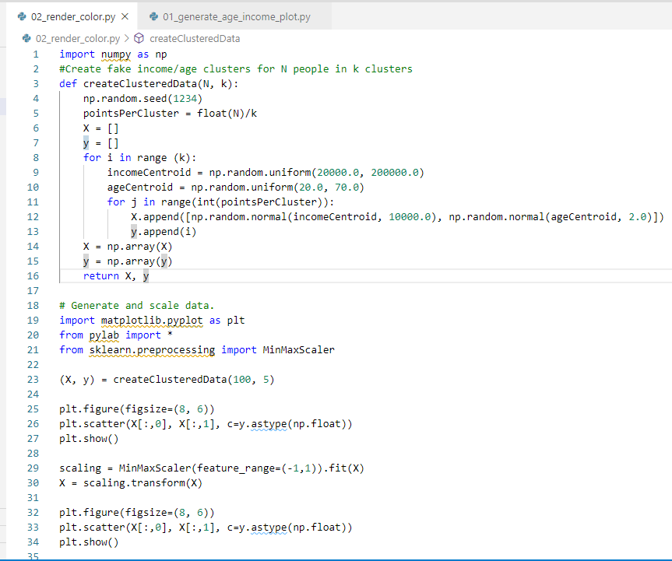
44.3 Render Cluster Color
https://www.udemy.com/course/data-science-and-machine-learning-with-python-hands-on/learn/lecture/4020604#overview
Render Cluster Color
By setting up a dense mesh of points in the grid and classifying all of them, we can render the regions of each cluster as distinct colors:

Slide 11
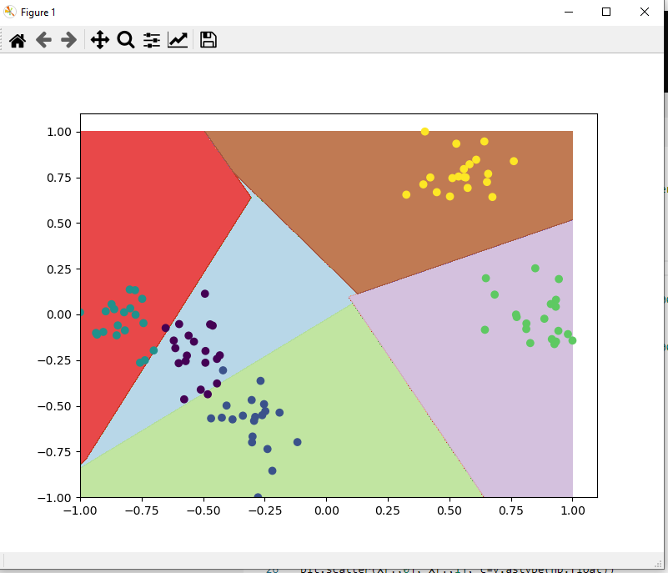
44.3 Render Cluster Color
https://www.udemy.com/course/data-science-and-machine-learning-with-python-hands-on/learn/lecture/4020604#overview
Render Cluster Color
Result

Slide 12
44.4 Prediction

Slide 13
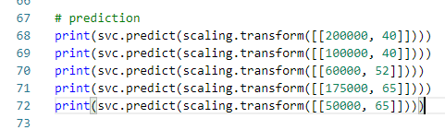
44.4 Prediction
https://www.udemy.com/course/data-science-and-machine-learning-with-python-hands-on/learn/lecture/4020604#overview
Prediction
Predict 5 points in different regions.
4
[50000, 65]
2
0
3
[100000, 40]
[200000, 40]
1

Slide 14
44.5 Exercise

Slide 15
44.5 Exercise
https://www.udemy.com/course/data-science-and-machine-learning-with-python-hands-on/learn/lecture/4020604#overview
Exercise
"Linear" is one of many kernels scikit-learn supports on SVC.
Look up the documentation for scikit-learn online to find out what the other possible kernel options are.
Do any of them work well for this data set?
Note:
Default kenerl is “rbf” (radial base function)
https://scikit-learn.org/stable/modules/generated/sklearn.svm.SVC.html
https://en.wikipedia.org/wiki/Radial_basis_function

Slide 16

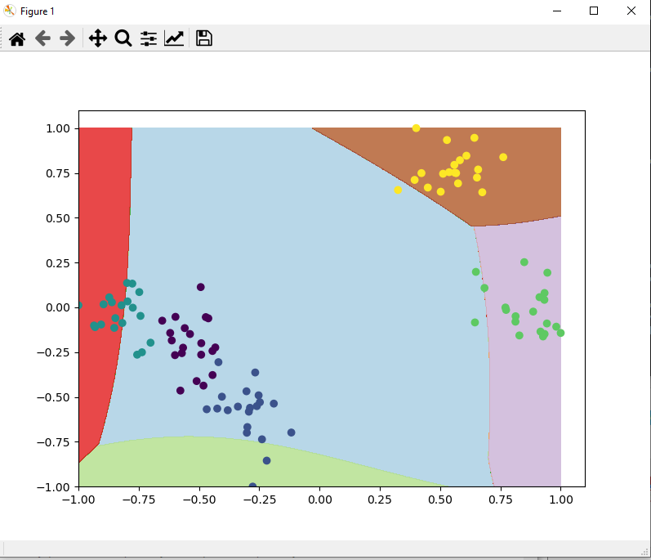
44.5 Exercise
https://www.udemy.com/course/data-science-and-machine-learning-with-python-hands-on/learn/lecture/4020604#overview
Exercise
Change kernel=“poly”
linear
ploy

Slide 17
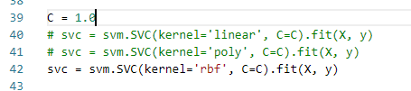
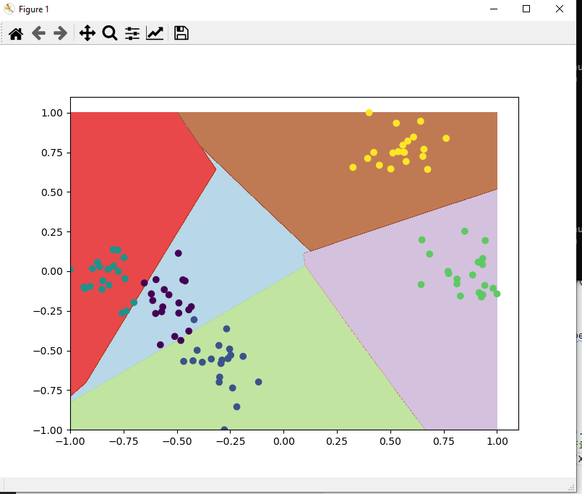
44.5 Exercise
https://www.udemy.com/course/data-science-and-machine-learning-with-python-hands-on/learn/lecture/4020604#overview
Exercise
Change kernel=“rbf” (radial base function)
linear
rbf

Slide 18
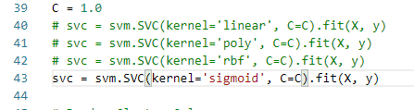

44.5 Exercise
https://www.udemy.com/course/data-science-and-machine-learning-with-python-hands-on/learn/lecture/4020604#overview
Exercise
Change kernel=“sigmoid”
sigmoid
linear

Slide 19
End of Chapter

