Slide 1

24 Bayes’ Theorem
Peter H. Chen

Slide 2
24 Bayes’ Theorem
https://www.udemy.com/course/data-science-and-machine-learning-with-python-hands-on/learn/lecture/4205584#overview
Bayes’ Theorem is based on conditional Probability
Bayes’ Theorem is very important for medical field.

Slide 3
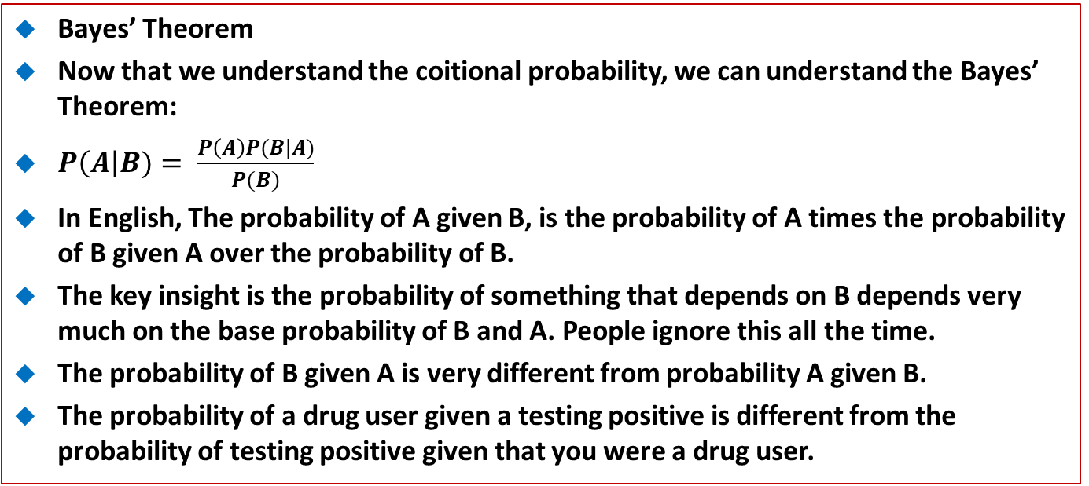
24 Bayes’ Theorem
https://www.udemy.com/course/data-science-and-machine-learning-with-python-hands-on/learn/lecture/4205584#overview
Bayes’ Theorem
Now that we understand the coitional probability, we can understand the Bayes’ Theorem:
$P\left(A\right|B)= \frac{P\left(A\right)P(B|A)}{P(B)}$
In English, The probability of A given B, is the probability of A times the probability of B given A over the probability of B.
The key insight is the probability of something that depends on B depends very much on the base probability of B and A. People ignore this all the time.
The probability of B given A is very different from probability A given B.
The probability of a drug user given a testing positive is different from the probability of testing positive given that you were a drug user.

Slide 4
24 Bayes’ Theorem
https://www.udemy.com/course/data-science-and-machine-learning-with-python-hands-on/learn/lecture/4205584#overview
Bayes’ Theorem
There is a real problem in medical or drug tests that yields a lot of false positive.
The probability of a test user is very high. It does not mean the probability of test positive of a given user.

Slide 5
24 Bayes’ Theorem
https://www.udemy.com/course/data-science-and-machine-learning-with-python-hands-on/learn/lecture/4205584#overview
Bayes’ Theorem to the rescue
Drug testing is a common example.
Even a “highly accurate” drug test can produce false positive than true positive
Lets’ say we have a drug test that can accurately identify users of a drug 99% of the time, and accurately has a negative result for 99% of non-users.
But only 0.3% of the overall population actually uses this drug.

Slide 6
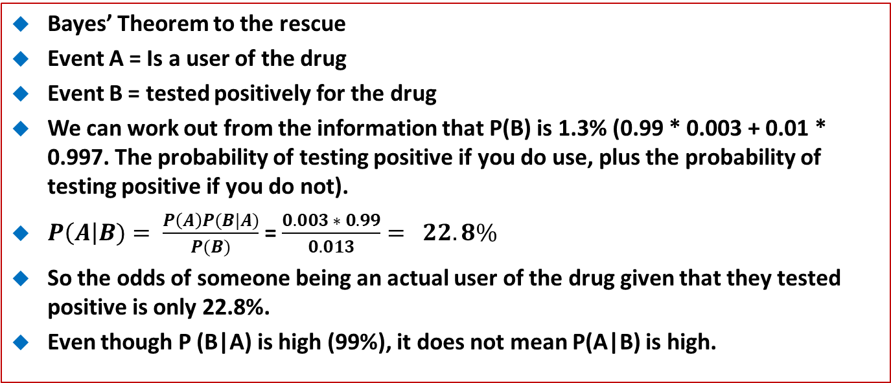
24 Bayes’ Theorem
https://www.udemy.com/course/data-science-and-machine-learning-with-python-hands-on/learn/lecture/4205584#overview
Bayes’ Theorem to the rescue
Event A = Is a user of the drug
Event B = tested positively for the drug
We can work out from the information that P(B) is 1.3% (0.99 * 0.003 + 0.01 * 0.997. The probability of testing positive if you do use, plus the probability of testing positive if you do not).
$P\left(A\right|B)= \frac{P\left(A\right)P(B|A)}{P(B)}$ = $\frac{0.003 ∗ 0.99}{0.013}= 22.8\%$
So the odds of someone being an actual user of the drug given that they tested positive is only 22.8%.
Even though P (B|A) is high (99%), it does not mean P(A|B) is high.

Slide 7
End of Chapter

