Slide 1

106 Some Reference Books
Peter H. Chen

Slide 2
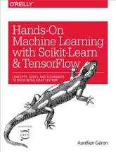
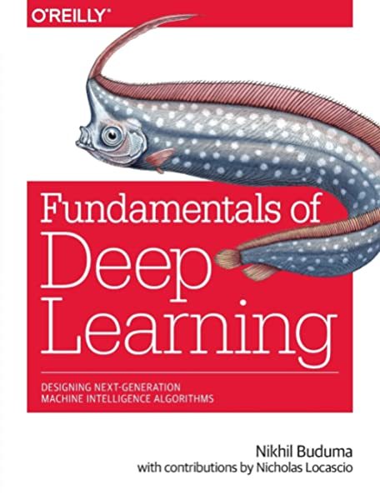
106 Some Reference Books
https://github.com/peterhchen/930_Python_ML_DS_DL
Some Reference Books
1. "Hands-on Machine Learning with Scikit-Learn & TensorFlow,“ O'Reilly (2017)
Summary:
It is lower level tensorflow, it doesn't get into Keras much.
It is a good overview of the theory behind the different techniques of neural networks and RNN’s and CNN’s.
2. “Deep Learning,“ O'Reilly (2017)
Summary:
It does not use Python Library. It uses DL4J Library.
It is a good book for Java Developer.

Slide 3
106 Some Reference Books
https://github.com/peterhchen/930_Python_ML_DS_DL
Some Reference Books
For GRU Cell in Keras, just look that into google and it will probably come up with some tutorials and documentation.

Slide 4
End of Chapter

