Slide 1

79 TF-IDF
Peter H. Chen

Slide 2
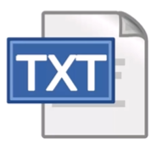
79 TF-IDF
https://github.com/peterhchen/900_Python_ML_DS_DL
TF-IDF (Term Frequency/Inverse Document Frequency)
TF-IDF stand for Term Frequency and Inverse Document Frequency.
They are import for search engine.
They figure out what terms are most relevant for a document.
They create a search engine for Wikipedia using Apache Spark and MLLib.
They are two metrics that are closely interrelated for doing search.
They find the relation of a given word to a document given a larger body of documents.
Our final exercise with Apache Spark and MLLib is in TF-IDF.

Slide 3
79.1 TF-IDF Explained

Slide 4
79.1 TF-IDF Explained
https://github.com/peterhchen/900_Python_ML_DS_DL
TF-IDF Explained
Term Frequency measures how often a word occurs in a specified document
A word that occurs frequently is specified document
Document Frequency is how often a word occurs in an entire set (entire collections) of document, i.e., all pages in Wikipedia (every web page of Wikipedia)
This tells us about common words that appear everywhere (entire sets of documents).
Inverse Document Frequency is equal to 1/Document Frequency. The word “inverse” means “divide by”.
The higher value of TF-IDF means the selected (specified) document has some key words that we are looking for.
The lower values of TF-IDF means the selected document has no relation to our key words.

Slide 5
79.1 TF-IDF Explained
https://github.com/peterhchen/900_Python_ML_DS_DL
TF-IDF Explained (Explanation)
For example, every article (document) in Wikipedia have a Term Frequency associated with it.
Every page on the internet could have a term frequency associated with it for every word that appears in that document.
The Term Frequency means is how often a given word occurs in a given document.
Within one webpage, within one Wikipedia article, and etc., how common is a given word within that document?
What is the ratio of that word's occurrence rate throughout all the words in that document?
That is the term frequency is. It is the frequency of a word in one specified document.

Slide 6
79.2 TF-IDF Measure

Slide 7
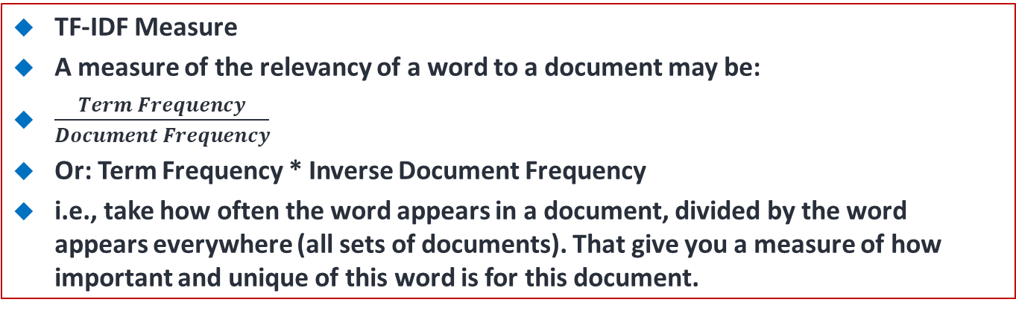
79.2 TF-IDF Measure
https://github.com/peterhchen/900_Python_ML_DS_DL
TF-IDF Measure
A measure of the relevancy of a word to a document may be:
$\frac{Term Frequency}{Document Frequency}$
Or: Term Frequency * Inverse Document Frequency
i.e., take how often the word appears in a document, divided by the word appears everywhere (all sets of documents). That give you a measure of how important and unique of this word is for this document.

Slide 8
79.2 TF-IDF Measure
https://github.com/peterhchen/900_Python_ML_DS_DL
TF-IDF Measure (Explanation)
It just stands for term frequency times inverse document frequency which means term frequency over document frequency.
If some word has high IF (in some specific document) but very low in IDF (in entire sets of documents). That mean the word is only has special meaning for that specific document but not for the entire sets of documents (or entire world of document).
TF-IDF means this word occur in this document compared to how often it occurs in the entire sets (collections) of documents.
That is TF-IDF means. It stands for Term Frequency times Inverse Document Frequency.

Slide 9
79.3 TF-IDF Practice

Slide 10
79.3 TF-IDF Practice
https://github.com/peterhchen/900_Python_ML_DS_DL
TF-IDF in Practice
We use the log (after video and string processing of raw data) data of the IDF (Inverse Document Frequency) instead of raw data, since the word frequencies are distributed exponentially.
The log data gives us a better weighting of a words overall popularity.
IF-IDF assumes a document is just a “bag of words”.
Parsing documents into a bag of words can be most of the work
Words can be represented as a hash value (number) for efficiency
What about synonyms? Various tenses? Abbreviations? Capitalization? Mis-spelling?
Doing this at scale is the hard part
That is why Spark comes in!

Slide 11
79.3 TF-IDF Practice
https://github.com/peterhchen/900_Python_ML_DS_DL
TF-IDF in Practice (Explanation)
For example, we use the actual log (after video and string processing) of the inverse document frequency instead of the raw value (before video and string processing) and that is because word frequencies in reality tend to be distributed exponentially.
So by taking a log, we end up with a slightly better weighting of words given their overall popularity.
There are some limitations to this approach.
One is that we assume a document is nothing more than a bag of full words.
We assume there are no relationships between the words themselves and obviously that's not always the case.
And actually parsing them out can be a big part of the work because you have to deal with things like synonyms and various tenses of words, abbreviations, capitalizations, misspellings.

Slide 12
79.3 TF-IDF Practice
https://github.com/peterhchen/900_Python_ML_DS_DL
TF-IDF in Practice (Explanation)
This gets back to the idea of cleaning your data being a large part of your job as a data scientist and it's especially true when you're dealing with natural language processing stuff.
Fortunately, there are some libraries out there that can help you with this, but it is a real problem and it will affect the quality of your results.
Another implementation trick that we use with TF-IDF is instead of actually storing actual string words with their term frequencies and inverse document frequencies, to save space and make things more efficient, we actually map every word to a numerical value, a hash value we call it.
So the idea is we have some function that can take any word, look at its letters and assign that in some fairly well-distributed manner to a set of numbers in some range.
So that way instead of using the word represented, that might have a hash value of 10 and we can refer to the word represented as 10 from now on.

Slide 13
79.3 TF-IDF Practice
https://github.com/peterhchen/900_Python_ML_DS_DL
TF-IDF in Practice (Explanation)
Now, if the space of your hash values isn't large enough, you could end up with different words being represented by the same number, which sounds worse than it is, but you want to make sure that you have a fairly large hash space so that that is unlikely to happen.
Those are called hash collisions and they can cause issues.
In reality, there's only so many words that people use in the English language commonly so you can get away with 100,000 or so and be just fine.
Then, we have obviously doing at scale is the hard part.
If you want to do this over all of Wikipedia, then you're going to have to run this on a cluster.
For the sake of argument, we're just going to run this on our own desktop for now using a small sample of Wikipedia data.
So how do we turn that into an actual search problem?

Slide 14
79.4 Using TF-IDF

Slide 15
79.4 Using TF-IDF
https://github.com/peterhchen/900_Python_ML_DS_DL
Using TF-IDF
A very simple search algorithm could be:
Compute TF-IDF for every word in a corpus
For a given search word, sort the documents by their TF-IDF score for that word
Display the result

Slide 16
79.4 Using TF-IDF
https://github.com/peterhchen/900_Python_ML_DS_DL
Using TF-IDF (Explanation)
Once we have TF-IDF, we have this measure of each word's relevancy to each document, what do we do with it?
Well, one thing you could do is compute TF-IDF for every word that we encounter in the entire body of documents that we have.
Then, if we want to search for a given term, a given word.
For example, if we want to search for “what Wikipedia article in my set of Wikipedia articles is most relevant to Gettysburg?”
I could sort all of the documents by their TF-IDF score for Gettysburg and just take the top results and those are my search results for Gettysburg.
That's it, just take your search word, compute TF-IDF, take the top results, what documents have the highest TF-IDF score, that's it.
Obviously in the real world, there's a lot more to search than that. Google obviously has armies of people working on this problem and it's way more complicated in practice, but this will actually give you a working search engine algorithm that actually produces reasonable results.

Slide 17
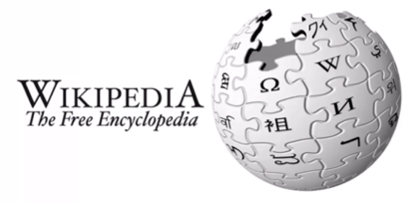
79.4 Using TF-IDF
https://github.com/peterhchen/900_Python_ML_DS_DL
Let's go ahead and dive in and see how it all works.
So there you have the concepts of TF-IDF, another one of those things that sounds really fancy, but once you understand it, it's actually quite simple.
We will rune example next by Spark TF-IDF for small Wikipedia exmaple.

Slide 18
79.5 Summary

Slide 19
79.5 Summary
https://github.com/peterhchen/900_Python_ML_DS_DL
Summary
TF-IDF is the way that Google search engine work.
The user give the search key words, the higher score of TF-IDF means the selected document contains the keywords that you are search for.
Google ranks the document in order by TF-IDF score.

Slide 20
End of Chapter

