Slide 1

18 Percentile and Moment
Peter H. Chen

Slide 2
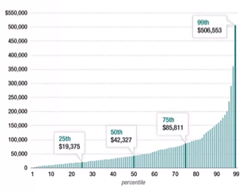
18 Percentile and Moment
https://www.udemy.com/course/data-science-and-machine-learning-with-python-hands-on/learn/lecture/4020104#overview
Percentiles
In a data set, what is the point at which x% of the values are less than that value?
Example: Income Distribution

Slide 3
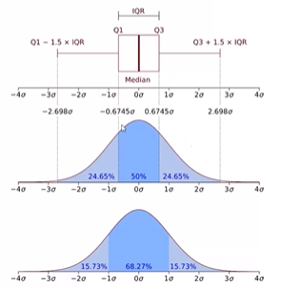
18 Percentile and Moment
https://www.udemy.com/course/data-science-and-machine-learning-with-python-hands-on/learn/lecture/4020104#overview
Percentiles in a Normal Distribution
In normal distribution, we have “Quartile”.
One quartile contains 50% of data in the middle, i.e., 25% data on each side of the median.
For example, in the IQR (Inner Quartile Range), it is the middle of the distribution that contain the 50% of the data.
In the diagrams, we have:
Q1 is on the left of IQR and Q3 is on the right of IQR.
Left side is Q1 - 1.5 x IQR to Q1 and right side is Q3 to Q3 + 1.5 x IQR

Slide 4
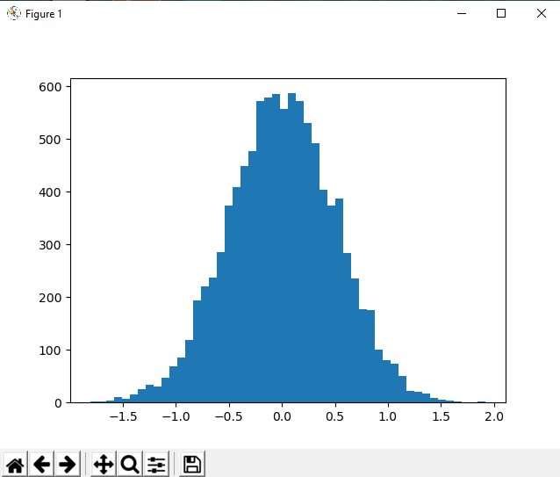

18 Percentile and Moment
https://www.udemy.com/course/data-science-and-machine-learning-with-python-hands-on/learn/lecture/4020104#overview
Percentiles in a Normal Distribution
Look at the Python example in Percentile:
Give a normal distribution with std = 0.5 and 10,000 point, find the value of percentile of 50%, 90%, and 20%.

Slide 5
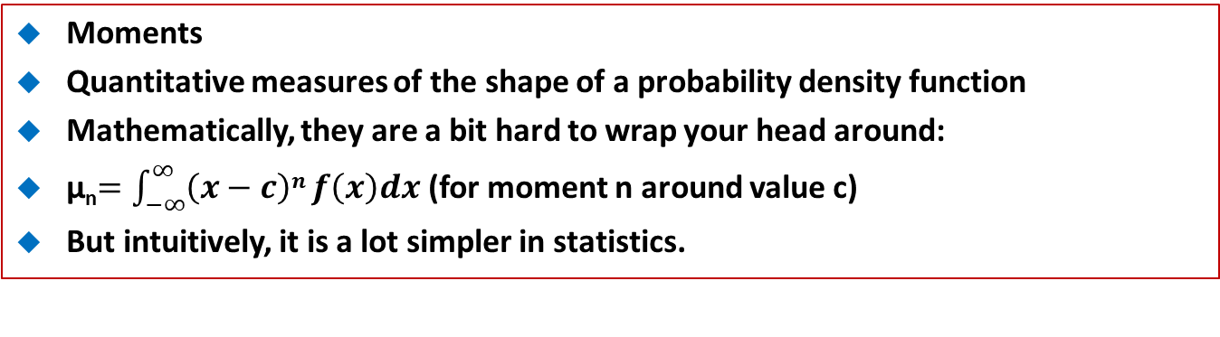
18 Percentile and Moment
https://www.udemy.com/course/data-science-and-machine-learning-with-python-hands-on/learn/lecture/4020104#overview
Moments
Quantitative measures of the shape of a probability density function
Mathematically, they are a bit hard to wrap your head around:
μ_{n}$=\int_{−∞}^{∞}{\left(x−c\right)n}f\left(x\right)dx$ (for moment n around value c)
But intuitively, it is a lot simpler in statistics.

Slide 6
18 Percentile and Moment
https://www.udemy.com/course/data-science-and-machine-learning-with-python-hands-on/learn/lecture/4020104#overview
Moments
The first moment is the mean.
The second moment is the variance.

Slide 7
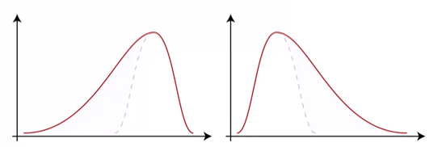
18 Percentile and Moment
https://www.udemy.com/course/data-science-and-machine-learning-with-python-hands-on/learn/lecture/4020104#overview
Moments
The third is “skew” (γ)
How “lopsided “ is the distribution?
A distribution with a longer tail on the left will be skewed left, and have a negative skew.
A distribution with a longer tail on the right will be skewed left, and have a positive skew.
Negative Skew
Positive Skew

Slide 8
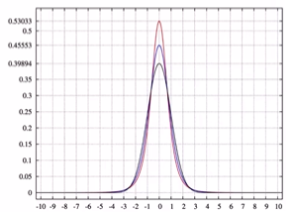
18 Percentile and Moment
https://www.udemy.com/course/data-science-and-machine-learning-with-python-hands-on/learn/lecture/4020104#overview
Moments
The fourth moment is “Kurtosis”
How thick is the tail, and how sharp is the peak, compared to a normal distribution?
Example: high peaks have the higher kurtosis.

Slide 9
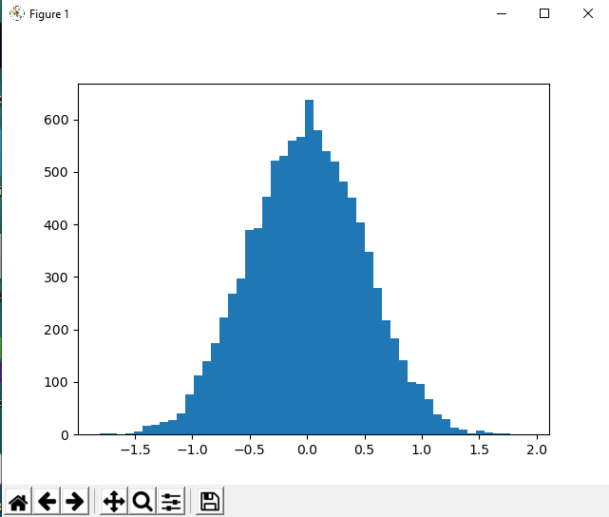
18 Percentile and Moment
https://www.udemy.com/course/data-science-and-machine-learning-with-python-hands-on/learn/lecture/4020104#overview
Moments
Let’s computer the 4 moments in Python.

Slide 10
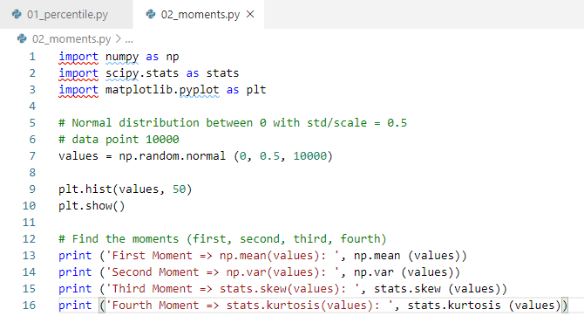
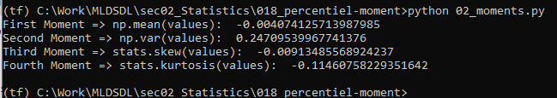
18 Percentile and Moment
https://www.udemy.com/course/data-science-and-machine-learning-with-python-hands-on/learn/lecture/4020104#overview
Moments
Let’s computer the 4 moments in Python.

Slide 11
End of Chapter

