Slide 1

19 Matplotlib
Peter H. Chen

Slide 2
19 Matplotlib
https://www.udemy.com/course/data-science-and-machine-learning-with-python-hands-on/learn/lecture/4020116#overview
Matplotlib
Matplotlib make your plot easy to do.

Slide 3
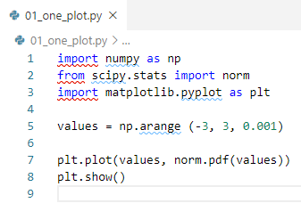
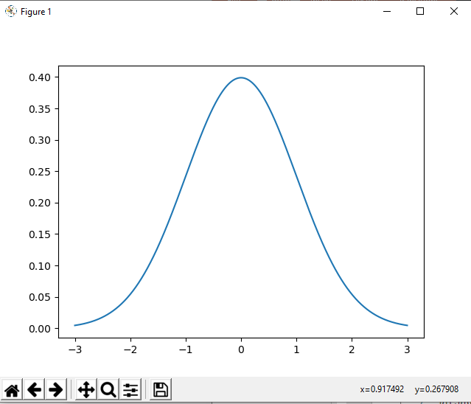
19 Matplotlib
https://www.udemy.com/course/data-science-and-machine-learning-with-python-hands-on/learn/lecture/4020116#overview
Plot one plot on one graph

Slide 4
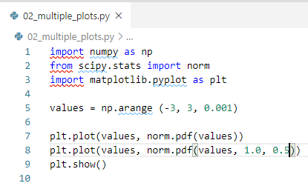
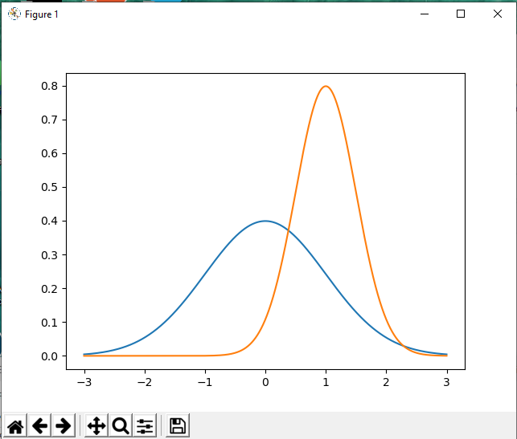
19 Matplotlib
https://www.udemy.com/course/data-science-and-machine-learning-with-python-hands-on/learn/lecture/4020116#overview
Multiple plots on one graph

Slide 5
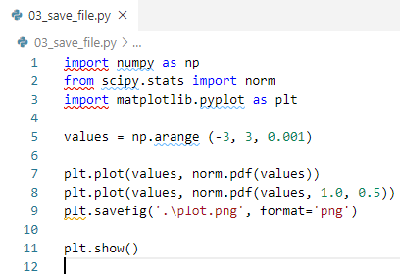
19 Matplotlib
https://www.udemy.com/course/data-science-and-machine-learning-with-python-hands-on/learn/lecture/4020116#overview
Save the plot before show.

Slide 6
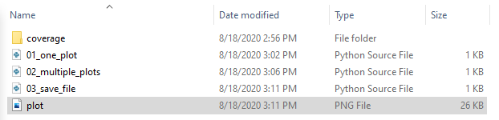
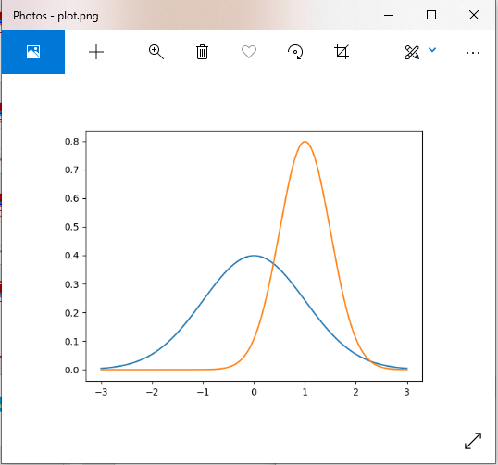
19 Matplotlib
https://www.udemy.com/course/data-science-and-machine-learning-with-python-hands-on/learn/lecture/4020116#overview
Double click the “plot.png” to display.

Slide 7
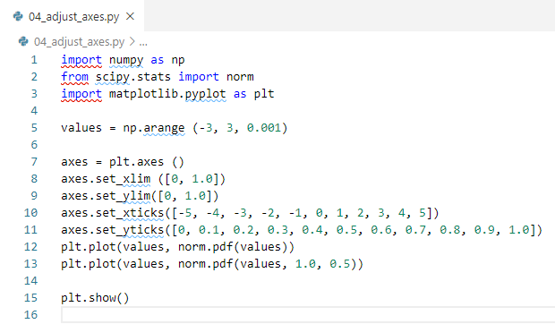
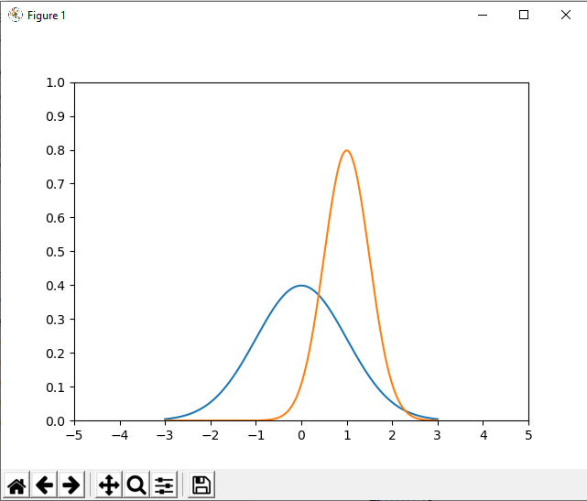
19 Matplotlib
https://www.udemy.com/course/data-science-and-machine-learning-with-python-hands-on/learn/lecture/4020116#overview
Adjust the Axes of plots

Slide 8
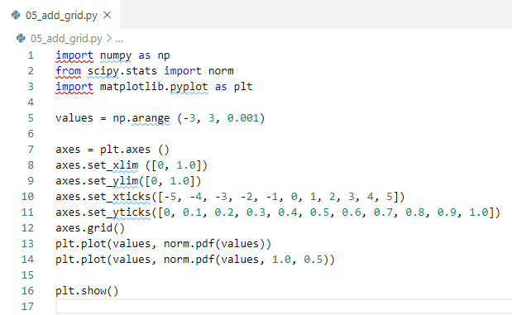
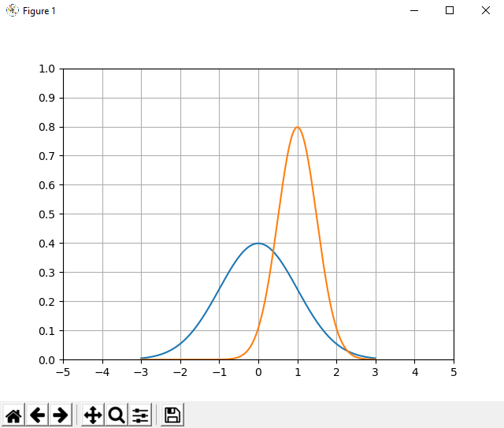
19 Matplotlib
https://www.udemy.com/course/data-science-and-machine-learning-with-python-hands-on/learn/lecture/4020116#overview
Add Grid

Slide 9
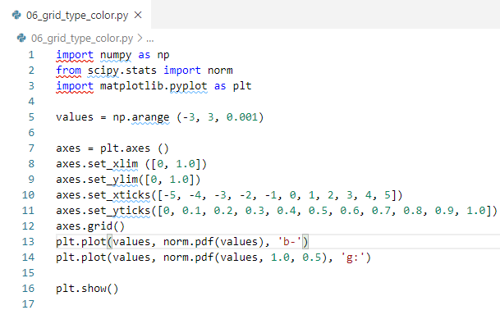
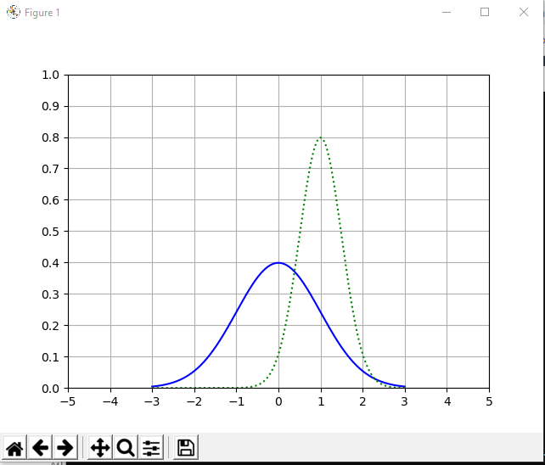
19 Matplotlib
https://www.udemy.com/course/data-science-and-machine-learning-with-python-hands-on/learn/lecture/4020116#overview
Change Line Types and Colors

Slide 10
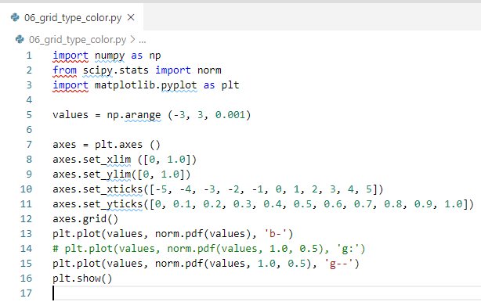
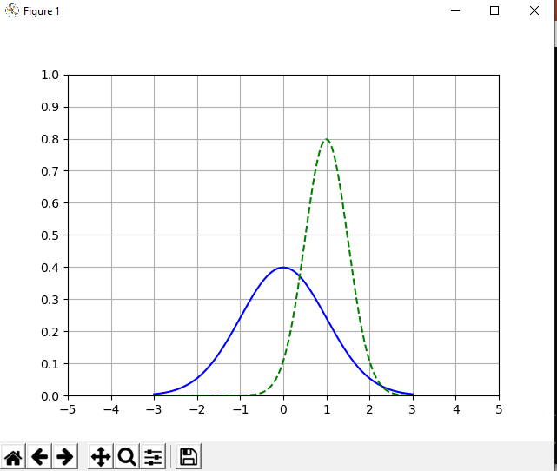
19 Matplotlib
https://www.udemy.com/course/data-science-and-machine-learning-with-python-hands-on/learn/lecture/4020116#overview
Change Line Types to double dash (--) and Colors
Change Line Types to double dash (-.) and Colors

Slide 11
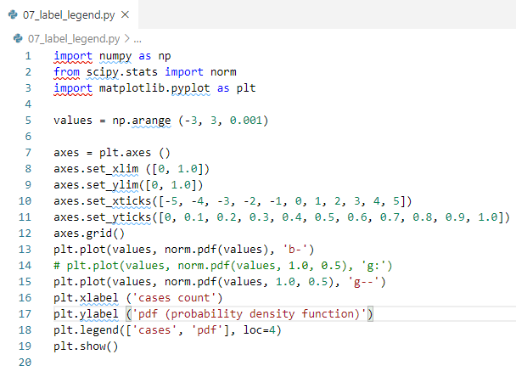
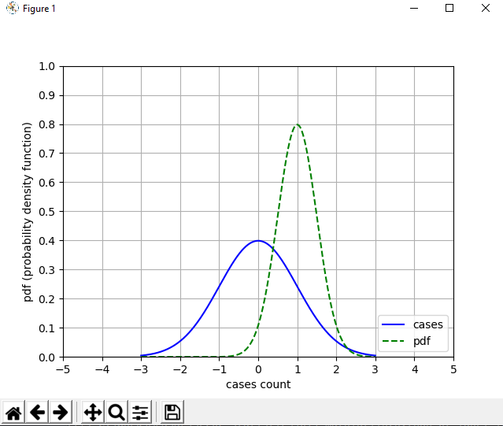
19 Matplotlib
https://www.udemy.com/course/data-science-and-machine-learning-with-python-hands-on/learn/lecture/4020116#overview
Label the Axes and Legend

Slide 12
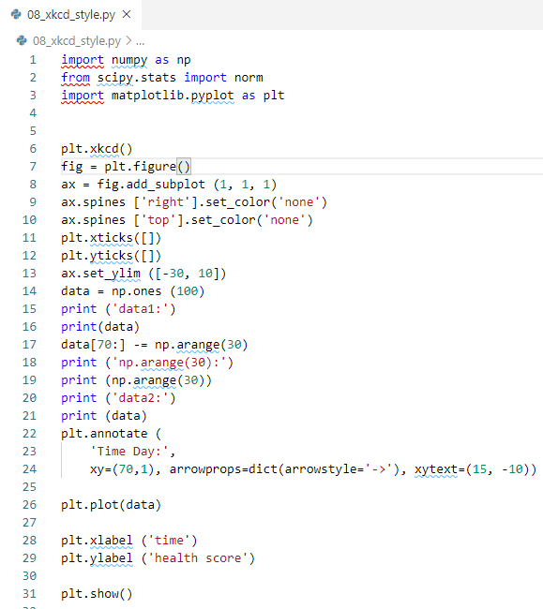
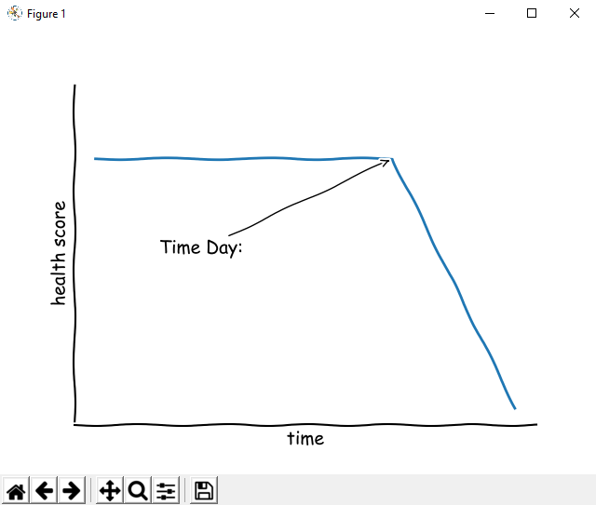
19 Matplotlib
https://www.udemy.com/course/data-science-and-machine-learning-with-python-hands-on/learn/lecture/4020116#overview
xkcd

Slide 13
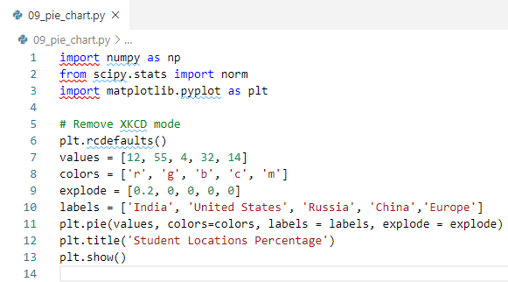
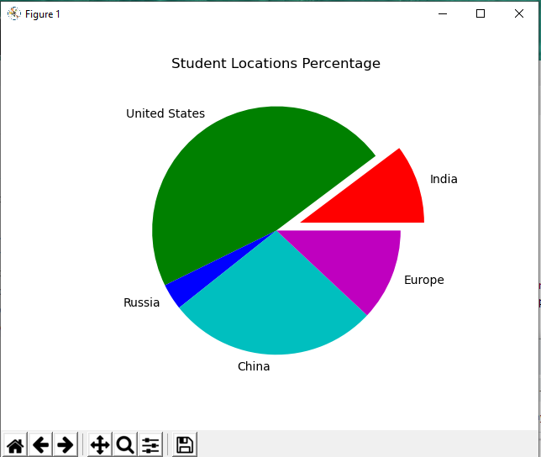
19 Matplotlib
https://www.udemy.com/course/data-science-and-machine-learning-with-python-hands-on/learn/lecture/4020116#overview
Pie Chart

Slide 14
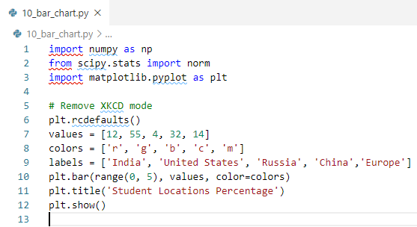
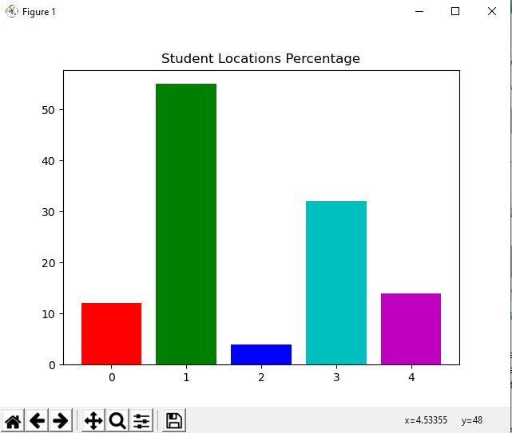
19 Matplotlib
https://www.udemy.com/course/data-science-and-machine-learning-with-python-hands-on/learn/lecture/4020116#overview
Bar Chart

Slide 15
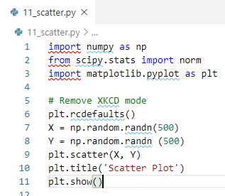
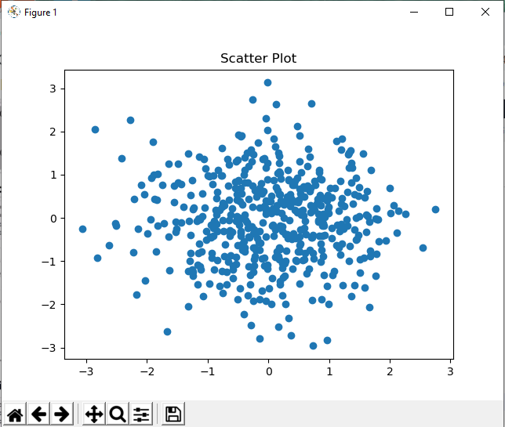
19 Matplotlib
https://www.udemy.com/course/data-science-and-machine-learning-with-python-hands-on/learn/lecture/4020116#overview
Scatter Chart

Slide 16
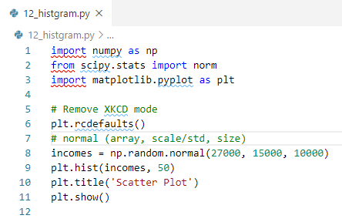
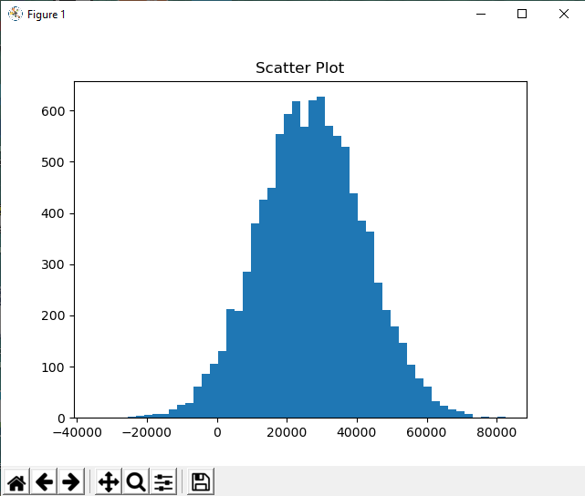
19 Matplotlib
https://www.udemy.com/course/data-science-and-machine-learning-with-python-hands-on/learn/lecture/4020116#overview
Histogram Chart

Slide 17
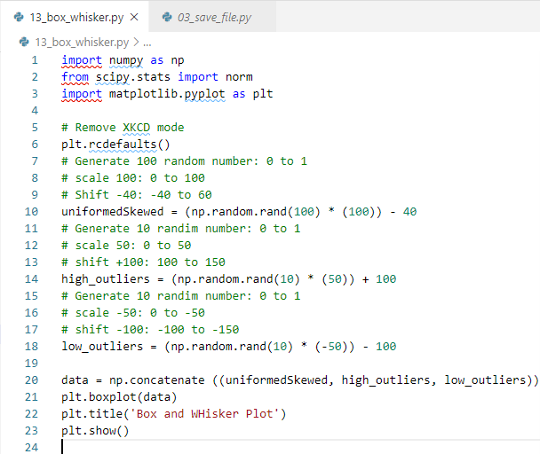
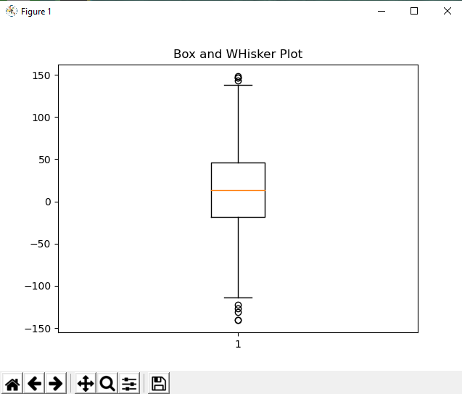
19 Matplotlib
https://www.udemy.com/course/data-science-and-machine-learning-with-python-hands-on/learn/lecture/4020116#overview
Box and Whisker Plot
Generate 100 points between -40 to 60, 100 point is 83% (100/120 = 83%).
Generate 10 points (8%) between 100 to 150 and 10 points (8%) between -100 to -150.
Plot with 100 point, high outliers 10 points, and low outliers 10 points.

Slide 18
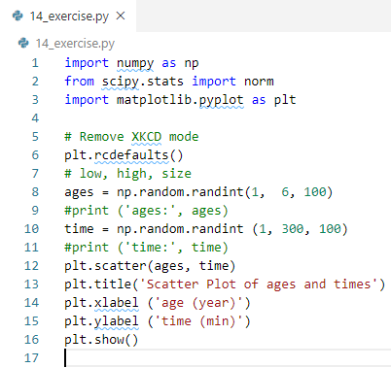
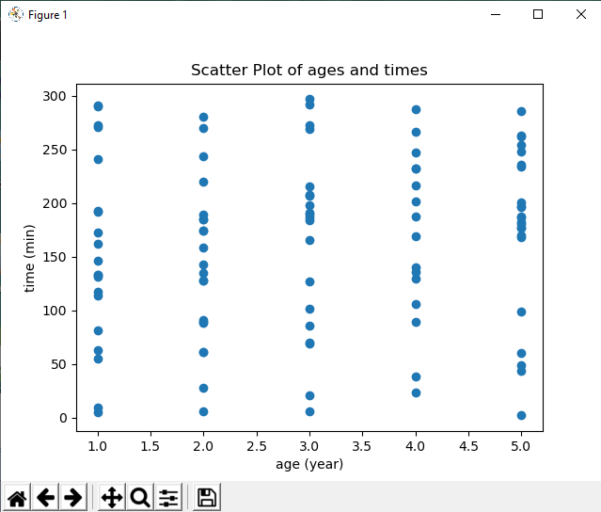
19 Matplotlib
https://www.udemy.com/course/data-science-and-machine-learning-with-python-hands-on/learn/lecture/4020116#overview
Assignment:
Create a Scatter plot with random data on age vs time spent time spent watching TV.
Label the axes.

Slide 19
End of Chapter

