Slide 1

51 KNN Concept
Peter H. Chen

Slide 2
51 KNN Concept
https://www.udemy.com/course/data-science-and-machine-learning-with-python-hands-on/learn/lecture/4020692#overview
KNN Concept
We discuss Data Mining and Machine Learning.
First, we discuss KNN (K-Nearest Neighbor). KNN is a Supervised Machine Learning Technique.

Slide 3
51.1 KNN

Slide 4
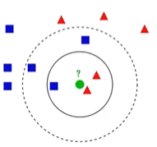
51.1 KNN
https://www.udemy.com/course/data-science-and-machine-learning-with-python-hands-on/learn/lecture/4020692#overview
KNN (K-Nearest Neighbor)
Used to classify new data points based on “distance” to known data
Find the K-nearest neighbors, based on your distance metric
Let them all vote on the classification
That is it.

Slide 5
51.1 KNN
https://www.udemy.com/course/data-science-and-machine-learning-with-python-hands-on/learn/lecture/4020692#overview
KNN (K-Nearest Neighbor) Explanation
The idea of K-Nearest Neighbor is you already have classified into groups that you can train the system from.
We get a new input point to put into the existed classified group. All we do is to look at K-Nearest Neighbor based on that distance metric and let them vote on the classification of that new point.
We have scatter plot as below to plot movies.
The blue square represent science fiction movies.
The red triangle represent drama movie.
The horizontal axis is rating. The vertical axis is popularity.
We have distance to compute based on rating and popularity.

Slide 6
51.1 KNN
https://www.udemy.com/course/data-science-and-machine-learning-with-python-hands-on/learn/lecture/4020692#overview
KNN (K-Nearest Neighbor) Explanation
We have new data compare to three point. It is 3-nearest neighbors and vote for the classification groups.
If we include 5 points. It will be 5-nearest neighbors and vote for classification group.
You can see the choice of K can be very important.
We want to make sure that you do not have to go too far and start picking up irrelevant neighbors.

Slide 7
51.2 Simple KNN

Slide 8
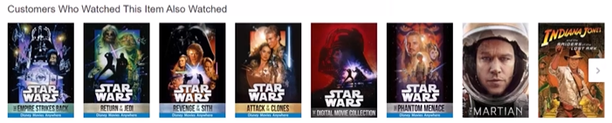
51.2 Simple KNN
https://www.udemy.com/course/data-science-and-machine-learning-with-python-hands-on/learn/lecture/4020692#overview
Simple KNN
KNN is one of the simplest marching learning models.
KNN is a Supervised Learning.
Movie similarities are based on meta data, i.e., intrinsic values of those movies. In KNN, the data size is keeping on increasing.

Slide 9
End of Chapter

